Slide 1
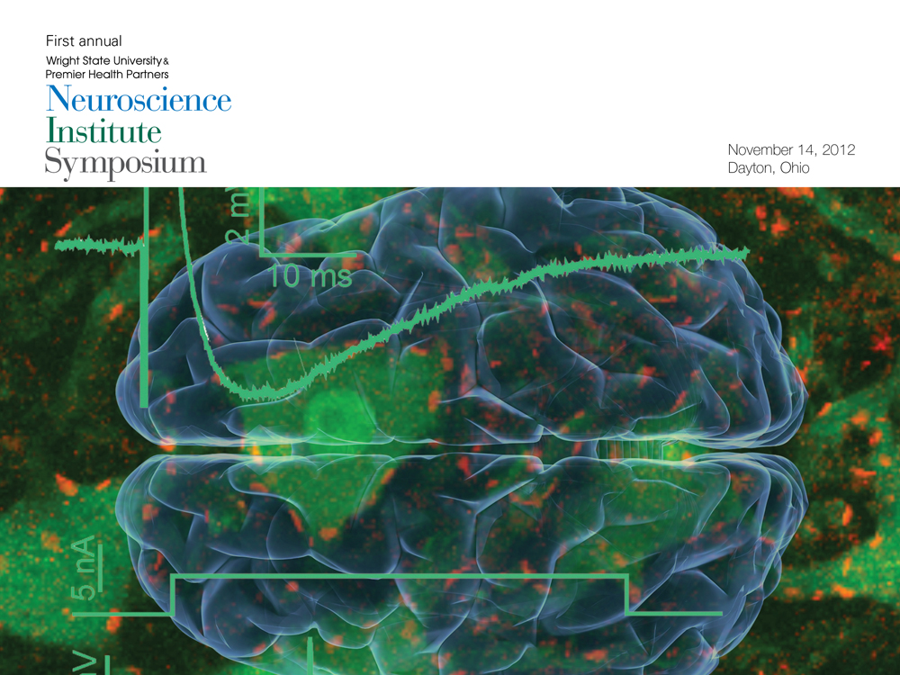

Slide 2
Welcome
Robert Fyffe, Ph.D.
Vice President for Research and Graduate Studies
Wright State University
Marjorie Bowman, M.D., M.P.A
Dean, Boonshoft School of Medicine
Wright State University
Timothy Cope, Ph.D.
Director, WSU & PHP Neuroscience Institute
Brage Golding Distinguished Professor of Research
Chair, Department of Neuroscience, Cell Biology & Physiology
Kenneth Gaines, M.D., M.B.A.
Codirector, WSU & PHP Neuroscience Institute
Chair and Professor, Department of Neurology

Slide 3
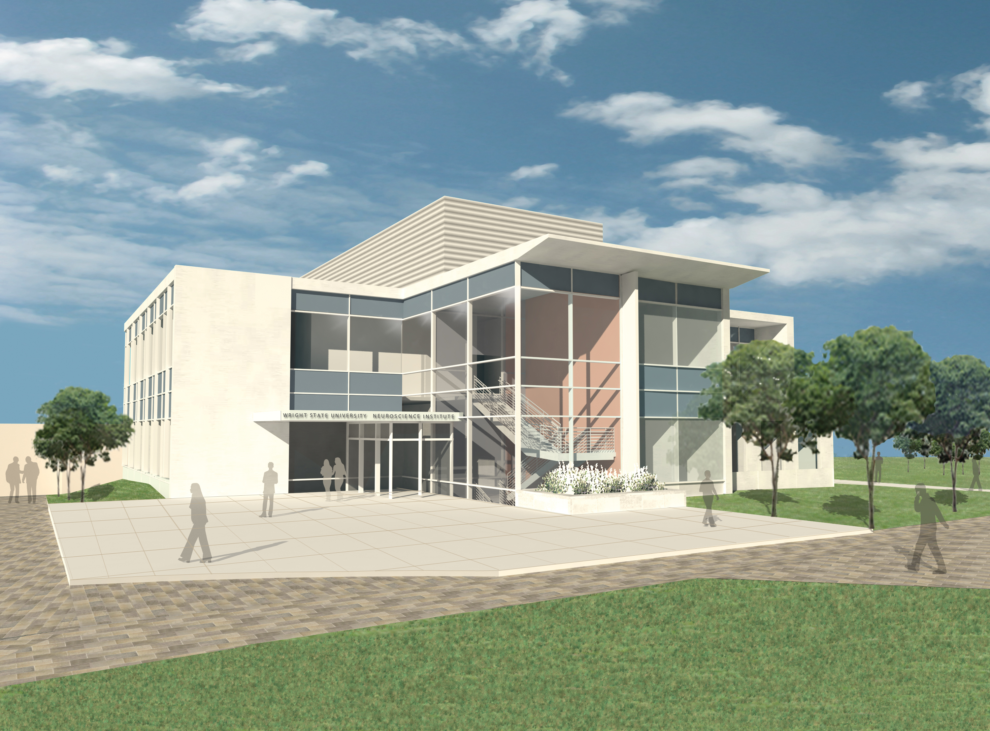
Neuroscience at WSU
Target – Excellence in NeuroTranslational Research
Neuroscience Institute
Community partnership with PHP to create academic Department of Neurology - $4.3M
2010
University System of Ohio
Center of Excellence in Neuroscience
More than 30 research laboratories/clinical sites
Comprehensive Neuroscience Center
NIH Program Project Grant (5 PIs) - $4.8M
2007
Supported by Boonshoft Innovation Fund
2005
Recruitment of funded neuroscientists to create critical mass (esp. research relevant to movement disorders)
Center for Brain Research
2000
Organize neuroscience community and resources; investment by Kettering Fund

Slide 4
Translating Basic Science to Clinical Practice
Assemble a critical mass of clinical and basic scientists in order to drive translational research and discovery.
Integrate new clinician scientists with existing basic
neuroscientists
Notes:
http://www.youtube.com/v/aX9InPSPM6U&feature=related

Slide 5
Translating Basic Science to Clinical Practice
Advance health care solutions for conditions including:
Neurodegenerative Disorders, esp. neuropathy in critical illness, chemotherapy
Movement Disorders
Stroke
Epilepsy
Multiple Sclerosis
Developmental Disabilities
Notes:
http://www.youtube.com/v/aX9InPSPM6U&feature=related

Slide 6
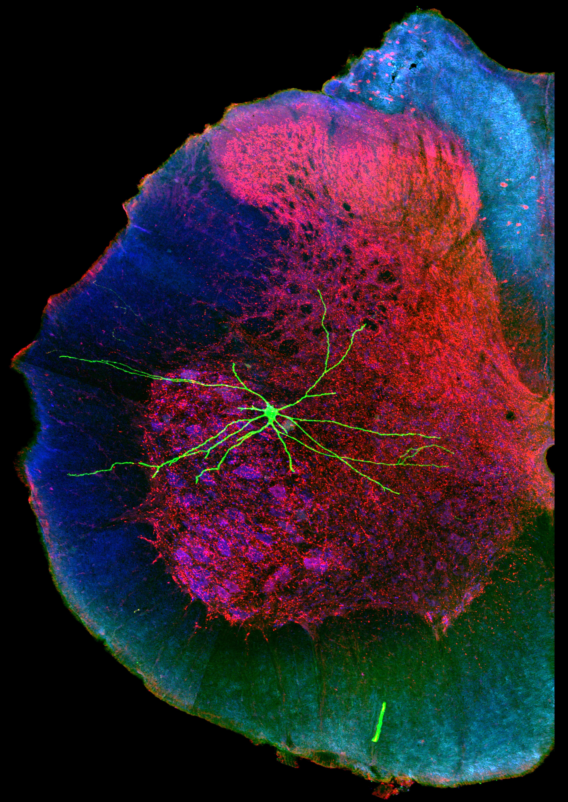
Translating Basic Science to Clinical Practice
Advance health care solutions for conditions including:
Neurodegenerative Disorders, esp. neuropathy in critical illness, chemotherapy
Movement Disorders
Stroke
Epilepsy
Multiple Sclerosis
Developmental Disabilities
Notes:
http://www.youtube.com/v/aX9InPSPM6U&feature=related

Slide 7
Translating Basic Science to Clinical Practice
Advance health care solutions for conditions including:
Neurodegenerative Disorders, esp. neuropathy in critical illness, chemotherapy
Movement Disorders
Stroke
Epilepsy
Multiple Sclerosis
Developmental Disabilities
Video courtesy of simtk.org
Notes:
http://www.youtube.com/v/aX9InPSPM6U&feature=related

Slide 8
Neuroscience Engineering Collaboration
(NEC) Building
New $37 million, 90,000 sq.ft. home for neuroscience-engineering collaboration
Home to scientists, physicians, engineers, students and post-docs
Laboratories and shared core infrastructure
Enable synergistic activity that will foster translational research and collaboration
Transform new discoveries into breakthroughs in patient care
Ground breaking slated for March 2013

Slide 9
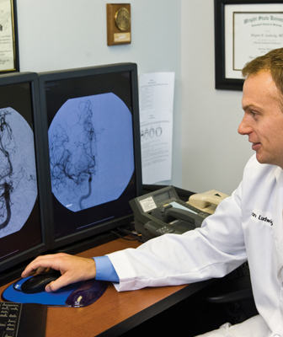
National Search for
Clinical Neuroscientists
The Institute is seeking two clinical (MD) neuroscientists who are accomplished researchers with record of scientific publication and funding
Develop a funded basic or clinical neuroscience research program in collaboration with basic scientists
75 percent protected time for active research, ample research lab space (NEC)
For more information: jobs.wright.edu/postings/5724

Slide 10
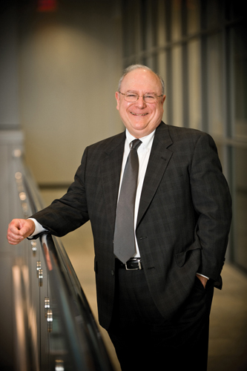
Kenneth Gaines, M.D. Chair, Department of Neurology Co-director, WSU & PHP Neuroscience Institute
Directs clinical research focus of the Institute
Most recently Chair, Department of Neurology, Ochsner Clinic and Foundation
Clinical research interests—improved health care delivery for stroke with subspecialty in vascular neurology
Basic research focus—brain hemorrhage
Board certified—neurology and vascular neurology, American Board of Psychiatry and Neurology
Fellow—American Academy of Neurology and American EEG Society

