Slide 1
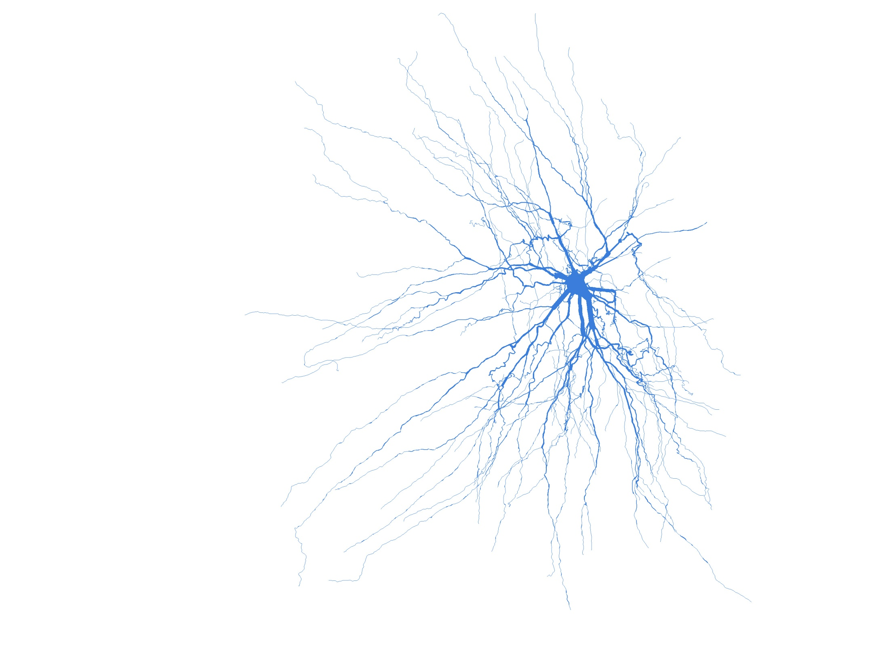
The Future of Neuroscience
Premier Health Partners /
Wright State University
Neuroscience Institute

Slide 2
WHY NEUROSCIENCE?
Decade of the Brain
Disease Burden

Slide 3
Importance of Neuroscience
EPILEPSY
10% of the population will have a seizure in their lifetime.
2.2 million people in the US have epilepsy
IOM: Access to high quality treatment falls short

Slide 4
Importance of Neuroscience
STROKE
1 out of 6 persons will have a stroke in their lifetime.
Stroke is the leading cause of adult disability.
Time is brain

Slide 5
Time is Brain -- Quantified (Saver J. Stroke 2006; 37: 263-66)
Pace of Neuronal Circuitry Loss in Acute Ischemic Stroke (Supratentorial)
 | Neurons lost | Synapses lost | Myelinated fibers lost | Accelerated aging
Per stroke | 1.2 billion | 8.3 trillion | 4470 miles | 36y
Per hour | 120 million | 830 billion | 447 miles | 3.6y
Per minute | 1.9 million | 14 billion | 7.5 miles | 3.1 wk
Per second | 32,000 | 230 billion | 218 yards | 8.7 hr

Slide 6
Importance of Neuroscience
ALZHEIMER’s DISEASE
5 million persons in US have Alzheimer’s
230,000 in Ohio have AD
High caregiver burden
US cost of AD in 2011 is $183 billion

Slide 7
Importance of Neuroscience
ALZHEIMER’s DISEASE
Over the next 5 years
Death from Alzheimer’s will increase 64%
Death from heart disease will decrease by 13%
Death from HIV will decrease by 29%

Slide 8
Importance of Neuroscience
HEAD INJURY
The leading cause of death in young adults
BRAIN HEALTH
Ohio ranks in top 30 but not top 10 of the 50 states in brain health

Slide 9
Importance of Neuroscience
SPINE DISEASE AND LOW BACK PAIN
8/10 persons have spine disease at some time
70 million physician office visits
130 million hospital and emergency room visits

Slide 10
Importance of Neuroscience
NEUROLOGICAL ONCOLOGY
Glioblastoma survival has tripled in the last 10 years
209/100,000 incidence in 2001
221/100,000 in 2010

Slide 11
Medications and Surgical Devices FDA Approved for Neuroscience Diseases

Slide 12
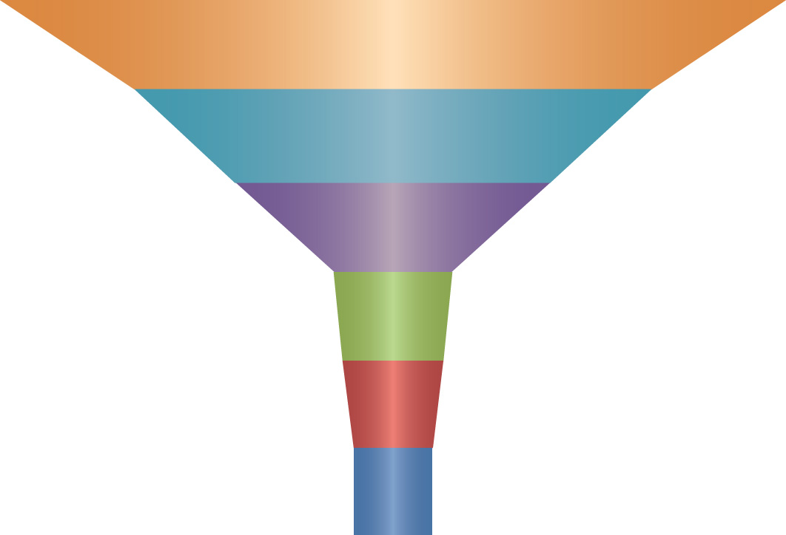
Medications and Surgical Devices FDA Approved for Neuroscience Diseases
2010-20
2000-10
1990-00
1980-90
1970-80
1950-70

Slide 13
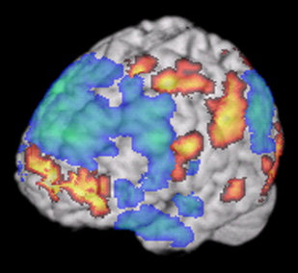
Functional MRI Imaging: The Brain at Work Improvising Jazz
Advances in Neuroimaging

Slide 14
PHP/WSU Neuroscience Institute Healthy Brain over the Ages
Innovative Teaching | Innovative Community Involvement
Innovative Clinical Care | Innovative Research

Slide 15
PHP/WSU Neuroscience Institute
Neuroscience Institute
Neurology
Neurosurgery
Neuroimaging/PM&R
Neurology
Multiple sclerosis program
Neuromuscular Disease Program
Pain management
Memory Disorders
Neurosurgery
Spine program
Neurotrauma
Joint Neuroscience Programs
Neuro-Oncology
Stroke and Neurocritical Care
Epilepsy Program
Movement Disorders Program
Research and Education
Basic Science
Neurology Residency
Medical Student Education
Clinical Research

Slide 16
PHP/WSU Neuroscience Institute
We cannot solve problems by using the same kind of thinking we used when we created them.
Albert Einstein

Slide 17
The Future of Neuroscience
PHP/WSU Neuroscience Institute
Join Us in the Journey

