Slide 1
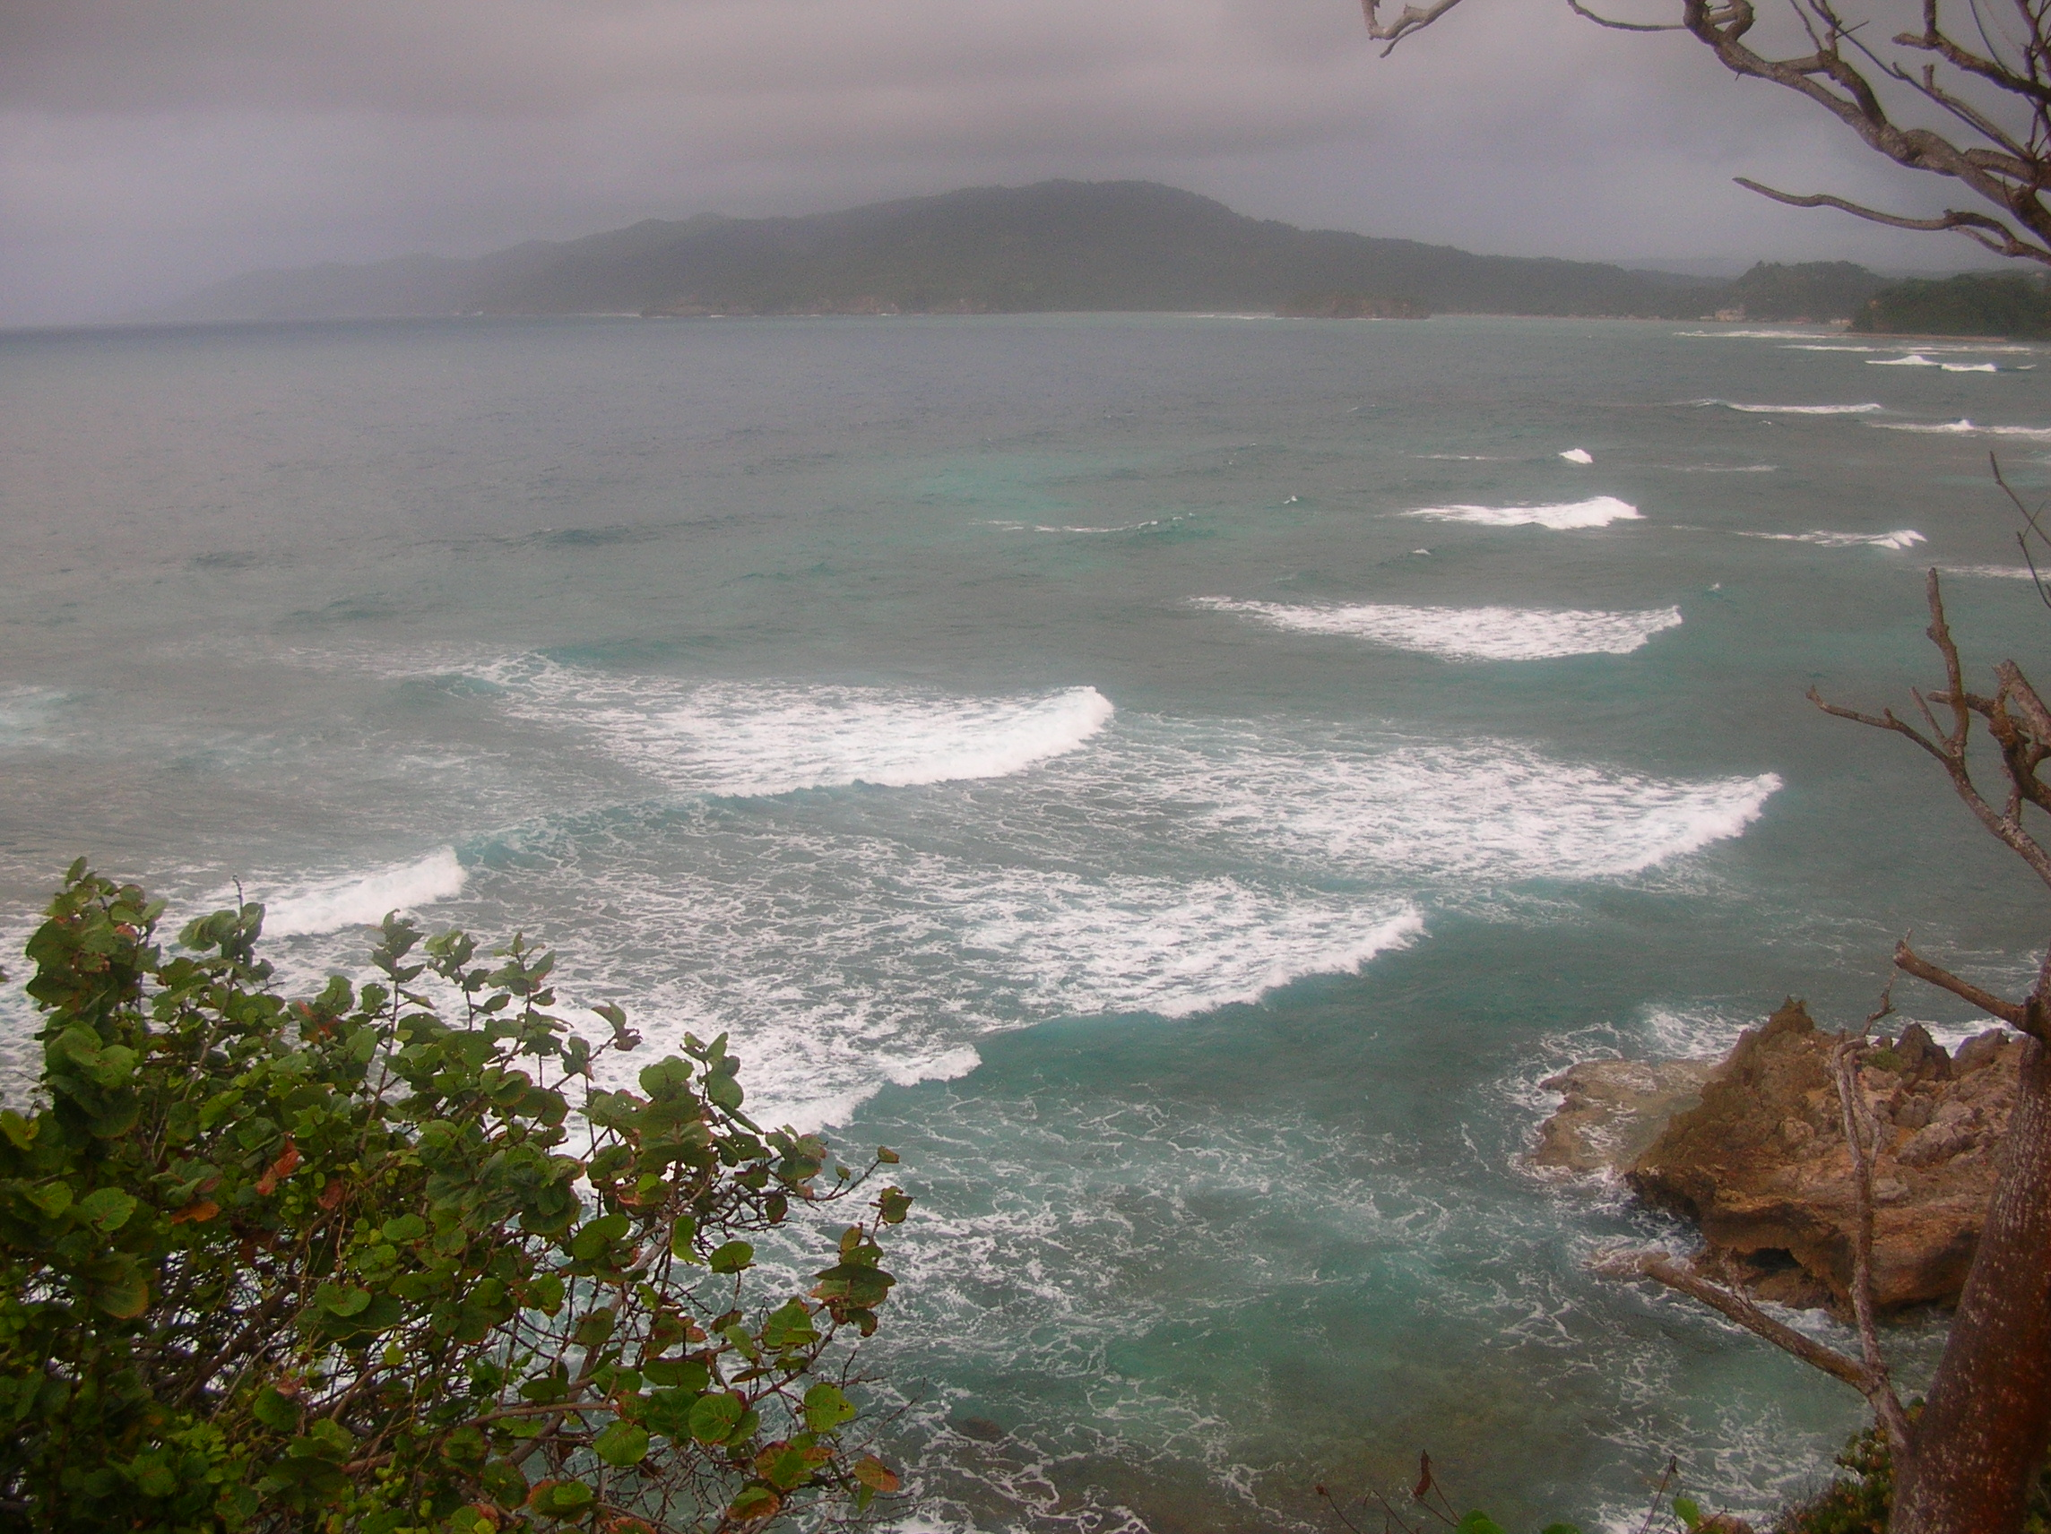
Jamaica Trip Yah, Mon!

Slide 2
Timeline
Twice a year (June/July and November-elective break)
Must decide before deadline to turn in paperwork for travel (end of March?)
Travel coordinator (Elena) will take care of turning in all the necessary paperwork for you.
Will start preparations a couple of months in advance (get vaccinations, meetings with Dr. Guy)
An exact timeline will be set up between Dr. Guy and the specific students.

Slide 3
Price Range
Two week trip during summer: ~$1,500
One week trip in November: ~1,000
These prices will vary based on the cost of transportation
Cost of housing, meals, and transportation while in Jamaica: ~$540/week
Airfare during summer ~$530 using Air Jamaica (Chicago-Montego Bay)
Fundraise/provide money for drugs:~$150/person
Extra money not necessary, unless you’re planning on buying gifts
Blue Mountain coffee (they say it’s the best in the world)=$12/pound
Tons of little paintings and wood carvings at pretty affordable prices
You MUST bargain…otherwise you’ll pay 25 dollars on something that’s worth 7 dollars.

Slide 4
Fundraising options
Ask your church, family, friends, work place.
For a list of churches and businesses in the area and for a sample fundraising letter, please contact Elena.

Slide 5
Vaccinations
Hepatitis A is recommended
Can get the vaccine at the Student Health Center, at your doctor’s office, or at the Department of Health in downtown Dayton
Our health insurance does not cover the vaccine
Call around to obtain the best price
Most places have an extra fee for administering the vaccine, so ask what that fee is

Slide 6
Passport and Visas
Anybody traveling to Jamaica needs a valid passport beginning with January 1st, 2006
If you’re not an American citizen, you must have a visa (check out the requirements at the Embassy of Jamaica website)

Slide 7
Who and when do I have to pay for the trip?
The deadlines for payment are decided by ACE
They will purchase plane tickets for the entire group
A deposit may be required and full payment is necessary before departing

Slide 8
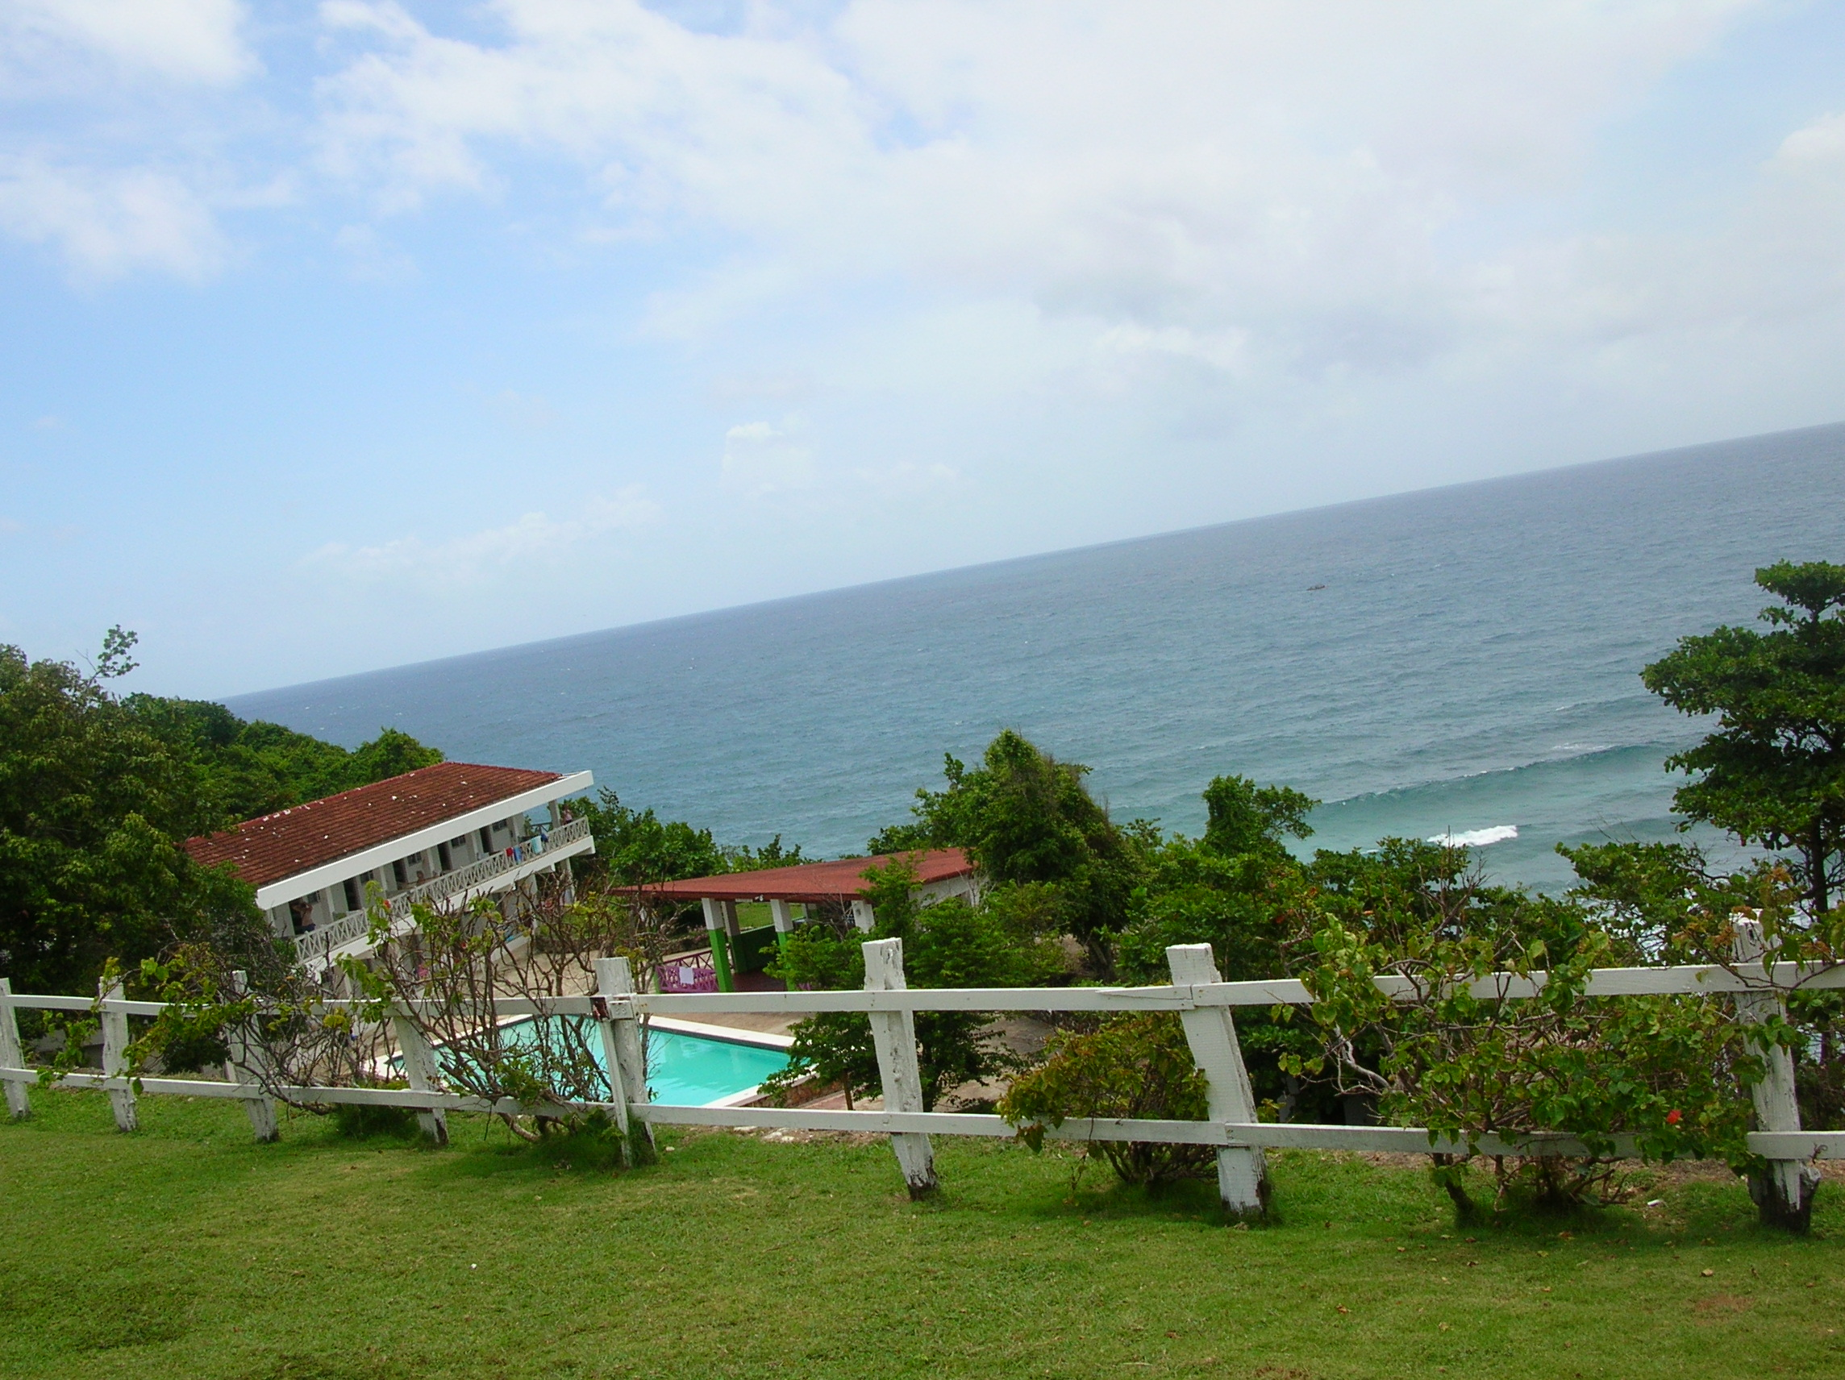
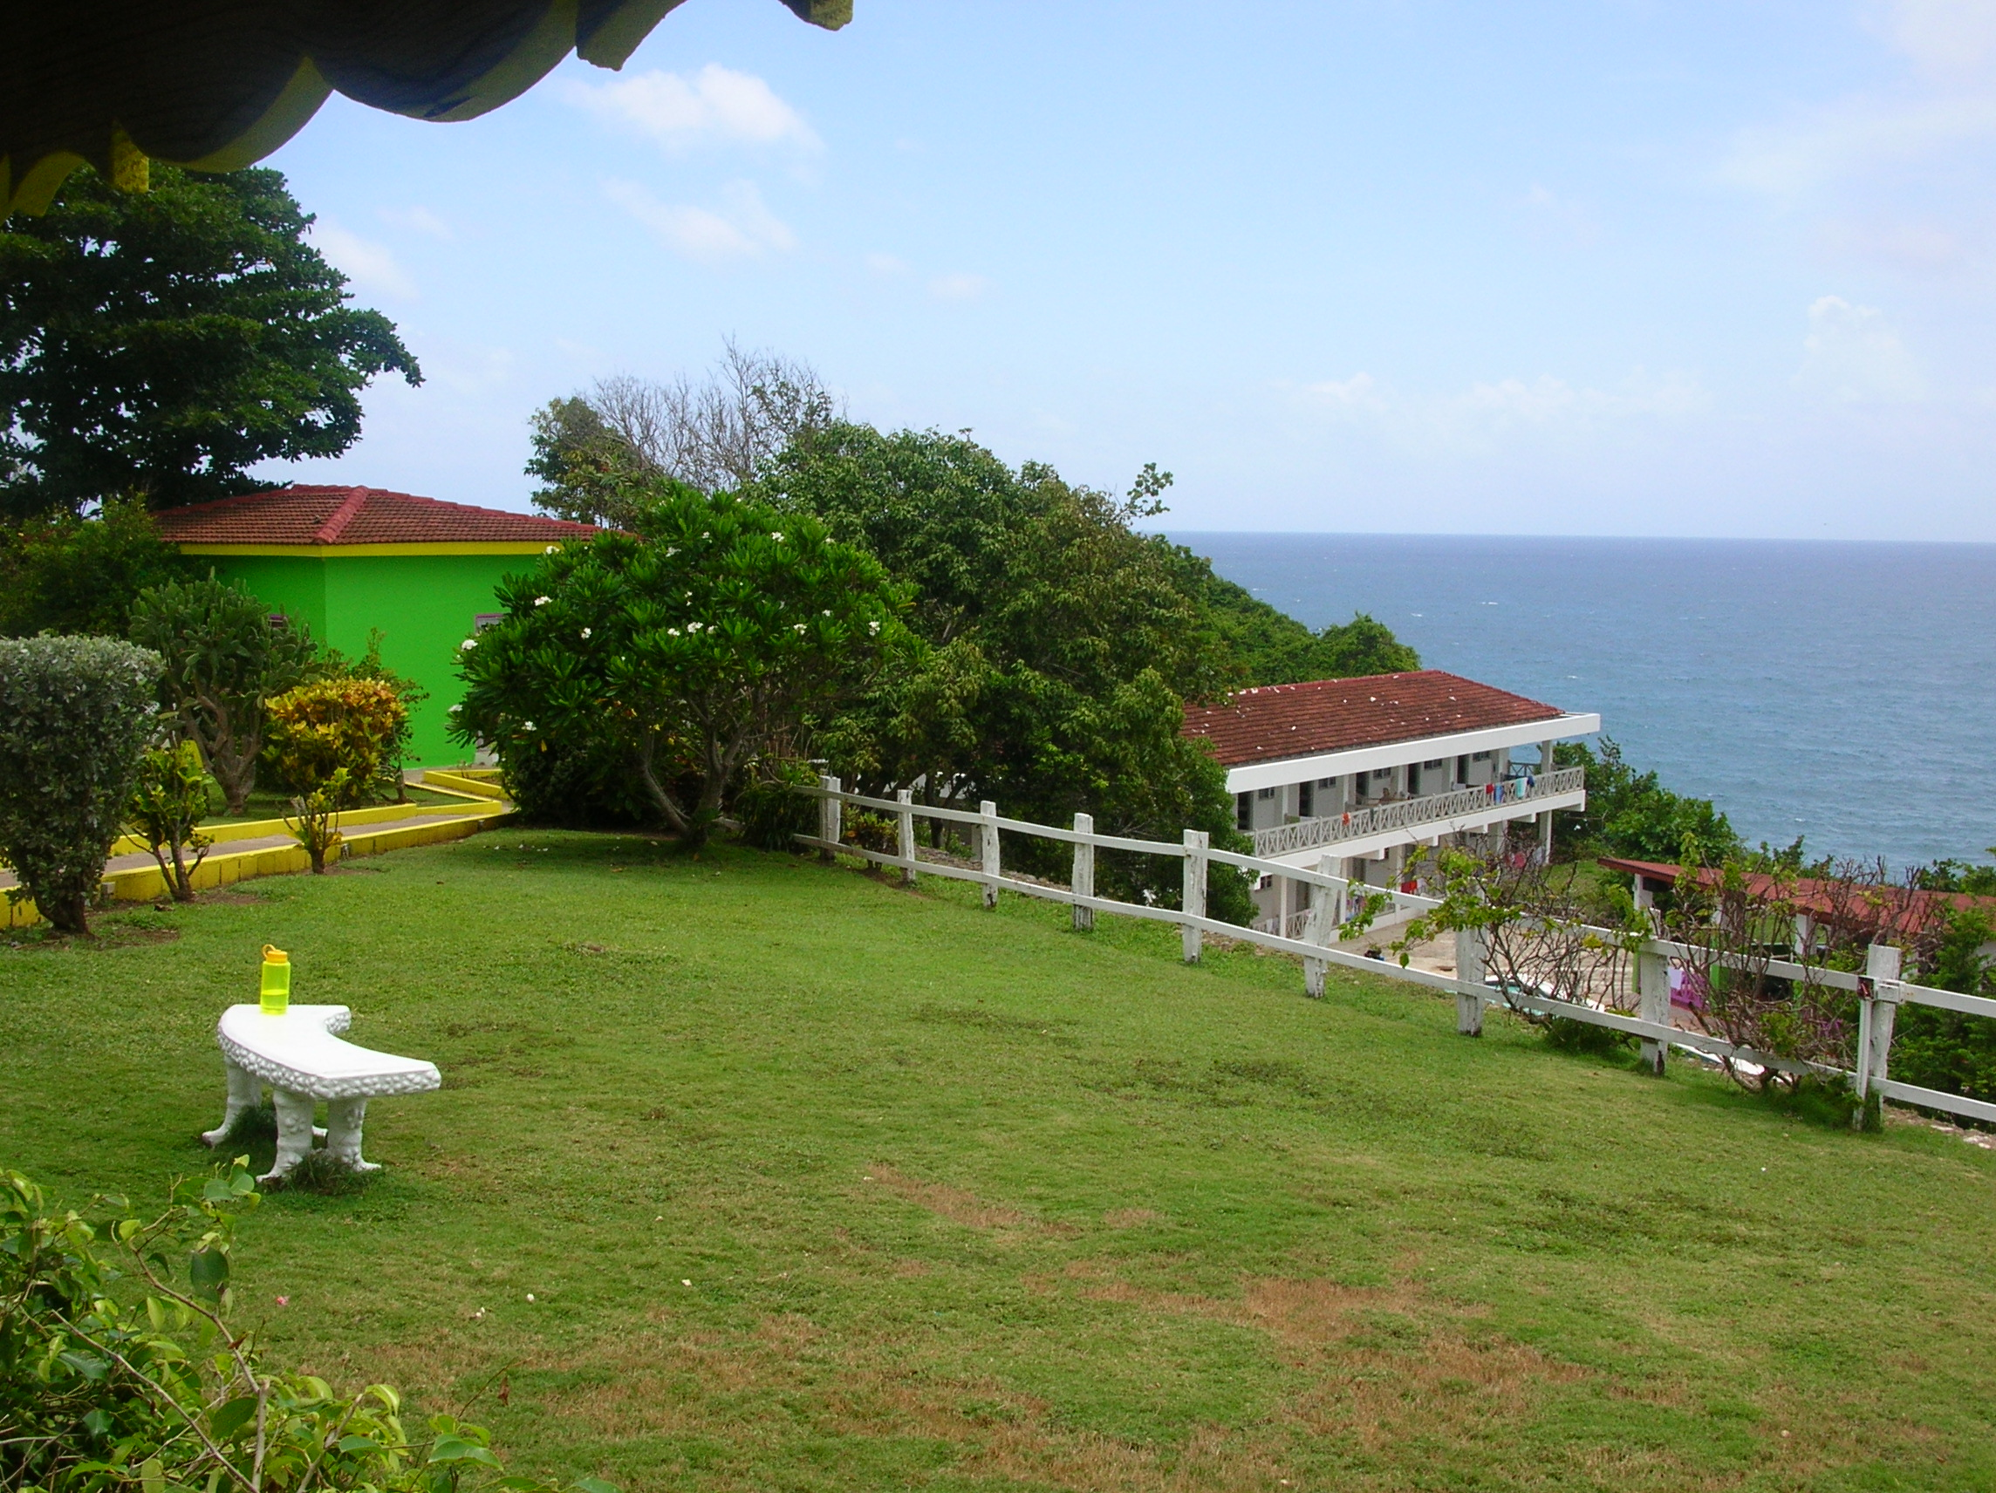
Where will I stay
Galina Breeze Hotel (aka, a little piece of Paradise)

Slide 9
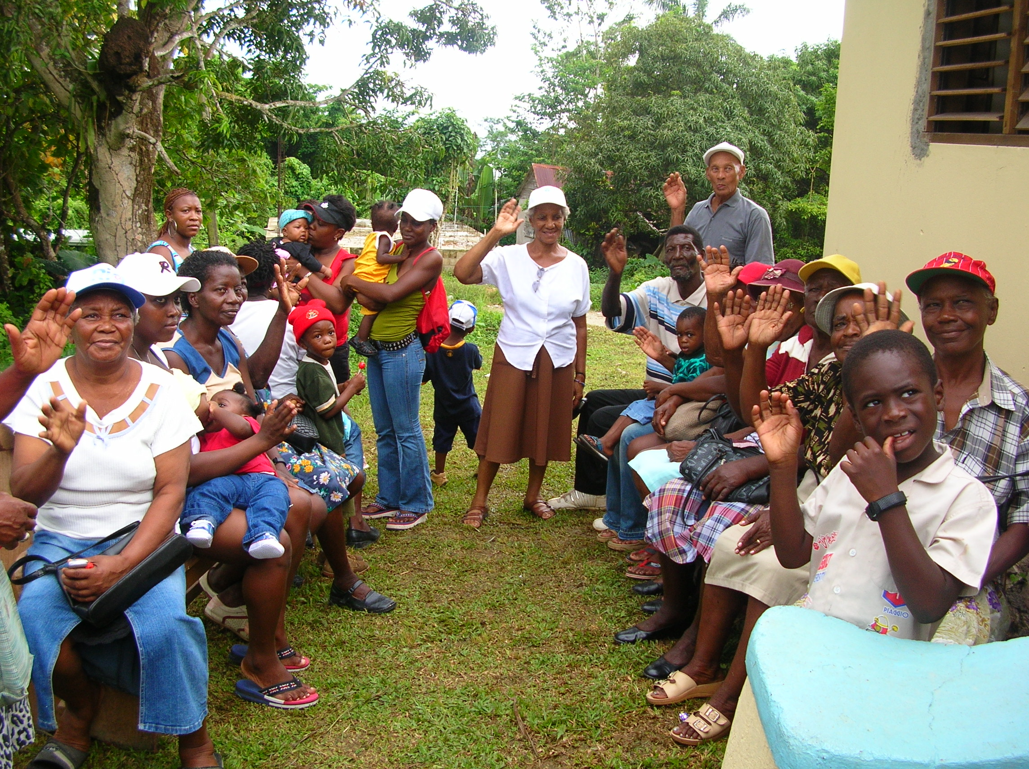
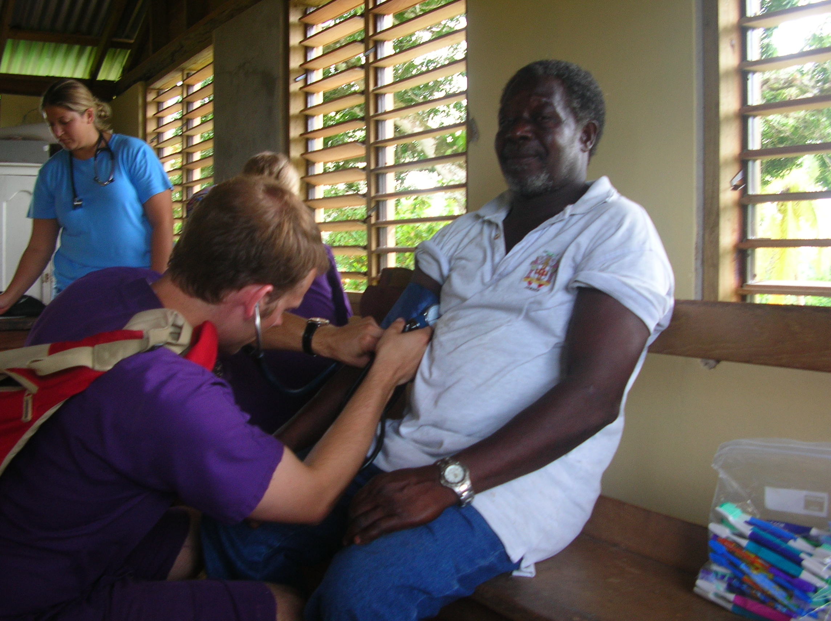
Where will I be working?
Clinics ran by the government or built by ACE

Slide 10
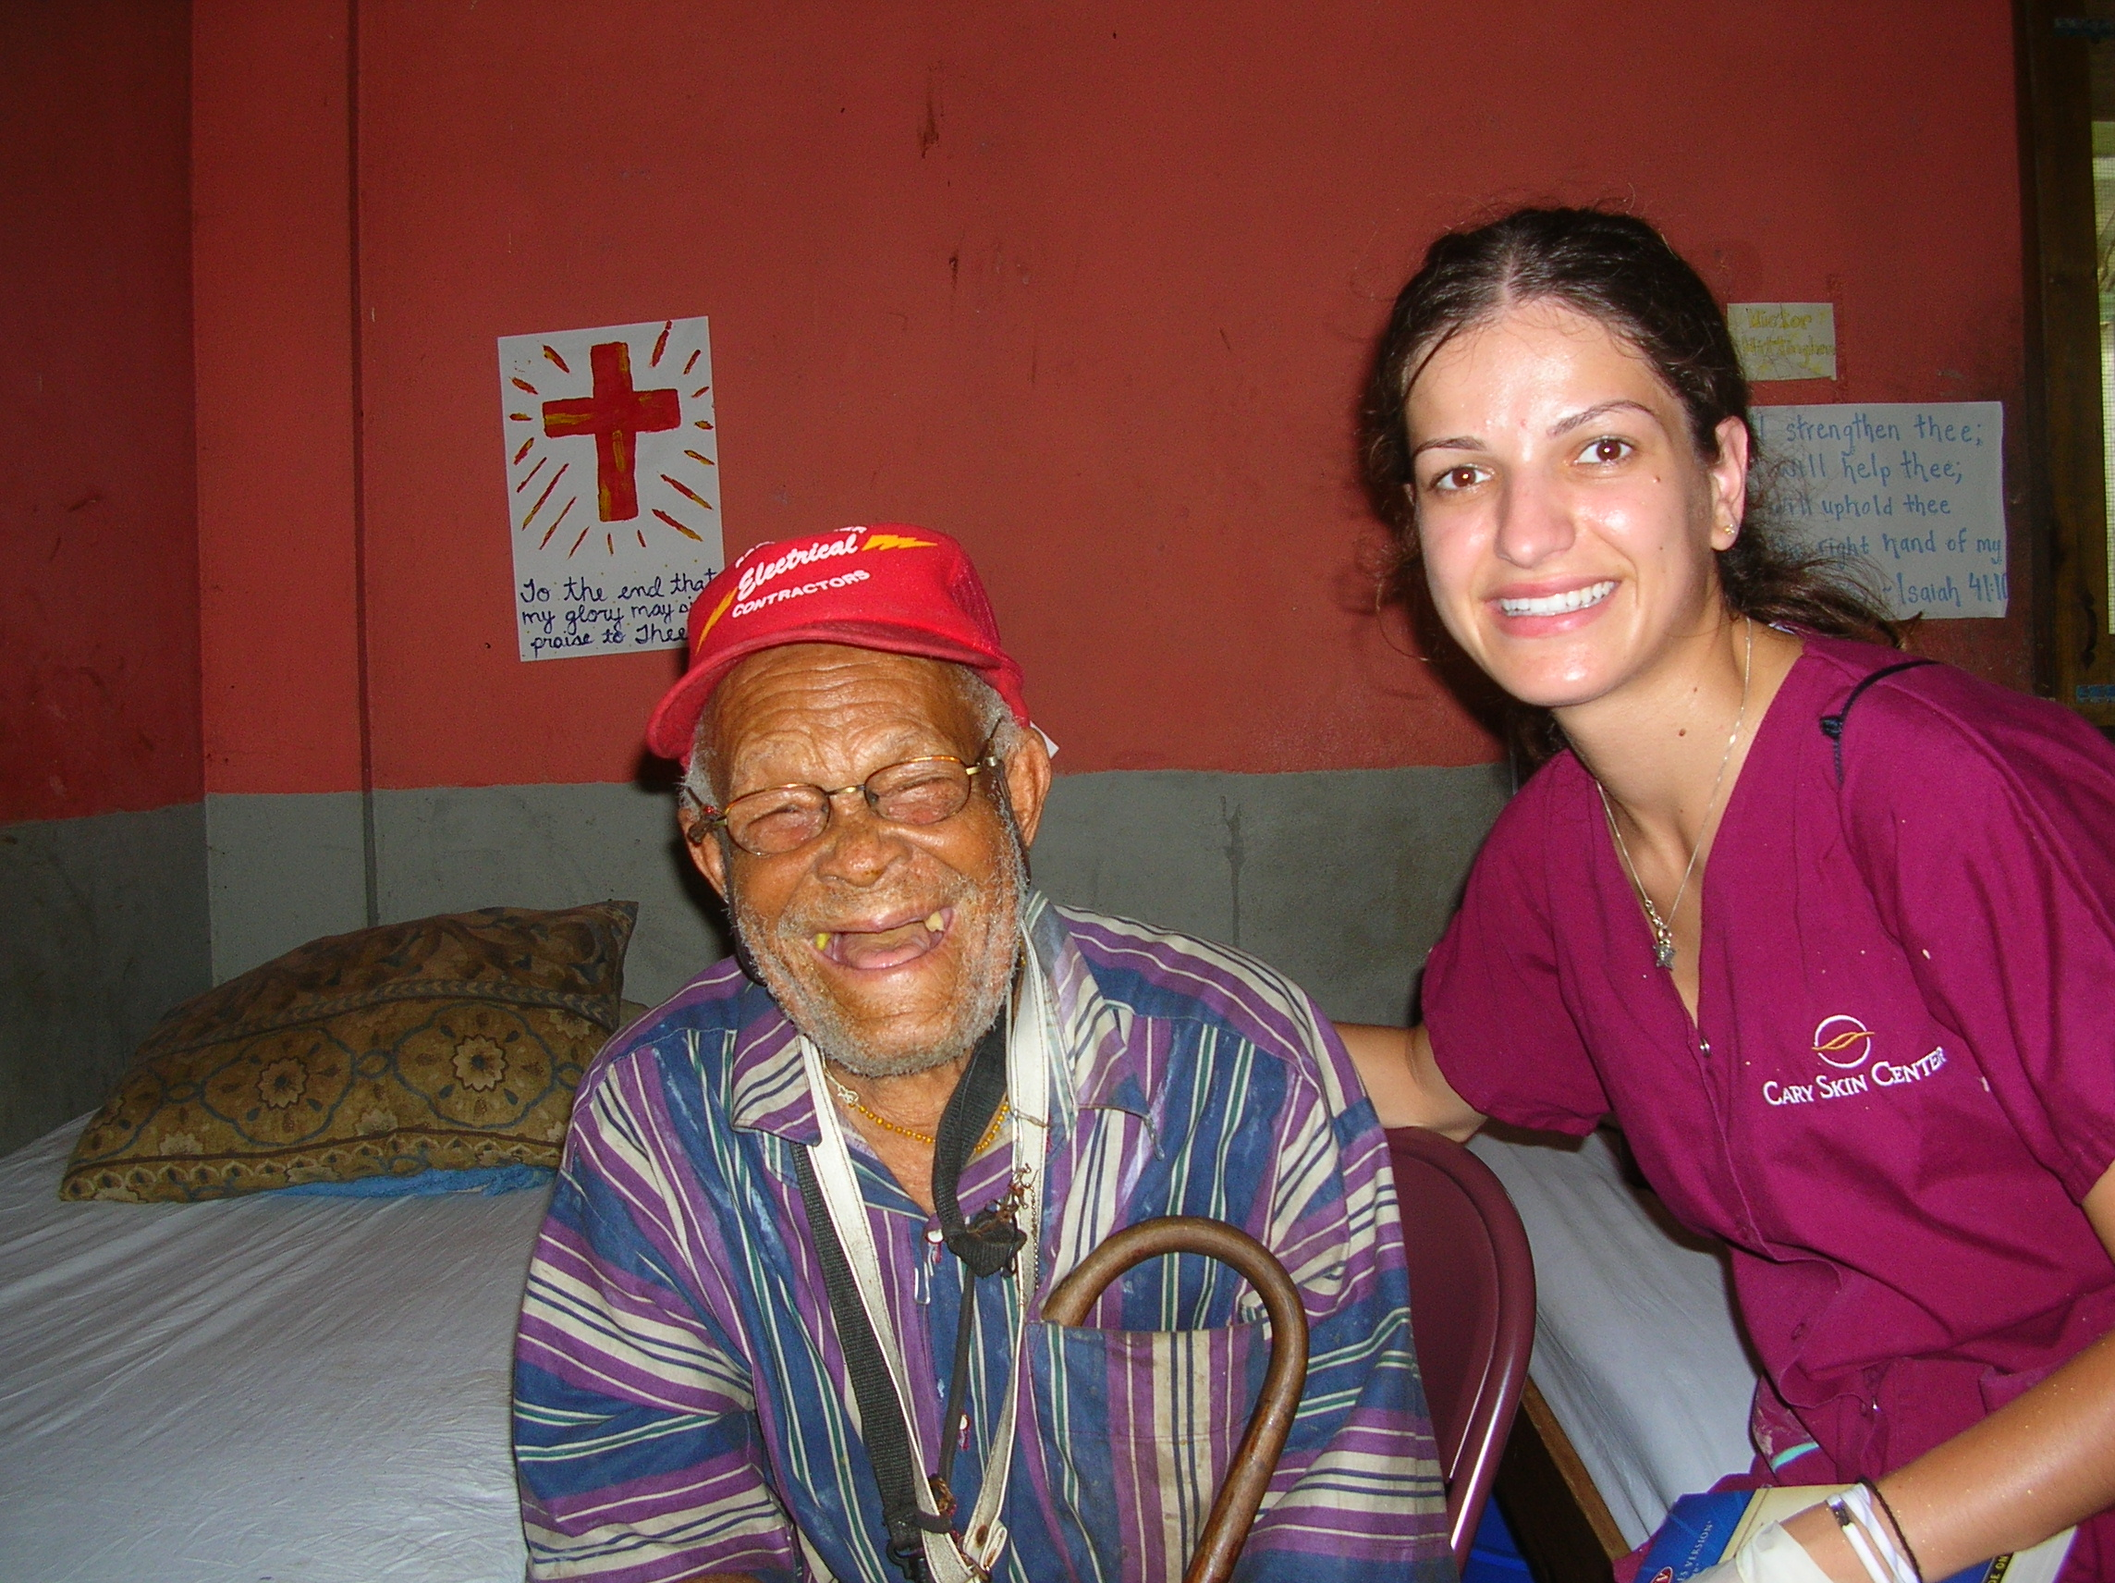
Visiting the Infirmary
Serves as a shelter for homeless or disabled people

Slide 11
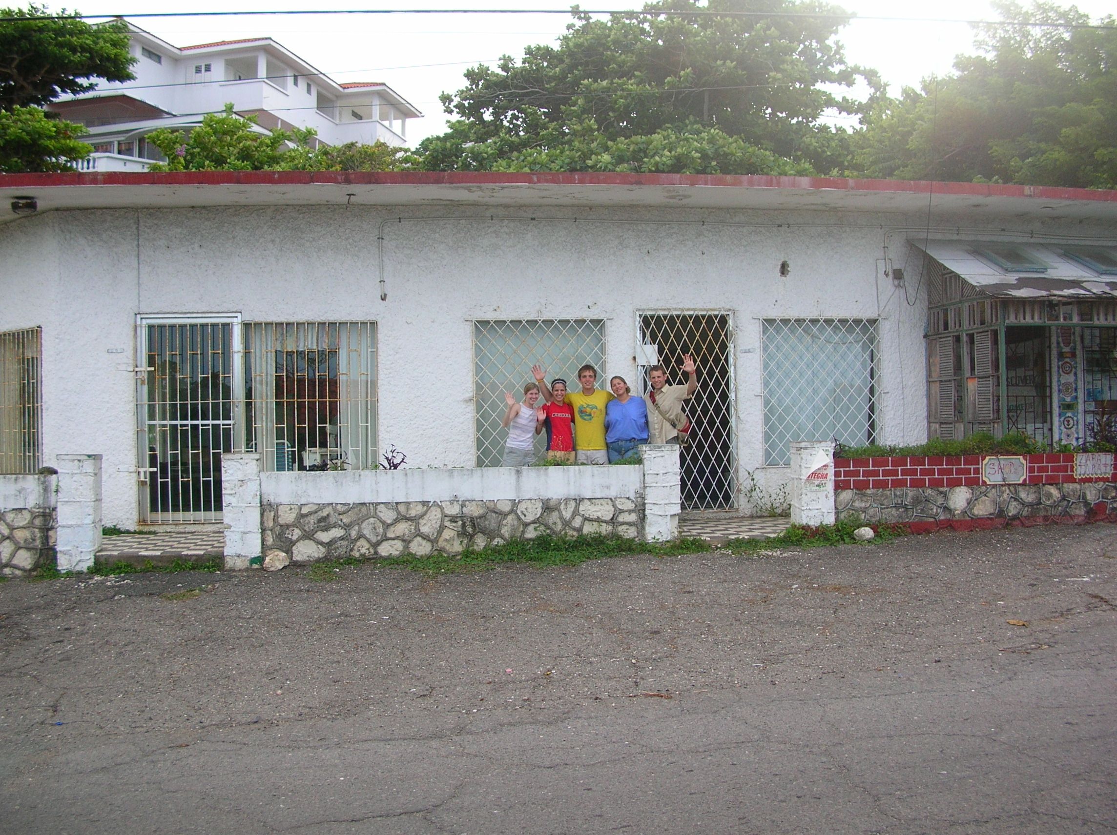
Our Pharmacy

Slide 12
Waiting for Dennis

Slide 13
Our last day

Slide 14
Caution: This picture was taken by a professional; don’t try this at home

