Slide 1
Interventional Management of Stroke
Bryan Ludwig, MD
NeuroInterventional Specialist, Inc.
Director of Neurointerventional Radiology
Miami Valley Hospital
Premier Health
Clinical Assistant Professor of Neurology
Wright State University Boonshoft School of Medicine

Slide 2
Objectives:
Review the advances within neurointerventional surgery including both proven therapies and experimental devices and techniques for treating cerebral vascular disease.
Illustrate the developing local collaboration to foster translational research in the neurosciences.

Slide 3
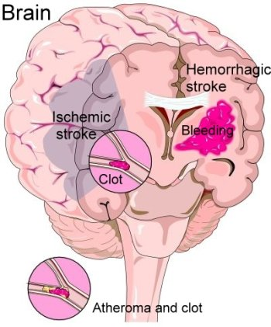
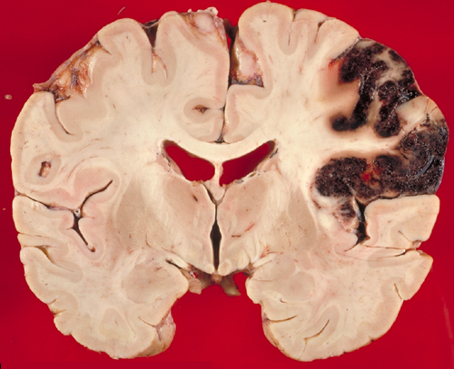
Stroke:
Background

Slide 4
Stroke:
When a blood vessel that carries oxygen and nutrients to the brain is either blocked or ruptures.
When the above happens, part of the brain cannot does not receive blood (and oxygen) and starts to die.

Slide 5
Is every stroke the same?
No
Stroke can be caused by either:
(1) A clot obstructing the flow of blood to the brain (~80%)
ischemic stroke
(2) A blood vessel rupturing and preventing blood flow to the brain (~20%)
hemorrhagic stroke

Slide 6
Stroke Statistics:
It is 4th leading cause of death in the United States.
Each year, 800,000 people experience a new or recurrent stroke.
$74 B = An estimate of direct and indirect cost of stroke in the U.S. for the year 2010.
* Downloaded from e100 Circulation Feb 2011. Refer to: Circ.ahajournals.org February 14, 2011

Slide 7
Neurointerventional Concepts to Treat Stroke:
Occlusion of aberrant arterial systems with liquid embolic agents, platinum coils, or other particles.
Revascularization of blocked arteries using aspiration catheters, mechanical manipulation, and stents.
Injection of Intra-arterial medications into the cerebral vascular system

Slide 8
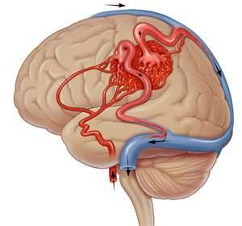
Hemorrhagic Stroke:
Arteriovenous
Malformations

Slide 9
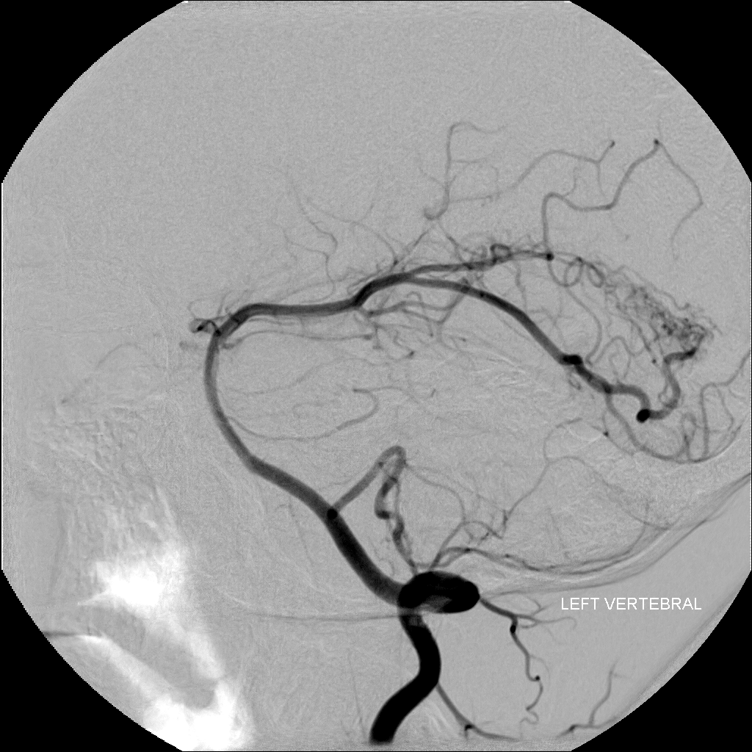
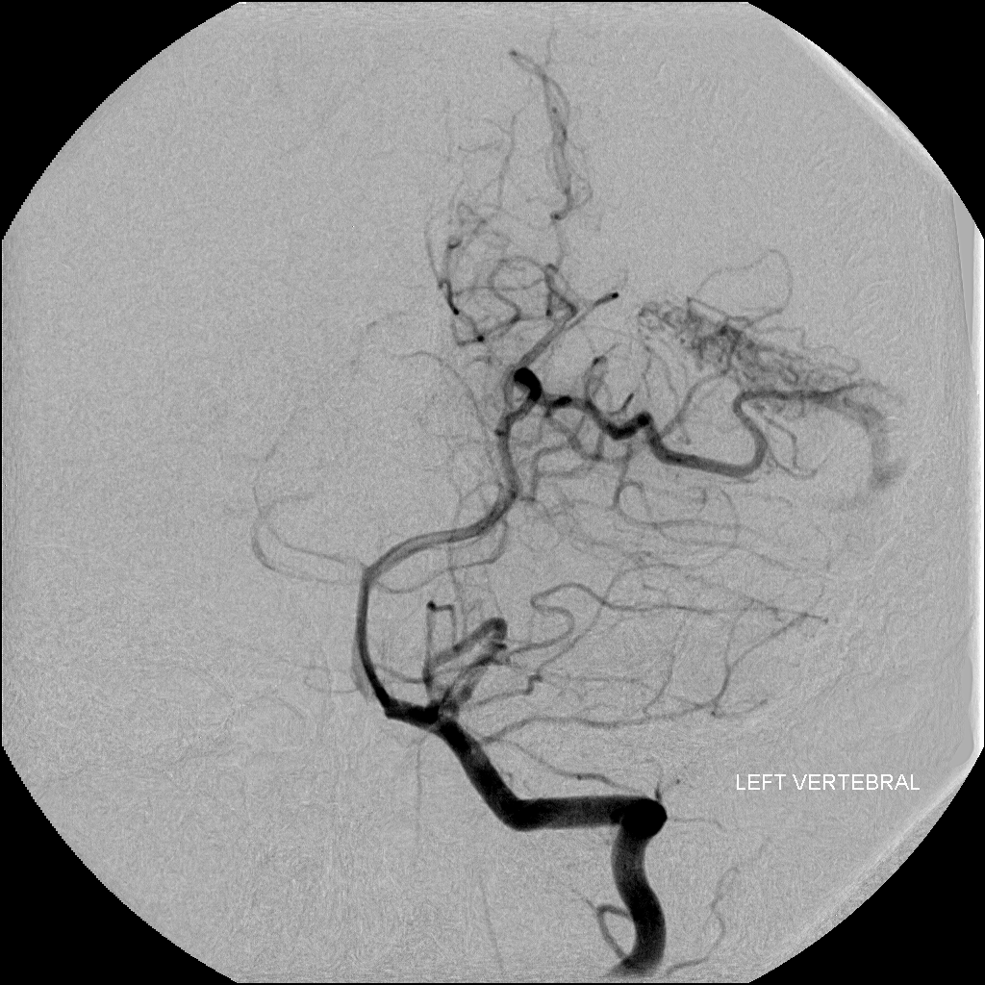

Slide 10
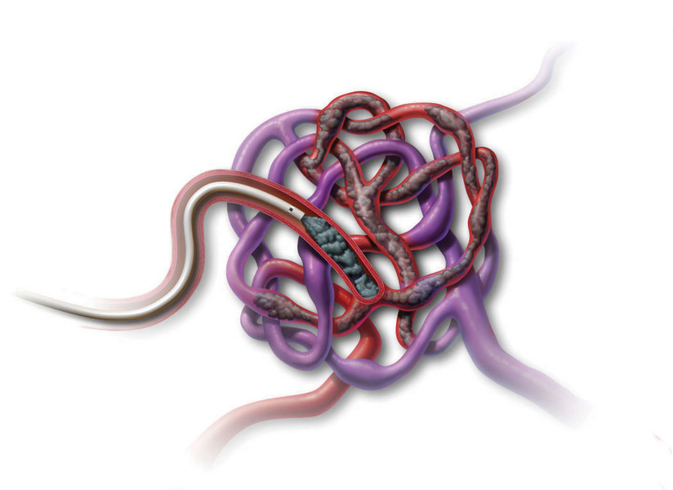
Embolic Materials
Onyx ® LES | Covidien www.ev3.net

Slide 11
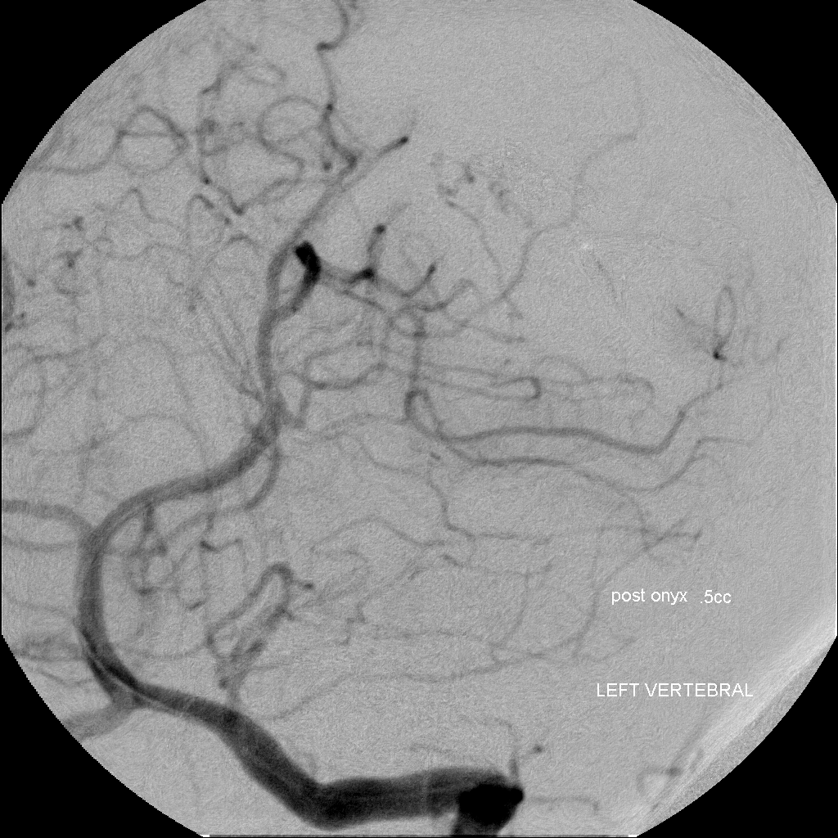
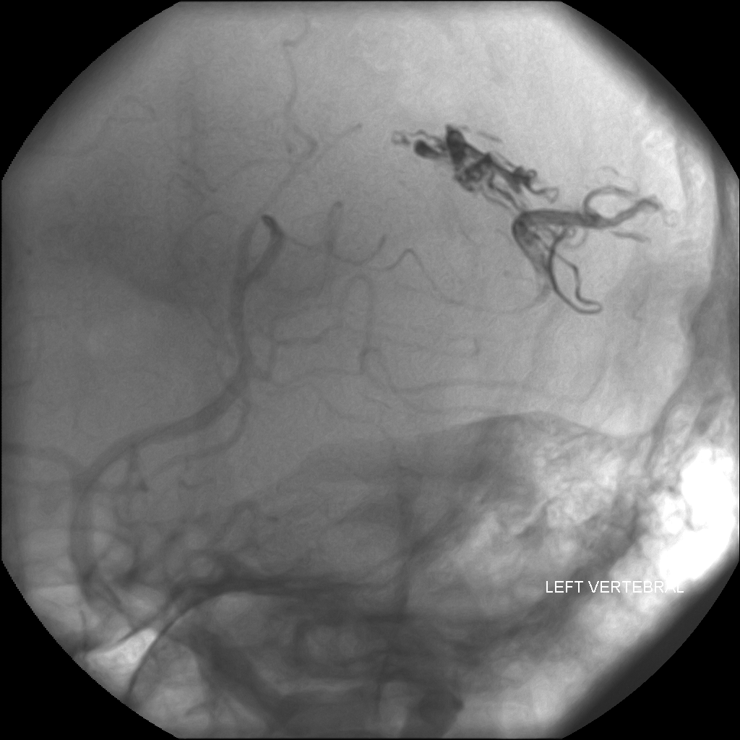

Slide 12
Hemorrhagic Stroke:
Intracranial Aneurysm Repair

Slide 13
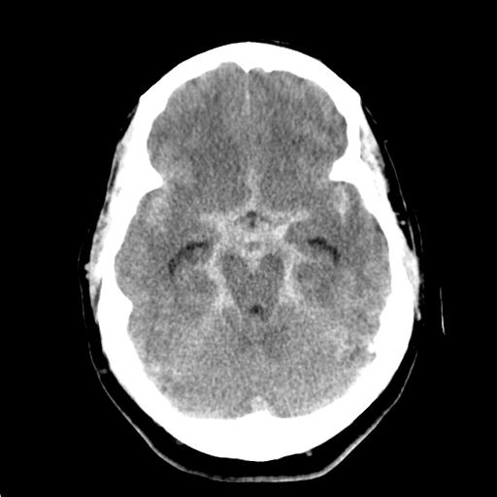
Head CT without contrast

Slide 14
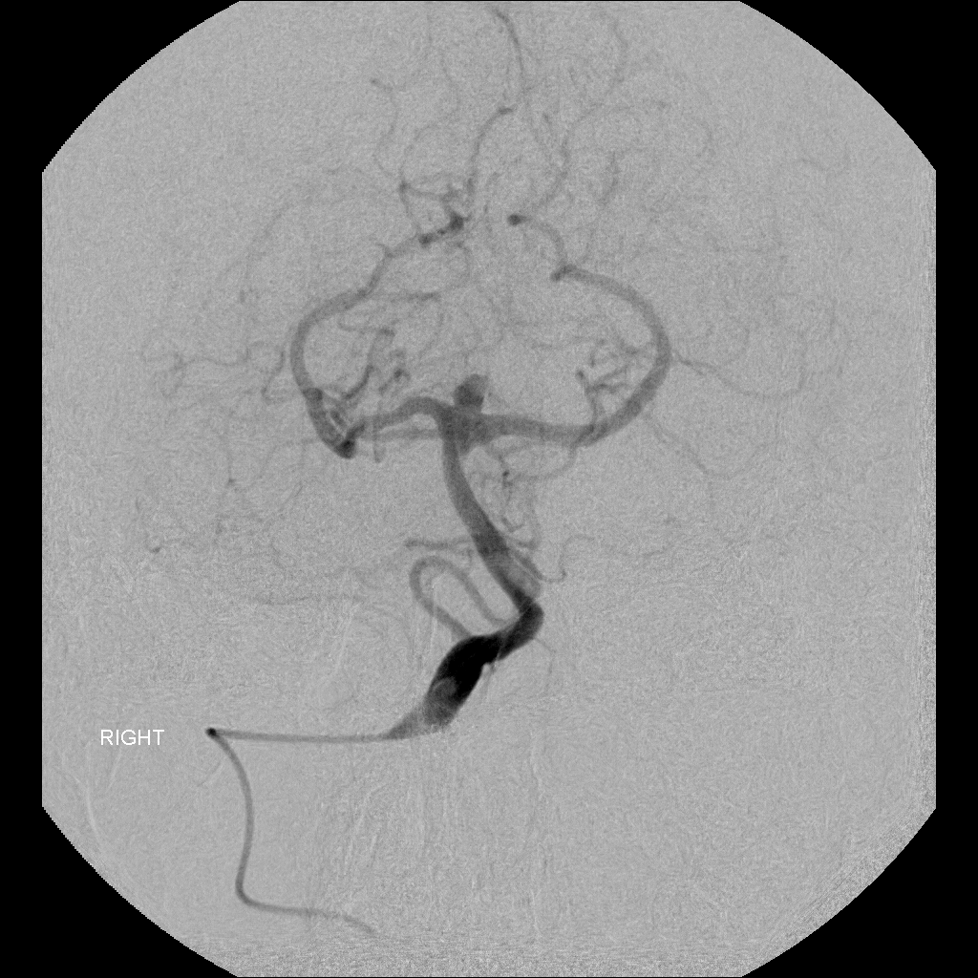
Digitally Subtracted Catheter Angiography

Slide 15
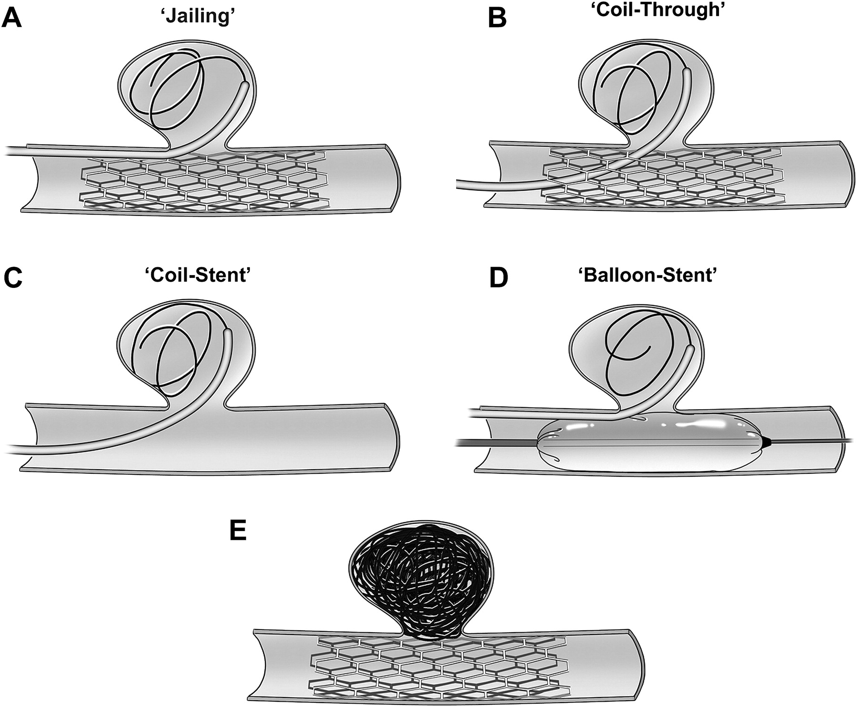

Slide 18
Pipeline Embolization Device
Pipeline ® PED | Covidien www.ev3.net

Slide 19
Thrombus within the aneurysmal sac

Slide 20
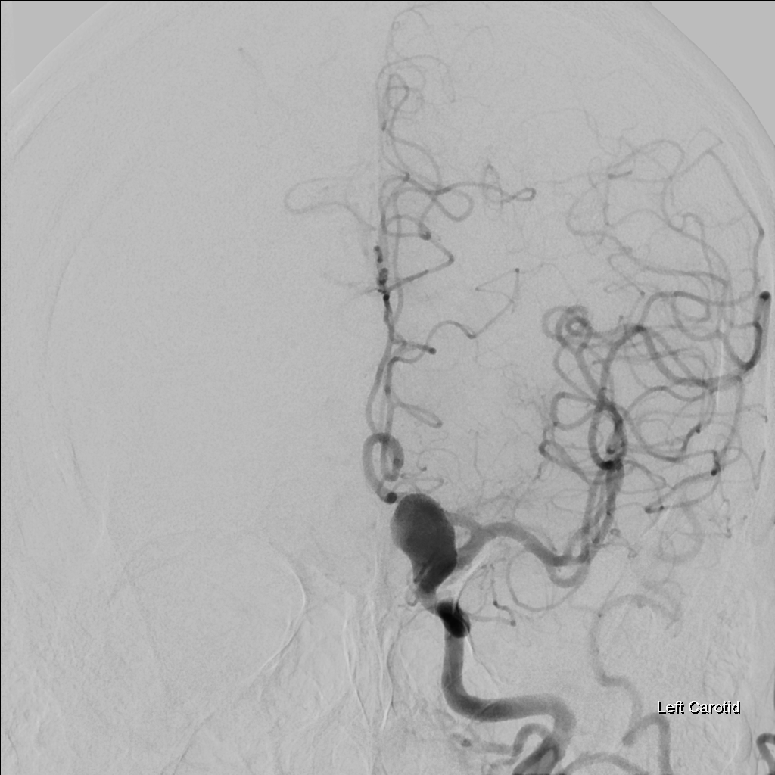
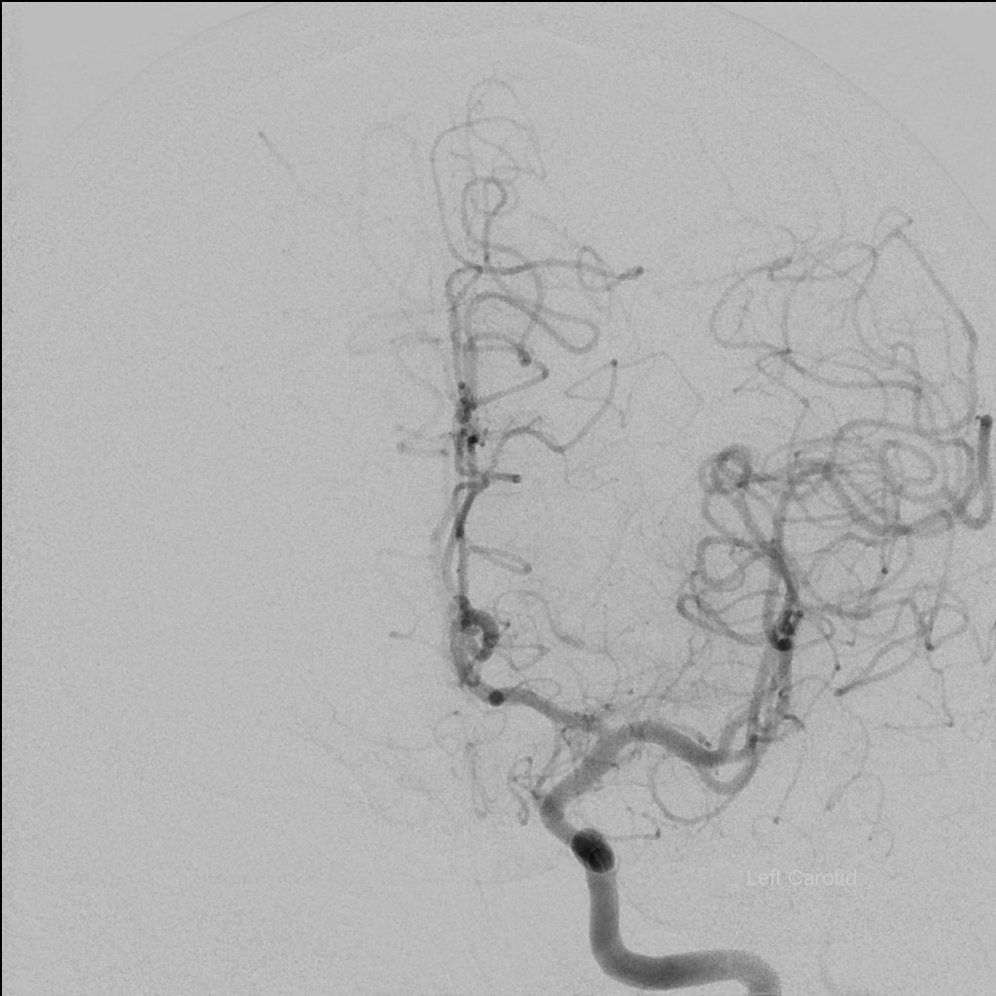

Slide 21
Ischemic Stroke:
Head CT Imaging Evaluation

Slide 22
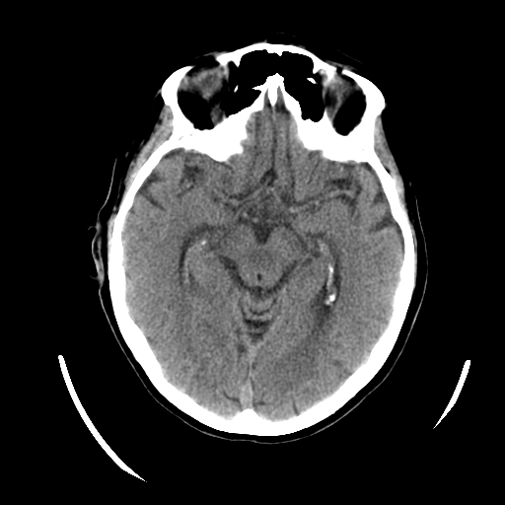
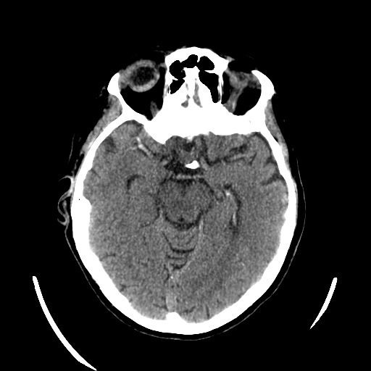
5 mm Slice Thickness 1.25mm Slice Thickness

Slide 23
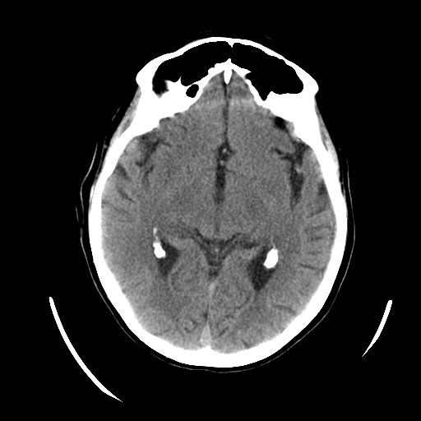
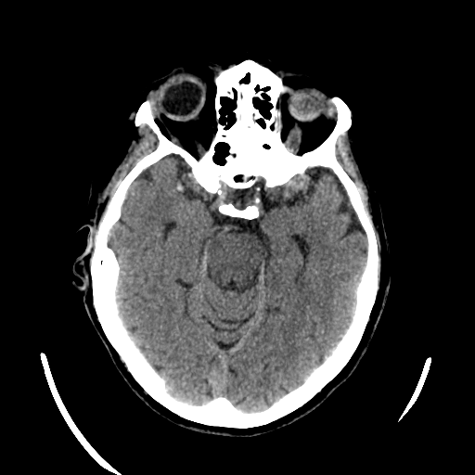
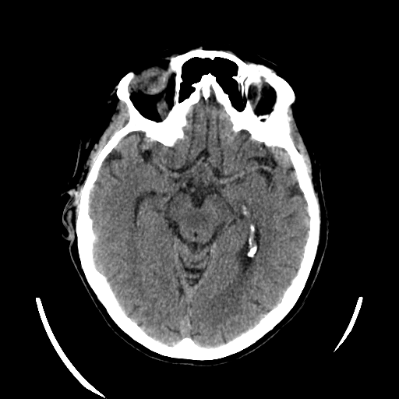
5 mm Slice Thickness 1.25mm Slice Thickness

Slide 24
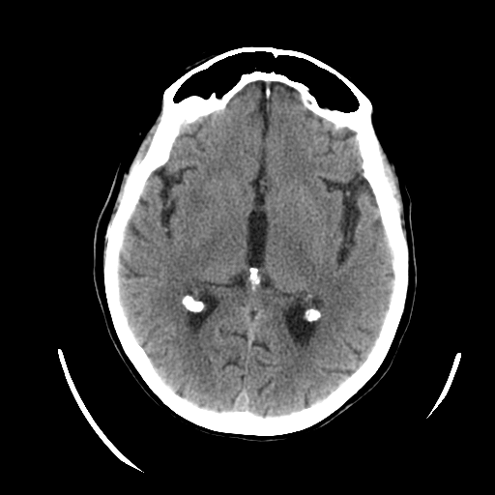
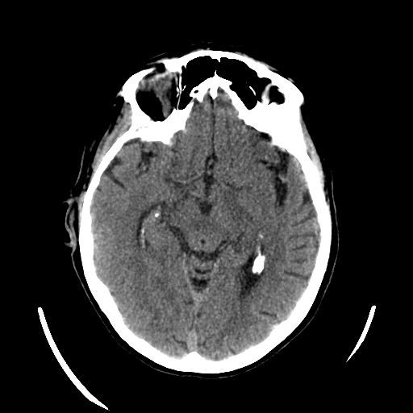
5 mm Slice Thickness 1.25mm Slice Thickness

Slide 25
Ischemic Stroke:
Novel imaging evaluation of a symptomatic carotid artery stenosis.

Slide 26
Carotid stenting and angioplasty of a critical, symptomatic, right, internal carotid artery origin stenosis.

Slide 27
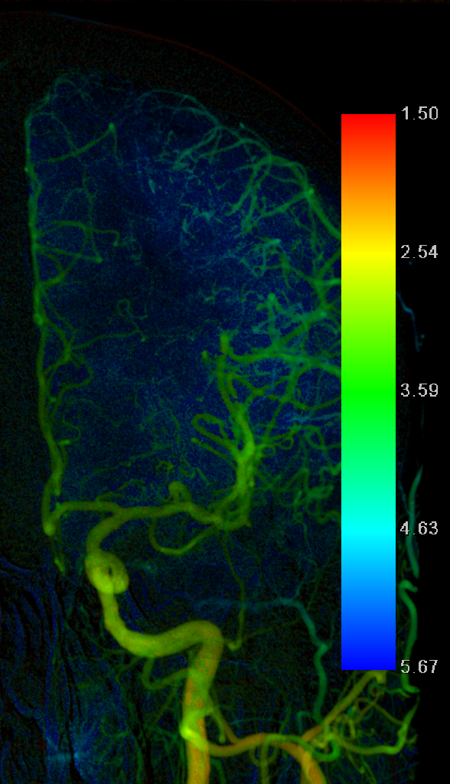
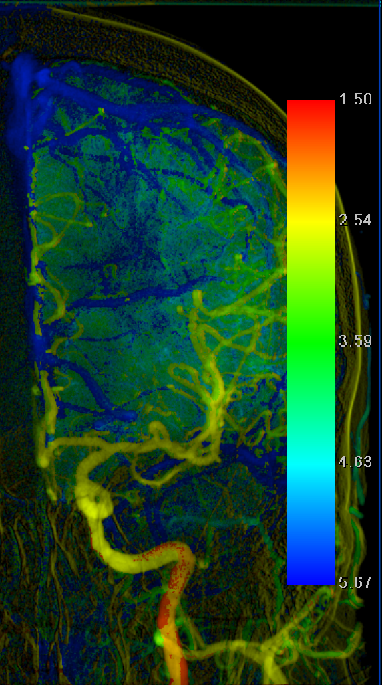
Before
After
Time

Slide 28
Ischemic Stroke:
Acute Stroke MRI Imaging Evaluation

Slide 29
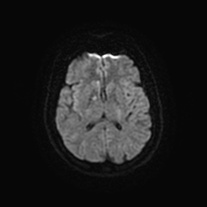
MRI DWI PWI

Slide 30
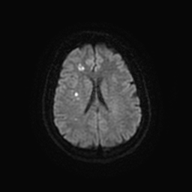
MRI DWI PWI

Slide 31
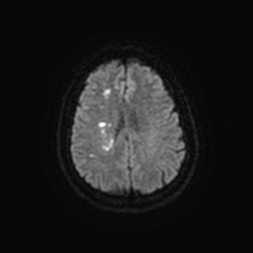
MRI DWI PWI

Slide 32
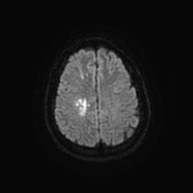
MRI DWI PWI

Slide 33
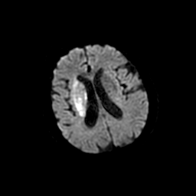
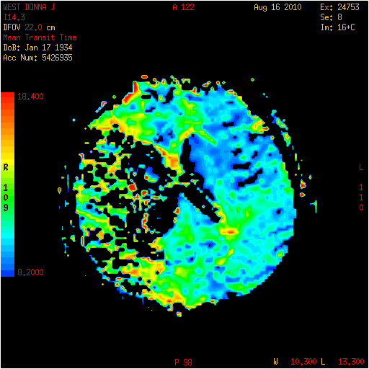

Slide 34
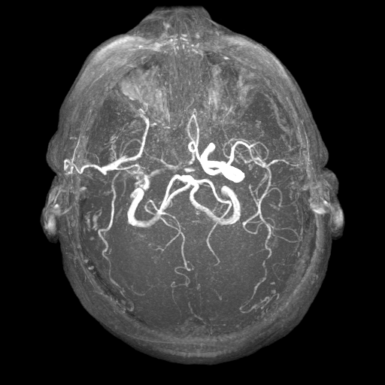
MRA of the brain - TOF

Slide 35
Ischemic Stroke:
Mechanical Thrombectomy

Slide 36
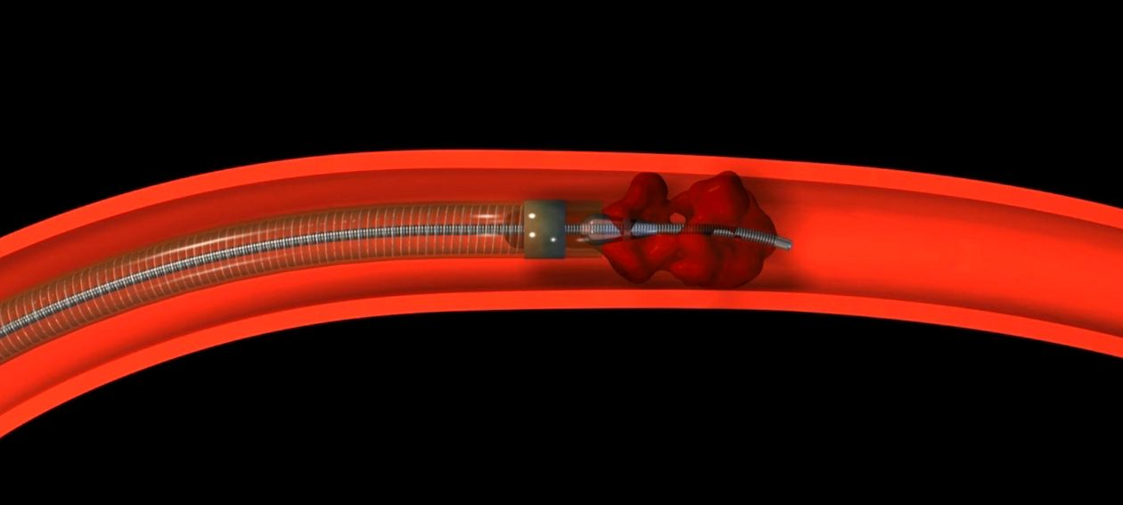
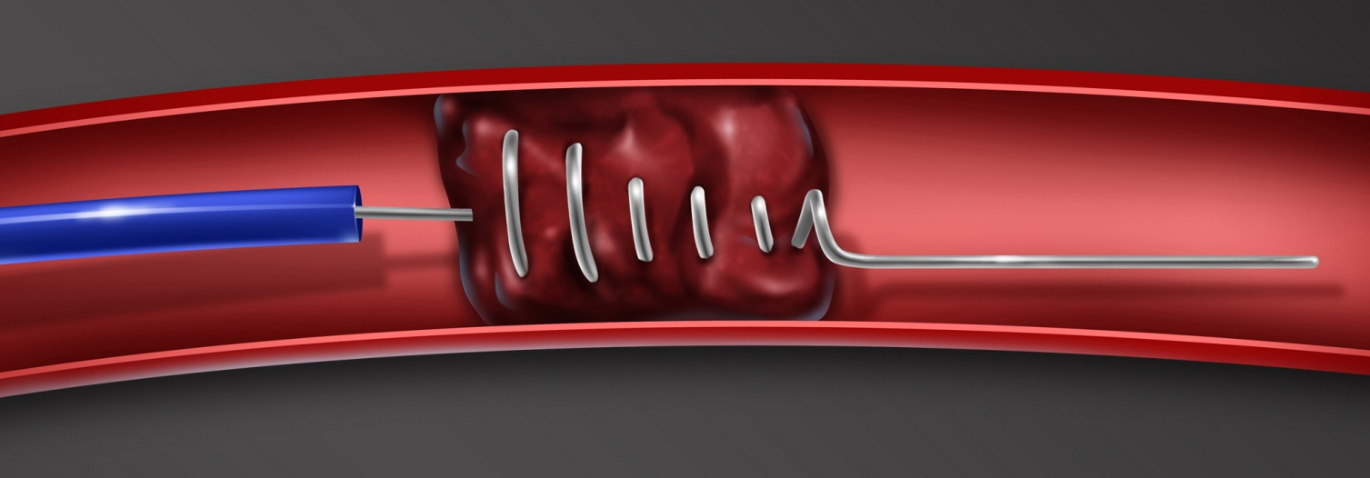
Penumbra aspiration catheter by Penumbra, Inc.
Merci Retrieval by Concentric Medical

Slide 37
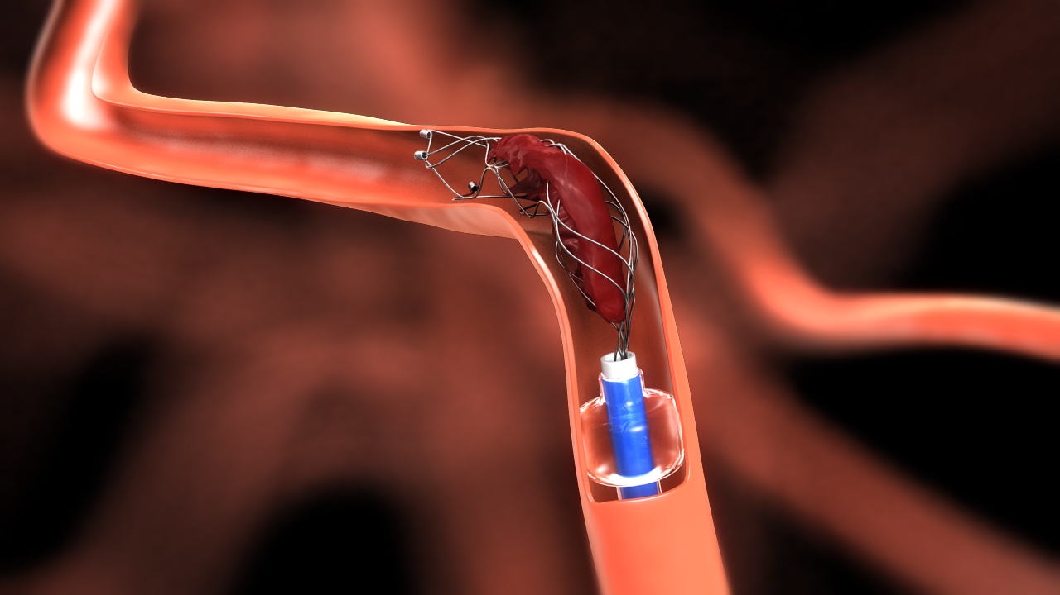
The Latest Technology:
Solitaire by Eve3, Inc.

Slide 38
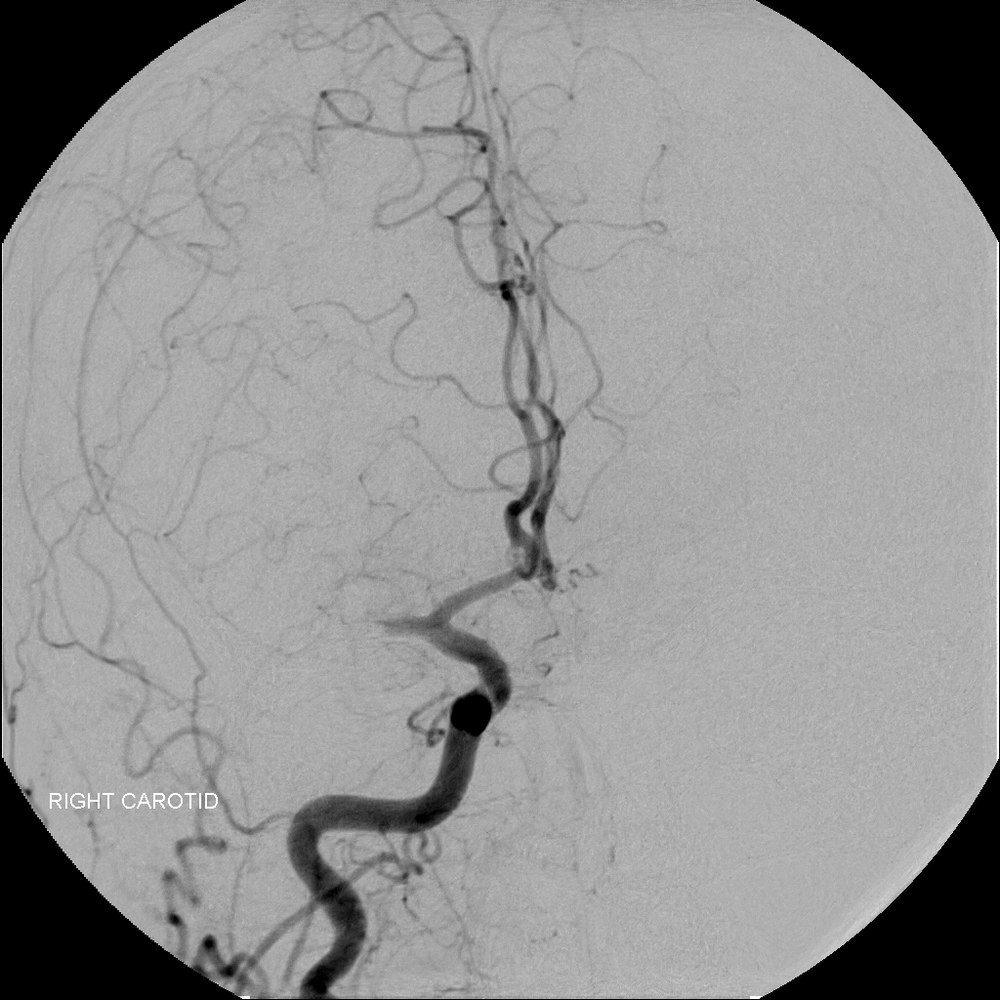
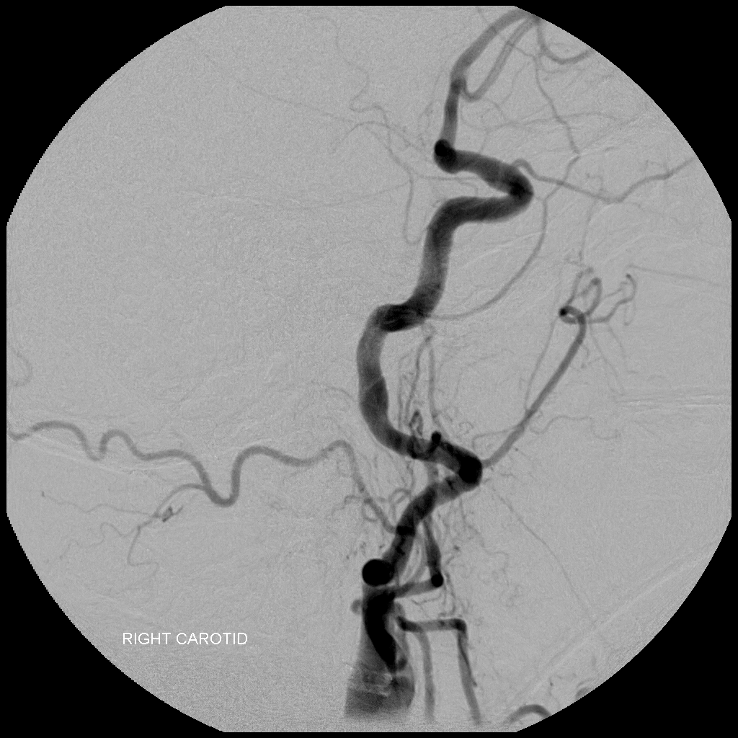

Slide 39
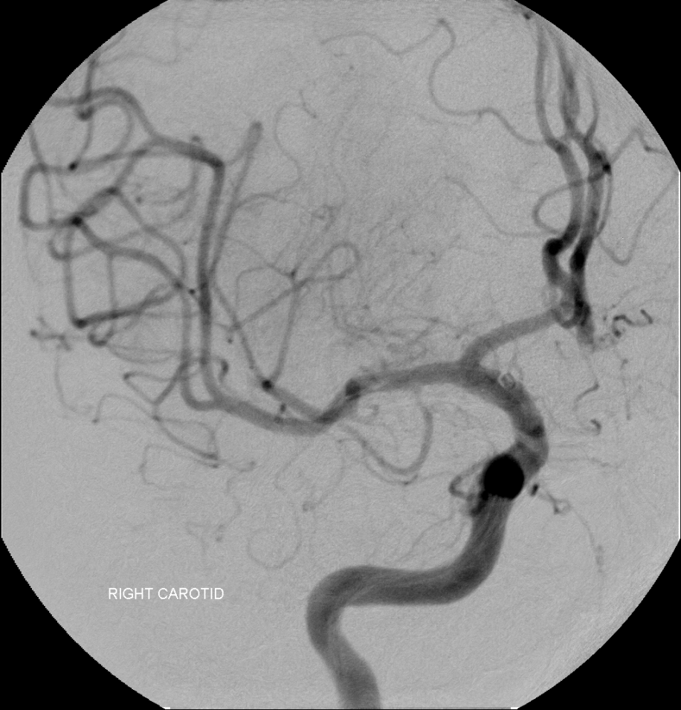
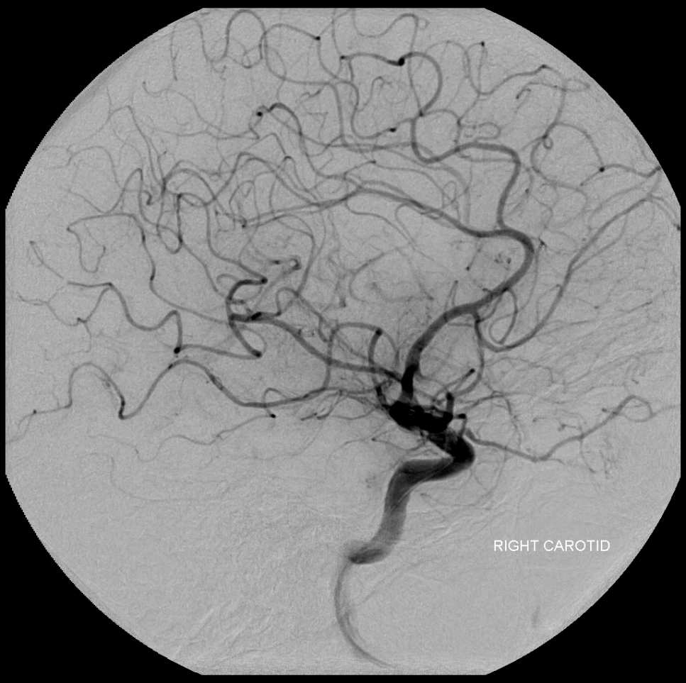
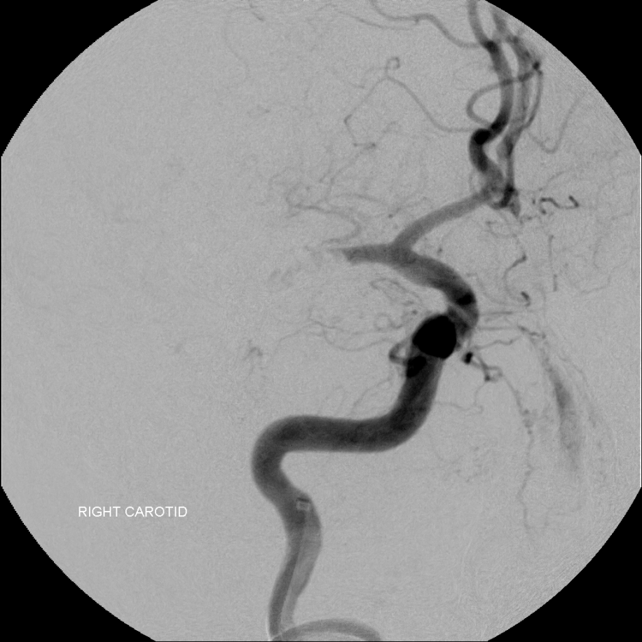
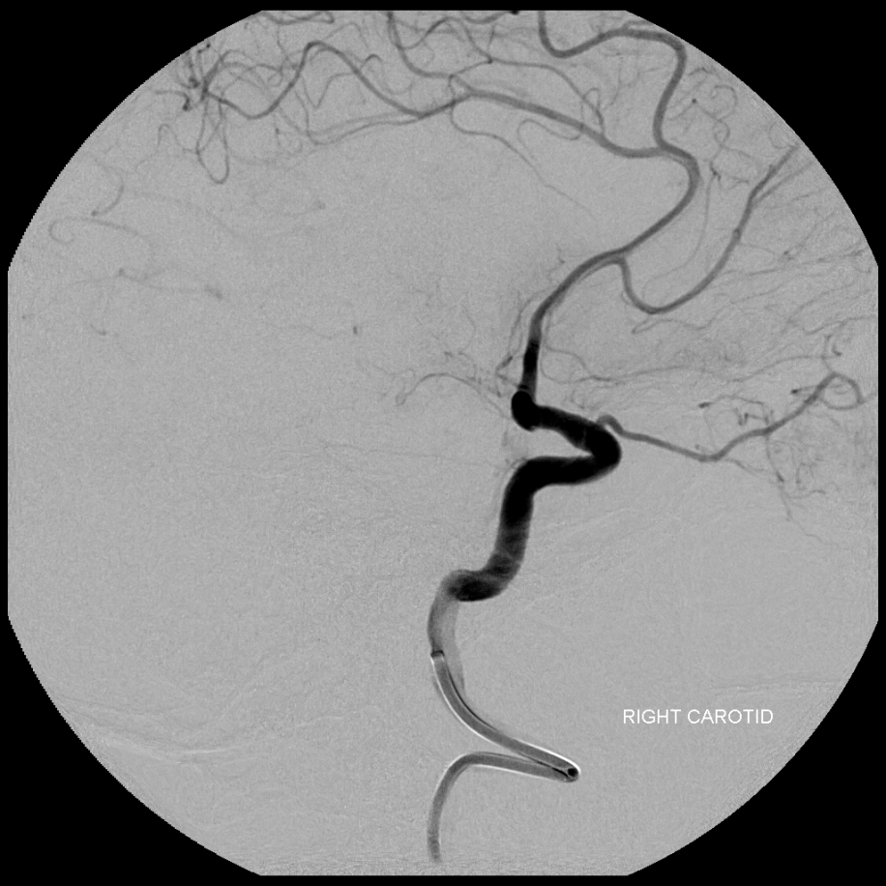

Slide 40
From bedside to bench: Using local collaboration to foster neuroscience translational research.

Slide 41
Industry Sponsored Clinical Trials:
THERAPY Trial:
Penumbra Inc is planning to investigate the outcomes of stroke victims post revascularization via endovascular means.
CHOICE Registry:
Abbott Vascular is studying the outcomes of carotid artery stenting and angioplasty in medically high risk patients.
Closed the registry in 2011.
ReVive Trial
Codman Neurovascular is currently planning to conduct a prospective, randomized, multi-center clinical trial to evaluate the 1st generation of the ReVive SE device in the treatment of acute ischemic stroke.
Preparing to enroll patients
Hydrogel Endovascular Aneurysm Treatment Trial (HEAT)
Sponsor: Northwestern University
Purpose : This research study is being done to test the effectiveness of a new FDA approved device for treating aneurysms in comparison to the current standard device for endovascular aneurysm treatment which is bare platinum coils.
Actively enrolling patients

Slide 42
Investigator Initiated Research Projects:
Investigating the relationship between aneurysm morphology and risk of rupture using internal database.
Evaluating the biology and treatment of intraoperative complications in patients undergoing carotid stenting and angioplasty.
Collaborating with WSU Engineering Department to create models capable of predicting aneurysm rupture using computational fluid dynamics.
Exploring potential partnerships among local area businesses to combine clinical expertise with cutting edge private technology.
Mound Laser and Photonics Center

Slide 43
Questions?
Thank You for your time and attention.

