Slide 1
Calendar
Requirements
VSAS
Scheduling Process
Off-cycle Students
VAMC Requirements
Step 2
Residency Information
Y-4 Scheduling
January 2014

Slide 2
M-4 Calendar, 2014-15
Block 1: June 30-July 27
Block 2: July 28-August 24
Block 3: August 25-September 21
Block 4: September 22-October 19
Block 5: October 20-November 16
Block 6: November 17-December 21 (includes swing week)
Block 7: December 22-January 25 (includes swing week)
Block 8: January 26-February 22
Block 9: February 23-March 22
Block 10: March 23-April 19
Block 11: April 20-May 17
Graduation anticipated: May 22, 2015 (Friday)

Slide 3
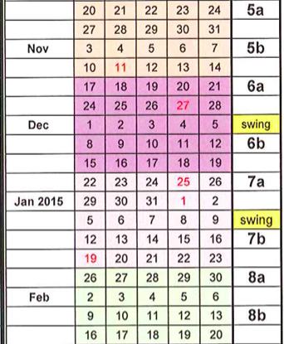

Slide 4
MS-4 Requirements
Year 4 is 11 blocks, June 30-May 17
  9 blocks of rotations required
  2 blocks available for residency interviewing and boards (RIB)
  Block 12 is available for off-cycle students, if needed
Nine Blocks include:
  Two blocks of Clerkships – one block each, must be in Dayton, graded Pass/Fail
    Emergency Medicine clerkship
    Neurology clerkship
  Sub-Internship - one block, must be in in MED, PED, FMD, SUR, WOH, or PYC
  Surgery Elective - 1 block or 2 half-blocks
      a Surgery/Ortho Sub-I does not fulfill this requirement
      Ortho and surgery electives fulfill it

Slide 5
MS-4 Requirements (cont.)
    Five electives of your choice…
      must be chosen from at least 3 different departments: triad requirement. The required surgical month and Sub-I count toward the three different departments.
      One elective must be in a primary care dept (FMD, MED, or PED)
      Parameters
        2-week blocks - max of 6 (12 weeks)
        Extramurals (XMLs) - max of 3 blocks (12 weeks)
        Student-initiated (SIEs) - max of 4 blocks (16 weeks)
        Out of town Blocks – max of 4 blocks (SIE or XML)
        Same discipline – max of 4 blocks (16 weeks)
        Longitudinal electives – max of 1 block (4 weeks) and must have corresponding time available in your schedule
        2-block electives – max of 1, must be taken in consecutive months (8 weeks)
        Identical electives - max of 2, one at WSUSOM & one away
        electives are graded P / F

Slide 6
MS-4 Requirements (cont.)
  TYPES OF ELECTIVES
  Catalog
  2014-15 catalog will be available at
  www.med.wright.edu/medu/electives and at http:// somfm.wright.edu/course-catalog/All_BSOM_Courses.pdf
  Student Initiated Elective (SIE)
    Must be approved by B2 Committee.
    Can be 2 weeks or 4 weeks
    Must submit proposal online at https://www.med.wright.edu/apps/sie/login
    Domestic SIE proposals must be submitted no later than 60 days in advance of elective.
    International SIE proposals are due no later than 90 days in advance.
    SIE is a longitudinal SIE if it takes more than 4 weeks to complete. You may do other electives simultaneously with a longitudinal SIE. Longitudinal electives must be submitted no later than September 1, regardless of when you plan to begin.
    Approval process and documents required can be found in the 2014-15 catalog.

Slide 7
MS-4 Requirements (cont.)
    Extramural Electives
      Electives that are in the catalog of another medical school are extramurals. An elective that you develop that is not in Dayton is not an extramural; it is SIE.
      Most SOMs use AAMC VSAS (Visiting Student Application Service) for application and information. https://www.aamc.org/students/medstudents/vsas/
      Contact Gwen/Erin if you want authorization to use VSAS.
      For SOMs not using VSAS, submit application and information needed by host school to Gwen/Erin. They will complete BSOM portions and send for you to host school.
      Extramural requests are due 60 days in advance of elective start date.

Slide 8
Visiting Student Application Service (VSAS)
  Provided by AAMC
    Used by most SOMs
  Requires authorization by SA/A to use
    Contact Gwen/Erin if want authorization
  SA/A can provide
    Verification of your information
    Transcript upload
    Photograph upload
    Upload any other required documents
    Some immunization forms
      Some SOMs require signature of health care professional on the host SOM form. Gwen/Erin can provide copies of original documents for you to take to your health care provider.
    Uploads of any other required documents
  You must provide
    Copy of health insurance card
    Copy of Step 1 Score Report, if requested
    Payments for any charges by VSAS or Host SOM
    CV, if requested
    Uploads of any other required documents
  You must request approval by Boonshoft SOM to receive academic credit. Approval by Host SOM via VSAS does not mean you have been approved by BSOM.

Slide 9
Scheduling Process
Eight Phases
  Phase 1 – Clerkships
    January 31-February 4
  Phase 2 - Sub-Internship
    February 7-10
  Phase 3 – Surgery
    February 13-17
  Phase 4 – 1st elective block
    February 20-23
  Phase 5 – 2nd elective block
    February 25-27
  Phase 6 – 3rd elective block
    March 1-3
  Phase 7 – 4th elective block
    March 5-6
  Phase 8 – 5th elective block
    March 8-10

Slide 10
Scheduling Process (cont.)
  General Information
  Each student will be assigned a new random number for each phase.
  Log in to website. The website URL will be emailed to you before the start of scheduling.
  In Phase 1, rank every block available for both clerkships, with 1 being your first choice. Submit your preferences by the deadline. If you do not submit preferences, you will be randomly assigned a clerkship block after all students who submitted preferences by the deadline.
  For each phase, when your number comes up, the computer will check to see if your first choice is available. If not, it will continue through your preferences until you are assigned each clerkship/elective.
  You will receive results of each phase before next phase begins.
  For Phases 2-3, failure to submit preferences by the deadline results in your inability to continue in the process.
  You will receive an email prior to each phase that includes a pre-phase worksheet to assist you in the process.

Slide 11
Phase 1 – Clerkships, January 31 –February 4
  Rank every block available for both clerkships, with 1 being your first choice.
  Failure to submit preferences by deadline will result in assignment to clerkships after all students who met the deadline have been assigned.
  There are enough spaces for both clerkships for all students. This does not mean you will be assigned in your most preferred blocks.
  Your randomly assigned number for this phase is reversed for the second clerkship assignment.

Slide 12
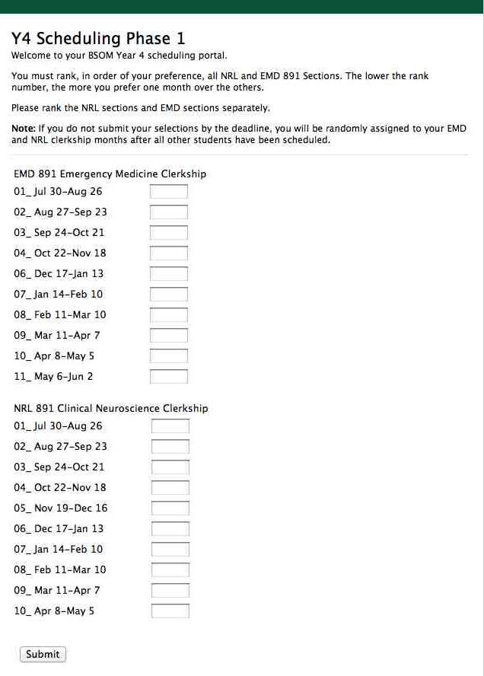
Preview of Screen, Phase 1

Slide 13
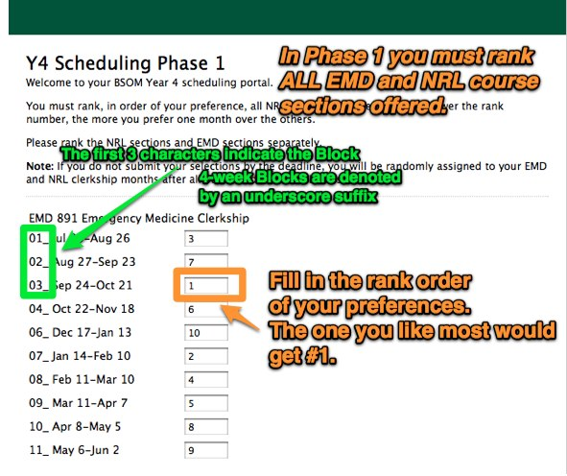

Slide 14
Phase 2 - Sub-Internships, February 7-10
  Select and rank your course section and block preference. For example, MED 829 in Block 2 is your first choice. Rank it as “1.”
  Select 10 preferences, ranking them from 1-10 with 1 being your highest preference.
  Submit your preferences by February 10, to continue with Phase 3.
  If you submit preferences by February 10, you will receive your results before you continue to Phase 3.
  Drop-down menus are used in Phases 2-8.

Slide 15
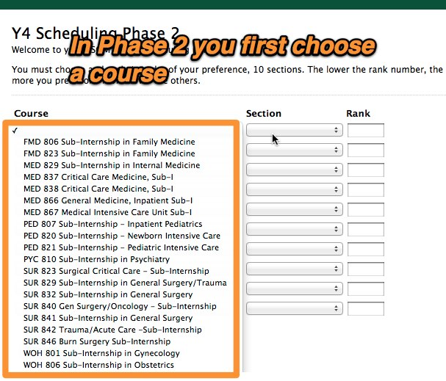
Directions for Phase 2, Step 1

Slide 16
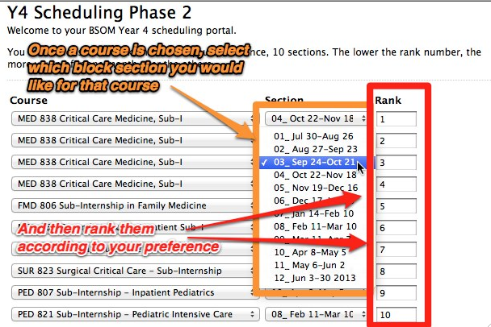
Directions for Phase 2, Step 2

Slide 17
Phase 3 – Surgery, February 13-17
  Select and rank your preferences for either 2-week or 4-week blocks of surgery/orthopedic surgery courses.
  Select at least 16 preferences, ranking them from 1-16 with 1 being your highest preference.
  Submit your preferences by February 17, to continue with Phase 4.
  If you submit your preferences by February 17, you will receive your results before Phase 4.

Slide 18
Phases 4-8 – Electives, February 20-March 10.
Select and rank your preferences for your electives and Residency Interviewing and Boards (RIB).
  You may select five 4-week electives or a combination of 4-week and 2-week electives. You must schedule a total of 5 blocks of electives.
  Select at least 16 preferences in each phase, ranking them from 1-16 with 1 being your highest preference.
  You may include SIEs and extramurals (XMLs) in your preferences. Place these last in your preferences. If you list XML or SIE, you will always be scheduled for it if you have not already been scheduled for an elective in the time frame requested.
  If you do not submit your preferences by the deadline for each phase, you will not be permitted to finish your schedule until all students who submitted preferences on time are scheduled.
  You will receive results of each phase before the start of the next phase.

Slide 19
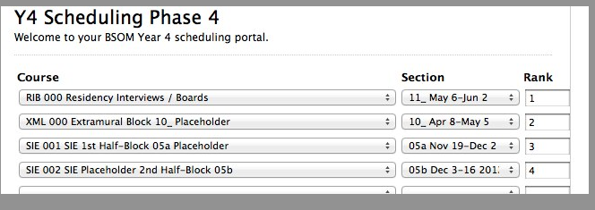
Preview of Screen, Phase 4

Slide 20
Phase 4 – 1st Elective February 20-23
Phase 5 – 2nd Elective February 25-27
Phase 6 – 3rd Elective March 1-3
Phase 7 – 4th Elective March 5-6
Phase 8 – 5th Elective March 8-10

Slide 21
Off-Cycle Students
An off-cycle student is one who will not complete MS-3 before June 30, 2014
Off-cycle students may opt to omit RIB time in MS-4 in order to offset the delay in beginning MS-4. You may march/graduate with your class if you are expected to complete requirements prior to September 30, 2015. If you have not completed all requirements by the date of graduation, you will receive a blank diploma at the graduation ceremony. Your official diploma will be mailed to you after you have completed all requirements.
MS-3 make-up clerkships will be scheduled in the first available rotation. In developing your schedule, assume you will complete MS-3 clerkships first. You will not be able to list preferences for those months.

Slide 22
Advisors
Consult with your advisor during the scheduling process. Your advisor will receive a copy of your final schedule.
I must receive an email from your advisor BEFORE February 7. The email must state that the advisor approves your anticipated schedule. You may participate only in Phase 1 without advisor approval. You cannot participate in the Phases 2-8 of the scheduling process without advisor approval.
Advisors are qualified to counsel & advise you for all specialties.
Specialty advisors are available for residency consultation. Please contact Gwen/Erin for questions about advisors.

Slide 23
Things to Avoid
Please minimize changes during year.
By not following drop/add lead times, you probably will not be able to make a change in your schedule.
All SIEs and extramurals must be approved in advance. You will not be given credit retroactively.
Please do not participate in any rotation unless it is on your official schedule. If an elective is not on your schedule, you have no professional liability insurance and will not receive academic credit!!!
You cannot go for an extramural month, and then decide to stay for an additional month.
If you fail to show-up for a clerkship or elective you will receive an F.
Unfortunately it has happened…

Slide 24
Changes Mid-Year
Information on vacancies and waiting lists is available by contacting Gwen/Erin.
See course descriptions for drop/add lead times
  Drop/add lead time for electives varies from 30 days to 90 days.
  After the drop/add lead time has passed, changes are permitted only under extenuating circumstances and only with the approval of departments.
To drop/add, contact Gwen/Erin.
  Drop/adds requested after the drop/add lead time require completion of a drop/add form, to be approved by your advisor and the department of the course(s) you are adding/dropping.
It is easier to drop/add before the deadline & probably not possible afterwards.
Each time you make a schedule change, a revised schedule will be emailed to you.…please, please look it over. Make sure it is correct.

Slide 25
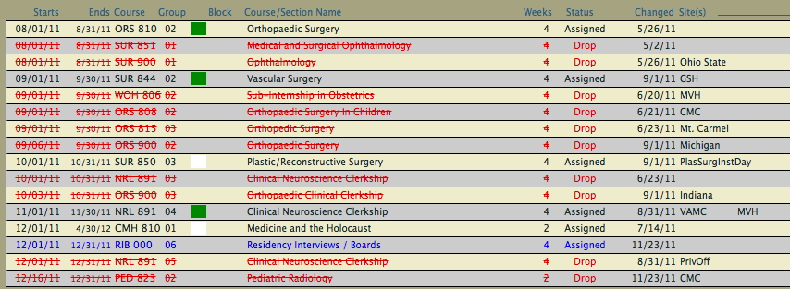
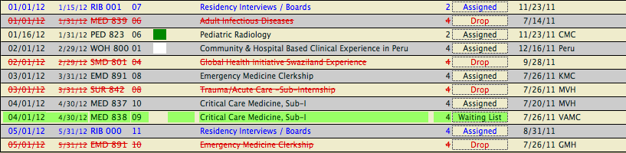
You do NOT want your schedule to look like this….

Slide 26
Your Role in MS-4 Scheduling
Prepare for each phase of the scheduling process. Contact your advisor to approve your schedule.
Submit your preferences on time.
International extramurals (XMLs) work better in the 2nd half of the year, except Block 9 (Match). You are too busy with boards, ERAS, the NRMP & interviewing in first half of the year. Match Day is in March.
Please do not leave your drop/add form for signature. It is better to hand-carry it to the next person.

Slide 27
VAMC Requirements
Assume that you will be assigned to VAMC for at least a day for some elective or clerkship.
Complete the V-10 form before June 30.
Complete the refresher course for mandatory online training before June 30.
Provide V-10 form and copies of training completion certificates to Gwen/Erin. They make a copy and forward originals to VAMC.
You will be emailed the form and the link for online training to you in February.

Slide 28

Boards, Step 2 CK & CS
You must pass the Step 2 CK and CS to graduate and receive your diploma
If you fail either exam, you will not receive your diploma until you pass.
  There is not a limit in the number of retakes.
  You must pass within 2 years of completing MS-4.
You are not automatically registered because you took Step 1. All students must register to take the exam & schedule a date.
Take the exam ASAP after completing MS-3. Many students take part or all of Block 1 off as a study time.
To graduate in May 2015 you must schedule the exams by December 31, 2014 AND you must take CS by the end of January 2015 and you must take CK by the end of February 2015. Failure to take Step 2 CK & CS by the deadlines may result in a blank diploma at graduation, if test scores are not received in time. (Exact dates will be emailed to you by Dr. LeRoy near end of July.)

Slide 29

Upcoming Residency Info Sessions
early April…
Careers in Medicine panel discussion of MS-4 students who recently matched. Date & time TBA through email from Dr. Kirkham. Hear it from students who have “been there, done that.”
June…
  2 sessions on consecutive evenings. You need to attend only 1 session. Look for an email from Erin about the date and time.
  The June session will cover the following: --NRMP
  ERAS
  Personal statements
  Letters of recommendation
  Curriculum vitae
  Advanced specialty PGY-2 matches in ophthalmology, neurology, neurosurgery, & plastic surgery
  Urology match

Slide 30
Have Questions?
Email Gwen,
gwen.sloas@wright.edu
Or
Erin Nash, erin.nash@wright.edu
Or phone....
937.775.2934

