Slide 1
Mastery Learning And Deliberate Practice
John Pelley, PhD
Department of Medical Education
Texas Tech HSC School of Medicine
August 4, 2014

Slide 2
If you don’t know where you are going, any path will take you there

Slide 3
“The purpose of an educational institution is to lead the students, who initially believe the educational institution is there to educate them, to the realization that they must educate themselves.”
“They must …learn how to learn [integratively]…”
From Willis Hurst, MD, Medscape
[and Pelley]
Notes:
Welcome slide.
How do we help students learn? Generally by telling them what to learn and then letting them go learn it.
We expect that this learning will be remembered,
We teach by organizing, by giving examples, and by modeling thinking.
In fact, we do everything for them while they watch.
You don't help people by doing their thinking for them.
The students must learn how and when to act on what they are supposed to learn.

Slide 4
Prefrontal Pause (1 minute)
Getting In Touch With Your Thalamus
Thalamus
Base of brain
Distributes sensory information to higher centers
Thinking requires both input and memory
Talk with a neighbor about how you do your best thinking:
Talk it out first or,
Think it through first

Slide 5
Low Gain vs. High Gain
Talk it out – “low gain” thalamic activity; seeking more input; more active
Extraversion; low arousal level – too quiet
Lower cerebral blood flow, augmentation of “evoked response,” lower doses of sedatives
Think it through – “high gain” thalamic activity; reducing input; more reclusive
Introversion; high arousal level – too loud
Higher cerebral blood flow, reduction of “evoked response,” higher doses of sedatives

Slide 6
Why is it important to know how the brain works? Answer: It affects “Mindset” – and mindset affects performance Mindset: The New Psychology of Success, Dweck, C., 2006

Slide 7
Prefrontal Pause Turn to a neighbor and answer – (1 min)
When do you feel smart?
When you are learning
Studying for a test
Or,
When you are flawless
Making a perfect score on a test

Slide 8
Growth vs Fixed Mindset
Growth Mindset – “Feel smart when you are learning.”
“You can always change how intelligent you are.”
Fixed Mindset – “Feel smart when you are flawless.”
“You have a certain amount of intelligence and you can’t change it.”
Notes:
The learner with the growth mindset believes that a test is just a means for determining areas that need attention.
They expect to develop that through practice (namely, Deliberate Practice).
The learner with the fixed mindset believes that the test is measuring their intelligence – and possibly its limitations.
They sense a finality to the assessment and see no way out.
Why emphasize only the Growth Mindset?

Slide 9
Mindset Comparison
Fixed Mindset
Growth Mindset
Success based on innate ability
Failure is dreaded, feared.
Least likely to succeed
Success based on hard work and learning
Failure is a challenge to adapt.
Most likely to succeed

Slide 10
Growth Mindset Through Deliberate Practice
Designed specifically to improve performance
Myth: “Practice makes perfect.”
Reality: “Perfect practice makes perfect.”
Reality: “Deliberate practice is perfect practice.”
Deliberate Practice: Practice correcting weaknesses.
Deliberate practice requires self-awareness … and self-acceptance.
Need to avoid automated behavior
Loss of focus and attention, esp. while reading
(K. Anders Erickson, “Deliberate Practice and the Acquisition and Maintenance of Expert Performance in Medicine and Related Domains.” Academic Medicine, 2004;79:October Suppl.70-S81.)

Slide 11
At-Risk Syndrome – The Need For Expert Skill Acquisition
Up until 2 am, reading and re-reading
Harder study = harder reading
Study effort ≠ test performance
Knew more than others who did better
Test questions are tricky
Notes:
Make sure these are referred to in sensing vs. n comparison

Slide 12
Myers-Briggs Personality Types And Learning Style
Preferences Influence how you learn.
Produces self awareness
Critical first step in Deliberate Practice
Affects academic performance
Also affects:
Communication skills
Choice of specialty

Slide 13
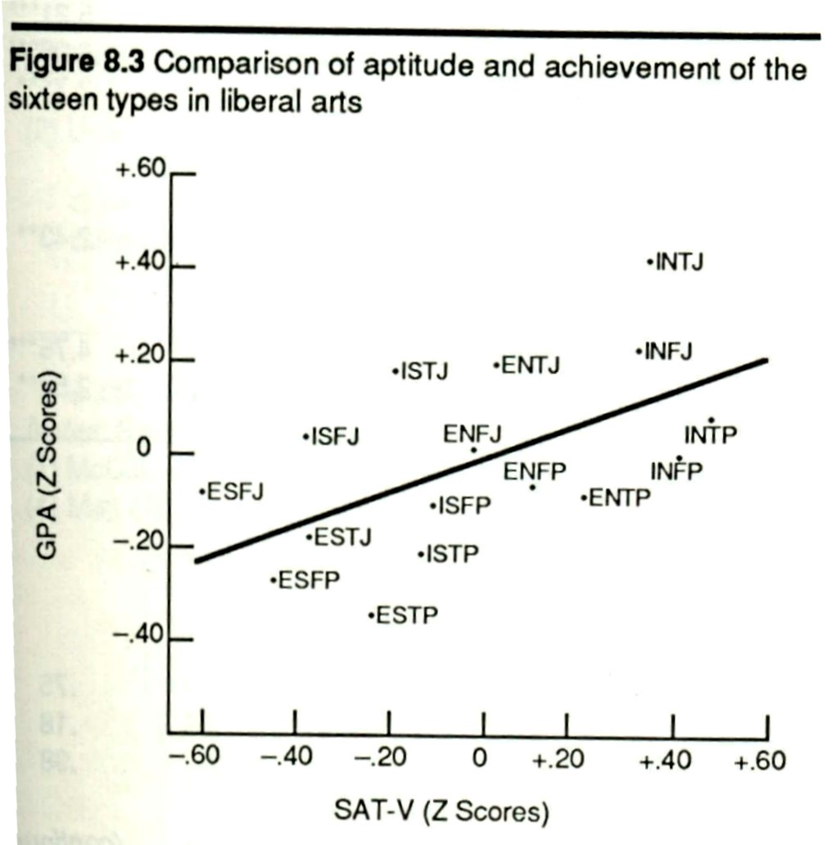

Slide 14
Myers-Briggs Personality Type – What It Is
Mental Model; many others also useful
Normal differences between people
Persistent tendencies (choices)
Do not change once established
e.g. Folding your arms, throwing a ball, writing your name
Comfort zone for thinking; requires less effort than the opposite
Use of opposite is a conscious effort

Slide 15
Myers-Briggs Personality Type – What It Isn’t
Not a measure of intelligence
Not a “limitation”
No negative aspects
No psychopathology
No stereotype

Slide 16
What Do Those Letters Mean?
Four dimensions of preferences
Extraversion (E) vs. Introversion (I)*
Sensing (S) vs. Intuition (N)*
Thinking (T)* vs. Feeling (F)
Judging (J) vs. Perceiving (P)*
*Pelley’s type

Slide 17
Prefrontal Pause
Talk for a minute with your neighbor about what your preference might be:
Think better with “facts and specifics”
Think better with “big picture and connections”
Try to give an example

Slide 18
Sensing (S) vs. Intuition (N)
What information do you give the most attention to?
Sensing types give their attention to specifics
Intuitive types give their attention to the big picture
Everyone does both, but only one is preferred.
Use of opposite is deliberate; not automatic

Slide 19
Test Taking Style
S style
Seek answer that matches memorized knowledge
Re-read question to stimulate recall
Memorization learning requires recognition
N style
Rule out answer choices
Don’t fit learned patterns
Big picture learning establishes patterns
Notes:
The Sensing type student looks for the answer that matches what they have memorized.
This is one-step thinking.
Failure to recognize a correct answer indicates that the question wasn’t read well.
Re-reading and guessing are the only options available.
The Intuitive type student also looks to see if they recognize the answer.
Their powers of memorization are less developed and they frequently have to begin ruling out wrong answers.\
On questions that require 2- and 3-step thinking, they are well prepared by their pattern learning.
Wrong answers don’t fit the patterns.
Ultimately, test taking skills can be traced back to learning skills.
How do the challenges to Sensing types and Intuitive types compare?

Slide 20
Problems With Big Pictures Vs Details
Sensing types tend to see a big picture (pattern) as one more fact.
Intuitive types tend to see only enough facts to make a big picture.
Notes:
Because sensing types expect a big picture concept to be taught as a fact they do not seek out a big picture on their own.
Because intuitive types need facts to build their big picture, they lose interest in the facts once their big picture is conceived.
How do these approaches to learning affect acquisition of higher order thinking skills (HOTS)?

Slide 21
Memorization vs HOTS Type Differences
Memorization
Recall: remembering facts/details and their “organization” (list the symptoms of heart attack)
Preferred by sensing types
Higher Order Thinking Skills (HOTS)
Grouping: “organizing” facts into patterns
Comparing: relationships between patterns (list the causes of chest pain)
Preferred by intuitive types
Notes:
Recall knowledge is critical learning because it constitutes the vocabulary that we use for thinking.
Facts by themselves do not confer understanding.
Students who rely only on fact memory are receivers of information, but don’t produce it.
HOTS permit us to manipulate facts to draw inferences and make deductions needed in problem solving.
Grouping facts into categories and comparing categories for similarities and differences requires decisions.
The process of decision making is the point in time that the learner produces their own knowledge.
Producing knowledge creates understanding.
Both fact knowledge and HOTS will be shown to correlate later with steps in concept mapping.
How does the brain process fact memorization compared to problem based decision making?

Slide 22
Thinking (T) vs. Feeling (F)
How do you react to new information?
Thinking types consider the logical implications.
Feeling types consider the impact on people.
Everyone does both, but only one is preferred.
Use of opposite is conscious

Slide 23
Judging (J) vs. Perceiving (P)
How do you manage your life?
Judging types prefer to be planned, organized (joy of closure).
Perceiving types prefer to be flexible, adaptive (joy of discovery).
Everyone does both, but only one is preferred.
Use of opposite is conscious

Slide 24
Exercise – Group Learning Application
Refer to handout

Slide 25
Transactional Analysis Ego States (Eric Berne)
Parent mode
telling, requiring
threat/coercion
reward/approval
Adult mode
mutual responsibilities
consequences/outcomes
developmental/adaptive
Child mode
obeying, compliant, dependent
Notes:
To learn how to educate yourselves, you have to be in the adult mode.

Slide 26
Ego States In Medical Education
Faculty
Student
Parent
Parent
D
A
Adult
Adult
B
C
Child
Child
Notes:
Which one is the easiest?
Which one is the most rewarding?
Which one is the most difficult?
When was the last time you were treated as an adult? Writing your student oath this week.

Slide 27
Transactional analysis
Adult To Adult
Parent To Child
Most desired
Most rewarding
Requires development
Creates inter-dependency
access help/support without becoming dependent on it
“Tell me about your thinking.”
Who, what, where, why, when?
Most common
Easiest
Prevents development
Creates dependency
Keeps student at “arms length”
Trains them to keep patients at a distance.

Slide 28
Achievement motivation
Motivation: decision to undertake a given behavior or action.
Expectation of success: Degree to which behavior or action can be accomplished. “This is impossible.” vs. “I can do this.”
Utility: Degree to which the behavior or action is needed or wanted. “This is of no value to me.” vs. “This will help me control my life.”

Slide 29
Achievement motivation
M = E x U
If either E or U is zero, everything goes to zero.
E = zero; learned helplessness
U = zero; real doctors don’t need to know this

Slide 30
Locus Of Control
Internal
External
I’m responsible for what happens to me.
I need to develop the skills and attitudes for adult to adult interactions.
I need to be responsible for the outcomes of my decisions.
Maximized in professionals
You are responsible for what happens to me.
I am what I am and you need to accommodate that.
I can’t help what happens to me because of the circumstances.
Maximized in children

Slide 31
ERG Hierarchy
Like Maslow’s pyramid, but with conditions.
People meet existence needs (E) first
Then people meet relationships needs (R)
When E and R are met, then growth needs (G) are met.
If either R or G are prevented or blocked, then the needs below that level become exaggerated.

Slide 32
ERG Hierarchy
A failing student doesn’t care about growth needs.
e.g. professionalism courses will become relevant when I’m not failing anatomy.

Slide 33
What Is Involved In Training?
Instruction: Provides information on goals and objectives of a procedure
Demonstration (teacher): Provides information on achieving objectives
Application (learner): Provides information on limitations
Deliberate Practice: Provides practice focused on limitation in skill

Slide 34
Deliberate Practice Characteristics
Discovered in human performance research
Evaluated factors that contribute to expert skill
Not correlated with IQ! … or with work experience
Always correlated with Deliberate Practice
Applied to limitation in skill; seeking superior skill
Not aimed at minimum standards
Self-actualization is the standard, AAMC CEPA
Expert skill = Performance x Professionalism
If either is zero, it’s all zero
Professionalism – unrelenting desire for DP skill

Slide 35
Deliberate Practice Characteristics
Applied to limitation in skill
Can be repeated a lot
Feedback continuously available
Most effective with experienced teacher
Not work, not play – focused effort; demanding
Need to avoid automated behavior
Not much fun; motivation critical
Highly demanding mentally; tiring
Not aimed at minimum standards
Self-actualization is the standard
10 years, 10,000 hours – Gladwell, “Outliers”

Slide 36
Exercise – Learning Style
Refer to handout

