Slide 1
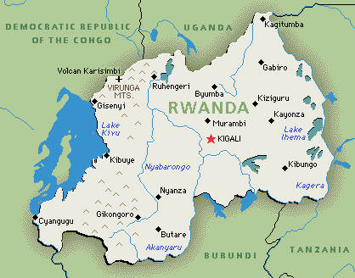
The Access Project
Bugesera District, Rwanda

Slide 3
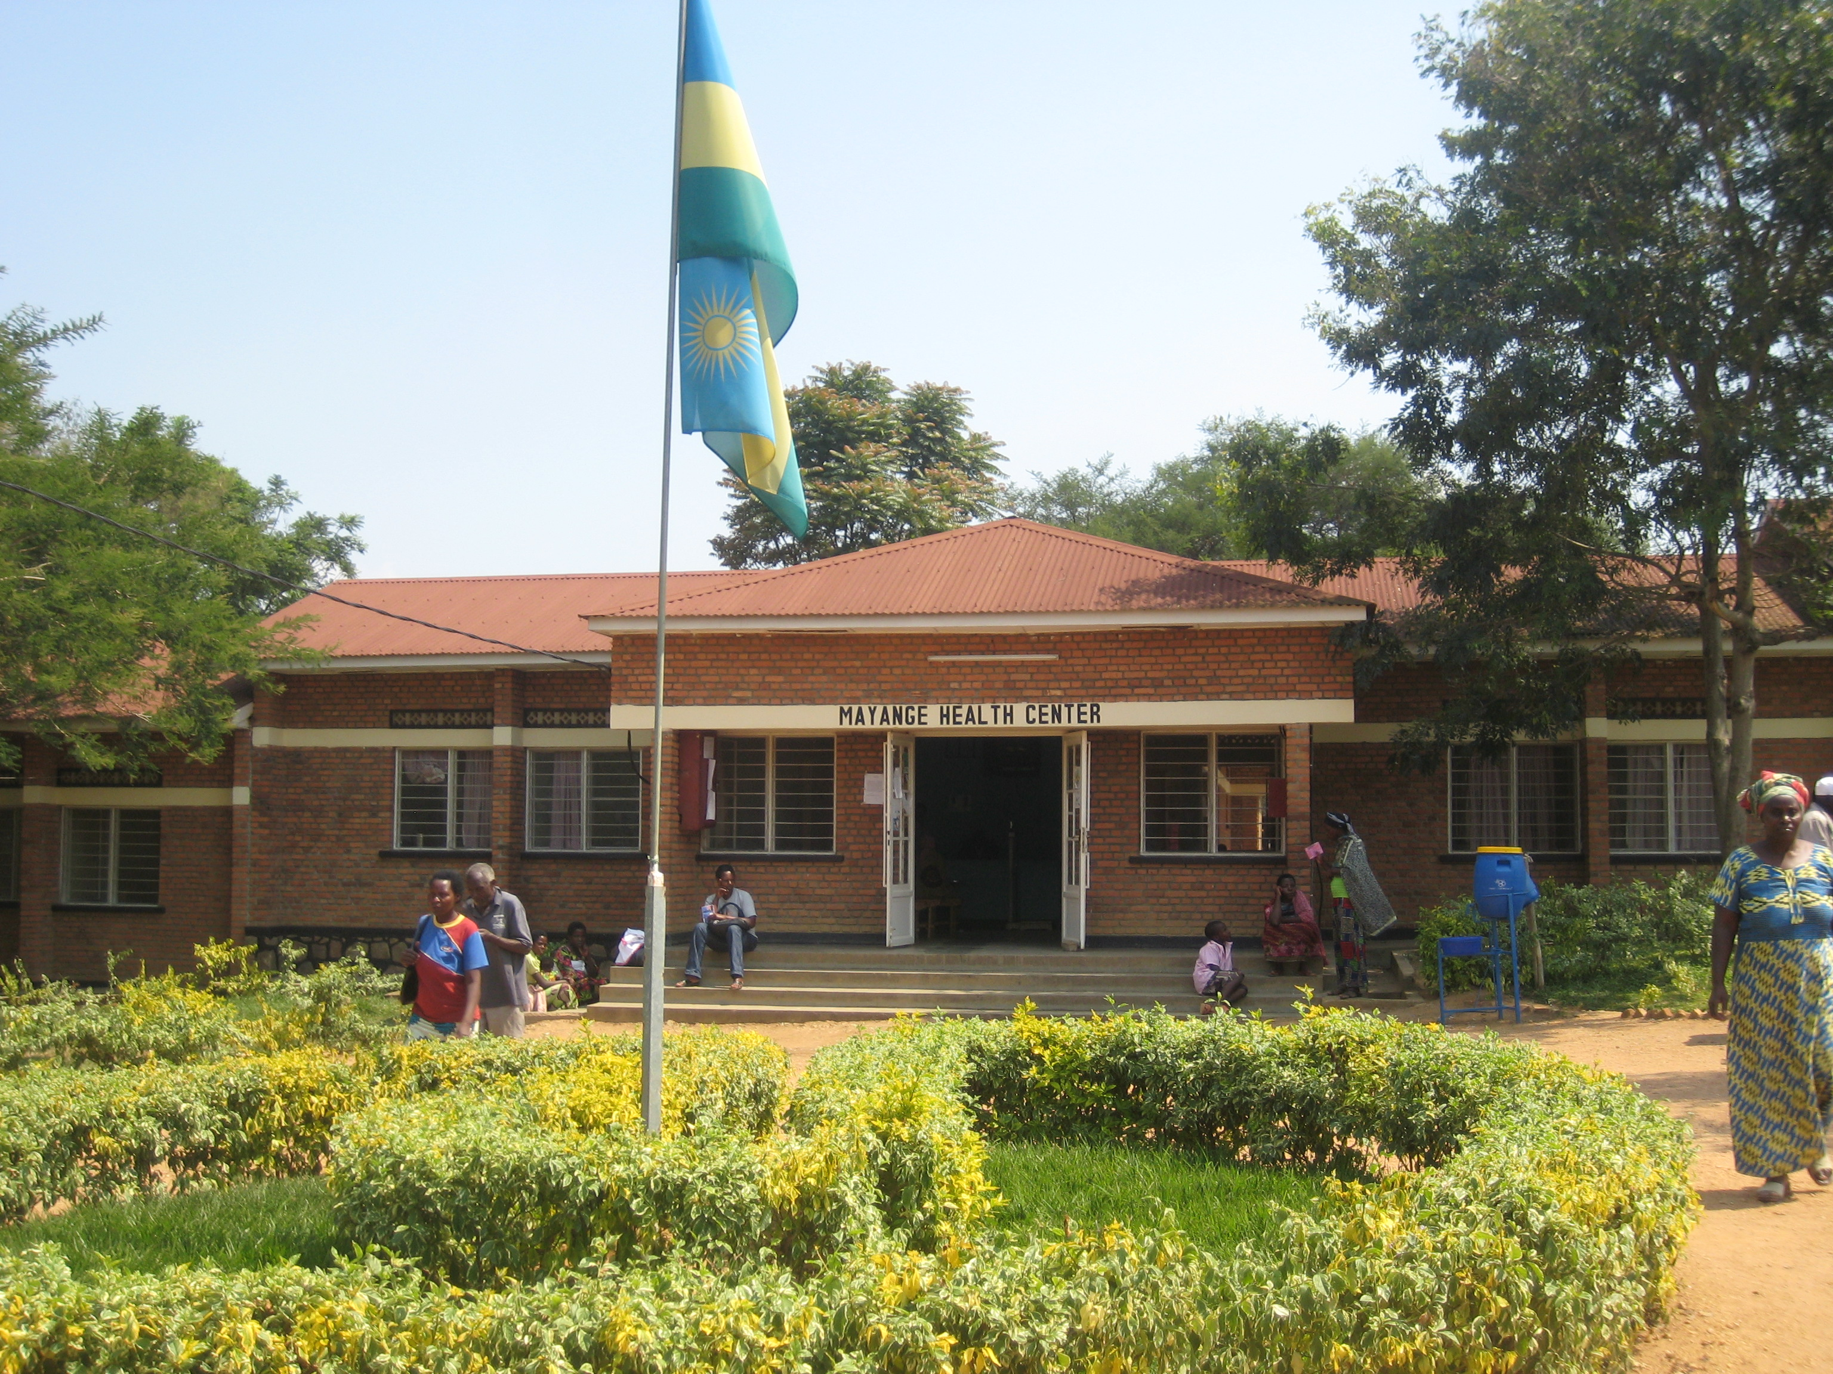
Kigali, Rwanda
2 July – 26 July
The Access Project
Nyungwe Forest
Akagera National Park
Genocide Memorials

