Slide 1
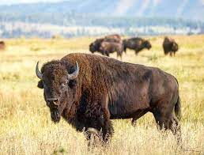
Immunity
Natural and Herd
H. Bradford Hawley, MD

Slide 2
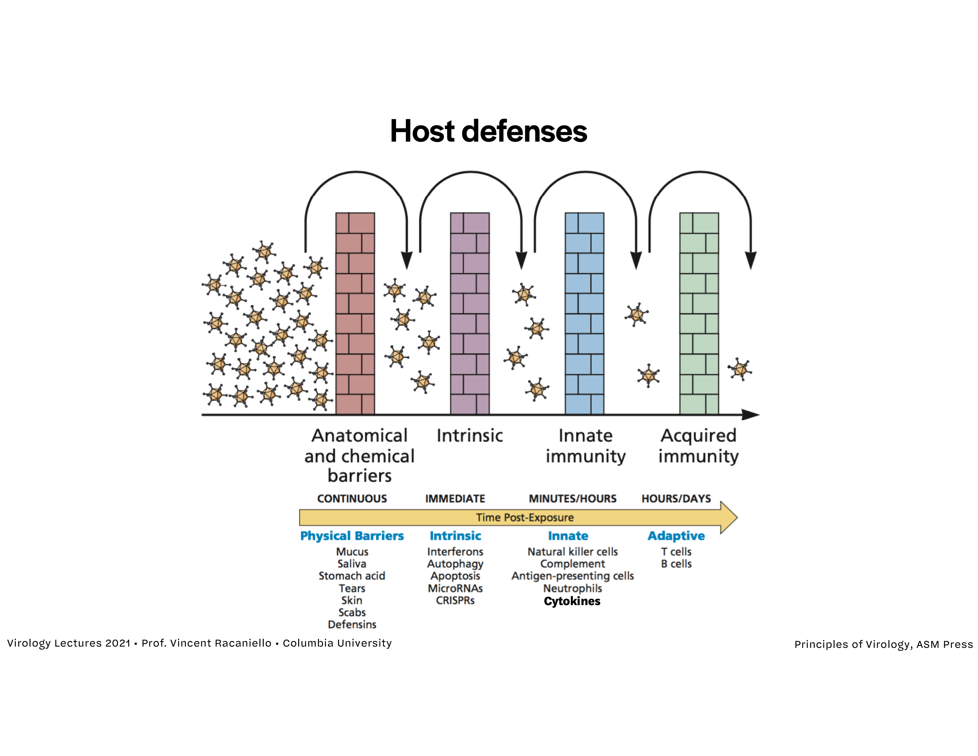
Protection Against Infection
Multiple Barriers

Slide 3
Active or Acquired Immunity
Natural and Vaccine
Natural immunity is acquired from exposure to a disease organism through infection with that organism.
Vaccine immunity is acquired through introduction of a killed or inactivated organism or part of an organism (directly or indirectly) through vaccination.

Slide 4
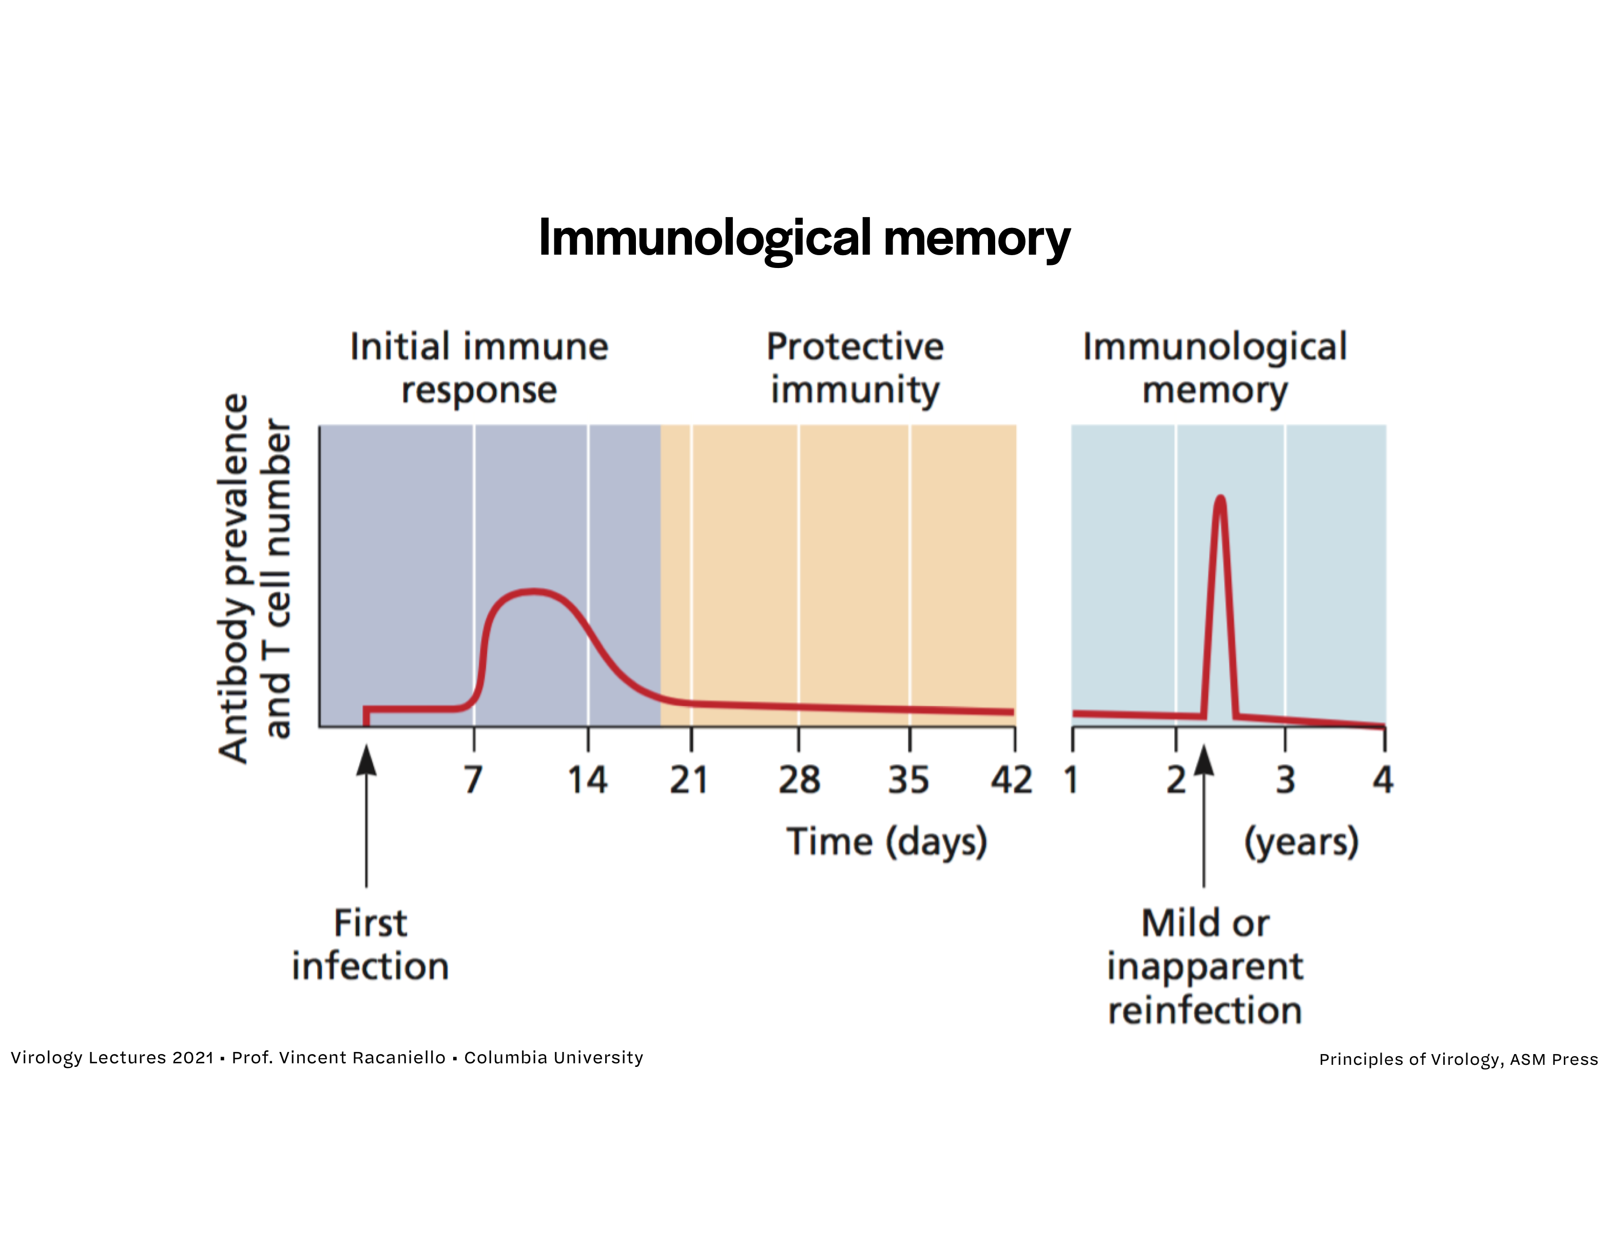
Memory
B cell and T cell

Slide 5
Memory Cells
B cells, plasma cells, and T cells

Slide 6
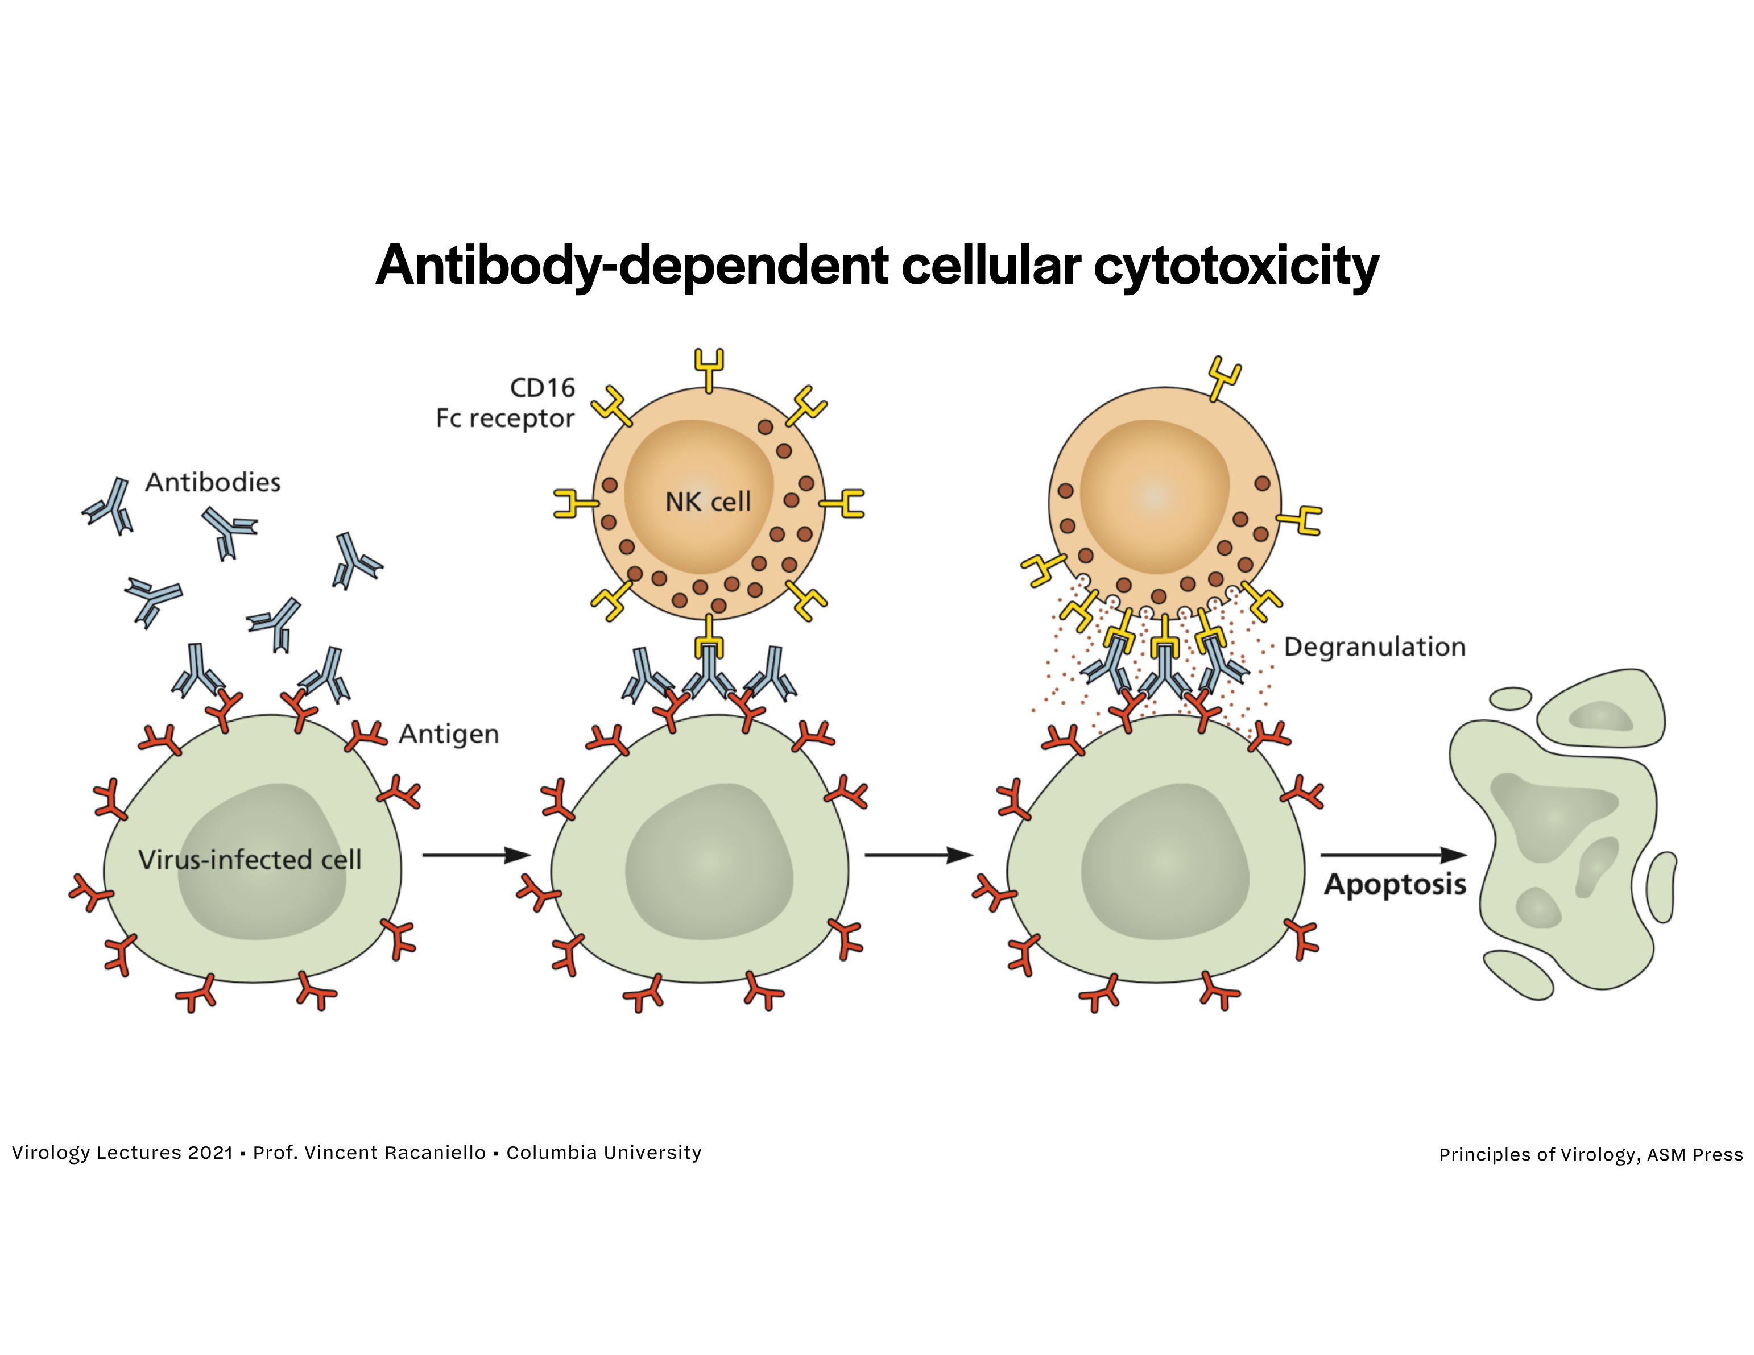
Cellular Cytotoxicity
NK (natural killer) cells

Slide 7
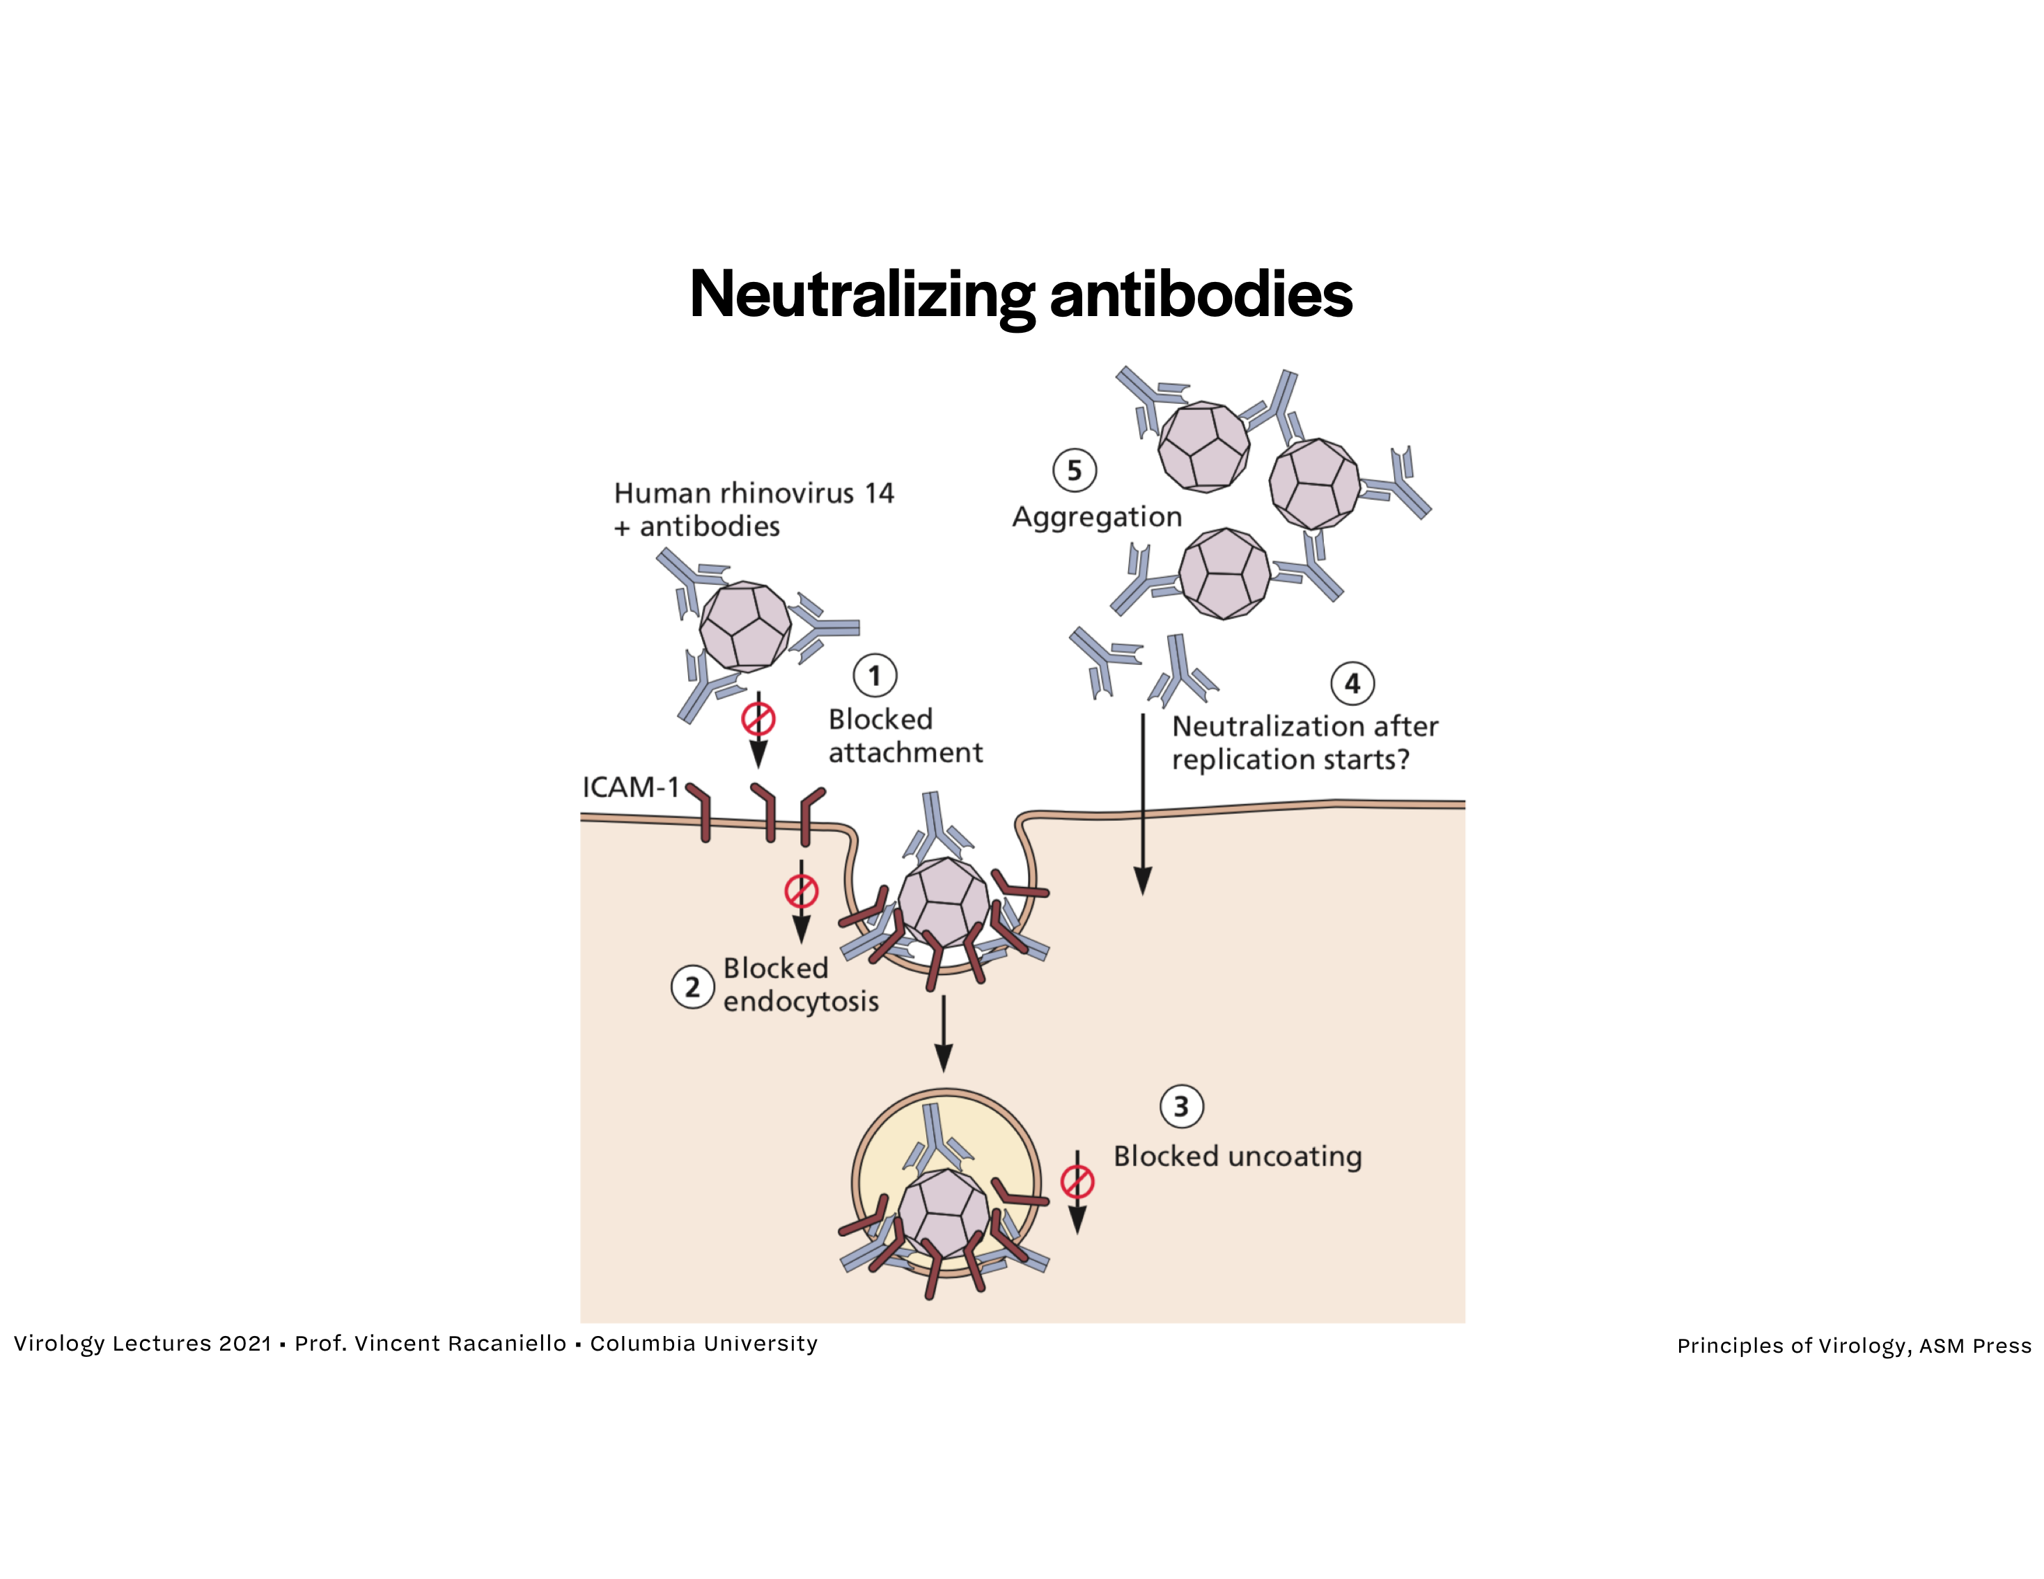
B cells
Antibodies

Slide 8
T cells
Cell lysis (apoptosis)

Slide 9
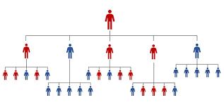
Basic Reproduction Number
Definition
The average number of secondary infectious persons resulting from a typical infectious person following their introduction to a totally susceptible population.

Slide 10
Net Reproduction Number
Rn = Ros
Rn is the average number of secondary infectious persons resulting from each infectious person in any specified population.
If each infectious person leads to more than one secondary infectious person (Rn>1) the incidence of infectious persons increases.
If each infectious person leads to less than one secondary infectious person Rn<1) the incidence of infectious persons decreases.
If each infectious person leads to exactly one secondary infectious person (Rn=1) the incidence of infectious persons remains unchanged.

Slide 11
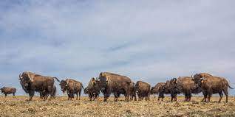
Herd Immunity Threshold
Definition and Formula
The proportion of the population which should be immune for the incidence to be stable or the net reproduction number to equal 1.
Herd immunity threshold = 1 - 1 / Ro

Slide 12
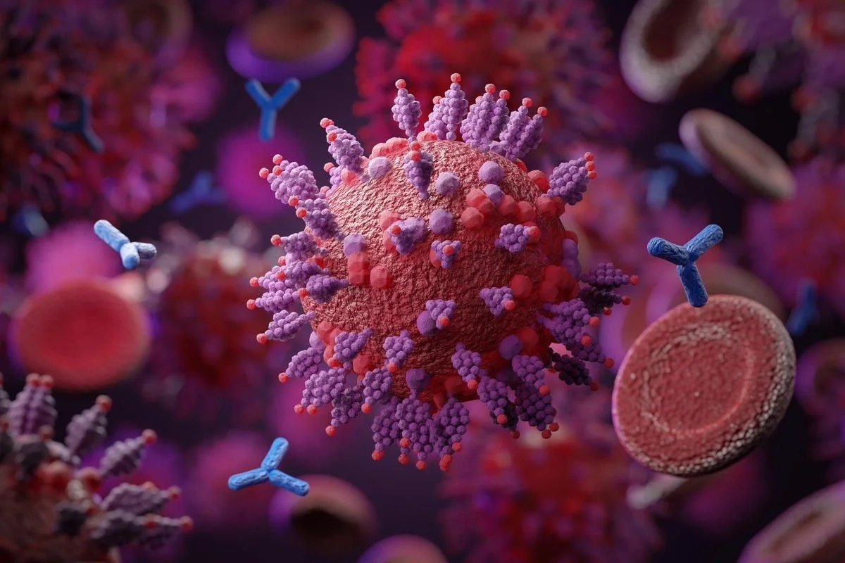
SARS-CoV-2 Basic Reproduction Number
Comparison of Variants
Wuhan (original virus) = 2.79
Delta = 5.08
Omicron = >7

Slide 13
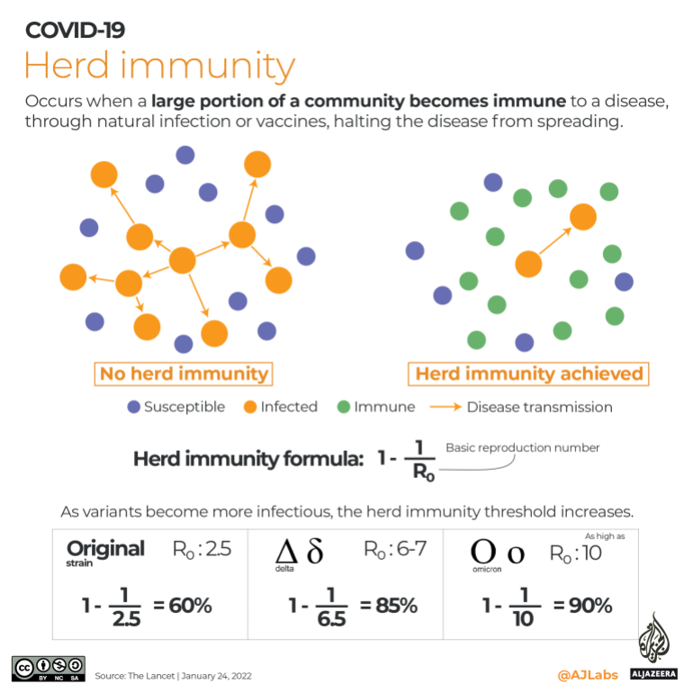
Herd Immunity
Calculation for SARS-CoV-2 Variants

Slide 14
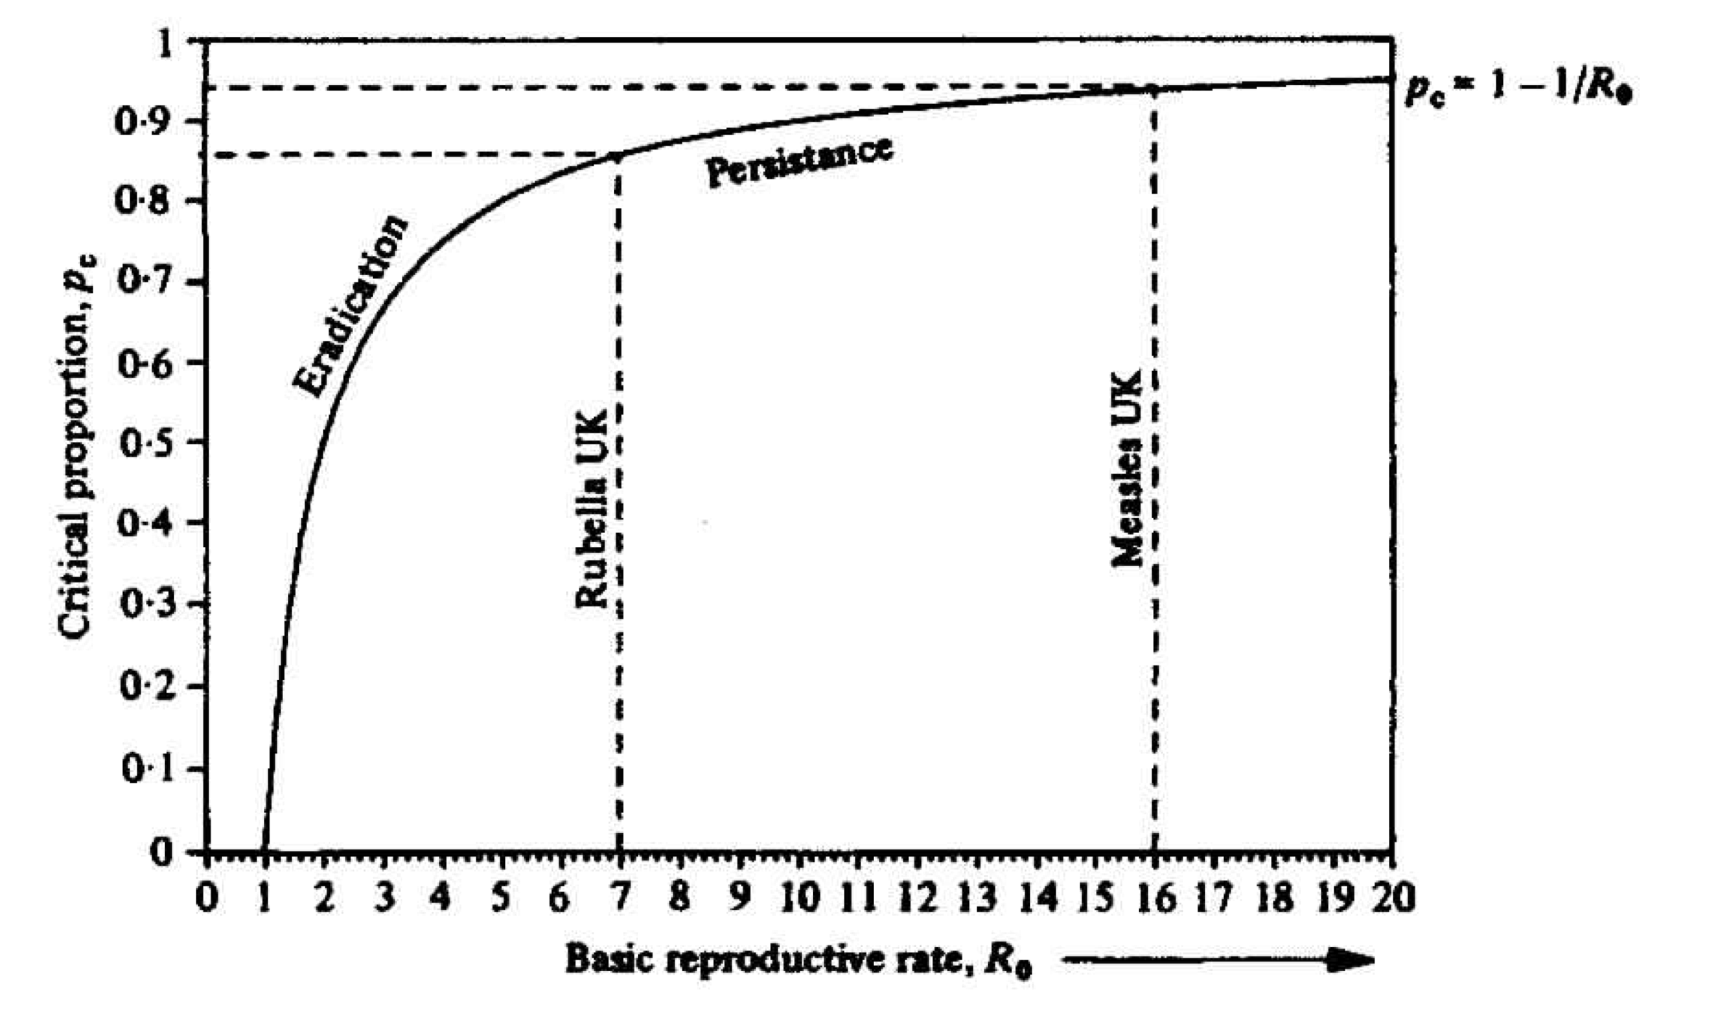
Basic Reproduction Number
Herd Immunity

Slide 15
Natural History of Infectious Disease
Sir Macfarlane Burnet (Nobel Laureate) & David O. White, 1972
“Infections spread by the respiratory (droplet) route can in practice only be blocked by immunization.”
“Unless a disease can be exterminated from the whole globe, the precautions necessary to prevent its spread must be permanently maintained and incorporated into the social life of the community.”

