Slide 1
Student Assessment What works; what doesn’t
Geoff Norman, Ph.D.
McMaster University
norman@mcmaster.ca

Slide 2
Why, What, How, How well
Why are you doing the assessment?
What are you going to assess?
How are you going to assess it?
How well is the assessment working?

Slide 3
Why are you doing assessment?
Formative
To help the student learn
Detailed feedback, in course

Slide 4
Why are you doing assessment?
Formative
Summative
To attest to competence
Highly reliable, valid
End of course

Slide 5
Why are you doing assessment?
Formative
Summative
Program
Comprehensive assessment of outcome
Mirror desired activities
Reliability less important

Slide 6
Why are you doing assessment?
Formative
Summative
Program
As a Statement of Values
Consistent with mission, values
Mirror desired activities
Occurs anytime

Slide 7
What are you going to Assess?
Knowledge
Skills
Performance
Attitudes

Slide 8
Axiom # 1
Knowledge, performance aren’t that separable. It takes knowledge to perform. You can’t do it if you don’t know how to do it.
Typical correlation between measures of knowledge and performance = 0.6 — 0.9

Slide 9
Corollary #1A
Performance measures are a supplement to knowledge measures;
they are not a replacement for knowledge measures
and a very expensive one at that!

Slide 10
Axiom # 2
There are no general cognitive (and few affective and psychomotor) skills
Typical correlation of “skills” across problems is 0.1 – 0.3
- So performance on one or a few problems tells you next to nothing

Slide 11
Corollary # 2a
Since there are no general cognitive skills
Since performance on one or a few problems tells you next to nothing
THE ONLY SOLUTION IS MULTIPLE SAMPLES
(cases, items, problems, raters, tests)

Slide 12
Axiom #3
General traits, attitudes, personal characteristics
(e.g. “learning style”, “reflective practice”)
are poor predictors of performance
“Specific characteristics of the situation are a far greater determinant of behaviour than stable characteristics (traits) of the individual”
R. Nisbett, B. Ross

Slide 13
Corollary #3A
Assessment of attitudes, like skills, may require multiple samples and may be context - specific

Slide 14
How Do You Know How Well You’re Doing?
Reliability
The ability of an instrument to consistently discriminate between high and low performance
Validity
The indication that the instrument measures what it intends to measure

Slide 15
Reliability
Rel = variability bet subjects
total variability
Across raters, cases, situations
> .8 for low stakes
> .9 for high stakes

Slide 16
Validity
Judgment approaches
Face, Content
Empirical approaches
Concurrent
Predictive
Construct

Slide 17
How are you going to assess it?
Something old
Global rating scales
Essays
Oral exams
Multiple choice
Something new
Self, peer assessment
Tutor assessment
Progress test
Clinical Assessment Exercise
Key Features Test
OSCE
Clinical Work Sampling

Slide 18
Somethings Old (that don’t work)
Traditional Orals
Essays
Global Rating Scales

Slide 19
Traditional Oral (viva)
Definition
An oral examination,

Slide 20
Traditional Oral (viva)
Definition
An oral examination,
usually based on a single case

Slide 21
Traditional Oral (viva)
Definition
An oral examination,
usually based on a single case
using whatever patients are up and around,

Slide 22
Traditional Oral (viva)
Definition
An oral examination,
usually based on a single case
using whatever patients are up and around,
where examiners ask their pet questions for time up to 3 hours

Slide 23
Triple Jump Exercise Neufeld & Norman, 1979
Standardized , 3 part, role-playing
Based on single case
Hx/Px, SDL, Report back, SA
Inter-Rater R = 0.53
Inter-Case R = .053

Slide 24
RCPS Oral (2 x 1/2 day) long case / short cases
Reliability
Inter rater – fine (0.65 )
Inter session – bad ( 0.39)
(Turnbull, Danoff & Norman, 1996)
Validity
Face – good
Content -- awful

Slide 25
The Long Case revisited(?)
Waas, 2001
RCGP(UK) exam
Blueprinted exam
2 sessions x 2 examiners
214 candidates
ACTUAL RELIABILITY = 0.50
Est. Reliability for 10 cases, 200 min. = 0.85

Slide 26
Conclusions
Oral works if
Blueprinted exam
Standardized questions
Trained examiners
Independent and multiple raters
and 8-10 (or 5) independent orals

Slide 27
Essay
Definition
written text 1-100 pages on a single topic
marked subjectively with / without scoring key

Slide 28
An example
Cardiology Final Examination 1999-2000
Summarize current approaches to the management of coronary artery disease, including specific comments on:
a) Etiology, risk factors, epidemiology
b) Pathophysiology
c) Prevention and prophylaxis
d) Diagnosis – signs and symptoms, sensitivity and specificity of tests
e) Initial management
f) Long term management
g) Prognosis
Be brief and succinct. Maximum 30 pages

Slide 29
Reliability of Essays (1)
(Norcini et al., 1990)
ABIM certification exam
12 questions, 3 hours
Analytical , Physician / Lay scoring
7 / 14 hours training
Answer keys
Check present /absent
Physician Global Scoring
Method Reliability Hrs to 0.8
Analytical, Lay or MD 0.36 18
Global, physician 0.63 5.5

Slide 30
Reliability of Essays (2)
Cannings, Hawthorne et al. Med Educ, 2005
General practice case studies
2 markers / case (2000-02) vs. 2 cases (2003)
Inter - rater reliability = 0.40
Inter-case reliability = 0.06

Slide 31
Global Rating Scale
Definition
single page completed after 2-16 weeks
Typically 5-15 categories, 5-7 point scale

Slide 32
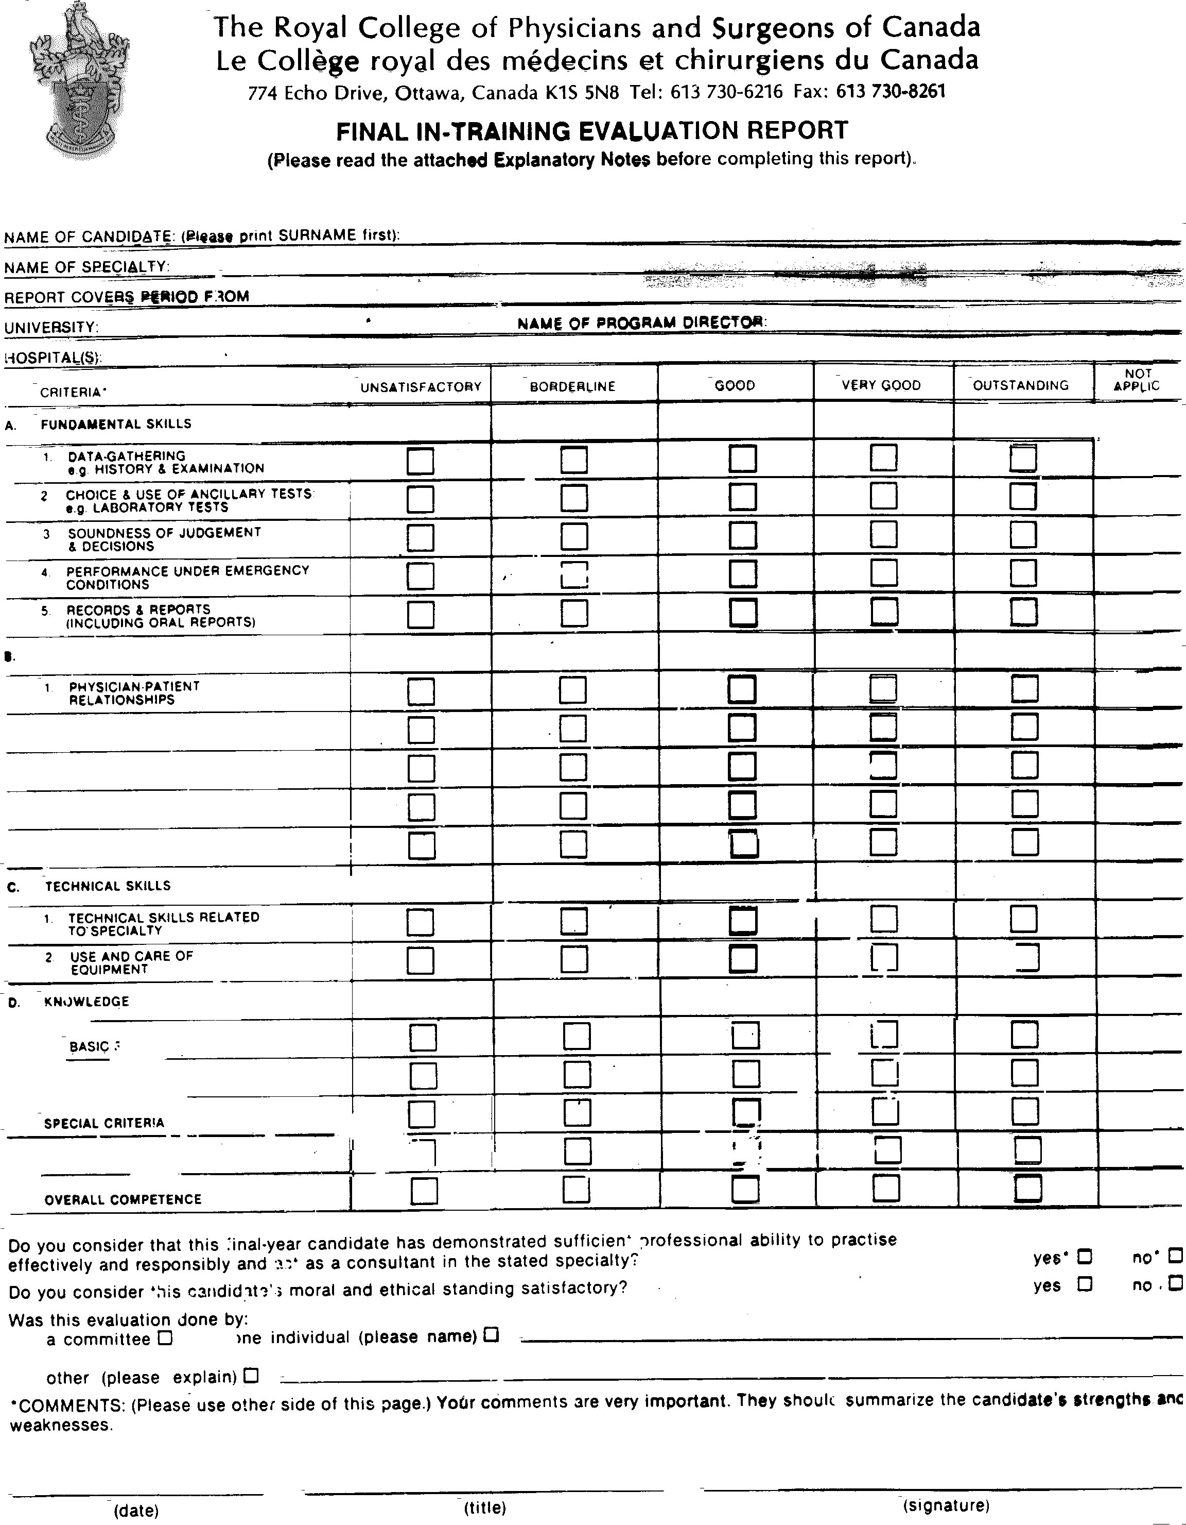

Slide 33
Reliability
Inter rater :
0.25 (Goldberg, 1972)
.22 -.37 (Dielman, Davis, 1980)
Everyone is rated “above average” all the time
Validity
Face – good
Empirical – awful
If it is not discriminating among students, it’s not valid (by definition)

Slide 34
Something Old (that works)
Multiple choice questions
GOOD multiple choice questions

Slide 35
Some bad MCQ’s
True statements about Cystic Fibrosis include:
a) The incidence of CF is 1:2000
b) Children with CF usually die in their teens
c) Males with CF are sterile
d) CF is an autosomal recessive disease
Multiple True / False. A) is always wrong. B) C) may be right or wrong

Slide 36
Some bad MCQ’s
True statements about Cystic Fibrosis include:
a) The incidence of CF is 1:2000
b) Children with CF usually die in their teens
c) Males with CF are sterile
d) CF is an autosomal recessive disease
The way to a man's heart is through his:
a) Aorta
b) Pulmonary arteries
c) Coronary arteries
d) Stomach

Slide 37
Another Bad MCQ
The usual dose of ibuprofen is:
50 mg.
100mg.
200 mg.
400 mg.
All of the above

Slide 38
A good one
Mr. J.S. and 55 year old accountant presents to the E.R. with crushing chest pain which began 3 hours ago and is worsening. The pain radiates down the left arm. He appears diaphoretic. BP is 120/80 mm Hg ,pulse 90/min and irregular.
An ECG was taken. You would expect which of the following changes:
a) Inverted t wave and elevated ST segment
b) Enhanced R wave
c) J point elevation
d) Increased Q wave and R wave
e) RSR’ pattern

Slide 39
Reliability
Typically 0.9-0.95 for reasonable test length
Validity
Concurrent validity against OSCE , 0.6

Slide 40
Representative objections
Guessing the right answer out of 5 (MCQ) isn’t the same as being able to remember the right answer

Slide 41
Guessing the right answer out of 5 (MCQ) isn’t the same as being able to remember the right answer
True. But they’re correlated 0.95 – 1.00
( Norman et al., 1997; Schuwirth 1996)

Slide 42
“Whatever is being measured by constructed – response [short answer questions] is measured better by the multiple-choice questions… we have never found any test… for which this is not true…”
Wainer & Theissen, 1973

Slide 43
So what does guessing the right answer on a computer have to do with clinical competence anyway.

Slide 44
So what does guessing the right answer on a computer have to do with clinical competence anyway.
Is that a period (.) or a question mark (?)?

Slide 45
Correlation with Practice Performance
Ram (1999) Davis (1990)
OSCE - practice .46 .46
MCQ - practice .51 .60
SP - practice .63

Slide 46
Ramsey PG (Ann Int Med, 1989; 110: 719-26)
185 certified, 74 non-certified internists
5-10 years in practice
Correlation between peer ratings and ABIM exam = 0.53-0.59

Slide 47
JJ Norcini et al. Med Educ, 2002; 36: 853-859
Data on all MI in Pennsylvania, 1993, linked to MD certification status in Internal Med, cardiology
Certification by ABIM (MCQ test) associated with 19% lower case fatality (after adjustment)

Slide 48
R.Tamblyn et al., JAMA 1998 Licensing Exam Score and Practice
Activity Rate/1000 Increase/SD
Consultation 108 +3.8
Symptom meds 126 -5.2
Inapprop Rx 20 -2.7
Mammography 51 +6.0

Slide 49
Extended Matching Question
A variant on Multiple Choice with a larger number of responses , and a set of linked questions

Slide 50
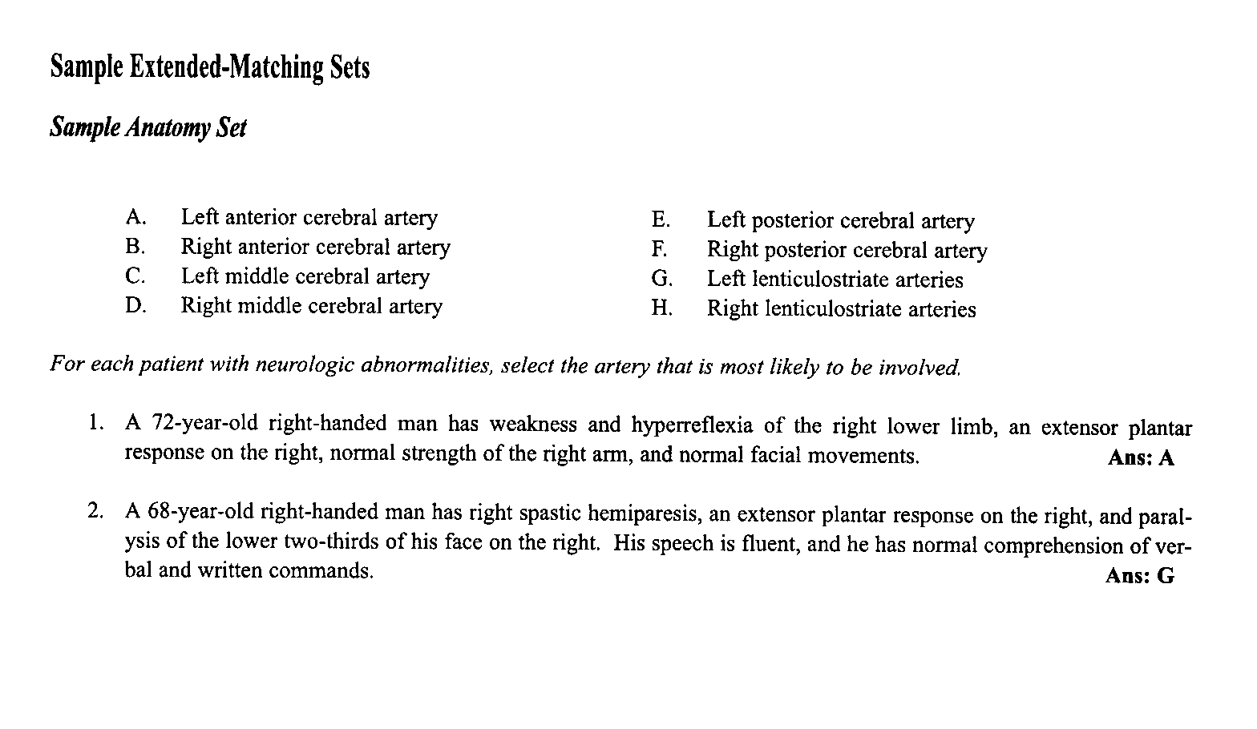

Slide 51
“ .. Extended matching…tests have considerable advantages over multiple choice and true/false examinations..”
B.A. Fenderson, 1997

Slide 52
Difficulty / Discrimination (Swanson, Case, Ripkey, 1994/1996)
MCQ EMQ
Difficulty .63 .67
.71 .66
Discrimination .14 .16
.16 .22

Slide 53
Test Reliability (120 quest)

Slide 54
“Larger numbers of options made items harder and made them take more time, but we did not find any advantage in item discrimination”
Dave Swanson, Sept. 20, 2004

Slide 55
Conclusion
MCQ (and variants) are the gold standard for assessment of knowledge (and cognition)
Virtue of broad sampling

Slide 56
New PBL- related subjective methods
Tutor assessment
(Learning portfolio)
Self-assessment
Peer assessment
Progress Test

Slide 57
Portfolio Assessment Study
Sample
8 students who failed licensing exam
5 students who passed
Complete written evaluation record (Learning portfolio)
3 raters, rate knowledge, chance of passing, on 5 point scale for each summary statement

Slide 58
Inter-rater reliability = 0.75
Inter-Unit correlation = 0.4

Slide 60
Tutor Assessment Study (multiple observations)
Eva, 2005
24 tutorials, first year, 2 ratings
Inter-tutorial Reliability 0.30
OVERALL 0.92
CORRELATION WITH:
OSCE 0.25
Final Oral 0.64

Slide 61
Conclusion
Tutor written evaluations incapable of identifying knowledge of students
Tutor rating with multiple brief assessments has good reliability and validity

Slide 62
Outcome LMCC Performance 1981-1989
19%

Slide 63
The Problem (ca. 1990)
Tutorial assessment is not providing sufficient feedback on knowledge
(FAILURE RATE IN LMCC = 19% (5 X avge)
How can we introduce objective testing methods (MCQ) into the curriculum, to provide feedback to students and identify students in trouble…..
without having assessment steer the curriculum

Slide 64
Self, Peer Assessment
Six groups, 36 students, first year
3 assessments (week 2,4,6)
Self, peer, tutor rankings
Best ---> worst characteristic

Slide 66
Conclusion
Self-assessment unrelated to peer, tutor assessment
Perhaps the criterion is suspect
Can students assess how much they know?

Slide 67
Self-Assessment of Exam Performance
93 students/ 2nd and 3rd year
Predict performance on the next Progress Test (MCQ exam)
7 point scale (Poor --->Outstanding)
Conceptual knowledge, factual recall
10 discipline domains

Slide 68
Average correlation Rating --> Performance

Slide 69
Self-Assessment of Exams - Study 2
Three classes -- year 1,2,3
N=75 /class
Please indicate what percent you will get correct on the exam
OR
Please indicate what percent you got correct on the exam

Slide 70
Self-Assessment of Exams -
Three classes -- year 1,2,3
N=75 /class
Please indicate what percent you will get correct on the exam
OR
Please indicate what percent you got correct on the exam

Slide 71
Correlation with PPI Score

Slide 72
Correlation with PPI Score

Slide 73
Correlation with PPI Score

Slide 74
Conclusion
Self, peer assessment are incapable of assessing student knowledge and understanding

Slide 75
The Problem
How can we introduce objective testing methods (MCQ) into the curriculum, to provide feedback to students and identify students in trouble
… without the negative consequences of final exams?

Slide 76
The Solution
1990-1993
Practice Test with feedback 2 mo. before LMCC
1994-2002
Progress test, 180 MCQ, 3 hour 3x/year with feedback and remediation

Slide 77
The Progress Test
University of Maastricht, University of Missouri
180 item, MCQ test
Sampled at random from 3000 item bank
Same test written by all classes, 3x/year
No one fails a single test

Slide 78
gif: Items corect (%)

Slide 79
Reliability
Across sittings (4 mo.) 0.65-0.7
Predictive Validity
Against performance on the licensing exam
48 weeks prior to graduation 0.50
31 weeks 0.55
12 weeks 0.60

Slide 80
Progress test \ student reaction
no evidence of negative impact on learning behaviours
studying? 75% none, 90% <5 hours
impact on tutorial functioning? >75% none
appreciated by students
fairest of 5 evaluation tools (5.1/7)
3rd most useful of 5 evaluation tools (4.8/7)

Slide 81
Outcome LMCC Performance 1980-2002
0%
5%
19%

Slide 82
Something New
Written Tests
Concept Application Exercise
Key Features Test
Performance Tests
O.S.C.E
Clinical Work Sampling

Slide 83
Concept Application Exercise
Brief problem situations, with 3-5 line answers
“why does this occur?”
18 questions, 1.5 hours

Slide 84
An example
A 60-year-old man who has been overweight for 35 years complains of tiredness. On examination you notice a swollen, painful looking right big toe with pus oozing from around the nail. When you show this to him, he is surprised and says he was not aware of it.
How does this man's underlying condition pre-dispose him to infection. Why was he unaware of it?

Slide 85
Rating scale
"The student showed..
1 | 2 | 3 | 4 | 5 | 6 | 7
No under-standing | Some major mis-conceptions | Ade- quate explanation | Complete and thorough under-standing

Slide 86
Reliability
inter-rater .56-.64
test reliability .64 -.79
Concurrent Validity
OSCE .62
progress test .45

Slide 87
Key Features Exam (Medical Council of Canada)

Slide 88
A 25 year old man presents to his family physician with a 2 year history of “fummy spells”. These occur about 1 day/month in clusters of 12-24 in a day. They are described as a “funny feeling” something like dizziness, nausea or queasiness. He has never lost consciousness and is able, with difficulty, to continue routine tasks during a “spell”
List up to 3 diagnoses you would consider:
1 point for each of:
Temporal lobe epilepsy
Hypoglycemia
Epilepsy (unsp)
List up to 5 diagnostic tests you would order:
To obtain 2 marks, student must mention:
CT scan of head
EEG

Slide 89
PERFORMANCE ASSESSMENT
The Objective Structured Clinical Examination (OSCE)
A performance examination consisting of 6 - 24 “stations”
- of 3 -15 minutes duration each
- at which students are asked to conduct one component of clinical performance
e.g . Do a physical exam of the chest
- while observed by a clinical rater
(or by a standardized patient)
Every 3-15 minutes, students rotate to the next station at the sound of the bell

Slide 90
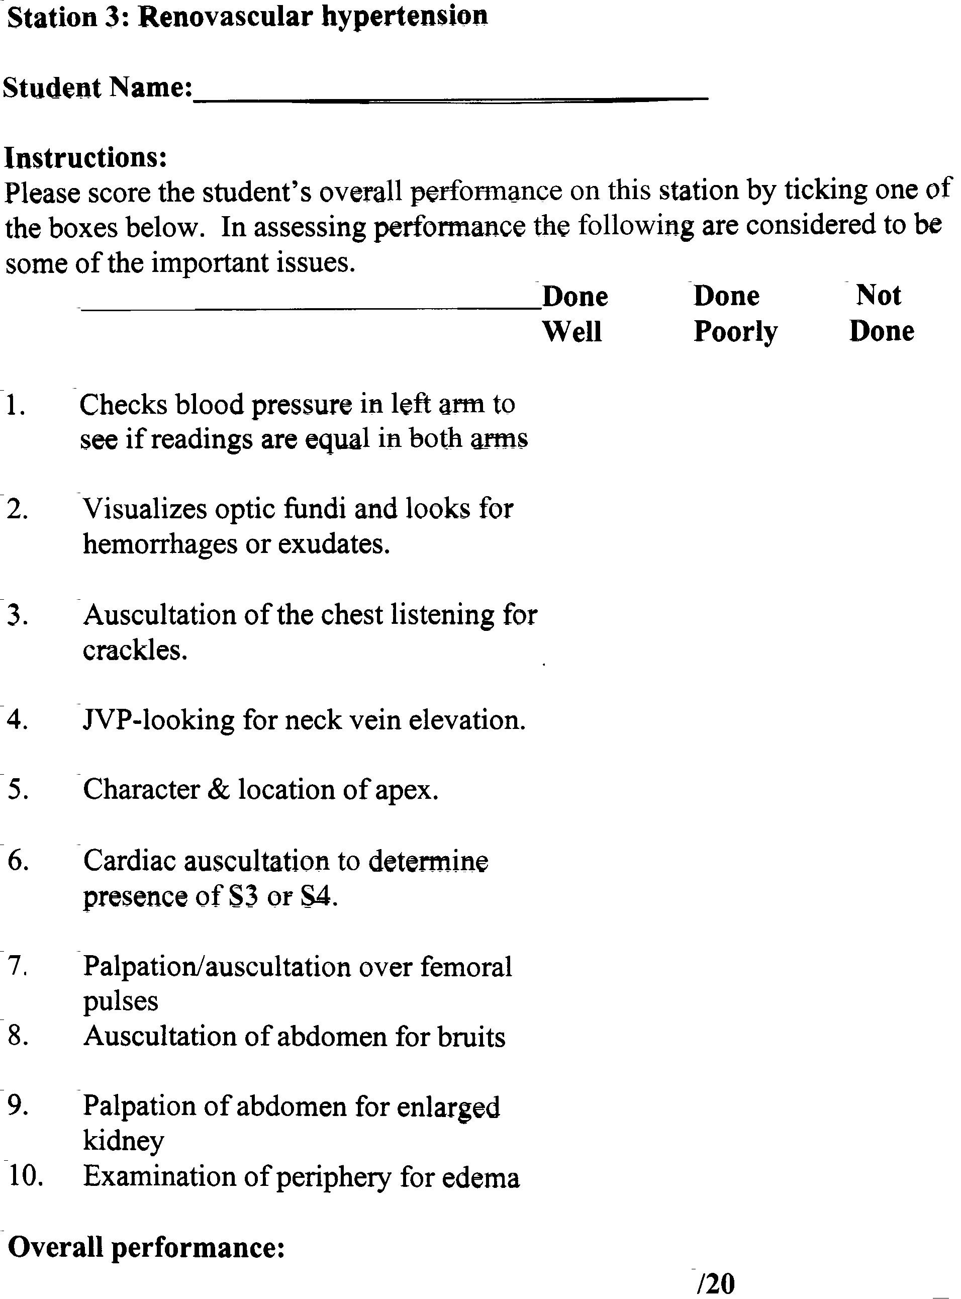

Slide 91
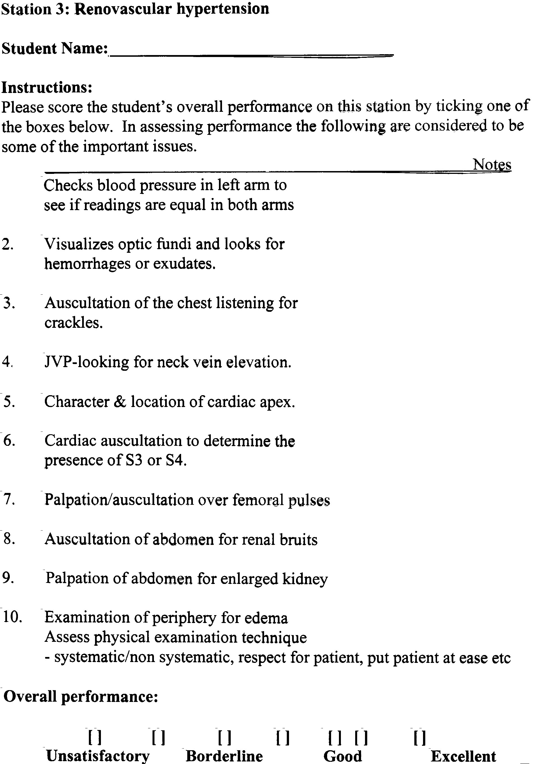

Slide 92
Reliability
Inter-rater --- 0.7—0.8 (global or checklist)
Overall test (20 stn) – 0.8 (global > check)
Validity
Against level of education
Against other performance measures

Slide 93
Hodge & Regehr

Slide 94
Is there no way to achieve the good reliability and validity of the OSCE without the horrific organizational effort and expense?
MAYBE YES

Slide 95
An Observation
In the course of clinical training, students (clerks, residents) are frequently observed by more senior clinicians (residents or staff) around patient problems. But these observations are never captured or documented (well, hardly ever).

Slide 96
An Observation
In the course of clinical training, students (clerks, residents) are frequently observed by more senior clinicians (residents or staff) around patient problems. But these observations are never captured or documented (well, hardly ever).
One reason is that it is too time consuming to complete a long evaluation form every time you watch a student

Slide 97
An Observation
In the course of clinical training, students (clerks, residents) are frequently observed by more senior clinicians (residents or staff) around patient problems. But these observations are never captured or documented (well, hardly ever).
One reason is that it is too time consuming to complete a long evaluation form every time you watch a student
But (aha!) we don’t need all that information. Ratings of different skills in an encounter are highly correlated. What we have to do is capture less information on more situations

Slide 98
Clinical Work Sampling (CWS) - Turnbull & Norman, 2001 Mini – Clinical Examination (Mini CEX) - Norcini et al., 2002

Slide 99
Clinical Work Sampling (CWS) (Chicken Wings Solution)

Slide 100
Clinical Work Sampling (CWS)
After brief encounter with student or resident, staff completes a brief encounter card listing discussion topic, and single 7 point evaluation
Can be linked to patient log
Can be done on PDA

Slide 101
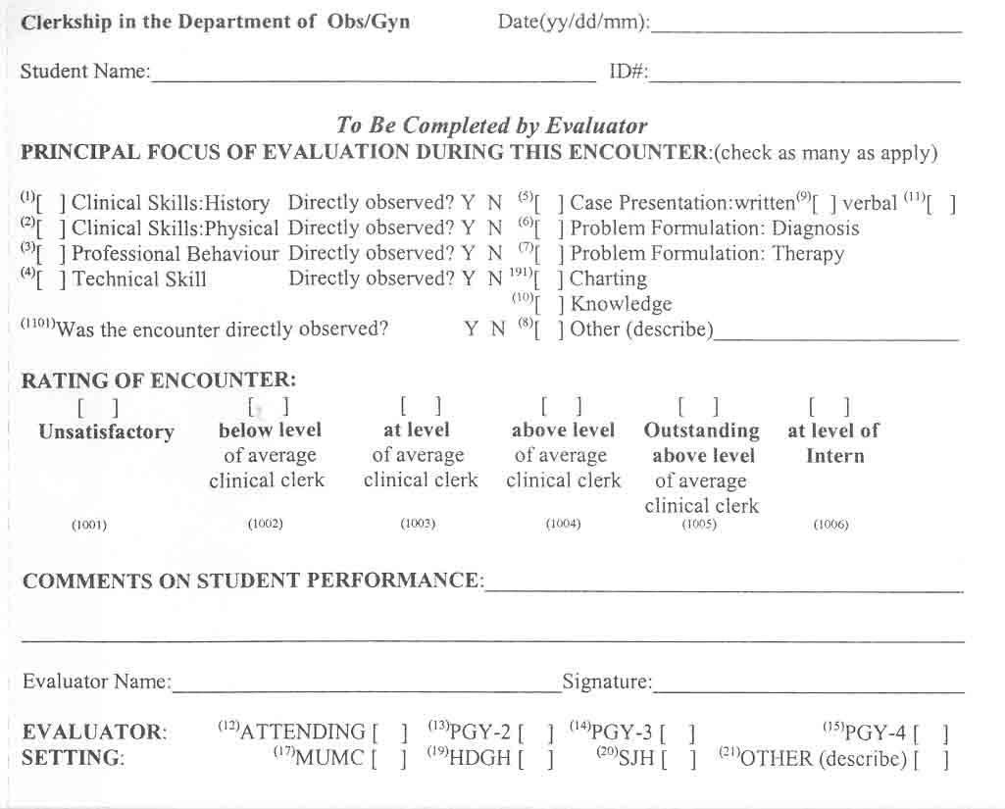

Slide 102
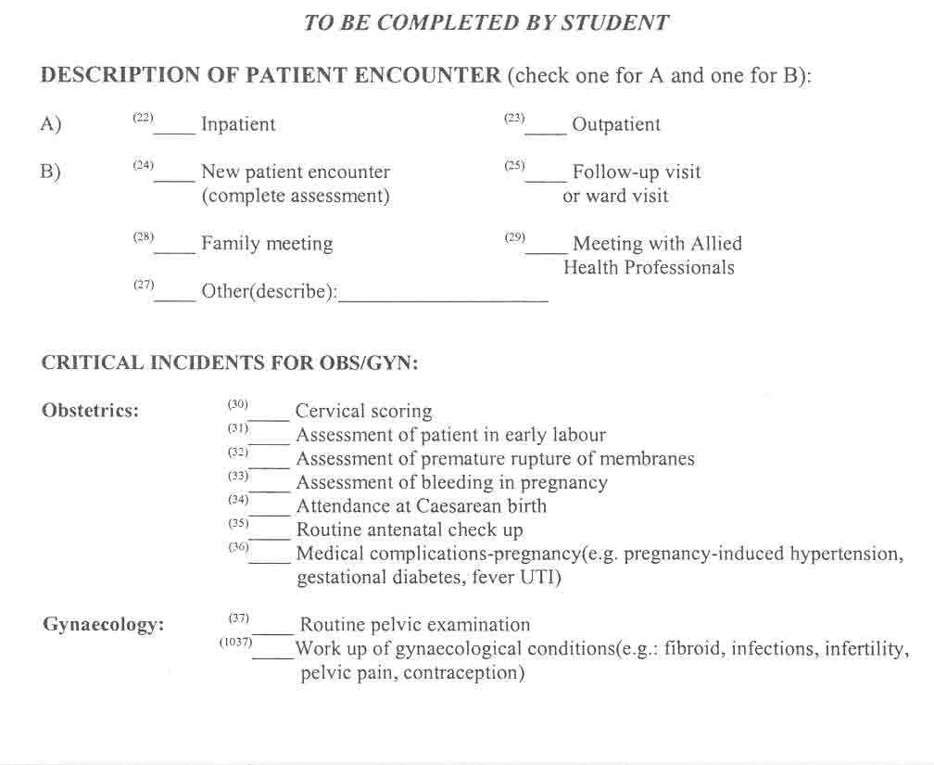

Slide 103
Reliability
Correlation between encounters -- 0.32
Reliability of 8 encounters -- 0.79
Validity
Not established
Logistics
On PDA (anesthesia, radiology, OB/GYN)
Used as part of Certification (ABIM)

Slide 104
Axiom 4
Sample, sample, sample
The methods that “work” (MCQ, CRE, OSCE, CWS) work because they sample broadly and efficiently
The methods that don’t work (viva, essay, global rating) don’t work because they don’t

Slide 105
Corollary #4A
NO amount of form – tweaking, item refinement, or examiner training will save a bad method
For good methods, subtle refinements at the “item” level (e.g. training to improve inter-rater agreement) are unnecessary

Slide 106
Axiom #5
Objective methods are not better, and are usually worse, than subjective methods
Numerous studies of OSCE show that a single 7 point scale is as reliable as, and more valid than, a detailed checklist

Slide 107
Corollary # 5A
Spend your time devising more items (stations, etc.), not trying to devise detailed checklists

Slide 108
Axiom # 6
Evaluation comes from VALUE
The methods you choose are the most direct public statement of values in the curriculum
Students will direct learning to maximize performance on assessment methods
If it “counts” (however much or little) students attend to it

Slide 109
Corollary #6A
Select methods based on impact on learning
Weight methods based on reliability and validity

Slide 110
“To paraphrase George Patton, grab them by their tests and their hearts and minds will follow”.
Dave Swanson, 1999

Slide 111
Conclusions
1) If there are general and content-free skills, measuring them is next to impossible. Knowledge is a critical element of competence and can be easily assessed. Skills, if they exist, are content-dependent.

Slide 112
Conclusions
2) Sampling is critical. One measure is better (more reliable, more valid) than another primarily because it samples more efficiently.

Slide 113
Conclusions
3) Objectivity is not a useful objective. Expert judgment remains the best way to assess competence. Subjective methods, despite their subjectivity, are consistently more reliable and valid than comparable objective methods

Slide 114
Conclusions
4) Despite all this, choice of an assessment method cannot be based only on psychometric (unless by an examining board). Judicious selection of method requires equal consideration of measurement and steering effect on learning.

