Slide 1
The Art and Science of Clinical Reasoning: The Role of Experience in Clinical Expertise
Geoff Norman, Ph.D.
McMaster University

Slide 2
The Conundrum
It takes about 10 years/ 10,000 hours of deliberate practice to make an expert
Chess
Medicine

Slide 3
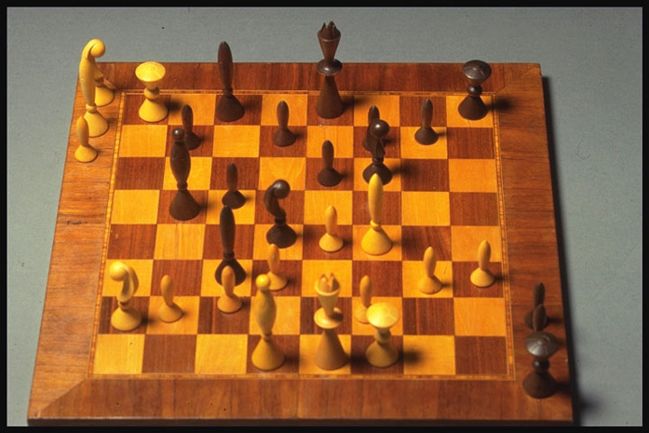

Slide 4
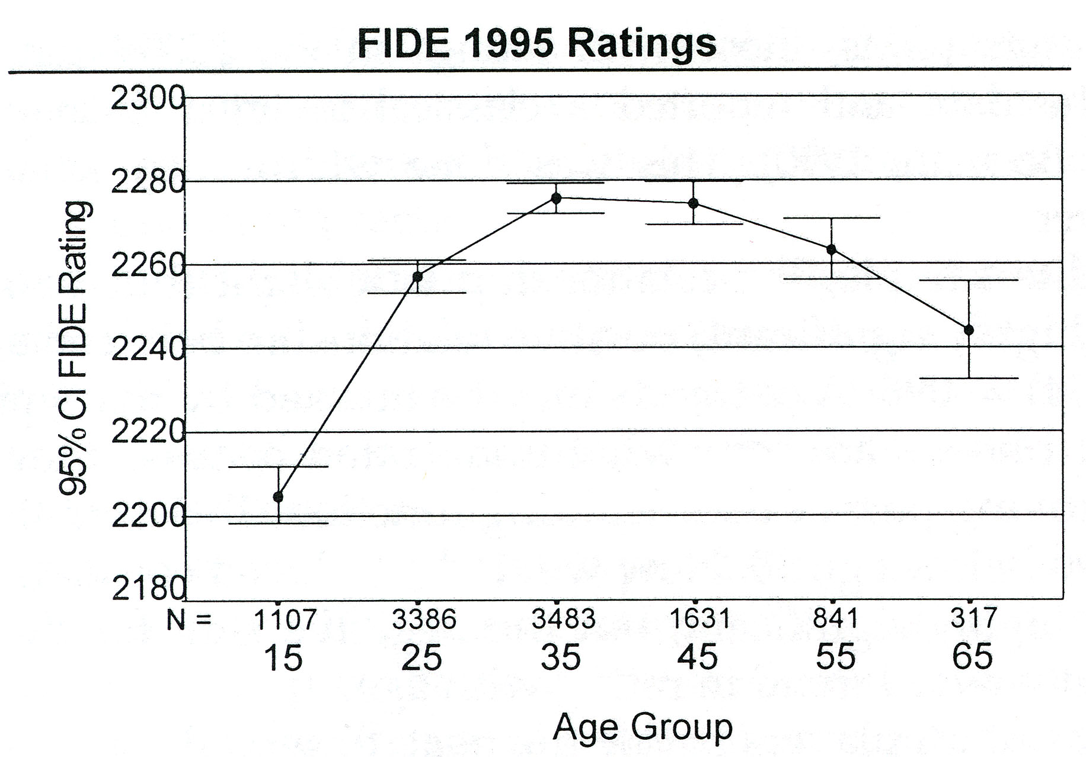
Age and Skilled Chess Performance
Ericsson and Charness, 1998

Slide 5
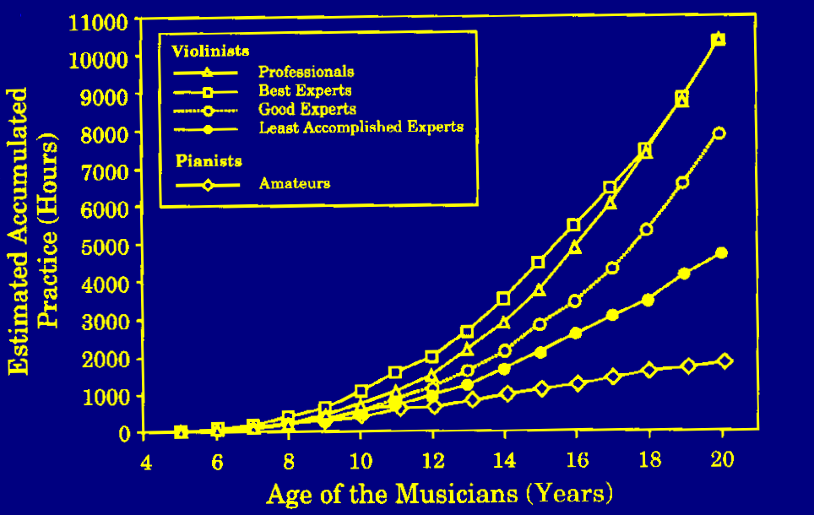
*
*

Slide 6
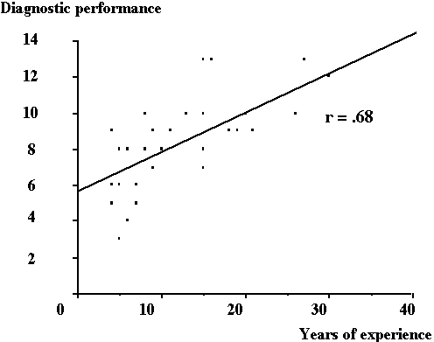
Age and Diagnostic Accuracy
Hobus & Schmidt, 1993

Slide 7
70
68
66
64
Total score on the CCT test
62
60
58
0
40000
80000
120000
20000
60000
100000
140000
EXPOSURE
Schuwirth et al., 2004

Slide 8
BUT
Every measure of knowledge/ performance decays right after graduation

Slide 9
Day and Norcini, 1988

Slide 10
What does the expert get from ten years of experience?

Slide 11
Early History of Clinical Reasoning (1973-79)
- Search for general problem - solving skills
- Content Specificity (Elstein, Shulman)
- Central Role of Knowledge

Slide 12
Early History of Clinical Reasoning (1973-79)
- Search for general problem - solving skills
- Content Specificity (Elstein, Shulman)
- Central Role of Knowledge

Slide 13
The Paradigm Shift (1979 - 99)
- Organization of knowledge as central focus
Hierarchical Networks
Propositions
Symptom x Disease probabilities
Individual exemplars

Slide 14
The Alternative View
In the course of becoming an expert, one requires an extensive stable of examples which guide diagnosis and management of new problems

Slide 15
Exemplar Theory - Medin, Brooks
Categories consist of a collection of prior instances
identification of category membership based on availability of similar instances
Similarity is “non-analytic” (not conscious), hence can result from objectively irrelevant features
Ratings of typicality, identification of features, etc. done “on the fly” at retrieval

Slide 16
Similarity and recognition of everyday objects
When we recognize everyday objects, the process is effortless, seemingly unconscious.
We are not aware that we are eliciting or weighting individual features
The process appears to occur all at once (Gestalt)

Slide 17
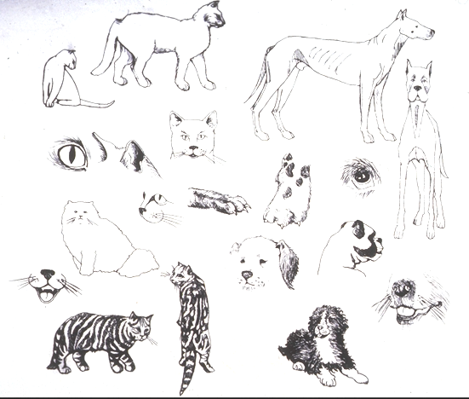

Slide 18
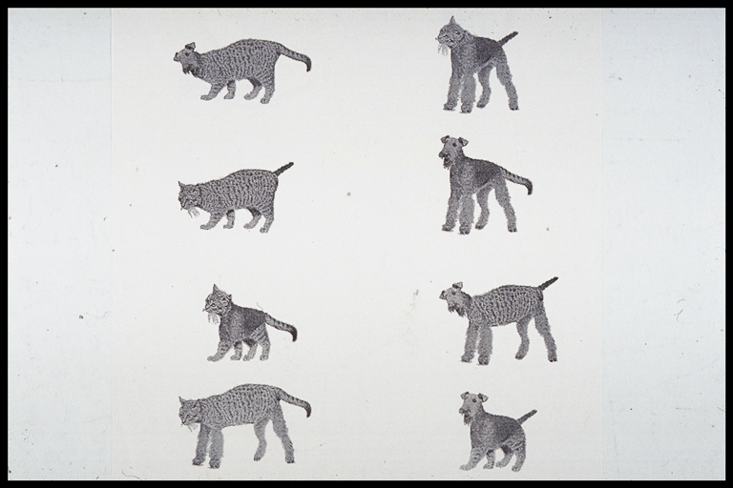

Slide 19
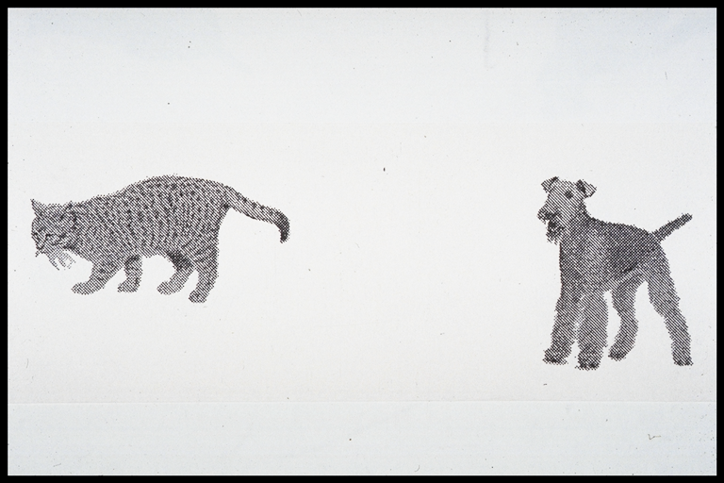

Slide 20
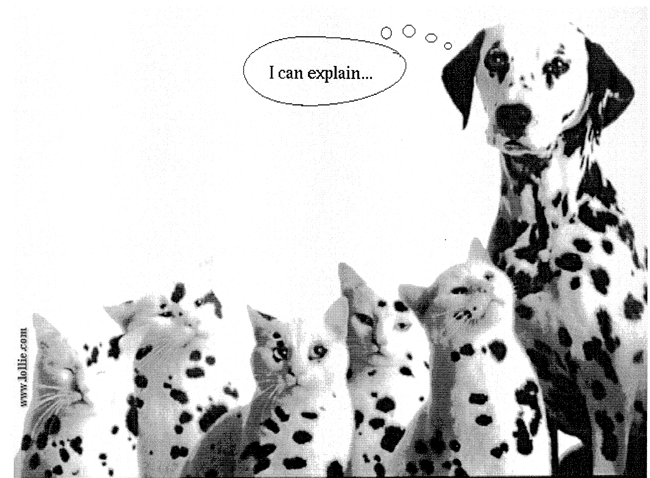

Slide 21
Effect of Similarity (Allen, Brooks, Norman, 1992)
24 medical students, 6 conditions
Learn Rules
Practice rules
Train Set A Train Set B
(6 x 4) x 5 (6 x 4) x 5
Test (9 / 30)

Slide 22
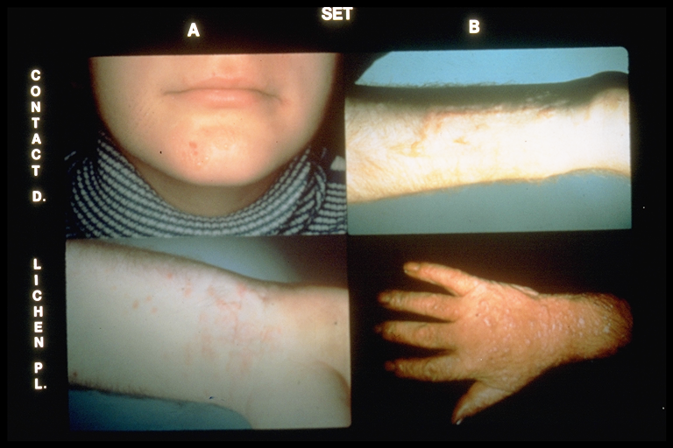

Slide 23
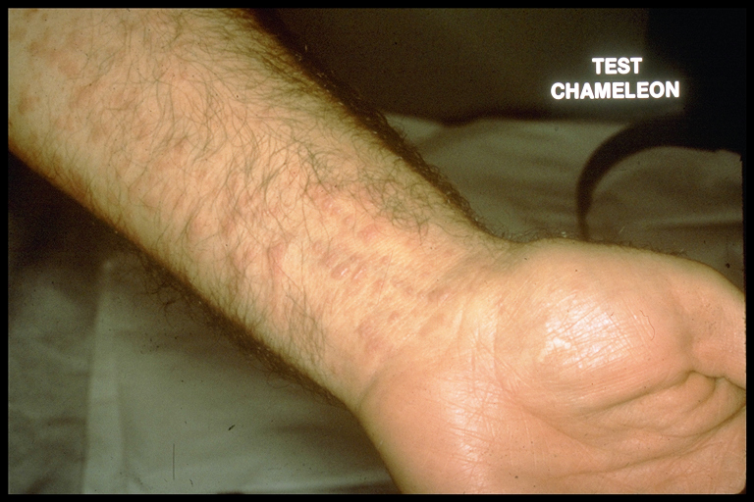

Slide 24
Accuracy by Bias Condition

Slide 25
Hatala et al, ECG Interpretation
Medical students/ Fam Med residents
PRACTICE (4/4 + 7 filler)
middle aged banker with chest pain
OR
elderly woman with chest pain
Anterior M I
TEST ( 4 critical + 3 filler)
Middle aged banker
Left Bundle Branch Block

Slide 26
RESULTS Percent of Diagnoses by Condition
Medical
Students

Slide 27
RESULTS Number of Features by Condition

Slide 28
Studies of Expert Pattern Recognition
Dermatologists/ GPs / residents
36 slides (typical / atypical)
Condition A
Verbal description of slide (verbal)
then photo (visual + verbal)
Condition B
Photo only (visual)

Slide 29
Diagnostic Accuracy

Slide 30
Diagnostic Accuracy

Slide 31
Diagnostic Accuracy

Slide 32
Conclusions
With experience (dermatologist + GP) greater information from visual alone than (visual + interpretation) or verbal
For relative novice, greater information from textbook description

Slide 33
CONCLUSIONS - The Role of Examples
Categories and Concepts are based on our specific experience with the world
The process is “non-analytic” (pattern recognition), based on holistic similarity not individual features, and occurs rapidly
Individual experience affects both the concept (diagnosis) and the features

Slide 34
Implications
Expertise associated with rapid diagnosis
Experts cannot predict errors of others
Features may be reinterpreted in line with hypotheses

Slide 35
Rapid Diagnosis
STUDY
100 slides in 20 categories
Students, clerks, residents, GPs, Dermatologist
Accuracy and Response Time

Slide 36
Response time by Educational Level

Slide 37
Clinicians cannot predict errors of others
STUDY
At conclusion of previous study, 3 dermatologists predict errors of residents, GPs, dermatologists

Slide 38
Proportion of Errors Predicted

Slide 39
Influence on Feature Interpretation
Diagnostic hypotheses arise from pattern recognition processes based on similarity to prior examples
In situations of feature ambiguity, hypotheses may influence what is seen
top-down processing; backward reasoning)

Slide 40
Influence of Diagnosis on Feature Perception (LeBlanc et al)
20 residents, 20 final year students
8 photos of classical signs from clinical diagnosis textbooks
Correct history and diagnosis
vs.
Incorrect history and diagnosis

Slide 41
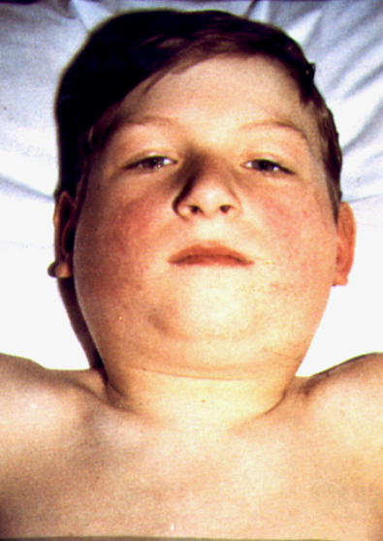

Slide 42
RESULTS Diagnostic Accuracy by Bias

Slide 43
RESULTS Number of Features of Correct Diagnosis by Condition

Slide 44
RESULTS Number of Features of Alternate Diagnosis by Condition

Slide 45
ECG Diagnosis Hatala et al., 1999
Cardiologists, Residents, Med student
10 ECG’s
Correct Hx, Alternate Hx, No Hx

Slide 46
Results -- Diagnosis

Slide 47
Results -- Features of Correct Dx

Slide 48
Conclusions - Ambiguity of Features
Clinicians at all levels are vulnerable to suggested diagnoses
Hypothesized diagnoses influence interpretation of features

Slide 49
Conclusions (to date)
Many aspects of clinical reasoning are consistent with a process based on similarity to prior exemplars
Is that all there is?
What is the role of analytical knowledge and reasoning?

Slide 50
Science and Clinical Reasoning (Patel, Schmidt)
Clinicians rarely use basic science explanation in routine practice.
While they may possess the knowledge, it remains “encapsulated” until mobilized for specific goals (to solve specific problems) (Schmidt, HG)

Slide 51
Where Do Clinicians Use Basic Science?
Some use physiology ALL the time
Nephrology, hematology, anesthesiology
Some use basic science some of the time
Difficult problems

Slide 52
Experimental Design
R1 --GP R2 -- IM Nephrol
n=4 n=4 n=4
Clinical Cases
k = 8
Explain and Diagnose

Slide 53
Diagnostic Accuracy

Slide 54
Causal Explanations

Slide 55
No of Diagnoses / Investigations

Slide 56
Conclusions - Use of Basic Science
In difficult diagnostic situations, clinicians use causal physiological knowledge
Expertise associated with more coherent explanations, better diagnosis

Slide 57
IMPLICATIONS for TEACHING
In the face of ambiguity, does pattern recognition help or hurt?
Studies of coordination of processes in dermatology
Studies of analytic and non-analytic processing by novices
Impact of mixed vs. blocked practice

Slide 58
Coordinating Analytical and Exemplar-Based Processing
Do students /physicians use both processes?
Is one more effective than the other?
Are the processes amenable to instruction?
Are there circumstances where one is more effective?
Does a combined strategy work better?

Slide 59
Analytical and Holistic Processes
Analytical (Rule-based)
Based on rules, individual features
Holistic (Similarity based)
Based on holistic similarity to prior exemplar
Index of rule-based processing:
Typical - Atypical
Index of similarity-based processing:
Similar- Dissimilar

Slide 60
Subjects:
39 medical students in McMaster MD Programme
3rd instructional unit (7 months completed).
No prior training in dermatology
Materials
10 disease quartets
2 typical cases (similar to one another)
2 atypical cases (similar to one another)

Slide 61
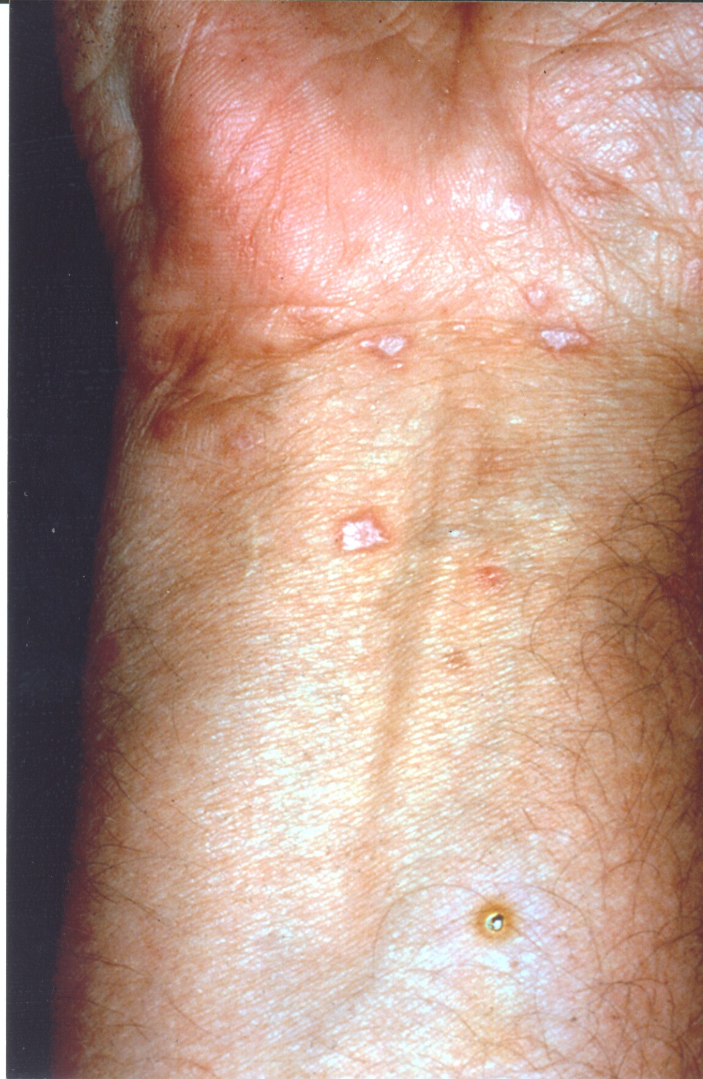
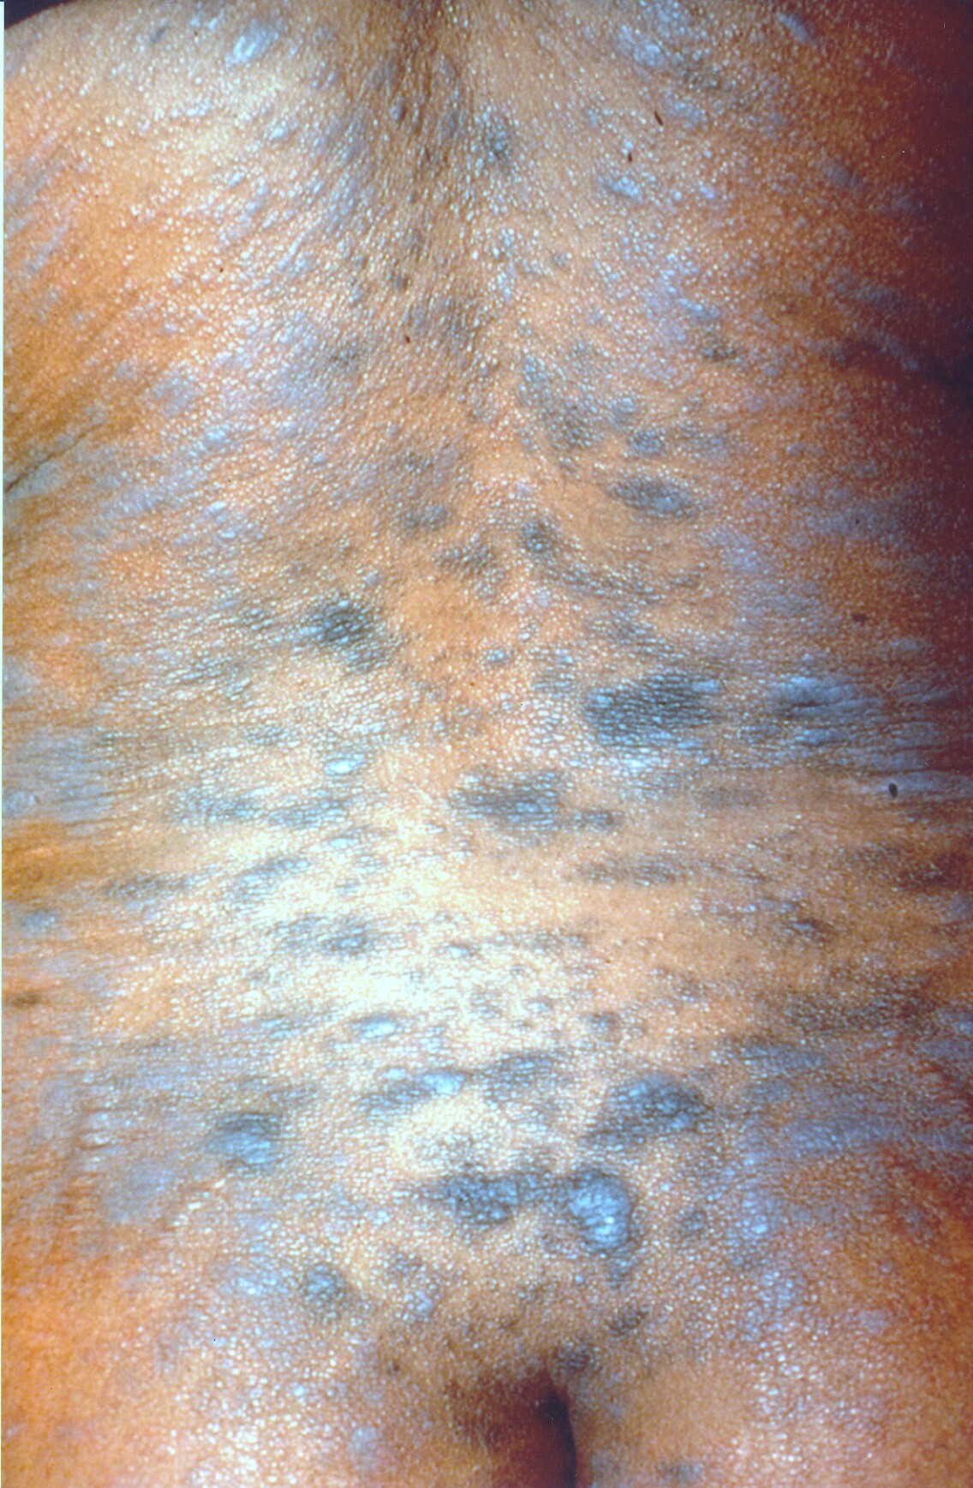
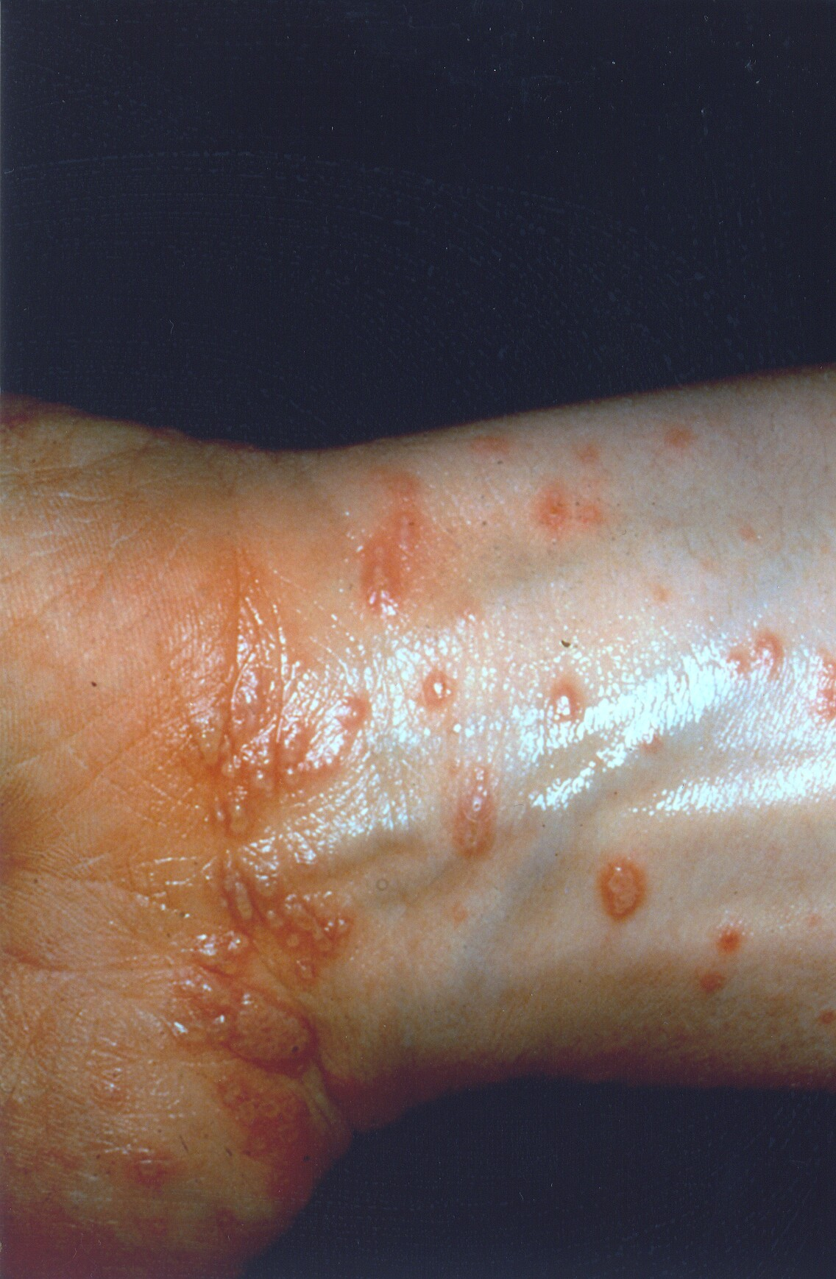
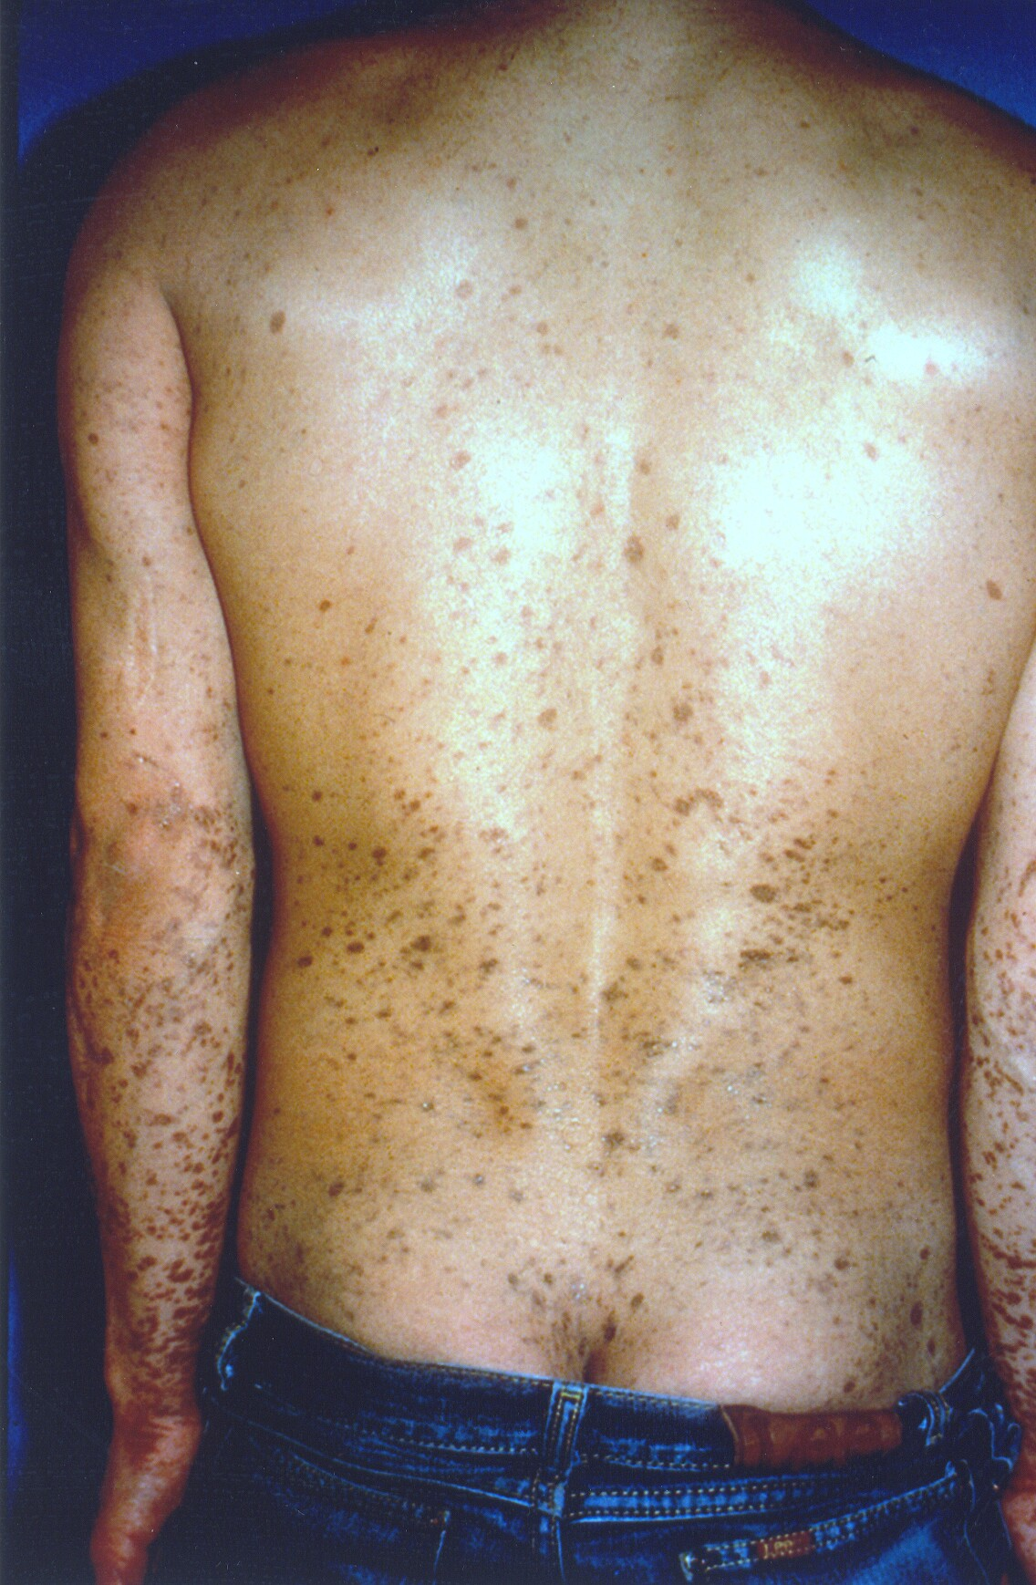
Example of a disease quartet:
Lichen Planus
T1
A1
T2
A2

Slide 62
Test Phase
Analytic (rule-based condition)
Identify features present prior to diagnosis
Allowed to use instructional booklet if necessary
Similarity then Analytic Session
Participants were presented with each test case twice
Pass 1 (similarity-based condition)
Give diagnosis that first comes to mind
Opportunity to reassess each case later
Pass 2 (similarity+rule condition)
Re-examine initial diagnosis with rules of diagnosis
Use instructional booklet if necessary
May keep or change their initial diagnosis

Slide 63
3 critical comparisons of performance may be made:
Rule-based vs. Similarity-based conditions
Evidence of both types of processing
Determine if instructions shift balance in processing
Interaction between Instruction and Material
Evidence of specific situations where strategy is more effective
(Rules on typical lesions; Exemplar on similar lesions)
Rule-based vs. Similarity+rule condition
Similarity-based vs. Similarity+rule conditions
Determine if performance under dual strategy is superior

Slide 64
Overall Comparison
Typical cases > Atypical cases
Similar cases > Dissimilar Cases
Evidence of both types of processing

Slide 65
Effect of Instructional Strategy
Rule-based group: Typical cases >> Atypical cases
Similarity-based group: Similar cases >> Dissimilar cases

Slide 66
Predictions:
Specific predictions with respect to the type of case:
TS cases
high accuracy
rule-based = similarity-based groups.
AD cases
low accuracy
rule-based = similarity-based groups.
TD cases
rule-based group > similarity-based group.
AS cases
similarity-based group > rule-based group.

Slide 67
Accuracy by Lesion Type

Slide 68
Combined vs. Individual Strategies
Similarity+Rule>Rule-based
Similarity+Rule>Similarity-based

Slide 69
INSTRUCTION AND PATTERN RECOGNITION
Contrast instructions to:
Think of the first thing that comes to mind
vs.
Gather all the data then arrive at diagnosis
with the ECG taken away
with the ECG present
32 Undergrad Psychology students
11 disorders, rules + examples
Test -- 10 new ECG’s

Slide 70
Diagnostic Accuracy
Resident
Clerk

Slide 71
Diagnostic Accuracy
Resident
Clerk

Slide 72
Conclusion
Systematic, hypothesis - free , search leads to no advantage in performance (even for novices)
Tendency to identify and label normal variation or irrelevant feature
Conbined strategy (pattern recognition + analytical) is optimal

Slide 73
Mixed vs. Blocked Practice
In the face of ambiguous features (which are subject to reinterpretation),and multiple categories, students must learn the features which discriminate one category form another, not those which support a particular category

Slide 74
Mixed vs. Blocked Practice Hatala, 2000
ECG Diagnosis -- 3 categories
6 examples / category
Blocked
Review, then 6 examples/category
Mixed
Review, 2/category, 12 (4 x 3) practice
TEST 6 new ECGs

Slide 75
Accuracy -- %

Slide 76
Conclusions
Mixed practice, contrast across categories, leads to 50% improvement in accuracy over blocked practice

Slide 77
OVERALL CONCLUSIONS
Clinical reasoning is based on both analytical facts and relationships and an accumulation of examples
Examples are rich source of hypotheses
Examples aid expert to interpret ambiguous features

Slide 78
Implications
Careful attention must be paid to the nature and number of examples students acquire during clinical education (deliberate practice)
Students should be encouraged (not discouraged) to try to recognize patterns and look for similarity to prior cases

