Slide 1
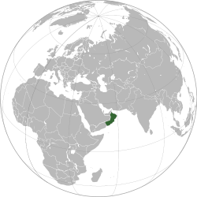
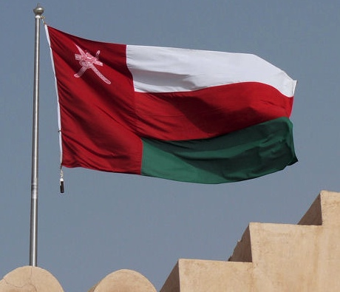
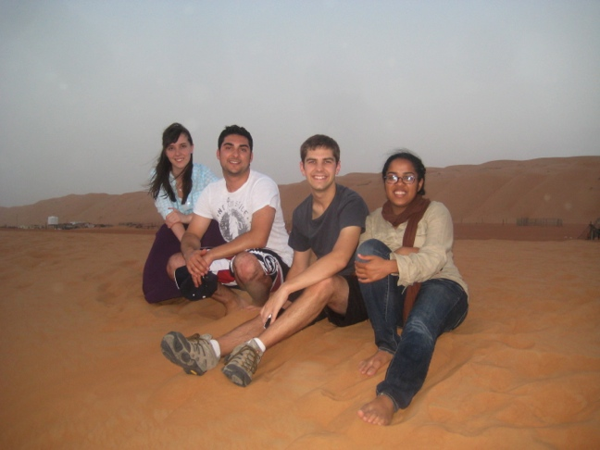
The Sultanate of Oman
Kelsey Black
Mai El Gasim
TJ Klein
Jeffrey Zabinsky

Slide 2
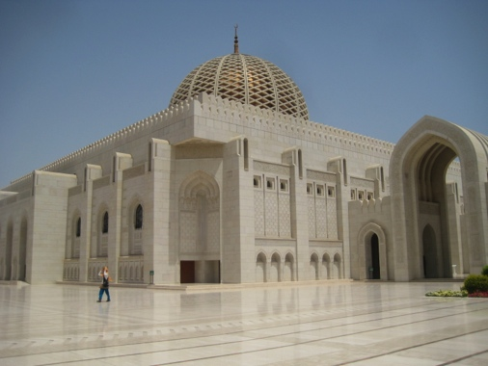
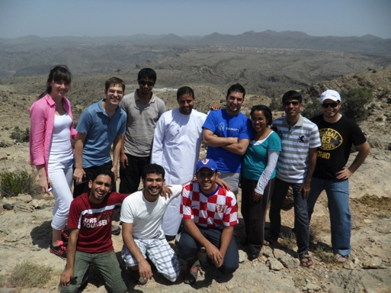
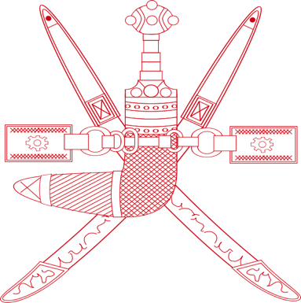
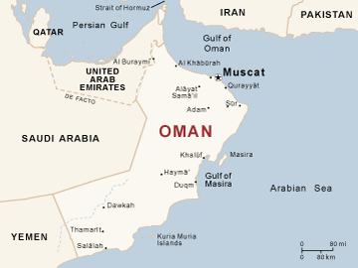
Oman
Arab country on southeast coast of Arabian Peninsula
Bordered by UAE, Saudi Arabia, & Yemen
Wealthy, but developing nation
HOT! (90-110 in summer)
Muslim country (conservative)
Weekends are Thursdays and Fridays
No public transportation; taxis only

Slide 3
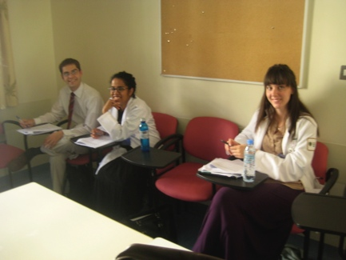
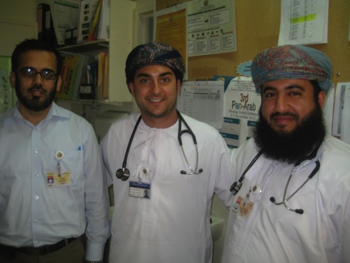
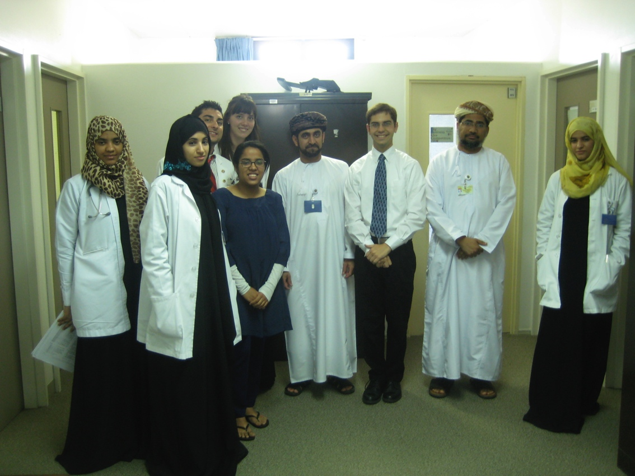
What we did
Observerships at Sultan Qaboos University Hospital
Kelsey
Hematology (1.5 weeks)
OB/Gyn (1.5 weeks)
Mai
Hematology (1 week)
Surgery (1 week)
TJ
Hematology (1.5 weeks)
Pediatrics (1.5 weeks)
Jeff
Hematology (1.5 weeks)
Surgery (1.5 weeks)

Slide 4
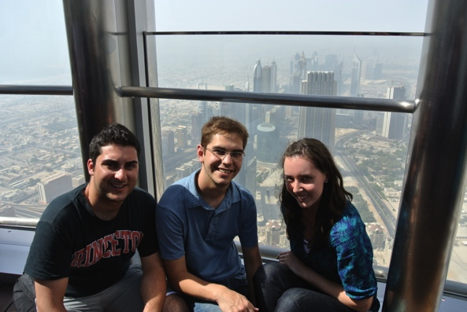
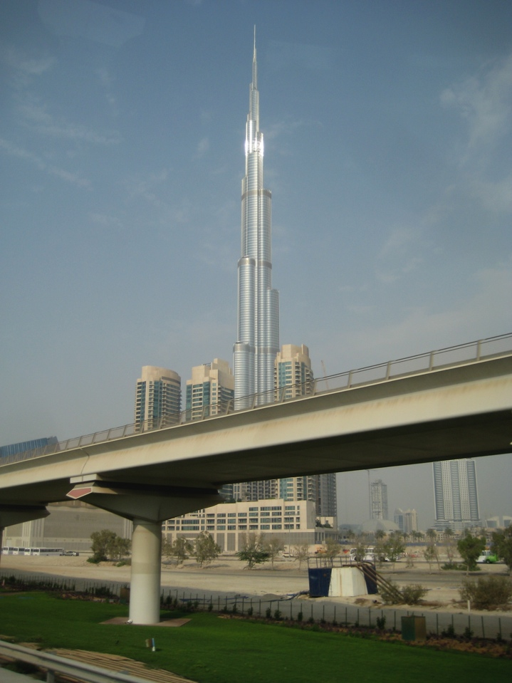
Where we went
Dubai for 2 days (6 June – 8 June)
Burj Khalifa
Jumeriah Beach Resort (JBR)
Dubai Mall (ice skating, aquarium)
Mall of Emirates (skiing)
Sheikh Zayed Al Maktoum House
Old Souk
Atlantis (aquarium, water park)
The Palm
Hotels/Clubs
Bus to Oman (bring copies of paperwork!)

Slide 5
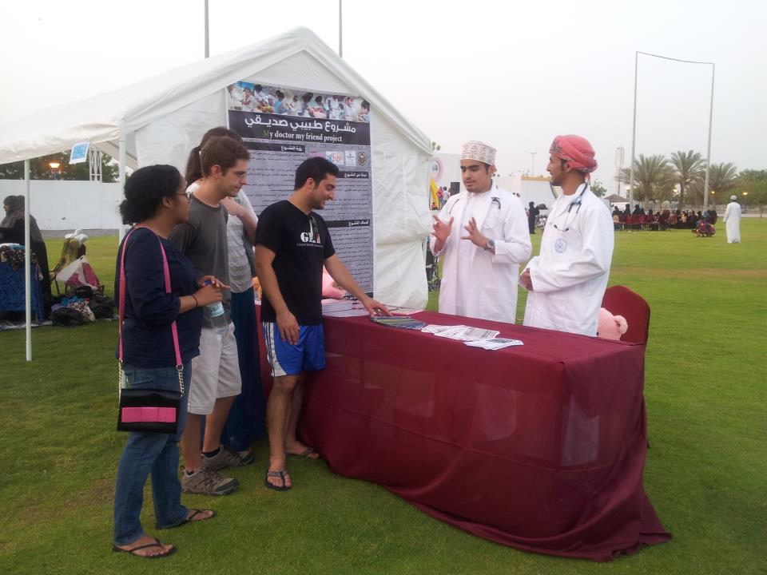
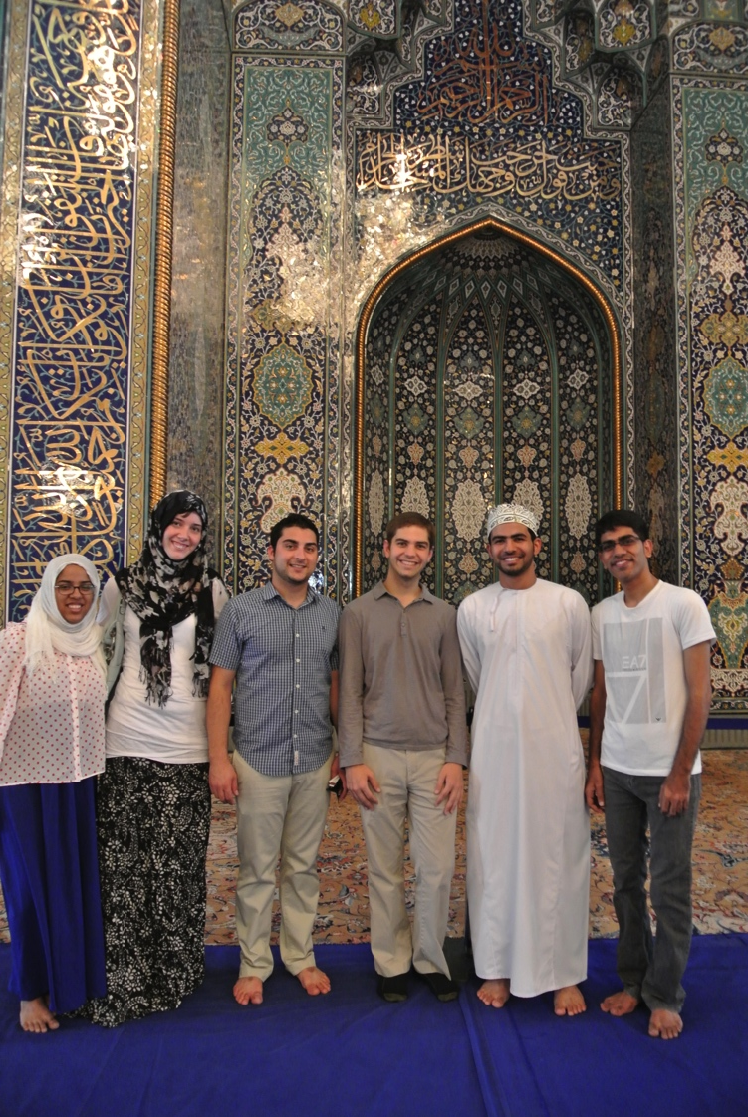
Where we went
Oman for 3 weeks (9 June – 28 June)
Sultan Qaboos University
Seeb beach
Muttrah Souk
Grand Mosque
Wadi Dayqah Dam
Camping at Green Mountain
Nizwa Fort
Desert (Camels!)
Wadi Bani Khalid (Swimming)
Ras Al Jinz (Sea Turtles)

Slide 6
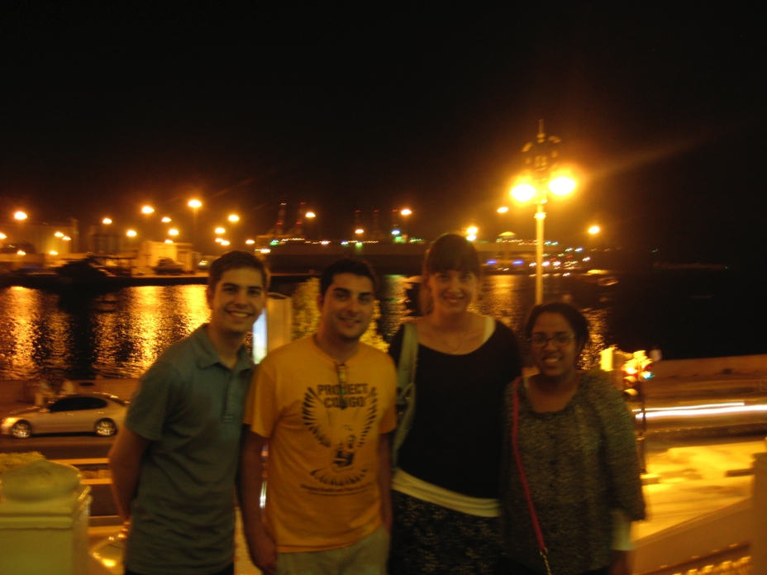
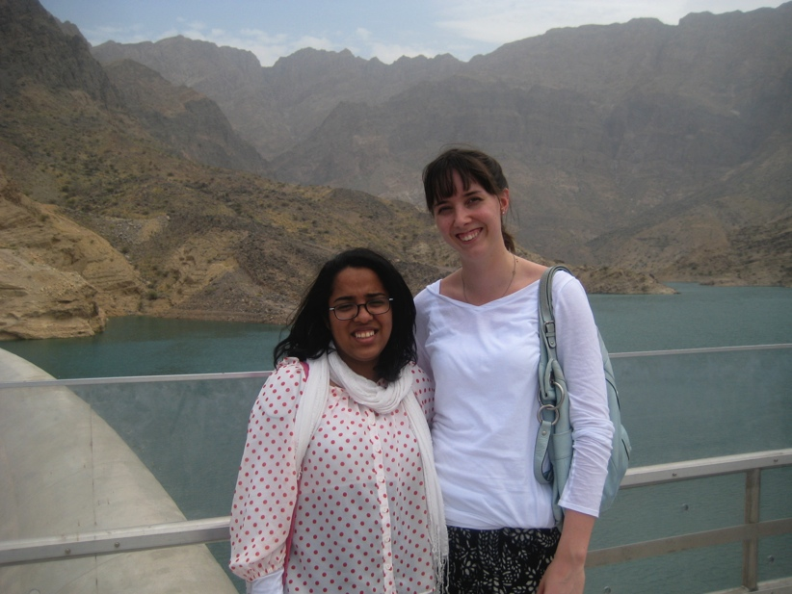
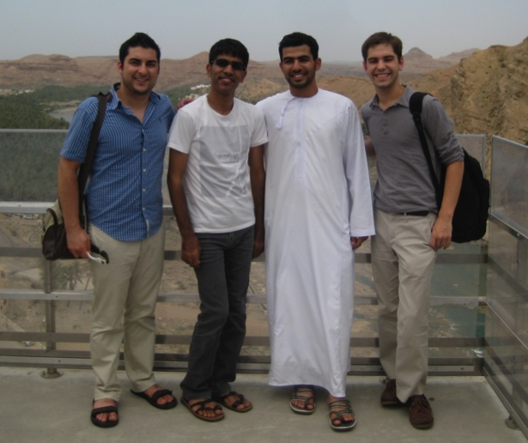
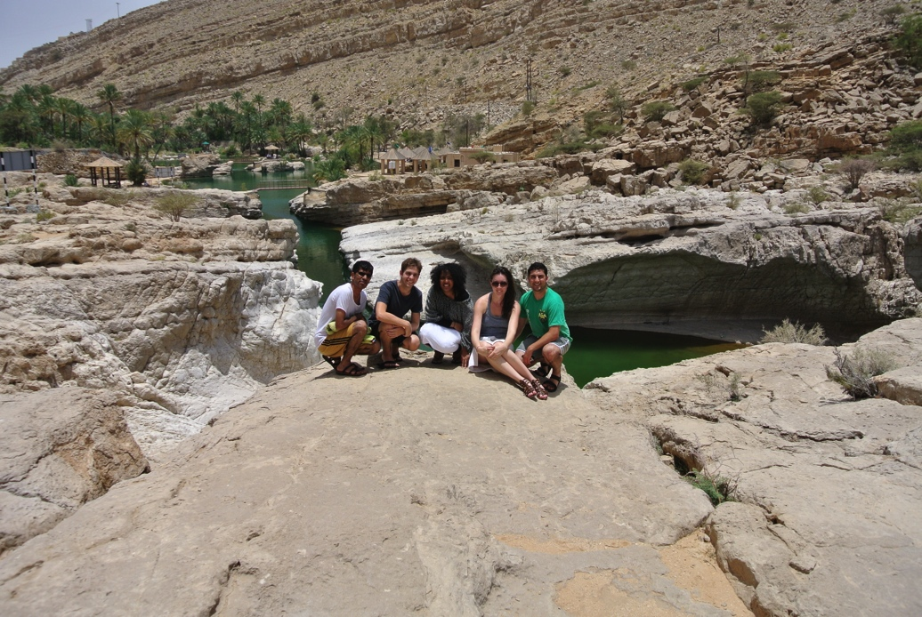

Slide 7
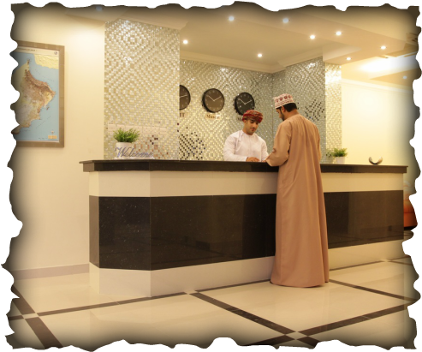
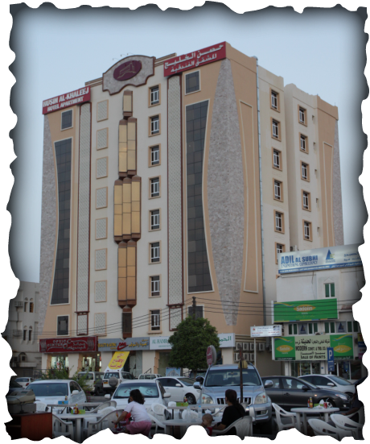
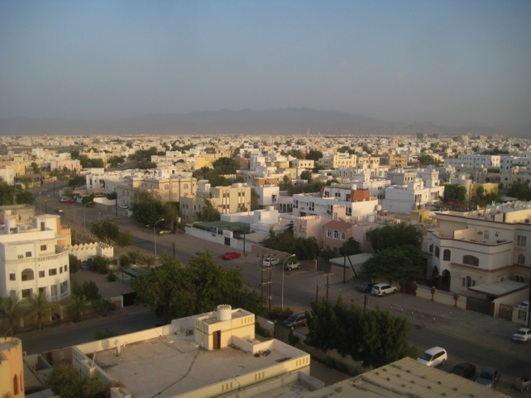
Where we stayed
Husin Al Khaleej Hotel Apartment
Seeb (~30 minutes from Muscat, ~5 min from SQU)
Air conditioning
Very nice room, service, & people!
Free wirelesss (very reliable)
http://www.h-khaleej.com/

Slide 8
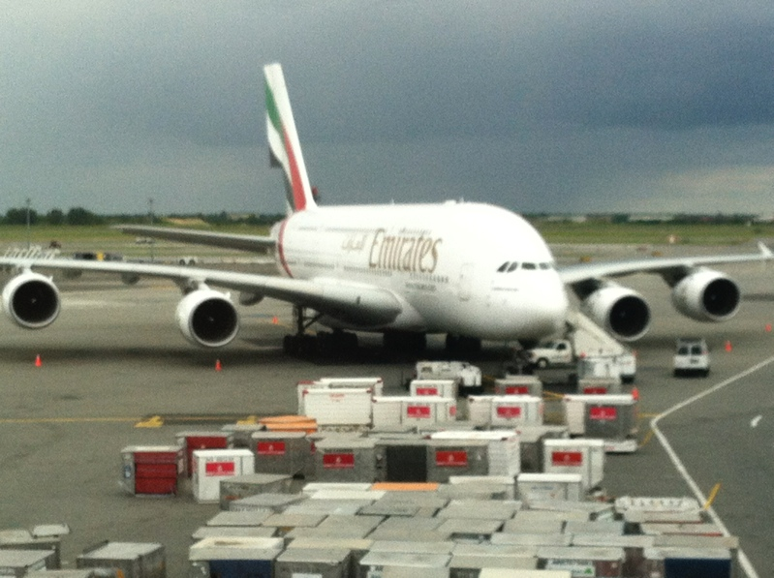
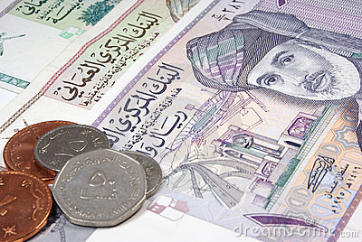
Cost
Flights from $1300-$1700 round trip
Hotel approx $450 for 3 weeks
Food is very cheap there (~$2-4 for a meal)
Omani Rials! (~2.6 dollars per rial)

Slide 9
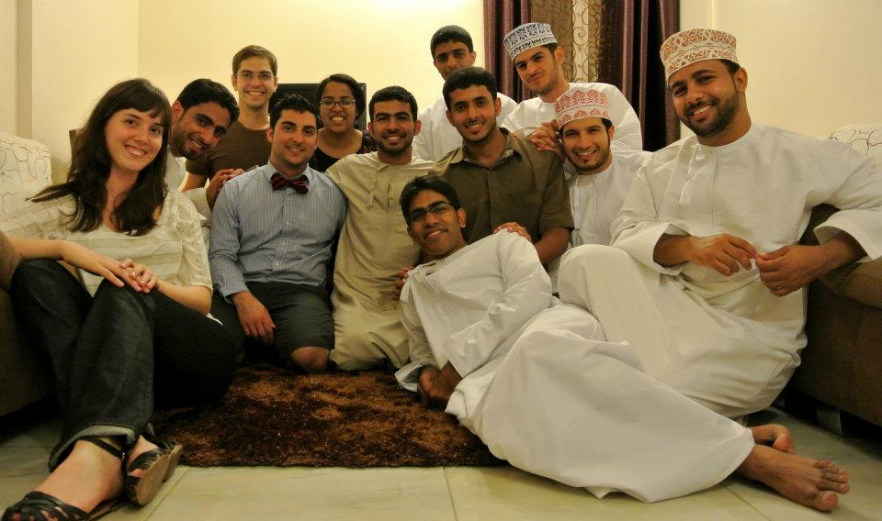
THANK YOU!

Slide 10
Questions?

