Slide 1
Paying for
Community Health Workers
Hospital Council of Northwest Ohio
November 17, 2016
A program of the

Slide 2

The Problem Runs Deep
Poor Health
Neighborhood
Race/Ethnicity
Social Determinants
of
Health
Occupation
Culture
Education
Socioeconomic Status/Income

Slide 3

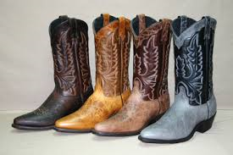
CHWs are the Boots on the Ground

Slide 4


The Pathways Community HUB Model creates an effective way for organizations to work toward common goals.
Common Goal=Reducing Health Disparities

Slide 5

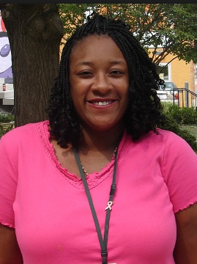
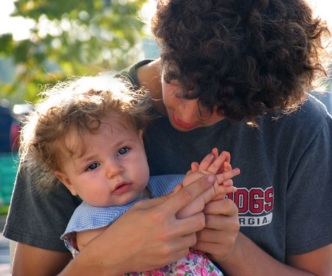
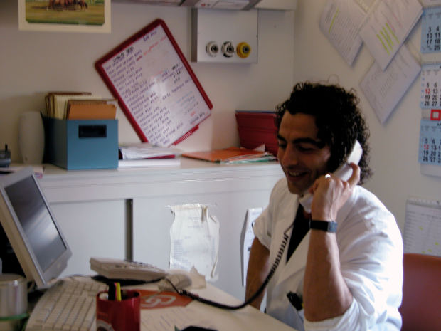

Find. Treat. Measure.
Step 1: Find
Step 2: Treat
Step 3: Measure
Comprehensive Risk Assessment
Track and Measure Pathways
Connections to Care
Assign Pathways

Slide 6
Milestones to Reducing Health Disparities
2015
-IM a priority in Healthy Lucas County Plan
-Assisted OCMH to secure funding to enhance/ replicate HUB Model
-Implemented Getting to 1 Assess/Refer
-CDC funded start up of chronic disease Pathways
2016
-Funded by OCMH to expand HUB and mentor new HUBs
-becoming regional
-Medicaid to analyze HUB ROI
-Received funding to bring to scale IM reduction efforts in the hotspot zip codes
-Applied for CMS AHC
-Healthier Buckeye Expansion
2005
Lucas County Initiative to Improve Birth Outcomes adopted HUB Model with local funding
2010
NW Ohio Pathways HUB began contracting with Medicaid Managed Care Plans for community based care coordination
2013
-Lucas County Equity Institute “Getting to 1” formed with Toledo-Lucas County Health Department and Hospital Council of Northwest Ohio as co-leads
-Pilot HMG HUB
2014
Healthy Start Grant Awarded to TLCHD for reproductive life planning to serve pre/inter- conception and expand Pathways HUB
2014
-HUB Certified
-GRC funded UT AHEC Partnership for CHWs to train and hire CHWs to work through HUB to serve Medicaid enrollees

Slide 7
Healthcare Access Initiative
NW Ohio Partnership for CHWs
Develop Community Health Worker (CHW) training programs as a way to increase the number of certified CHWs in Ohio and cultivate additional community-based safety net provider placement sites for CHW students and certified CHWs.
  88 certified CHWs since FY 2015
  51 planned for FY 2016
  30+ practicum sites
    12 practicum sites that are safety net providers
  38 employment sites
    10 employment sites that are safety net providers

Slide 8
Practicum Sites
2-1-1/United Way of Greater Toledo
Adelante
Bethany House
Cedar Creek Community Free Clinic
Center for Appalachia Research in Cancer Education – Project Hoffnung
Community Health Access Project (CHAP)
Clark County Combined Health District
Dental Center of Northwest Ohio
East Toledo Family Center
Elyria City Health Department
Erie County Health Department
Friendly Center
Hospital Council of Northwest Ohio
Mercy Health - Adult Medical Clinic
Mercy Health - Children's Hospital/Healthy Connections
Mercy Health - Family Care Center
Mercy Health - St. Vincent Medical Center
Neighborhood Health Association (NHA)
North East Ohio Neighborhood (NEON) Health Services
Padua Center
Paramount Health Care
Planned Parenthood
ProMedica Center for Health Services (CHS) - Adult Clinic
ProMedica Toledo Hospital – Behavioral Health Inpatient Unit
ProMedica Toledo Hospital - Toledo Healthy Tomorrows/Help Me Grow
Rahab's Heart
Reynolds Elementary
Sandusky County Emergency Medical Services
Santa Maria Community Services
Senior Independence Home Health and Hospice
Toledo Lucas County Health Department
Toledo Lucas County Health Department - Minority Health
Toledo/Lucas County CareNet
University of Toledo Clinics
Wood County Board of Developmentally Disabled
Woodlane Residential
Your First Look/Heartbeat
Zablocki Senior Center

Slide 9
Job Development Sites
Adelante, Inc.
Dental Center of Northwest Ohio
East Toledo Family Center
Economic Opportunity Planning Association (EOPA)/Pathway
Mercy Health - Family Care Center
Mercy Health - Children's Hospital/Healthy Connections
Neighborhood Health Association (NHA) (3 positions)
ProMedica Physician Group
ProMedica Toledo Hospital - Toledo Healthy Tomorrows
Sandusky County Emergency Medical Services
Senior Independence Home Health and Hospice
Toledo/Lucas County CareNet
Toledo-Lucas County Health Department
University Church
University of Toledo Clinics
Your First Look/Heartbeat

Slide 10


CHWs=
Community Based Care Coordination

Slide 11
Pathways Address Health Disparities
Funders currently focused on . . .
  Low income Pregnant Women
  Low Income Adults with Chronic Disease
  Low Income Adults Diagnosed with Breast Cancer
  Victims of Human Trafficking
  Low Income Direct Service Providers employed by agencies serving the developmental disabilities population for job retention and performance

Slide 12

Hired with Job Development Stipends
Sustained by achieving outcomes
  Paying for CHWS
  Grants
    Stipends for training and start up costs
  Contracts for Outcomes
    Outcome oriented contracts
    Pay for Value/performance
New CHWs from Medicaid funded training at the University of Toledo 2016

Slide 13
CHW HUB Outcomes through Grants and Contracts
  Ohio Medicaid Managed Care
    Paramount
    Buckeye
    CareSource
    United Healthcare
  Lucas County Healthier Buckeye Council
  Ohio Commission on Minority Health
  The Stranahan Foundation
  Komen Northwest Ohio

Slide 14
20 Core Pathways – National Certification
Adult Education
Employment
Health Insurance
Housing
Medical Home
Medical Referral
Medication Assessment
Medication Management
Smoking Cessation
Social Service Referral
Behavioral Referral
Developmental Screening
Developmental Referral
Education
Family Planning
Immunization Screening
Immunization Referral
Lead Screening
Pregnancy
Postpartum
Notes:
JR

Slide 15
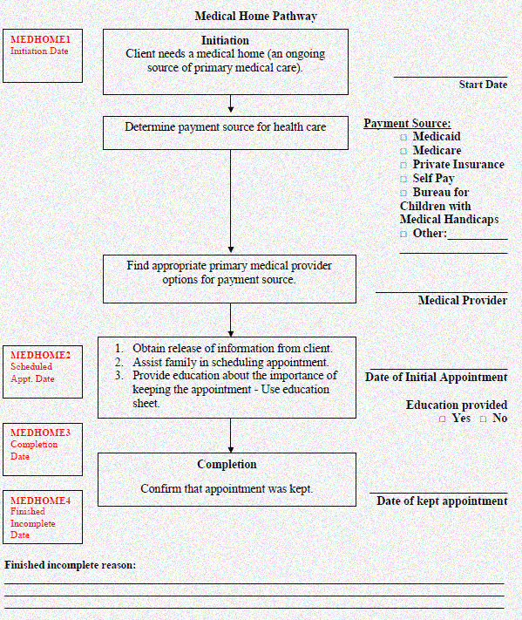
Treat: Risk = Pathways (PW)
20 Standard Pathways:
One risk factor at a time
Outcome achieved = finished PW & Payment!
Outcome not achieved = finished incomplete PW

Slide 16
Pathways Community HUBs in Ohio
Toledo
Cincinnati
Mansfield
Columbus
Youngstown
Columbus
Athens

Slide 17
Sample Outcome Payment Points
Payment Point | Document Completion | Description | RVU | Cost (RVU x $per RVU) | Code | Modifier
Pregnancy
Enrollment | Initial Pregnancy Checklist | completed 1 time at enrollment
Enrollment | Initial Pregnancy Checklist | 1st Trimester | 10 |  | G9003 | R1
Enrollment | Initial Pregnancy Checklist | 2nd Trimester | 8 |  | G9003 | R2
Enrollment | Initial Pregnancy Checklist | 3rd Trimester | 5 |  | G9003 | R3
Maternal Education Face to Face Visit | Pregnancy Checklist | Completed at each face-to-face encounter with Member | 4 |  | G9010 | R
First Prenatal Visit | Pregnancy Pathway | member attends 1st PNV | 3 |  | G9009 | RS
Healthy Birth Weight Baby | Birth Information Tool | Delivery-Normal Weight (per delivery) enrolled | 20 |  | G9009 | W1
Healthy Birth Weight Baby | Birth Information Tool | Twins, Mod/High risk and babies born > 35 weeks | 24 |  | G9009 | W2
Healthy Birth Weight Baby | Birth Information Tool | Triplets or higher and babies born > 32 weeks | 28 |  | G9009 | W3
Postpartum Visit | Postpartum Pathway | confirmation appt kept- must occur 21-56 days after delivery | 20 |  | G9009 | RR
Social Service Referral | Social Service Pathway | confirmation of kept appt for social services | 3 |  | G9009 | RU
Social Service Referral | Medical Referral Pathway | Confirmation of kept appt for health services (includes dentist, mental health provider, substance abuse treatment, or other specialty care provider) | 4 |  | G9009 | RN
Social Service Referral | Smoking Cessation Pathway | Tobacco free at postpartum | 6 |  | G9009 | RV
Connection to Medical Home (Mom or Baby) | Medical Home Pathway | Confimation of kept appt with medical home | 6 |  | G9009 | RM
Family Planning | Family Planning Pathway | LARC or permanent method | 6 |  | G9009 | G1
Family Planning | Family Planning Pathway | All other family planning methods | 5 |  | G9009 | G2

Slide 18
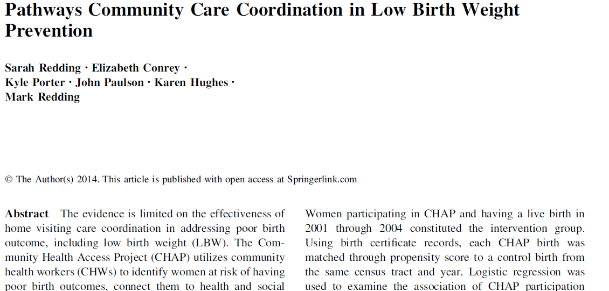
Published Study on Results
Cost Savings: $3.36 for 1st year of life; $5.59 long-term for every $1 spent
Pathway intervention over 4 years
Notes:
SR
2015 Maternal and Child Health Journal
Collaboration between CHAP, ODH, OSU, CDC
High risk population for LBW – 68% AA, 25% 18 or less, 39% tobacco use, 85% unmarried
6.1% LBW in intervention group, 13% in control group
NO difference in access to or use of health care services, average of 5.6 Pathways in intervention
Cost Savings: $3.36 for 1st year of life; $5.59 long-term; 1 LBW birth prevented for every 11.5 participants

Slide 19
2013-2015 Low Birth Weight Rates
All Pathways Clients vs. Clients Enrolled at Least 90 Days

Slide 20
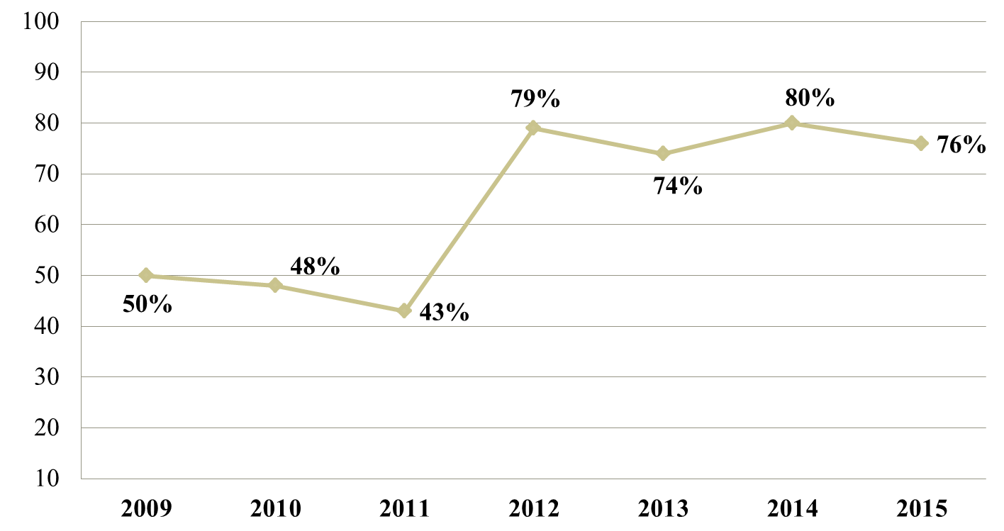
Clients Attending Post-Partum Appointment 21-56 days
2009-2015
Ohio Medicaid Post-Partum Attendance Rate: 63%
Notes:
Add 2015

Slide 21


Slide 22









Certified Pathways Community HUB Model Endorsers
The CMS Innovation Center
Notes:
JR

Slide 23
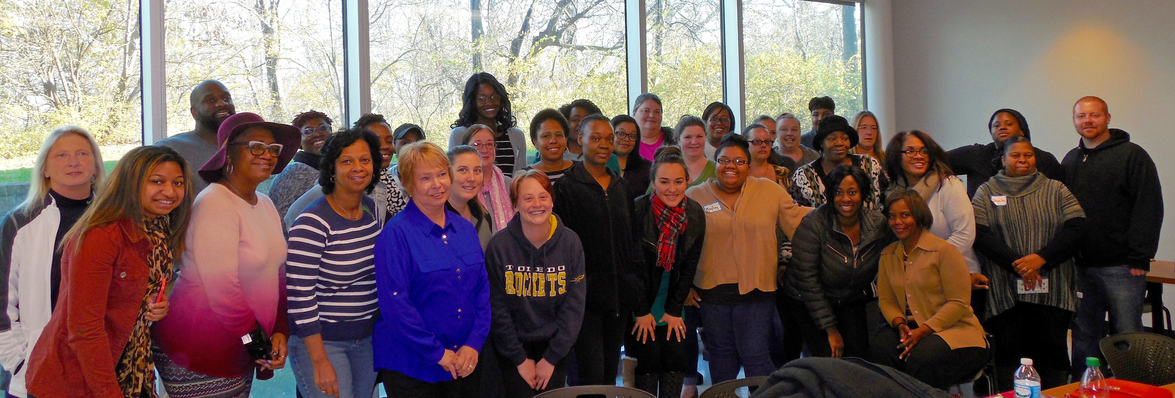
Questions?

