Slide 1
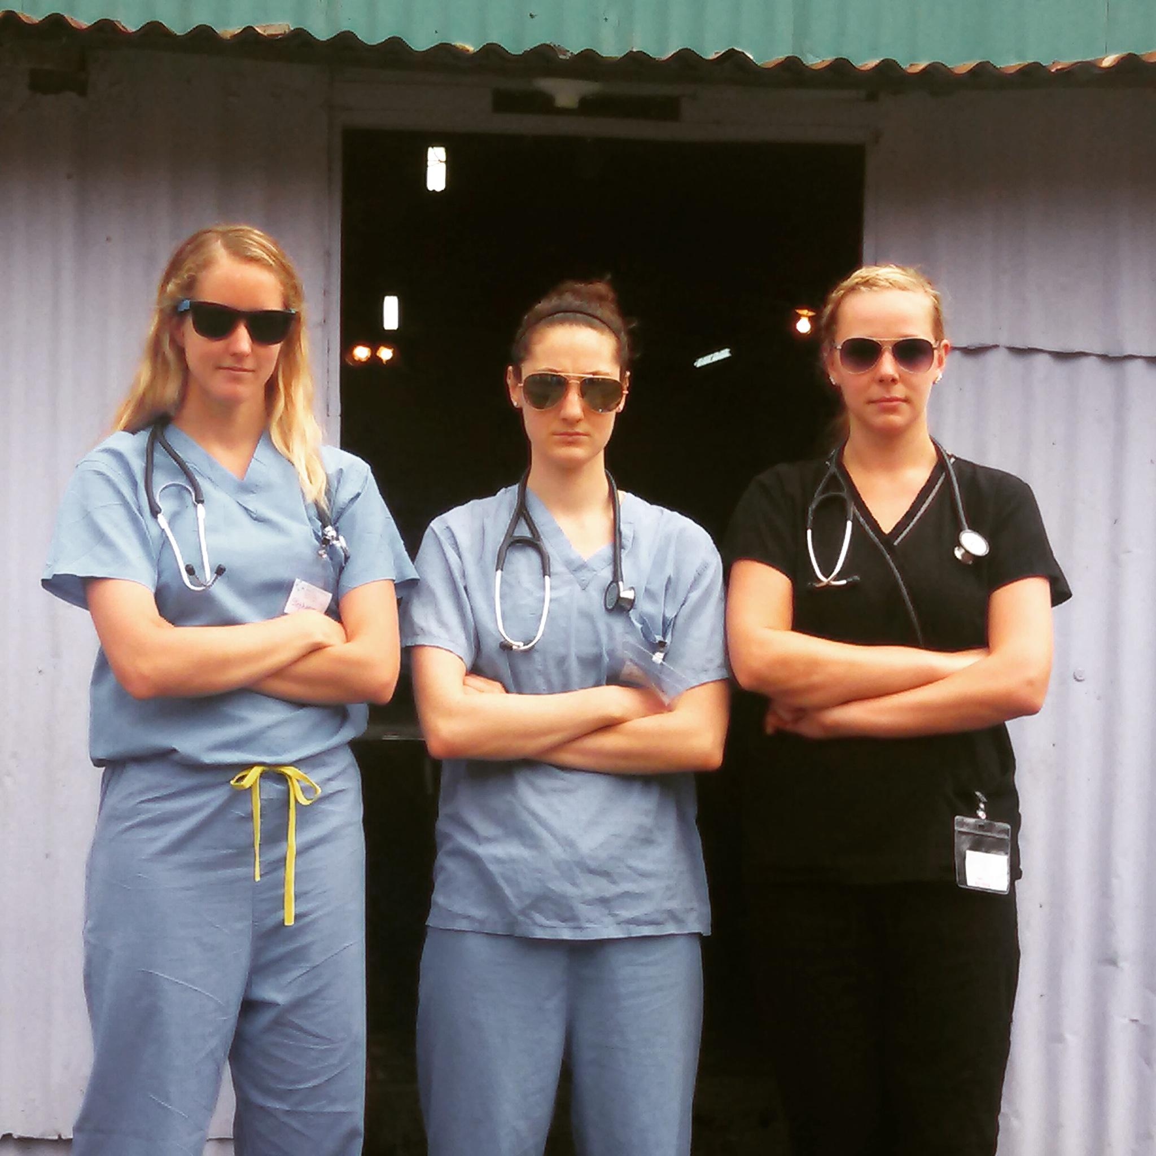
Costa Rica
Rachael Libertin, Casey Smiley, & Steph Welsh

Slide 2

International Service Learning
2 week medical mission trips for students and professionals
Visit ISLonline.org

Slide 3
Logistics
Travel:
Fly Dayton -> Baltimore -> San José
In-country travel provided by ISL buses
Housing:
ISL-owned home in San Jose with camp-style bedrooms
Wifi, hot water, flushing toilets, laundry
Food:
70% ISL provided, 30% restaurants in the local community

Slide 4
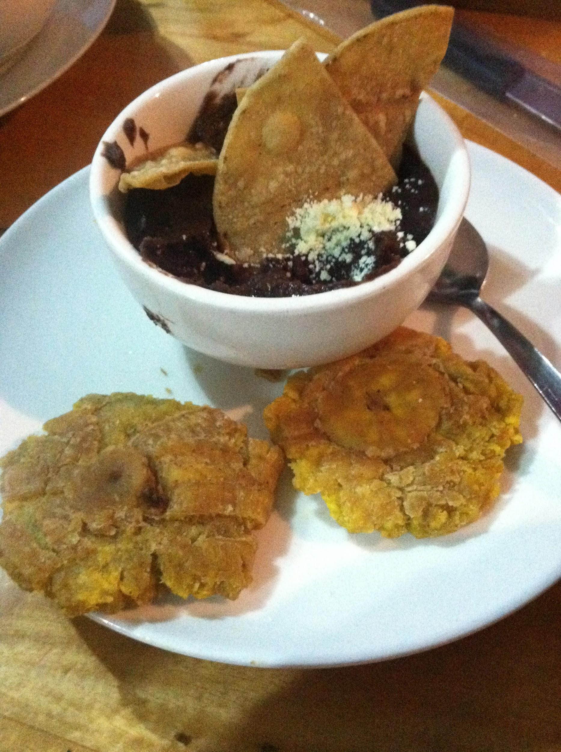
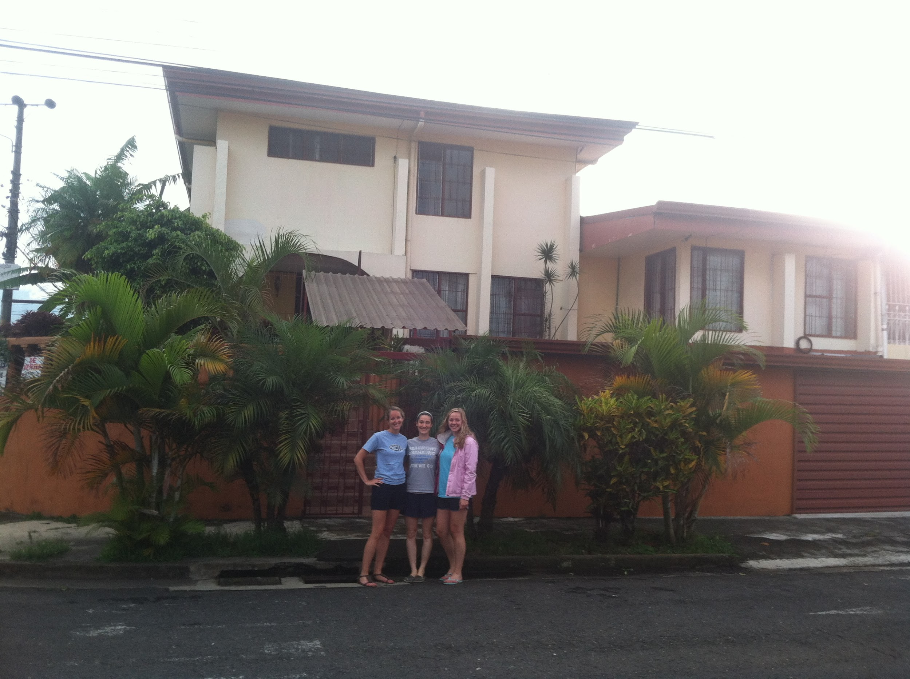
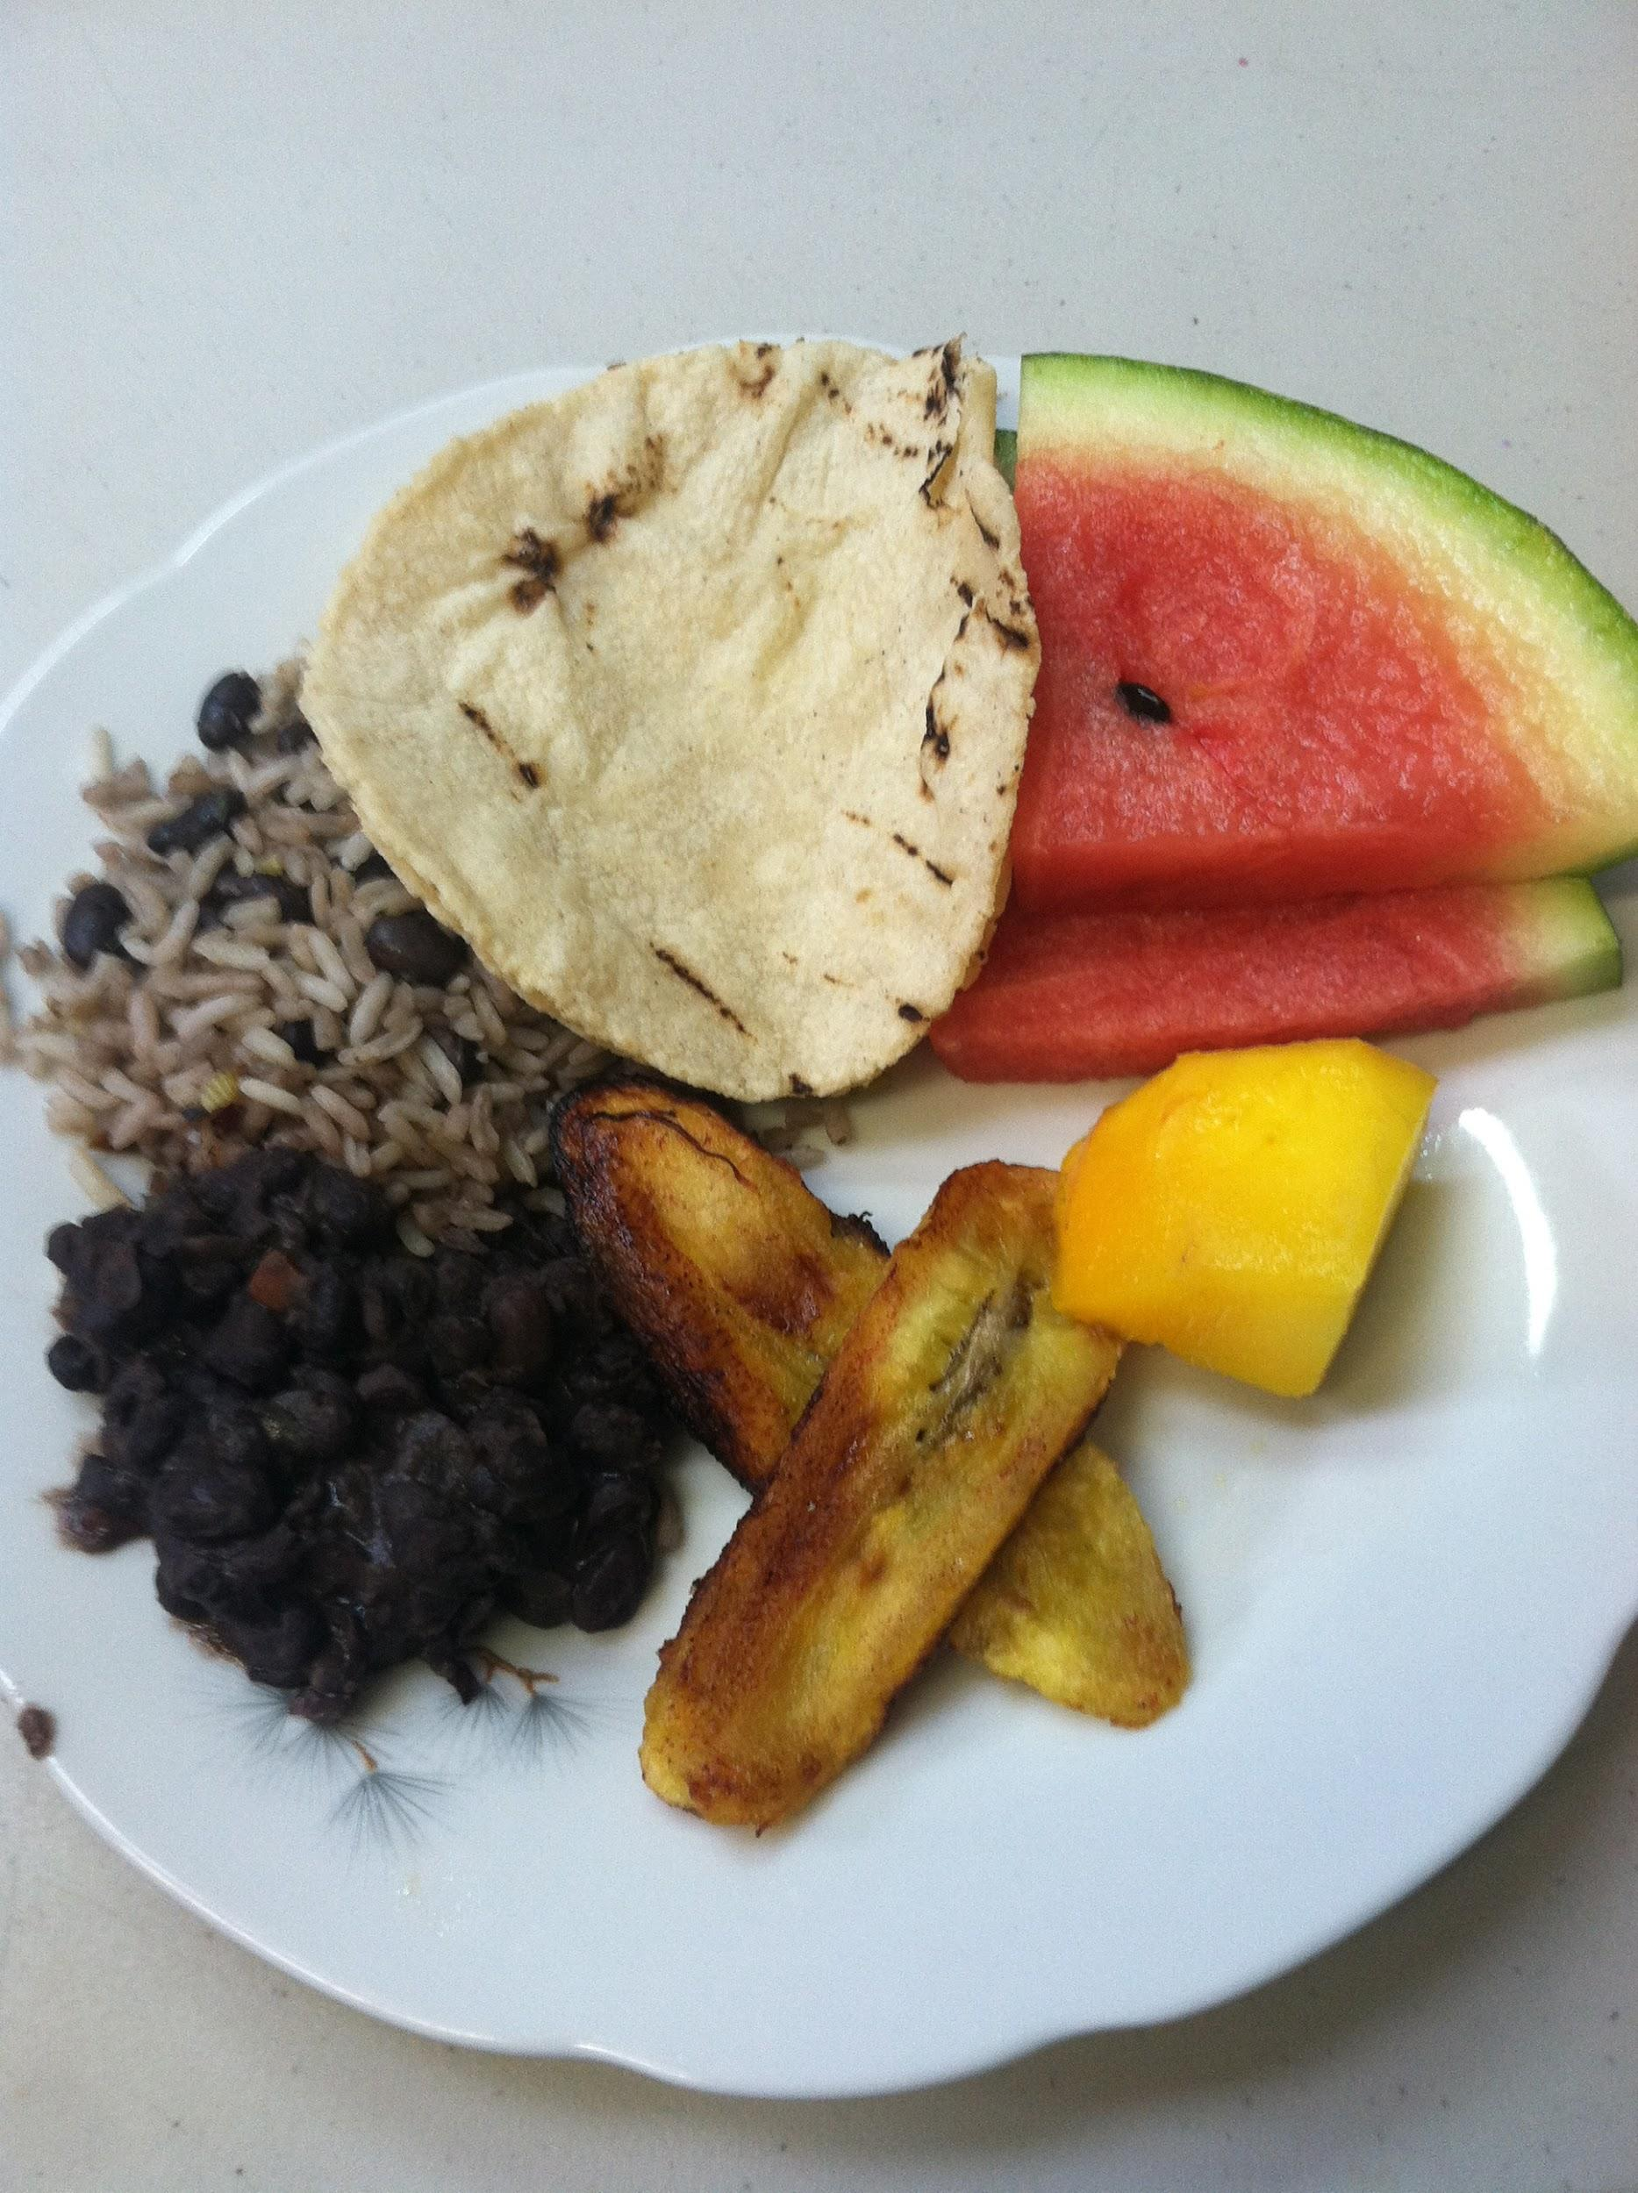
Our ISL home and amazing food!

Slide 5
Clinical Activities
House visits collecting census info + inviting ill household members to clinics
Mobile clinics, students rotating between triage and pharmacy
ISL and visiting physicians supervise
Workshops: suture, injections
Disease presentations

Slide 6
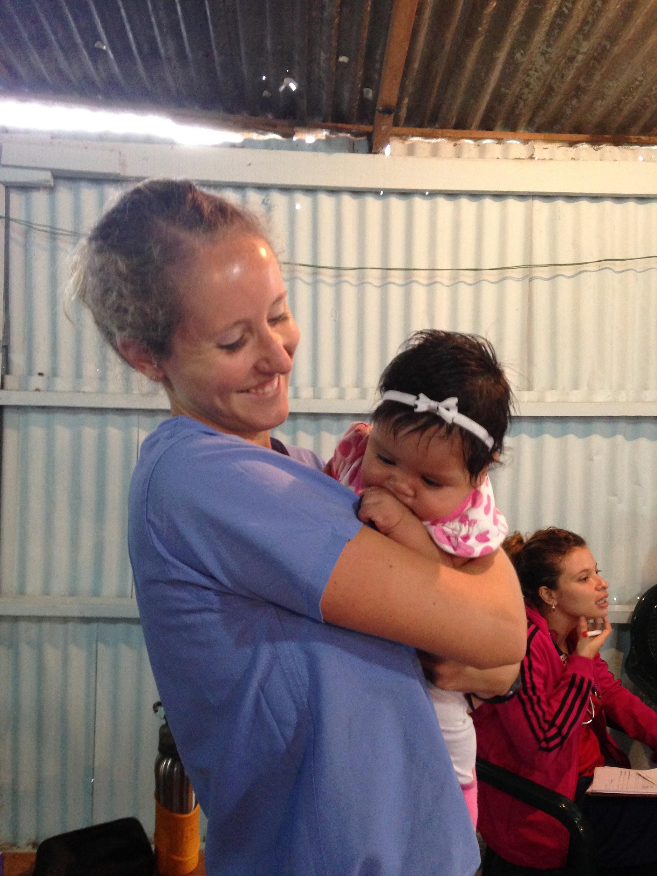
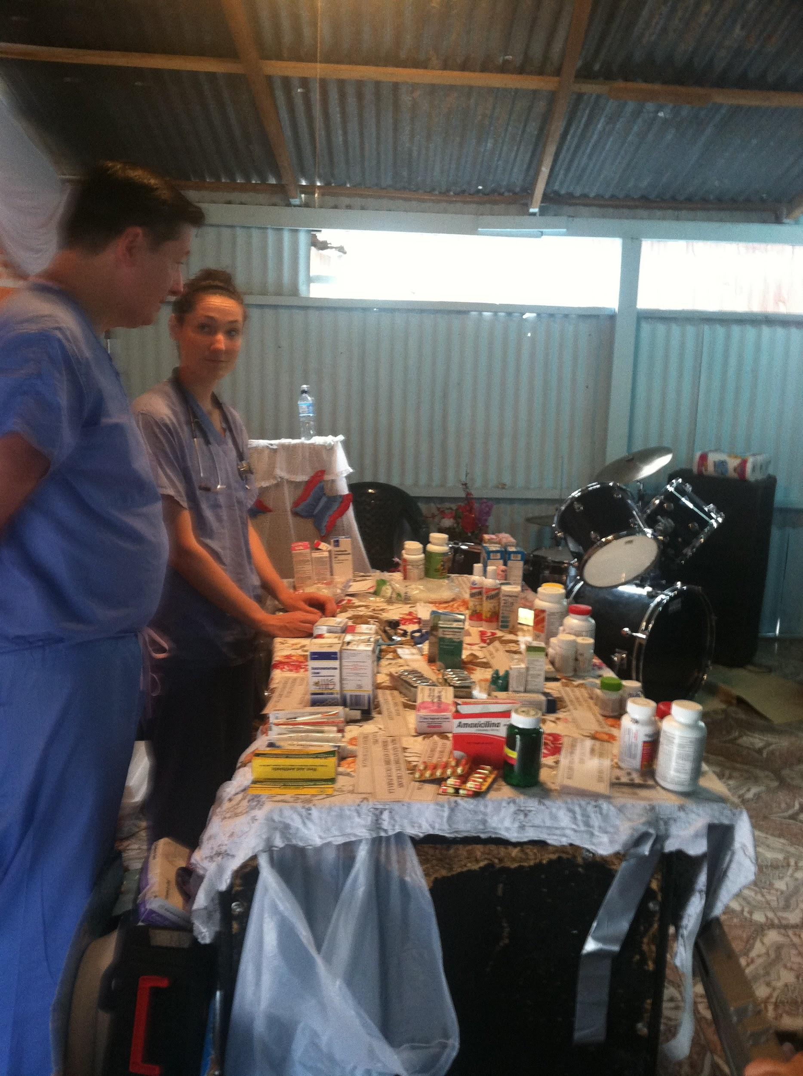
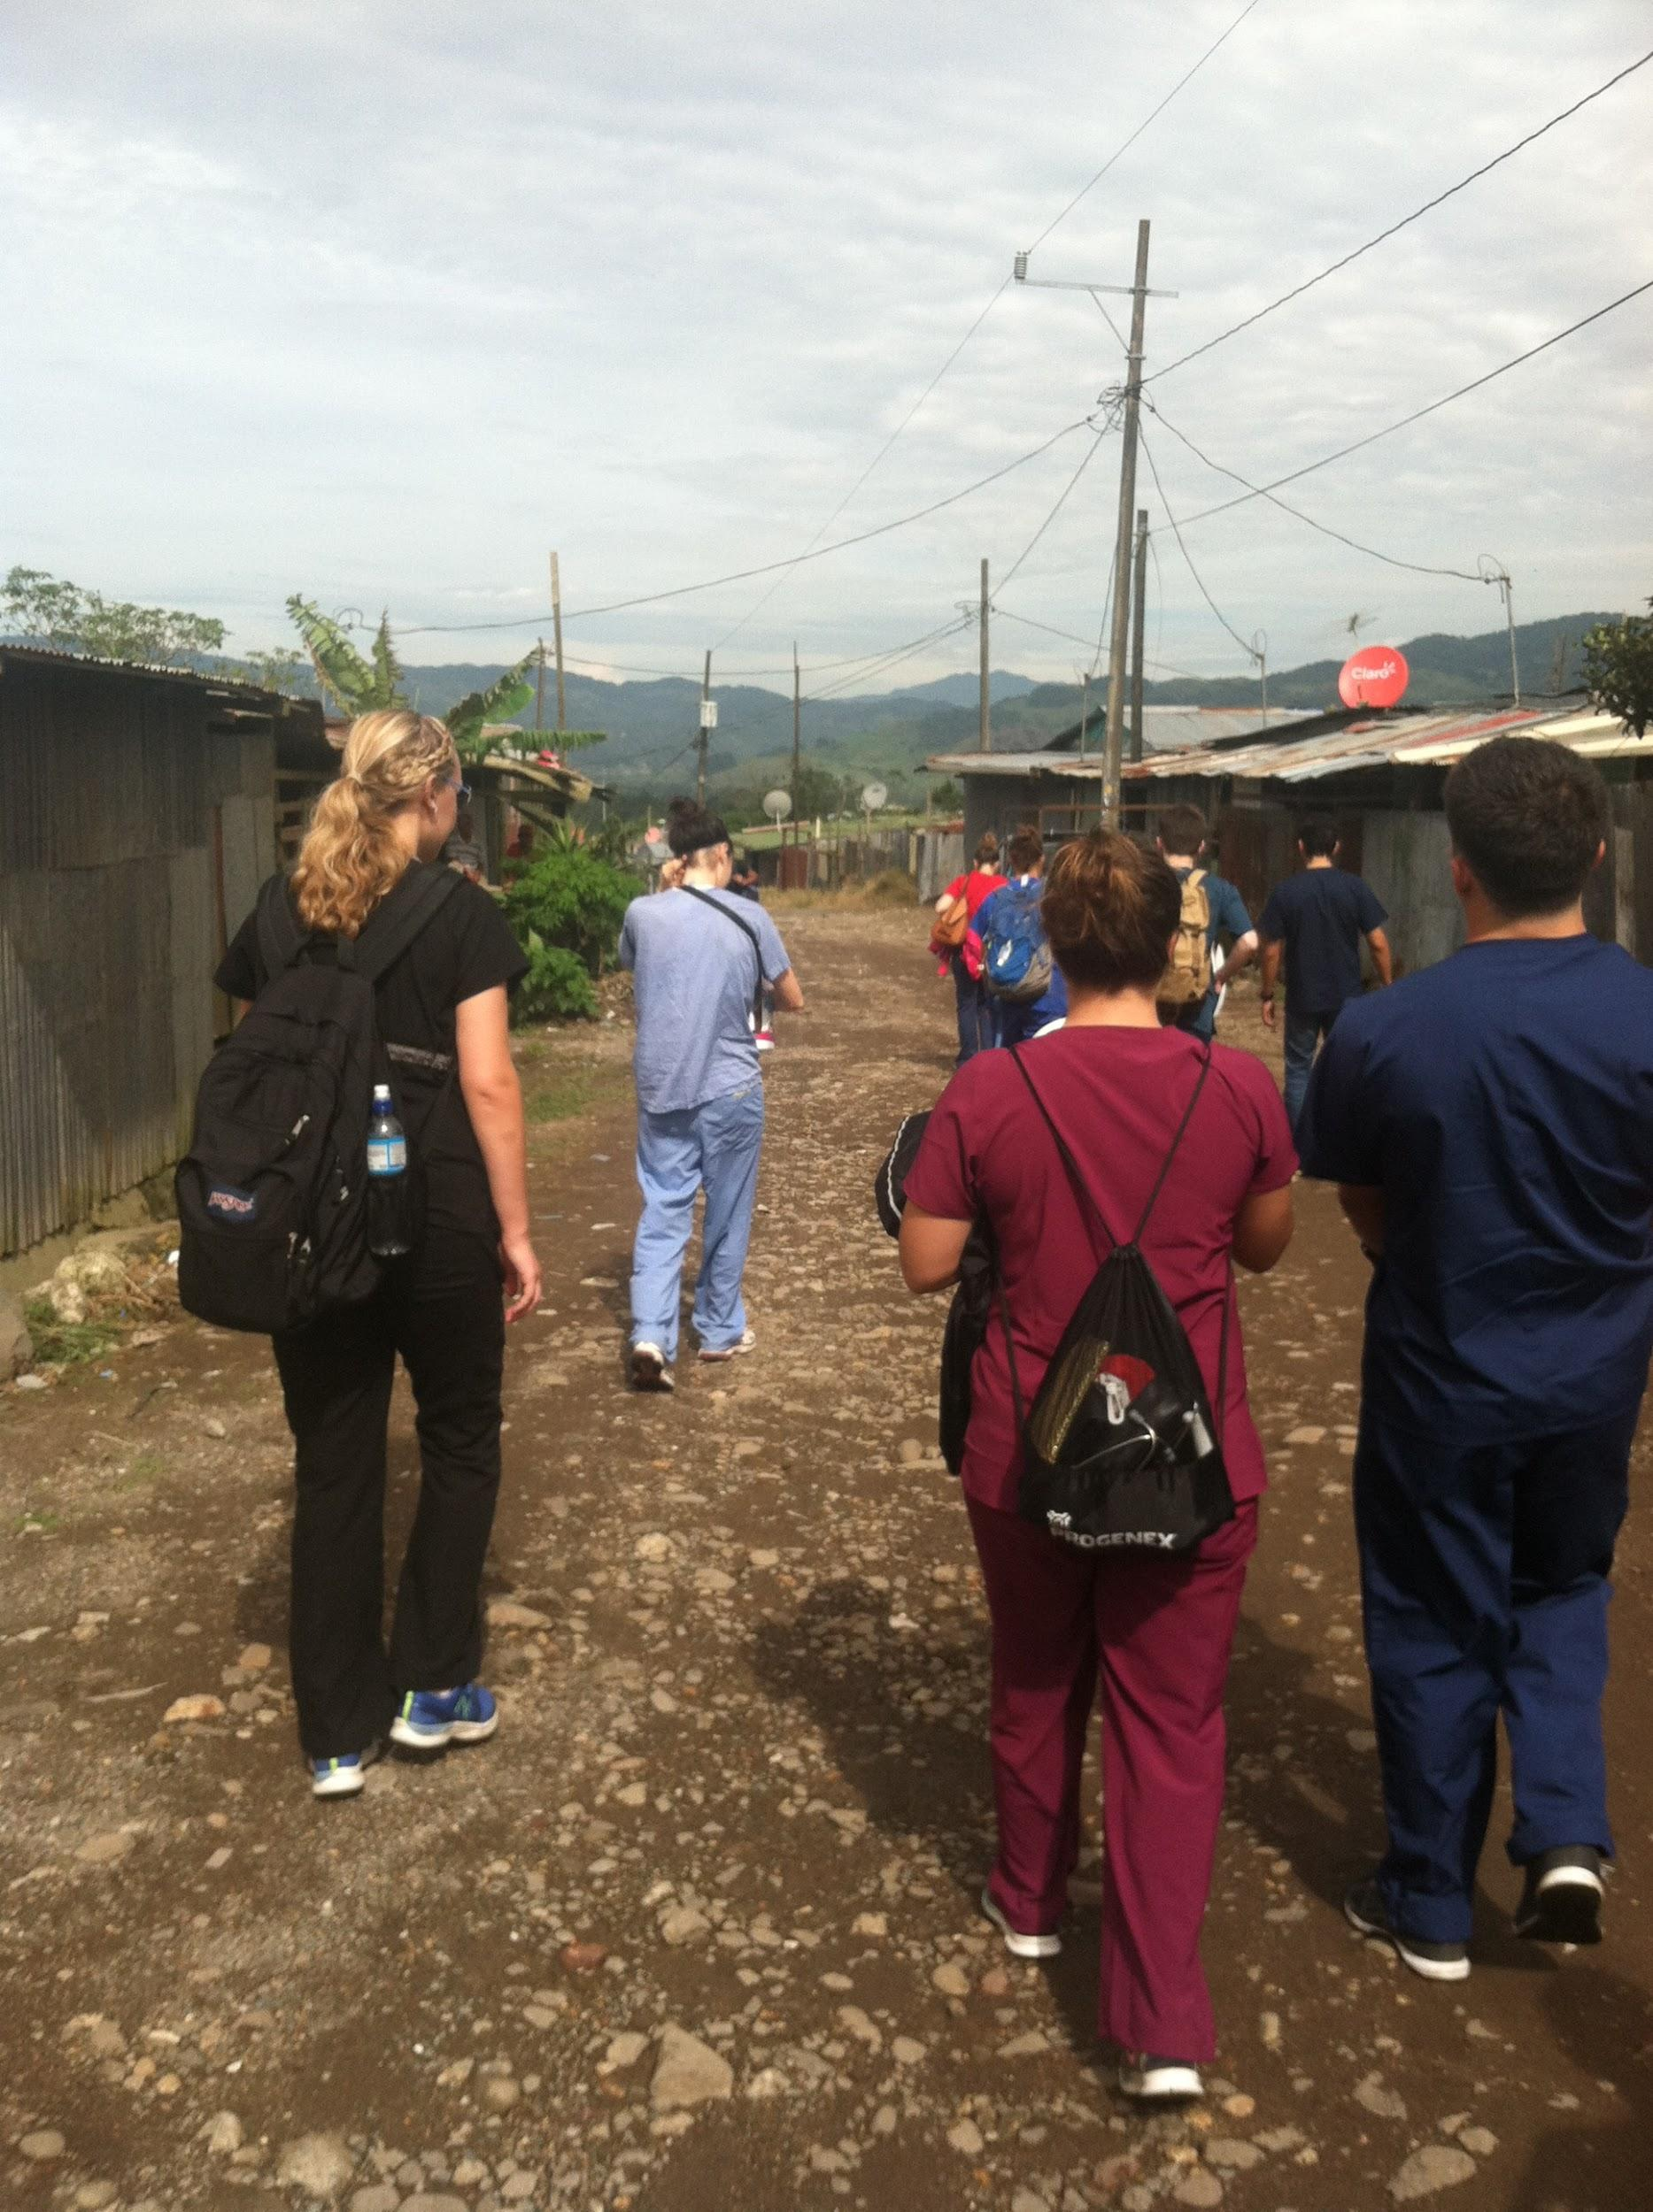
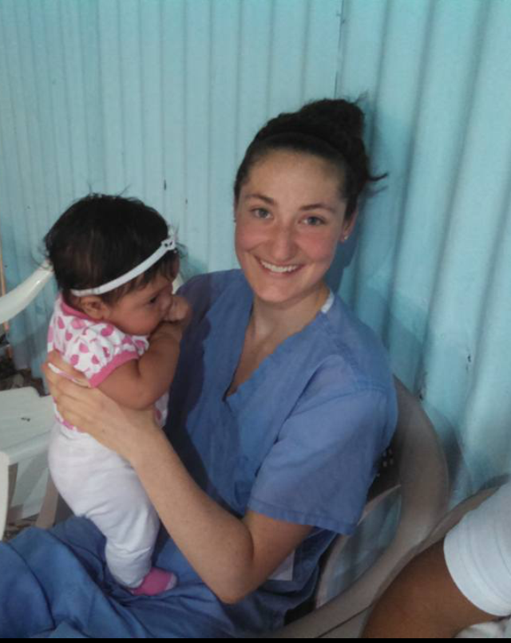
Pharmacy work, house visits, cute baby holding...

Slide 7
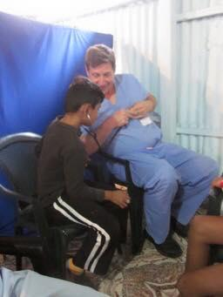
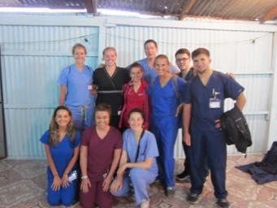
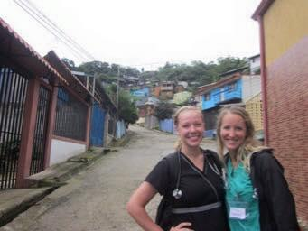
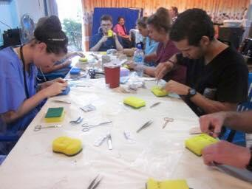
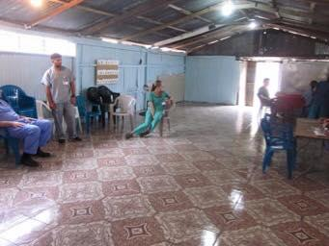
Our volunteer group, suture workshop, our mobile clinic inside a church

Slide 8
Recreational Activities
Tour of San José
Manuel Antonio National Park: beach, jungle with monkeys, sloths
Ziplining through the mountains at Vista de los Sueños
Salsa lesson

Slide 9


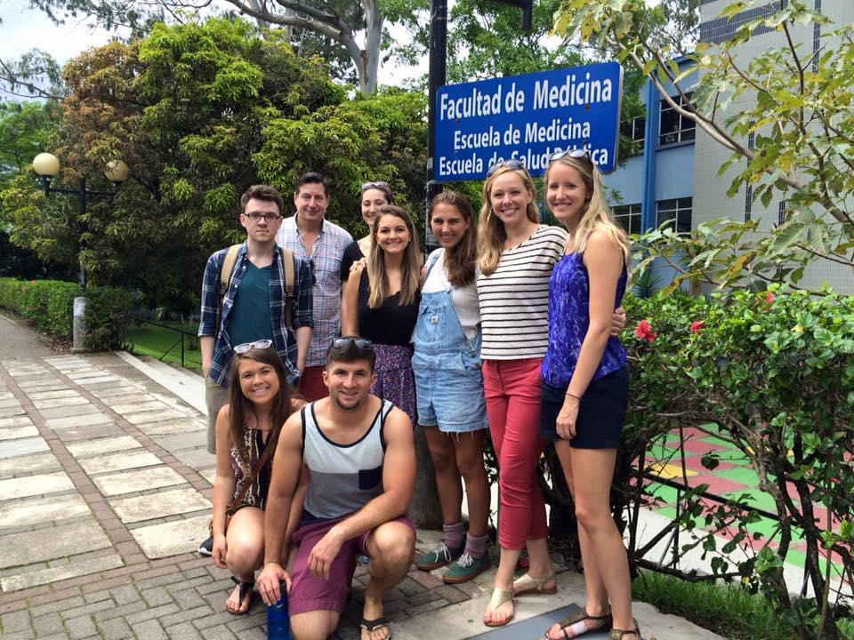

Ziplining and city tour

Slide 10
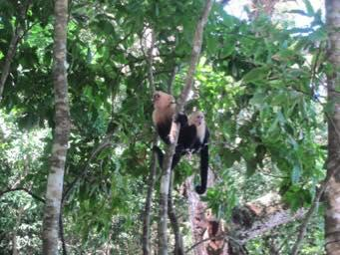
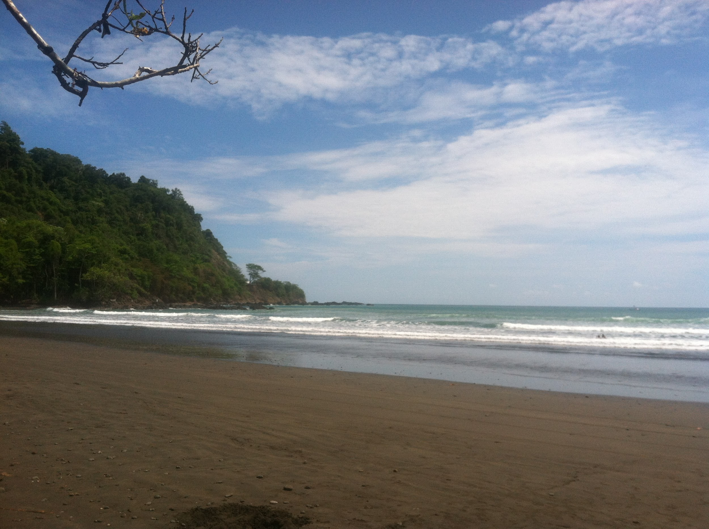
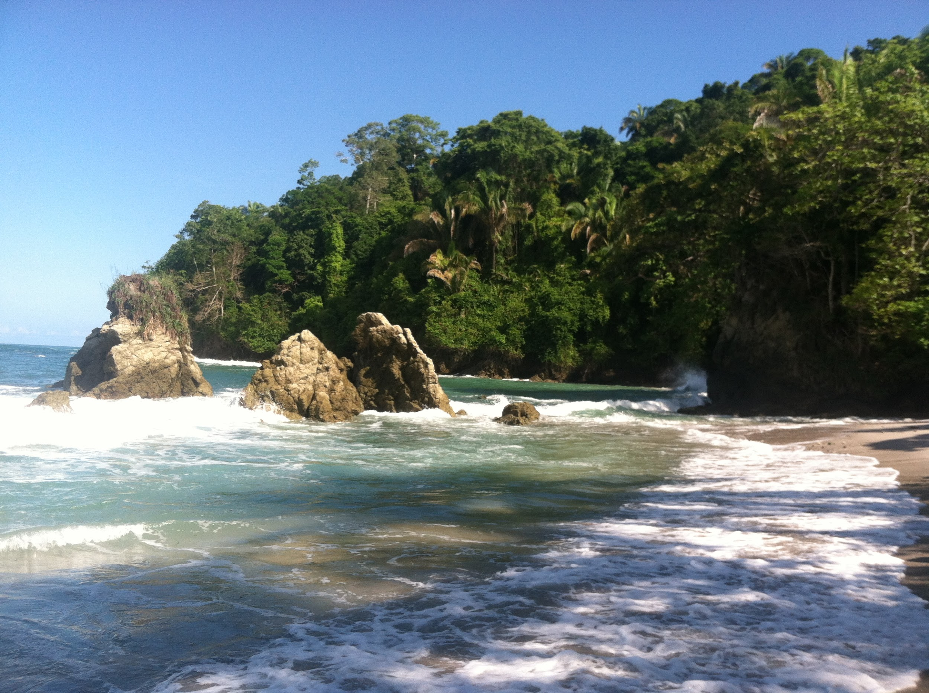
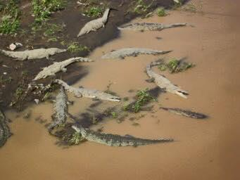
Beaches and animals

Slide 11
What we learned
Ultrastructure of the Costa Rican healthcare system
Opportunity to implement ICM-1 skills (i.e. patient interviews and physical exam skills)
Costa Rican culture: food, history...food.
Common illnesses and diseases

Slide 12
Challenges
Language barrier and medical Spanish
Limited treatment options available: pharmacy supplied with basics only
Staying healthy: watch what you eat and drink!

Slide 13
Advice
Flights: look at several nearby airports and many different airlines; flights were very reasonable
Pack several pairs of scrubs
Bring extra cash
Pack a journal
Bring first aid supplies and GI meds (tums, immodium)

Slide 14
Prices
Flights (Southwest): $700
ISL program: $2000
Non-ISL provided food: $200
Souvenirs and misc.: $200, shop around and haggle!

Slide 15
Contact Us!
Steph: welsh.24@wright.edu
Casey: smiley.21@wright.edu
Rachael: libertin.3@wright.edu

