Slide 1
Genetic Epilepsies and GABA_{A} Receptor Mutations November 17, 2012
Robert L. Macdonald M.D., Ph.D.
Department of Neurology
Vanderbilt University Medical Center

Slide 2
Definitions
Seizures: the clinical manifestations (symptoms and signs) of excessive and/or hypersynchronous, usually self-limited, abnormal activity of neurons.

Slide 3
Definitions
Seizures: the clinical manifestations (symptoms and signs) of excessive and/or hypersynchronous, usually self-limited, abnormal activity of neurons.
Epilepsy: a chronic disorder characterized by recurrent unprovoked seizures.

Slide 4
Etiologies of the epilepsies
Symptomatic (Acquired) Epilepsies
(~50%)
Unknown 15.5%
Idiopathic (Genetic) Epilepsies
(~50%)
Infection 2.5%
Degenerative 3.5%
Cancer 4.1%
Head Injury 5.5%
Congenital
Malformations 8.0%
Hauser
Stroke 10.9%

Slide 5
Idiopathic Epilepsy Syndromes (IES)
Idiopathic Generalized Epilepsies (IGE)
Childhood absence epilepsy (CAE)
Generalized epilepsy with febrile seizures plus (GEFS+)
Juvenile myoclonic epilepsy (JME)
Epilepsy with myoclonic absences
Juvenile absence epilepsy (JAE)
Epilepsy with grand mal (generalized tonic-clonic) seizures on awakening
Benign myoclonic epilepsy in infancy
Idiopathic Focal Epilepsies (IFE)
Benign childhood epilepsy with centrotemporal spikes (BCECTS)
Benign childhood occipital epilepsy (BCOE)
Benign familial neonatal/infantile seizures (BFNS, BFNIS, BFIS)
Autosomal nocturnal frontal lobe epilepsy (ADNFLE)
Epileptic Encephalopathies (EE)
Dravet Syndrome (Severe Myoclonic Epilepsy of Infancy)
Lennox Gastaut Syndrome
Doose Syndrome
Engel, Epilepsia 42:796-803, 2001

Slide 6
Idiopathic Epilepsy Syndromes (IES)
Idiopathic Generalized Epilepsies (IGE)
Childhood absence epilepsy (CAE)
Generalized epilepsy with febrile seizures plus (GEFS+)
Juvenile myoclonic epilepsy (JME)
Epilepsy with myoclonic absences
Juvenile absence epilepsy (JAE)
Epilepsy with grand mal (generalized tonic-clonic) seizures on awakening
Benign myoclonic epilepsy in infancy
Idiopathic Focal Epilepsies (IFE)
Benign childhood epilepsy with centrotemporal spikes (BCECTS)
Benign childhood occipital epilepsy (BCOE)
Benign familial neonatal/infantile seizures (BFNS, BFNIS, BFIS)
Autosomal nocturnal frontal lobe epilepsy (ADNFLE)
Epileptic Encephalopathies (EE)
Dravet Syndrome (Severe Myoclonic Epilepsy of Infancy)
Lennox Gastaut Syndrome
Doose Syndrome
Engel, Epilepsia 42:796-803, 2001

Slide 7
IGEs
IGEs have been associated primarily with ion channel mutations/variants.
IGEs have genetic components that include:
fully penetrant monogenetic alleles and less penetrant alleles of large effect (<2%)
rare polygenetic alleles of small effect (>98%)

Slide 8
IGEs
IGEs have been associated primarily with ion channel mutations/variants.
IGEs have genetic components that include:
fully penetrant monogenetic alleles and less penetrant alleles of large effect (<2%)
rare polygenetic alleles of small effect (>98%)

Slide 9
IGEs
IGEs have been associated primarily with ion channel mutations/variants.
IGEs have genetic components that include:
fully penetrant monogenetic alleles and less penetrant alleles of large effect (<2%)
rare polygenetic alleles of small effect (>98%)

Slide 10
Ion channel human epilepsy (hEP) genes
Cholinergic Receptor Genes
CHRNA2
CHRNA4
CHRNB2
Chloride Channel Genes
CLCN2
GABA_{A} Receptor Genes
GABRA1
GABRB3
GABRG2
Voltage-gated Potassium Channel Genes
KCNA1
KCNQ2
KCNQ3
Potassium Inwardly Rectifying Channel Genes
KCNJ11
KCNJ6
Calcium Activated Potassium Channel Genes
KCNMA1
Voltage-gated Sodium Channel Genes
SCN1A
SCN1B
SCN2A2
Voltage-gated Calcium Channel Genes
CACNA1A
Klassen et al., Cell 24;145:1036-48 ,2011

Slide 11
GABA_{A} receptor subunit genes
GABA_{A} Receptor Genes (19)
GABRA1-6
GABRB1-3
GABRG1-3
GABRD
GABRE
GABRP
GABRQ
GABRR1-3
GABA_{A} Receptor hEP Genes (3)
GABRA1
GABRB3
GABRG2

Slide 12
GABA_{A} receptor subunits
Mature Peptide
Signal Peptide
γ2
Extracellular
Extracellular
Cell membrane
M1
M2
M3
M4
Cell Membrane
Intracellular
Intracellular
Subunits
α
β
γ
δ
ε
π
θ
ρ
Subtypes
6
3
3
1
1
1
1
3

Slide 13
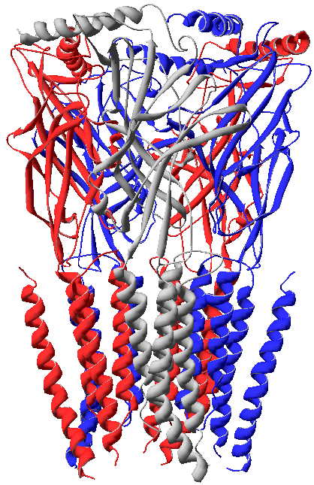
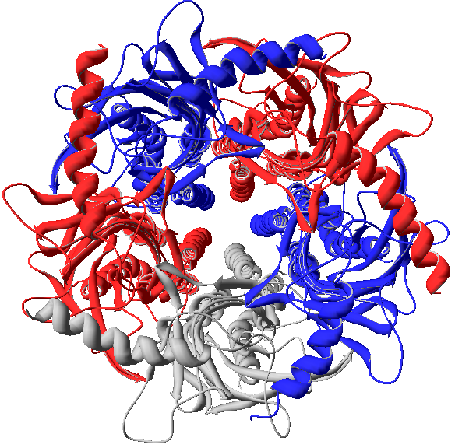
GABA_{A} receptors are heteropentamers.
γ2
β3
-
-
+
α1
+
Extracellular
α1
Cell Membrane
α1
β3
γ2
β3
Intracellular
γ2

Slide 14
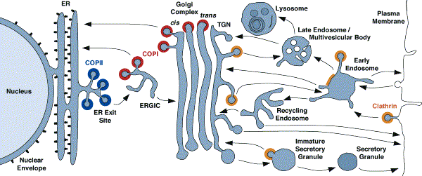
GABA_{A} receptor biogenesis
subunit gene transcription
subunit biogenesis
receptor assembly/trafficking
receptor channel function
x
Xxxxxxxxxxxxxxx xxxxxxxxxxxxxxxxxxx
x
xxxxxxxxxxxxxxx

Slide 15
GABR human epilepsy genes
Genetic epilepsies have been associated with 20 mutations in human epilepsy GABR genes and variants.
Epilepsy mutations have been shown to impair:
subunit gene transcription ([1]reduced promoter function)
subunit biogenesis (degraded subunit [2]mRNA or [3]protein)
receptor assembly/trafficking (ER retention due to [4]subunit truncation with a dominant negative effect or [5]impaired subunit oligomerization)
receptor channel function ([6]impaired channel gating).
Epilepsy mutations have been classified into these 6 mechanistic classes.

Slide 16
Defects in mutant GABA_{A} receptor biogenesis or function
Class I (promoter) Mutations:
Reduced subunit due to impaired transcription
β3(-897 T/C) CAE
x
Xxxxxxxxxxxxxxx xxxxxxxxxxxxxxxxxxx
x
xxxxxxxxxxxxxxx

Slide 17
Defects in mutant GABA_{A} receptor biogenesis or function
Class I (promoter) Mutations:
Reduced subunit due to impaired transcription
β3(-897 T/C) CAE
Class II (early exon nonsense) Mutations:
Impaired translation (NMD) of truncated subunits
γ2(Q40X) FS, GEFS+; γ2(IVS6+2T->G) CAE, FS;
γ2(R136X) CAE, FS; α1(975delC, S326fs328X) CAE
x
Xxxxxxxxxxxxxxx xxxxxxxxxxxxxxxxxxx
x
xxxxxxxxxxxxxxx

Slide 18
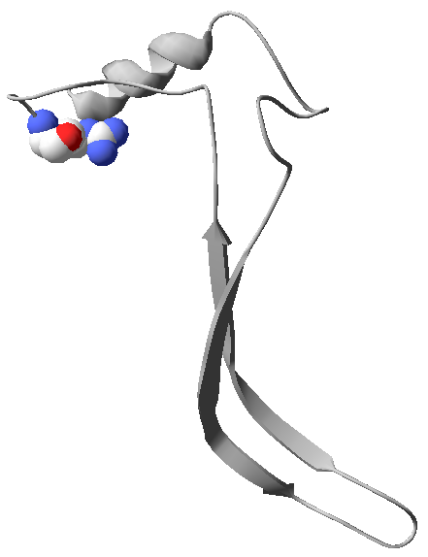
GABR IGE nonsense mutations: early exons
γ2(Q40X)*
γ2(R136X)
γ2(IVS6+2T→G)
α1(S326fs328X)
N-terminal
Q40X
FS,GEFS+
Hirose et al., 2004
TMs
R136X
FS
Johnston et al., submitted
IVS6+2T->G
AD CAE & FS, DS
Kananura et al., 2002
ITD
975delC, S326fs328X
AD CAE
Maljevic et al., 2006
*aa position in the immature peptide
Notes:
For γ2(IVS6+2T→G), the modeling is predicting a short α-helix that is inserted on the membrane as a novel TM1 (in red). Note that there is not C-tail following TM4 in the γ2wt subunit (in black).

Slide 19
ER Quality Control Nonsense-Mediated mRNA Decay (NMD)
Start codon mRNA Stop codon
3’-most exon-exon junction
During the first (pioneer) round of translation, NMD degrades mRNAs with PTCs >50-55 bp upstream of an exon-exon junction to prevent translation of truncated proteins that could have deleterious actions.
Notes:
Nonsense-mediated mRNA decay (NMD) factors have multiple functions. (a) RNA splicing recruits NMD factors to exon–exon junctions, which promote robust
translation. (b) Without introns, there is no recruitment of NMD factors, and translation is weak. (c) If NMD factors are knocked out or prevented from being recruited, stop
codons are sometimes ignored, this leads to the production of C-terminally extended proteins. (d) The presence of a premature stop codon (signal 1) in conjunction with a
downstream NMD factor (signal 2) leads to RNA decay.

Slide 20
Defects in mutant GABA_{A} receptor biogenesis or function
Class I (promoter) Mutations:
Reduced subunit due to impaired transcription
β3(-897 T/C) CAE
Class II (early exon nonsense) Mutations:
Impaired translation (NMD) of truncated subunits
γ2(Q40X) FS, GEFS+; γ2(IVS6+2T->G) CAE, FS;
γ2(R136X) CAE, FS; α1(975delC, S326fs328X) CAE
x
Xxxxxxxxxxxxxxx xxxxxxxxxxxxxxxxxxx
x
xxxxxxxxxxxxxxx
Class III (missense) Mutations:
Subunit misfolded and degraded (ERAD)
α1(A322D) JME

Slide 21
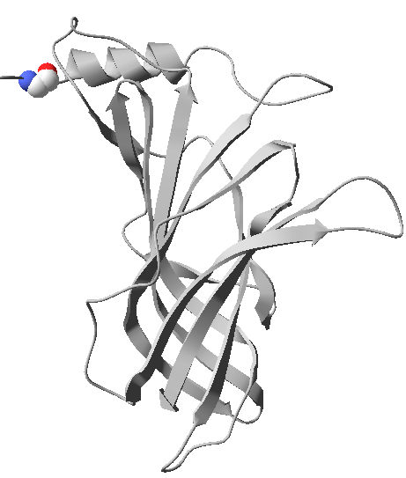
GABR IGE missense epilepsy mutations
α1 Subunit
β3 Subunit
γ2 Subunit
δ Subunit
N-terminus
TMD
A322D
AD JME
Cossette et al., 2002
ITD
Hernandez and Macdonald, unpublished

Slide 22
ER Quality Control ER associated degradation (ERAD)
ER
UPS
Meusser et al., Nature Cell Biology 7:766, 2005

Slide 23
Defects in mutant GABA_{A} receptor biogenesis or function
Class I (promoter) Mutations:
Reduced subunit due to impaired transcription
β3(-897 T/C) CAE
Class IV (last exon nonsense) Mutations:
ER retention of truncated subunits, with dominant negative effect
γ2(Q390X) GEFS+
γ2(W429X) GEFS+
γ2(S443delC) GEFS+
α1(K353delins18X) GTCS
Class II (early exon nonsense) Mutations:
Impaired translation (NMD) of truncated subunits
γ2(Q40X) FS, GEFS+; γ2(IVS6+2T->G) CAE, FS;
γ2(R136X) CAE, FS; α1(975delC, S326fs328X) CAE
x
Xxxxxxxxxxxxxxx xxxxxxxxxxxxxxxxxxx
x
xxxxxxxxxxxxxxx
Class III (missense) Mutations:
Subunit misfolded and degraded (ERAD)
α1(A322D) JME

Slide 24
GABR IGE nonsense mutations: last exon
γ2(Q390X)
γ2(W429X)
γ2(S443delC)
α1(K353delins18X)
N-terminal
TMs
ITD
Q390X
AD GEFS+
Harkin et al., 2002
W429X
AD GEFS+
Sun et al., 2008
S443delC
GEFS+
Tian et al., in press
K353delins18X
GTCS
Lachance-Touchette et al., 2011
Notes:
These are the new models for Q290x and W429x, where Q390 is predicted to be more disordered than W429 as confirmed by PrDOS (Protein DisOrder prediction System). For γ2S443delC, the modeling is predicting an α-helix that is inserted on the membrane as a novel TM4 with a long extracellular C-tail (in red). Note that there is not C-tail following TM4 in the γ2wt subunit (in black).

Slide 25
Defects in mutant GABA_{A} receptor biogenesis or function
Class I (promoter) Mutations:
Reduced subunit due to impaired transcription
β3(-897 T/C) CAE
Class IV (last exon nonsense) Mutations:
ER retention of truncated subunits, with dominant negative effect
γ2(Q390X) GEFS+
γ2(W429X) GEFS+
γ2(S443delC) GEFS+
α1(K353delins18X) GTCS
Class II (early exon nonsense) Mutations:
Impaired translation (NMD) of truncated subunits
γ2(Q40X) FS, GEFS+; γ2(IVS6+2T->G) CAE, FS;
γ2(R136X) CAE, FS; α1(975delC, S326fs328X) CAE
x
Xxxxxxxxxxxxxxx xxxxxxxxxxxxxxxxxxx
x
xxxxxxxxxxxxxxx
Class III (missense) Mutations:
Subunit misfolded and degraded (ERAD)
α1(A322D) JME
Class V (missense) Mutations:
ER retention with impaired subunit oligomerization
α1β2γ2(R82Q) CAE/FS, α1β2γ2(P83S) FS
α1β2γ2(D219N) FS +/- GTCS, CAE
α1β2γ2(R177G) FS
α1β2β3(P11S, S15F, G32R)? CAE

Slide 26
GABR IGE missense epilepsy mutations
α1 Subunit
β3 Subunit
γ2 Subunit
δ Subunit
N-terminus
P11S
N79S GTCS
Sh i et al., 2010
R82Q AD CAE/FS
Wallace et al., 2001
S15F
P83S FS, CAE
Lachance-Touchette et al., 2011
G32R
CAE
Tanaka et al., 2008
R177G
AD FS
Audenaert et al., 2006
D219N
FS +/- GTCS
Lachance-Touchette et al., 2011
TMD
A322D
AD JME
Cossette et al., 2002
ITD
Hernandez and Macdonald, unpublished

Slide 27
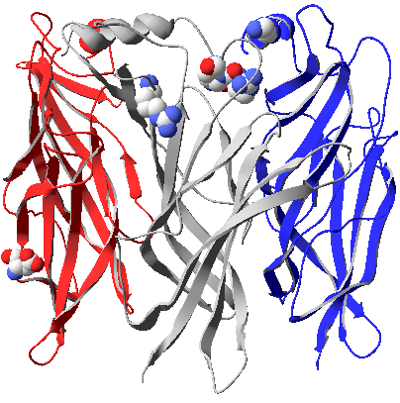
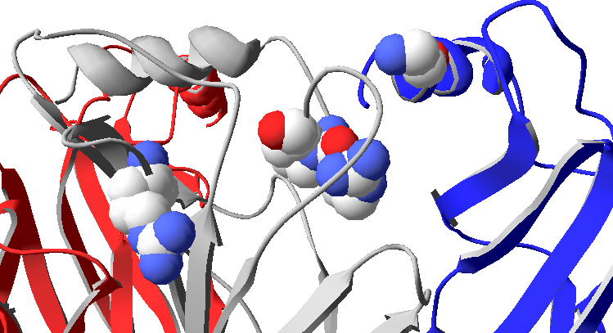
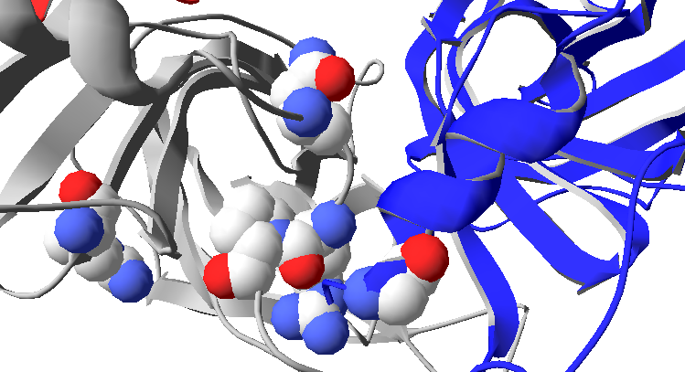
The γ2 (N79S, R82Q, P83S, R177G) and β3(G32R) subunit mutations are at subunit-subunit interfaces.
N79S
G32R
G32R
P83S
P83S
N79S
R82Q
R177G
R82Q
R177G
α1+
γ2-
γ2+
β3-
α1
γ2
β3
N79S
N79S
P83S
R177G
G32R
R177G
G32
P83S
R82Q
R82Q
α1+
γ2-
γ2+
β3-
Hernandez and Macdonald, unpublished

Slide 28
Defects in mutant GABA_{A} receptor biogenesis or function
Class I (promoter) Mutations:
Reduced subunit due to impaired transcription
β3(-897 T/C) CAE
Class III (last exon nonsense) Mutations:
ER retention of truncated subunits, with or without dominant negative effect
γ2(Q390X) GEFS+
γ2(W429X) GEFS+
γ2(S443delC) GEFS+
α1(K353delins18X) GTCS
Class II (early exon nonsense) Mutations:
Impaired translation (NMD) of truncated subunits
γ2(Q40X) FS, GEFS+; γ2(IVS6+2T->G) CAE, FS;
γ2(R136X) CAE, FS; α1(975delC, S326fs328X) CAE
x
Xxxxxxxxxxxxxxx xxxxxxxxxxxxxxxxxxx
x
xxxxxxxxxxxxxxx
Class IV (missense) Mutations:
Subunit misfolded and degraded (ERAD)
α1(A322D) JME
Class V (missense) Mutations:
ER retention with impaired subunit oligomerization
α1β2γ2(R82Q) CAE/FS, α1β2γ2(P83S) FS
α1β2γ2(D219N) FS +/- GTCS, CAE
α1β2γ2(R177G) FS
α1β2β3(P11S, S15F, G32R)? CAE
Class VI (missense) Mutations:
Impaired surface receptor function
α1β2γ2(K328M) GEFS+
α1β2δ(E177A) GEFS+
α1β2δ(R220H) GEFS+

Slide 29
GABR IGE missense epilepsy mutations
α1 Subunit
β3 Subunit
γ2 Subunit
δ Subunit
N-terminus
P11S
N79S GTCS
Sh i et al., 2010
R82Q AD CAE/FS
Wallace et al., 2001
S15F
P83S FS, CAE
Lachance-Touchette et al., 2011
G32R
CAE
Tanaka et al., 2008
R177G
AD FS
Audenaert et al., 2006
D219N
FS +/- GTCS
Lachance-Touchette et al., 2011
E177A
R220H, R220C
AD GEFS+
Dibbens et al., 2004
TMD
K328M
AD GEFS+
Baulac et al., 2001
A322D
AD JME
Cossette et al., 2002
ITD
Hernandez and Macdonald, unpublished

Slide 30
Mutation-specific therapies for IGEs associated with GABA_{A} receptor mutations.
Class I therapy (Reduced subunit due to impaired transcription)
Use specific transcriptional activators to increase gene transcription.
Class II therapy (Reduced subunit due to impaired translation (NMD))
Use aminoglycoside antibiotics, or related drugs, to suppress PTCs by enabling amino acid incorporation (read-through), thus permitting translation to continue until the normal termination of the transcript.
Class III therapy (Subunit misfolded and degraded by ERAD)
Up regulate wild type or replace mutant subunits – “gene therapy”.

Slide 31
Mutation-specific therapies for IGEs associated with GABA_{A} receptor mutations.
Class I therapy (Reduced subunit due to impaired transcription)
Use specific transcriptional activators to increase gene transcription.
Class II therapy (Reduced subunit due to impaired translation (NMD))
Use aminoglycoside antibiotics, or related drugs, to suppress PTCs by enabling amino acid incorporation (read-through), thus permitting translation to continue until the normal termination of the transcript.
Class III therapy (Subunit misfolded and degraded by ERAD)
Up regulate wild type or replace mutant subunits – “gene therapy”.

Slide 32
Mutation-specific therapies for IGEs associated with GABA_{A} receptor mutations.
Class I therapy (Reduced subunit due to impaired transcription)
Use specific transcriptional activators to increase gene transcription.
Class II therapy (Reduced subunit due to impaired translation (NMD))
Use aminoglycoside antibiotics, or related drugs, to suppress PTCs by enabling amino acid incorporation (read-through), thus permitting translation to continue until the normal termination of the transcript.
Class III therapy (Subunit misfolded and degraded by ERAD)
Up regulate wild type or replace mutant subunits – “gene therapy”.

Slide 33
Mutation-specific therapies for IGEs associated with GABA_{A} receptor mutations.
Class IV therapy (Subunit truncated with or without dominant negative effect)
Use aminoglycoside antibiotics or other drugs to promote read-through.
Knock-down dominant negative gene – viral delivery of an siRNA?
Class V therapy (ER retention with impaired subunit oligomerization)
Use pharmacological chaperones (correctors) to stabilize protein structure and promote folding and assembly, enabling surface expression of functional mutant receptors.
Class VI therapy (Impaired surface receptor function)
Use specific or nonspecific GABA_{A} receptor positive allosteric modulators to enhance current (channel ‘potentiators’).

Slide 34
Mutation-specific therapies for IGEs associated with GABA_{A} receptor mutations.
Class IV therapy (Subunit truncated with or without dominant negative effect)
Use aminoglycoside antibiotics or other drugs to promote read-through.
Knock-down dominant negative gene – viral delivery of an siRNA?
Class V therapy (ER retention with impaired subunit oligomerization)
Use pharmacological chaperones (correctors) to stabilize protein structure and promote folding and assembly, enabling surface expression of functional mutant receptors.
Class VI therapy (Impaired surface receptor function)
Use specific or nonspecific GABA_{A} receptor positive allosteric modulators to enhance current (channel ‘potentiators’).

Slide 35
Mutation-specific therapies for IGEs associated with GABA_{A} receptor mutations.
Class IV therapy (Subunit truncated with or without dominant negative effect)
Use aminoglycoside antibiotics or other drugs to promote read-through.
Knock-down dominant negative gene – viral delivery of an siRNA?
Class V therapy (ER retention with impaired subunit oligomerization)
Use pharmacological chaperones (correctors) to stabilize protein structure and promote folding and assembly, enabling surface expression of functional mutant receptors.
Class VI therapy (Impaired surface receptor function)
Use specific or nonspecific GABA_{A} receptor positive allosteric modulators to enhance current (channel ‘potentiators’).

Slide 36
IGEs
IGEs have been associated primarily with ion channel mutations
IGEs genetic components include:
fully penetrant monogenetic alleles less penetrant alleles of large effect (~2%)
polygenetic alleles of small effect (>95%)

Slide 37
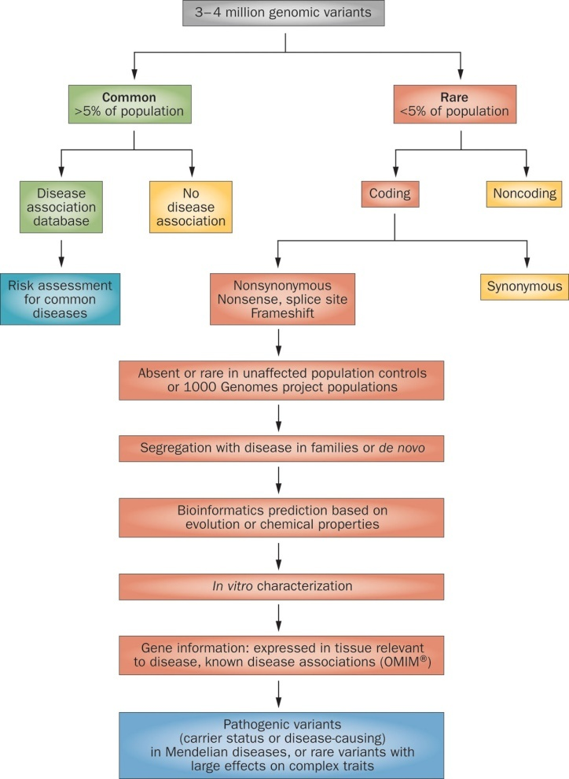
Steps in filtering genomic variants for identification of Mendelian disease mutations or rare variants
Premise is that one or multiple nsSNPs in one or more excitability gene confers additive risk for IGE
Foo, J.-N. et al. Nat. Rev. Neurol. 8:508, 2012

Slide 38
Whole exome sequencing: single nucleotide polymorphisms (SNPs) in ion channel genes (237) in IGE cases (152) and controls (139)
 |  |  |  | Number of Validated SNPs/Megabases Sequenced
Type/Location of SNP | Number of Validated SNPs | Percent of Validated Data Set | Number of Novel SNPs Discovered | Cases Only (n = 152) | Controls Only (n = 139) | SNPs in Both (n = 291)
Promoter | 80 | 2.6 | 18 | 0.4 | 0.1 | 0.4
5′ UTR | 79 | 2.6 | 7 | 0.2 | 0.1 | 0.5
3′ UTR | 461 | 14.9 | 62 | 1.4 | 0.6 | 3.0
Synonymous (sSNP) | 936 | 30.2 | 351 | 5.1 | 2.2 | 4.2
Nonsynonymous (nsSNP) | 668 | 21.6 | 415 | 4.9 | 2.2 | 1.9
Nonsense | 9 | <1 | 9 | 0.1 | 0.03 | 0
Splice site SNP | 12 | <1 | 9 | 0.1 | 0.03 | 0.02
Splice region SNP | 90 | 2.9 | 13 | 0.3 | 0.1 | 0.6
Intron SNP | 737 | 23.8 | 101 | 2.3 | 1.0 | 4.7
Undefined | 23 | <1 | 4 | 0.1 | 0 | 0.2
Totals | 3095 | 100.0 | 989 | 14.6 | 6.3 | 15.6
Klassen et al., Cell 24;145:1036-48 ,2011

Slide 39
Whole exome sequencing: single nucleotide polymorphisms (SNPs) in ion channel genes (237) in IGE cases (152) and controls (139)
 |  |  |  | Number of Validated SNPs/Megabases Sequenced
Type/Location of SNP | Number of Validated SNPs | Percent of Validated Data Set | Number of Novel SNPs Discovered | Cases Only (n = 152) | Controls Only (n = 139) | SNPs in Both (n = 291)
Promoter | 80 | 2.6 | 18 | 0.4 | 0.1 | 0.4
5′ UTR | 79 | 2.6 | 7 | 0.2 | 0.1 | 0.5
3′ UTR | 461 | 14.9 | 62 | 1.4 | 0.6 | 3.0
Synonymous (sSNP) | 936 | 30.2 | 351 | 5.1 | 2.2 | 4.2
Nonsynonymous (nsSNP) | 668 | 21.6 | 415 | 4.9 | 2.2 | 1.9
Nonsense | 9 | <1 | 9 | 0.1 | 0.03 | 0
Splice site SNP | 12 | <1 | 9 | 0.1 | 0.03 | 0.02
Splice region SNP | 90 | 2.9 | 13 | 0.3 | 0.1 | 0.6
Intron SNP | 737 | 23.8 | 101 | 2.3 | 1.0 | 4.7
Undefined | 23 | <1 | 4 | 0.1 | 0 | 0.2
Totals | 3095 | 100.0 | 989 | 14.6 | 6.3 | 15.6
Klassen et al., Cell 24;145:1036-48 ,2011

Slide 40
Steps in filtering genomic variants for identification of Mendelian disease mutations or rare variants
Foo, J.-N. et al. Nat. Rev. Neurol. 8:508, 2012

Slide 41
GABR nsSNPs in controls (42) and cases (144)
Controls, 147 GABR nsSNPs (3.5 nsSNP/con).
Cases, 525 GABR nsSNPs (3.6 nsSNP/case).
Klassen et al., Cell 24;145:1036-48, 2011
Hernandez and Macdonald, unpublished

Slide 42
GABR nsSNPs in controls (42) and cases (144)
Controls, 147 GABR nsSNPs (3.5 nsSNP/con).
Cases, 525 GABR nsSNPs (3.6 nsSNP/case).
Controls, 15 different GABR nsSNPs (.10 different nsSNP/con).
Cases, 36 different GABR nsSNPs (.07 different nsSNP/case).
Klassen et al., Cell 24;145:1036-48, 2011
Hernandez and Macdonald, unpublished

Slide 43
GABR nsSNPs in controls (42) and cases (144)
Controls, 147 GABR nsSNPs (3.5 nsSNP/con).
Cases, 525 GABR nsSNPs (3.6 nsSNP/case).
Controls, 15 different GABR nsSNPs (.10 different nsSNP/con).
Cases, 36 different GABR nsSNPs (.07 different nsSNP/case).
Controls only, 2 rare and 13 common GABR nsSNPs (13% rare nsSNPs).
Cases only, 24 rare and 12 common GABR nsSNPs (67% rare nsSNPs).
Klassen et al., Cell 24;145:1036-48, 2011
Hernandez and Macdonald, unpublished

Slide 44
Rare GABR nsSNPs in controls or cases only
Controls only | Cases only, novel | Cases only, not novel
2 | 14 | 10
A4:T355A (1) | A1:T20I (1) | A4:A19T (1)
R2:Q352R (1) | A4:H372P (1) | A5:V204I (1)
 | A5:W280R (3) | A5:S402A (1)
 | A5:P453L (1) | A6:Q237R (1)
 | B2:R293W (1) | B1:H421Q (1)
 | G3:A303T (1) | B2:R354C (2)
 | E:R472H (1) | G1:S16R (1)
 | E:S484L (1) | G1:S414N (1)
 | P:R200H (2) | E:R452G (1)
 | P:S292P (1) | P:V349A (5)
 | P:S293P (1)
 | P:R389N (1)
 | R2:R287H (1)
 | R2:V294I (2)
Klassen et al., Cell 24;145:1036-48, 2011
Hernandez and Macdonald, unpublished

Slide 45
Rare nsSNPs in GABRA5 in cases only
Controls only | Cases only, novel | Cases only, not novel
2 | 14 | 10
A4:T355A (1) | A1:T20I (1) | A4:A19T (1)
R2:Q352R (1) | A4:H372P (1) | A5:V204I (1)
 | A5:W280R (3) | A5:S402A (1)
 | A5:P453L (1) | A6:Q237R (1)
 | B2:R293W (1) | B1:H421Q (1)
 | G3:A303T (1) | B2:R354C (2)
 | E:R472H (1) | G1:S16R (1)
 | E:S484L (1) | G1:S414N (1)
 | P:R200H (2) | E:R452G (1)
 | P:S292P (1) | P:V349A (5)
 | P:S293P (1)
 | P:R389N (1)
 | R2:R287H (1)
 | R2:V294I (2)
Klassen et al., Cell 24;145:1036-48, 2011
Hernandez and Macdonald, unpublished

Slide 46
Rare nsSNPs in GABRA5 in cases only
Controls only | Cases only, novel | Cases only, not novel
2 | 14 | 10
A4:T355A (1) | A1:T20I (1) | A4:A19T (1)
R2:Q352R (1) | A4:H372P (1) | A5:V204I (1)
 | A5:W280R (3) | A5:S402A (1)
 | A5:P453L (1) | A6:Q237R (1)
 | B2:R293W (1) | B1:H421Q (1)
 | G3:A303T (1) | B2:R354C (2)
 | E:R472H (1) | G1:S16R (1)
 | E:S484L (1) | G1:S414N (1)
 | P:R200H (2) | E:R452G (1)
 | P:S292P (1) | P:V349A (5)
 | P:S293P (1)
 | P:R389N (1)
 | R2:R287H (1)
 | R2:V294I (2)
Novel and predicted by SIFT and Polyphen to affect protein function and/or probably to be damaging.
Not novel and predicted by SIFT and Polyphen not to affect protein function or to be damaging.
Klassen et al., Cell 24;145:1036-48 ,2011
Hernandez and Macdonald, unpublished

Slide 47
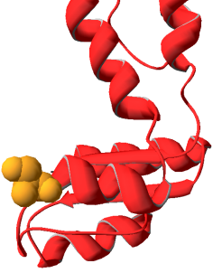
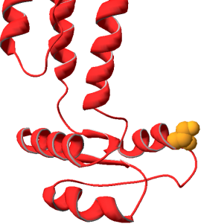
Rare nsSNPs in GABRA5 in only cases
α5V204I
α5P453L
α5W280R
α5
α5
β3
α5S402A
β
β
x
Novel and predicted by SIFT and Polyphen to affect protein function and/or probably to be damaging.
α
α
α
α
x
Not novel and predicted by SIFT and Polyphen not to affect protein function or to be damaging.
γ
β
γ
β
wt
variant

Slide 48
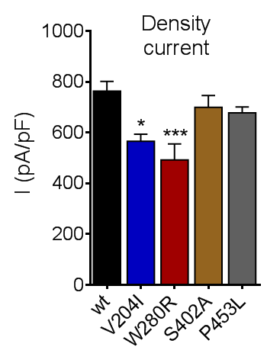
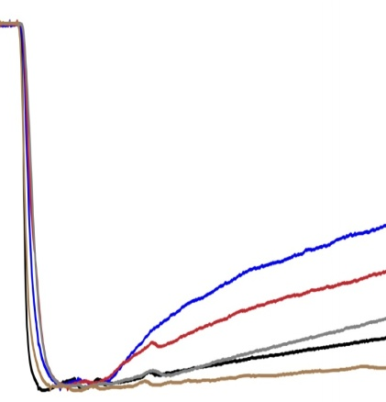
Rare nsSNPs in GABRA5 in only cases
GABA 1 mM
α5V204I
20 ms
V204I
α5P453L
W280R
P453L
wt
S402A
Transfected HEK293T cells
α5W280R
α5
α5
β3
α5S402A
β
β
x
α
α
α
α
x
γ
β
γ
β
wt
variant

Slide 49
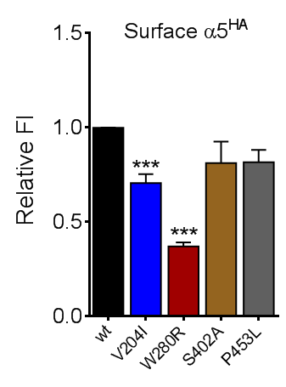
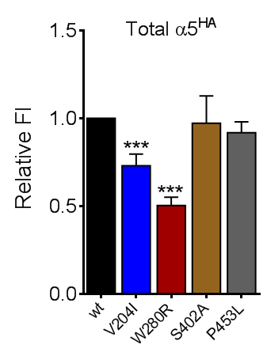
Rare nsSNPs in GABRA5 in only cases
GABA 1 mM
α5V204I
20 ms
V204I
α5P453L
W280R
P453L
wt
S402A
Transfected HEK293T cells
α5W280R
α5
α5
β3
α5S402A
β
β
x
α
α
α
α
x
γ
β
γ
β
wt
variant

Slide 50
Next steps
Determine functional significance of all rare variants in all channel genes (668 nsSNPs).
Determine “Functional Channotypes” for cases and controls.
Compare hEP genes to nonhEP genes.
Disease causing versus increased susceptibility
Functional channotype/IGE concordance
Functional channotype/IGE inheritance

Slide 51
Colleagues!
Vanderbilt:
Jing-Qiong (Katty) Kang - γ2(R82Q, Q390X, W429X, R136X), α1(975delC), γ2(Q390X) KI mouse
Mengnan Tian - γ2(IVS6+2T→G, Q40X, S443delC)
Xuan Huang - γ2(Q40X, N79S, R82Q, P83S)
Ciria Hernandez – α6(R46W), γ2(Q40X, N79S, R82Q, P83S)
Chenwen Zhou – γ2(Q390X) KI mouse
Kate Gurba – β3(G32R)
Martin Gallagher – α1(A322D)
Matt Bianchi - γ2(R82Q), γ2(K328M)
Jerry Feng – δ(R220H), δ(E177A)
Emily Schwartz – γ2(R177G)
Manuel Botzolakis - γ2(R177G)
Baylor:
Tara Klassen
Jeff Noebels
Ningning Hu
Wangzhen Shen
Luyan Song
Helen Zhang
Funding:
NIH R01 33300
NIH R01 51590

