Slide 1
Cutaneous Findings Encountered in the Outpatient Setting

Slide 2
Pityriasis Rosea
Benign exanthem likely viral in origin
Linked to URIs, can present in many family members
Occasional pruritis (75%, severe in 25%)

Slide 3
Pityriasis Rosea
Herald Patch
Single pink patch 2-10 cm in diameter
On neck or trunk with fine scale
Found in greater than 50% of patients
Generalized Eruption
1-2 weeks after appearance of herald patch
Salmon colored macules with fine scale
Organized in linear fashion along cleavage lines

Slide 4
Treatment
Reassurance
Pruritis relief – topical steroids, oral antihistamines, oatmeal baths
NO USE for systemic steroids
UVB light may be necessary
Usually resolves by 12 weeks

Slide 5
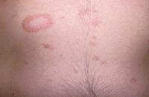
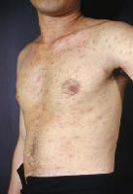
Pityriasis Rosea

Slide 6
Seborrheic Dermatitis
Papulosquamous disorder occuring on sebum-rich areas of face, scalp, trunk
Intermittant active phases – burning, scaling, itching
Can be complicated by secondary infections
Activity increased in winter, early spring

Slide 7
Seborrheic Dermatitis
Appearance varies from mild, patchy scaling to thick, adherent crusts
Scaling over red, inflamed skin
Hypopigmentation in dark-skinned races
Distribution – oily and hair-bearing areas
Typically an annular scaling

Slide 8
Treatment
Early treatment of flares encouraged
Topical steroids for short-term use ONLY
Sulfur, sulfonamide preparations, ketoconazole gels
Dandruff – long periods of lathering; shampoos with selenium, sulfer, zinc, salicylic acid

Slide 9
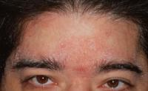
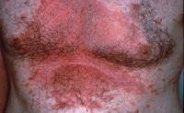
Seborrehic Dermatitis

Slide 10
Allergic Contact Dermatitis
Initial Sensitization phase (10-14 days)
T-cell mediated immune response
Once sensitized – rash develops within hours to several days after exposure
Can occur over existing skin pathology (i.e. neomycin rxtns on stasis ulcers)

Slide 11
Allergic Contact Dermatitis
Pruritic papules and vesicles on an erythematous base
Lichinified plaques may exist in chronic ACD
Location can give important clues as to causation

Slide 12
ACD
Hands: an important site of ACD, particularly in the workplace. Common causes include the chemicals in rubber gloves.
Perianal: frequent in the perianal area as a result of the use of sensitizing medications and remedies (eg, topical benzocaine).
Otitis externa: Topical medications
Airborne ACD: Chemicals in the air. Usually occurs maximally on the eyelids, but imay affect other areas, particularly the head and the neck.
Ophthalmologic: chemicals in ophthalmologic preparations may provoke dermatitis around the eyes.
Hair dyes: Individuals allergic to hair dyes typically develop the most severe dermatitis on the ears and adjoining face rather than on the scalp.
Stasis dermatitis and stasis ulcers: Individuals with stasis dermatitis and stasis ulcers are at high risk for developing ACD to topical medications applied to inflamed or ulcerated skin. May develop widespread dermatitis from topical medications applied to leg ulcers or from cross-reacting systemic medications administered intravenously. A patient allergic to neomycin may develop systemic contact dermatitis if treated with intravenous gentamicin.

Slide 13
ACD
25 chemicals responsible for approximately ½ of all cases
Poison ivy, nickel, chemicals in rubber gloves, dyes and chemicals in textiles, preservatives in moisturizers, cosmetics, topical meds, formaldehyde, fragrance, topical corticosteroids, neomycin, benzocaine, preservatives in sunscreen

Slide 14
ACD
Can be diagnosed with Patch testing
Treatment
Cool compresses, lukewarm oatmeal baths
Oral antihistamines
Corticosteroids
In severe cases – 2 weeks of po steroids starting at 40-60 mg and tapering
Immunosuppressive agents (Imuran, Neoral) may be needed in severe, recalcitrant cases

Slide 15
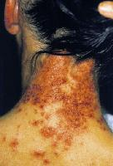
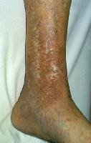
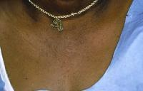
Allergic Contact Dermatitis

Slide 16
Folliculitis
Results from obstruction/disruption of hair follicles
Can result from infection or physical/chemical irritation
May cause mild discomfort/pruritis
Lesion is papule/pustule with central hair
May be bacterial (staphylococcal, gram negative), fungal (pityrosporum), viral (HSV), irritant

Slide 17
Folliculitis
Can empirically treat based on history/physical exam
If resistant to therapy, cultures, Gram stain, KOH prep, and biopsy are the diagnostic tests of choice
Nasal culture of family members to look for S aureus colonization may be needed in chronic cases

Slide 18
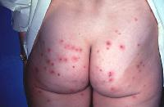
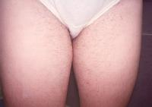
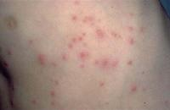
Folliculitis

Slide 19
Rosacea
Common condition -- facial flushing, erythema, telangiectasia, coarseness of skin, an inflammatory papulopustular eruption resembling acne
Rhinophyma -- may occur as an isolated entity; can be disfiguring
Lymphoedema may be marked periorbitally
Ocular rosacea may be accompanied by conjunctival injection, and rarely, chalazion and episcleritis

Slide 20
Rosacea
Treatment
Tetracycline 250 mg – 500 mg tid for acneiform lesions; treat 2-4 mos
Topical metronidazole
Accutane
Ocular rosacea – tetracycline for minimum of 3 mos

Slide 21
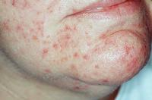
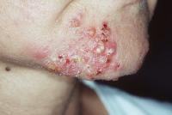
Rosacea

Slide 22
Tinea Corporis
A superficial dermatophyte infection of the glabrous skin of the skin; inflammatory lesions and noninflammatory lesions
Infection occurs through contact with infected humans, animals, or inanimate objects
Pruritic annular plaque is characteristic of a symptomatic infection

Slide 23
Tinea Corporis
Lesion typically begins as an annular, erythematous, papulosquamous lesion
May grow rapidly; may become annular in shape after central resolution occurs
Scaling, crusting, vesicle formation, and papules may also be present

Slide 24
Tinea Corporis
Dermatophytes rarely invade living tissues
Topical therapy is recommended for localized cases - should be applied to an area at least 2 cm beyond the edge of the identified lesion once or twice a day for at least 2 weeks
Systemic therapy -- for cases of tinea corporis that are extensive, those that involve patients who are immunocompromised, or those that are not responsive to topical therapy

Slide 25
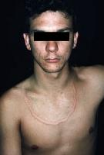
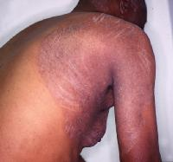
Tinea Corporis

Slide 26
Granuloma Annulare
A benign inflammatory dermatosis -- dermal papules and annular plaques
Its precise cause is unknown
Asymptomatic cutaneous lesions
Few to thousands of 1- to 2-mm papules or nodules that range in color from flesh-toned to erythematous

Slide 27
GA
Hypothesized to be associated with tuberculosis, insect bites, trauma, sun exposure, thyroiditis, and viral infections, including HIV, Epstein-Barr virus, and herpes zoster virus
Intralesional corticosteroid is the most uniformly successful therapy

Slide 28
GA
Spontaneous resolution occurs within 2 years in 50% of cases, although lesions may last weeks to decades
Recurrence, often at the same site, is noted in 40% of cases

Slide 29
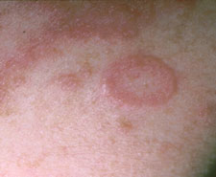
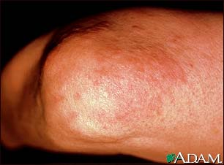
GA

