Slide 1

PRESTO
Promoting Engagement for Safe Tapering of Opioids
(and Benzodiazepines)
Dean D. Bricker, M.D.
Department of Internal Medicine
Paul J. Hershberger, Ph.D.
Angie Castle, M.A.
Department of Family Medicine
Wright State University Boonshoft School of Medicine

Slide 2
presto
adverb or adjective
Definition of presto
1: suddenly as if by magic; immediately
2: at a rapid tempo -- used as a direction in music

Slide 3
What are the challenges of working with patients taking opioids and benzodiazepines?

Slide 4
What are the challenges of working with patients taking opioids and benzodiazepines?
Patient goals vs physician goals
Tolerance/dependence
Psych co-morbidities
Aberrant behavior
Unexpected UDS
Chronic pain

Slide 5
Why PRESTO?
OD
Prescribing guidelines
Medical law
PDMP
Challenges with tapering (patient engagement)
Notes:
PRESTO is a paradigm for a systematic approach to patients taking long-term opioids and benzodiazepines.
Analogous to SBIRT for alcohol use, PRESTO attempts to assess risk and apply principles of Motivational Interviewing to conversations with patients aimed at reducing risk by tapering these medications.
Physicians need to know the medical details
Physicians need to know how to engage patients

Slide 6
Opioids and abuse
10 million US adults prescribed long-term opioid tx
Higher dose associated with OD risk
Associations with incidence of opioid use disorder
Edlund MJ, Martin BC, Russo JE, et al. The Role of Prescription in Incident
Opioid Abuse and Dependence Among Individuals with Chronic Non-cancer
Pain: The Role of Opioid Prescription. Clin J Pain. 2014: 30(7):557-564.
Low dose (1-36 MME), acute OR = 3.03
Low dose, chronic OR = 14.92
Medium dose (36-120 MME) acute OR = 2.80
Medium dose, chronic OR = 28.69
High dose (> 120 MME) acute OR = 3.10
High dose, chronic OR = 122.45
Notes:
2 to 3% of the US population takes long-term opioids
There is lack of evidence of benefit form long-term opioid and growing evidence for harm
No published studies comparing long-term (> 1 year) opioid vs placebo, no opioid, or non-opioid therapies
In past 3 decades there has been progressive increases in prescription of opioids- despite poor quality evidence treatment guidelines from numerous professional organizations endorsed chronic opioid therapy
Past decade saw concurrent increases in OD deaths (33,000 in 2015, 42,000 2016)

Slide 7
The STATS
> 42,000 OD deaths in 2016, US;
Prescription opioids involved in 40%
2.1 million opioid use disorder
11.5 million misused prescription pain relievers in 2016
215 million opioid prescriptions dispensed per year
66.5 dispensed opioid prescriptions per 100 persons
45% of opioid prescriptions by primary care physicians

Slide 8
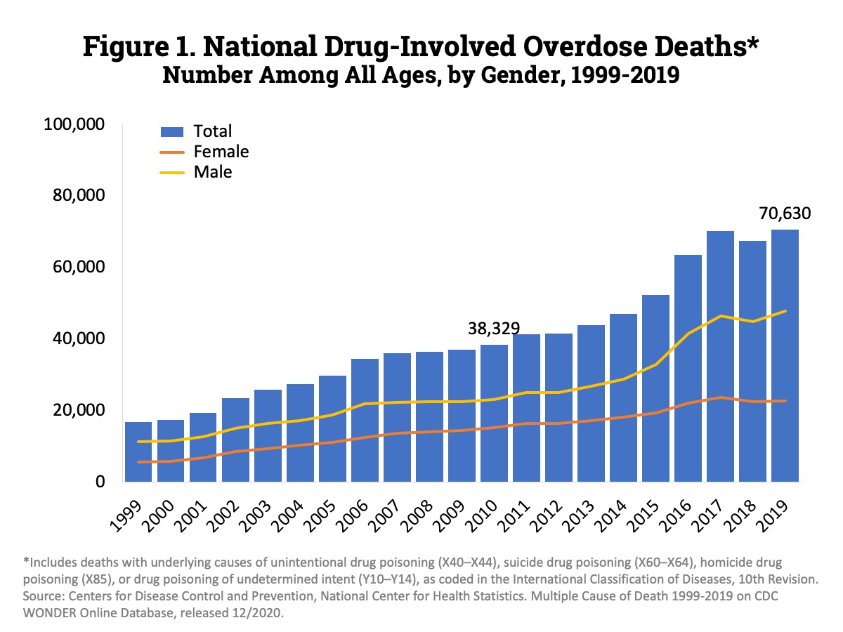

Slide 9
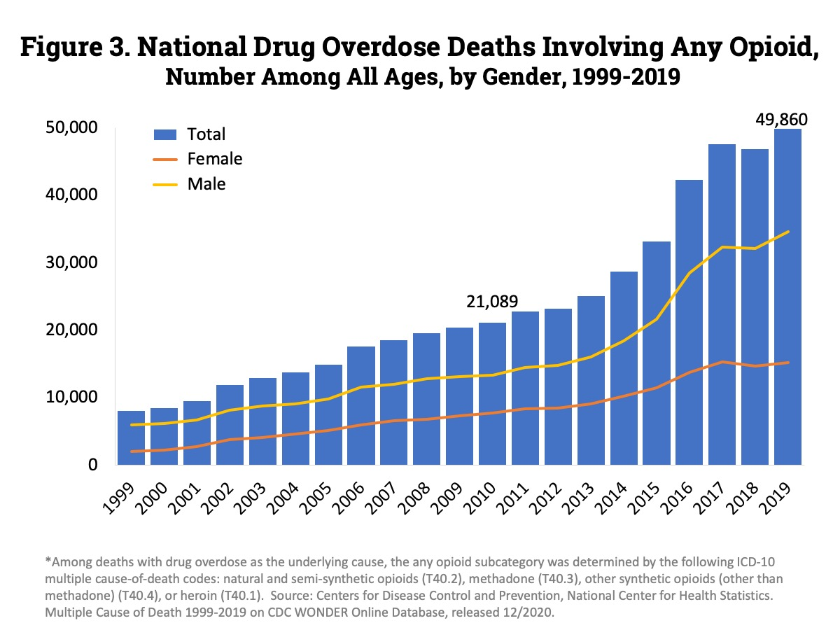

Slide 10
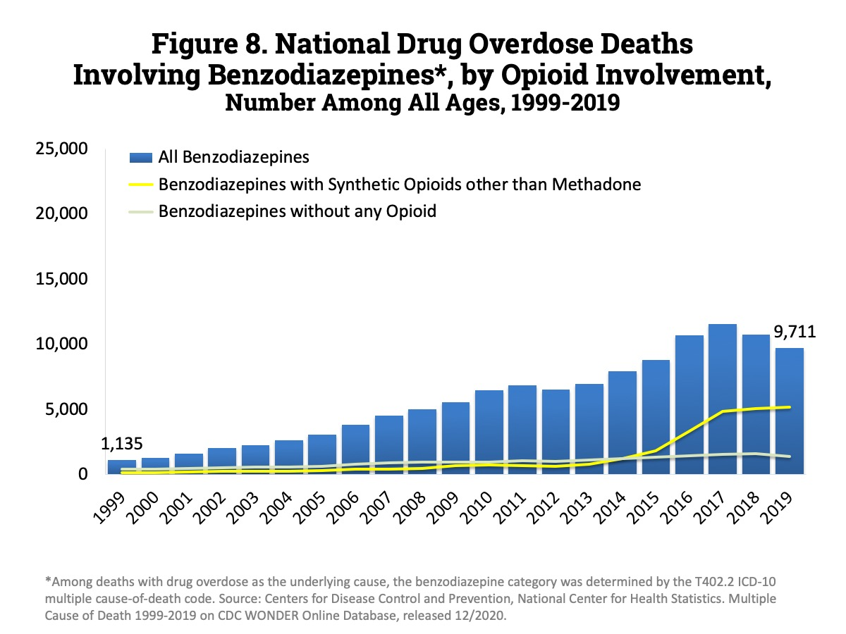

Slide 11
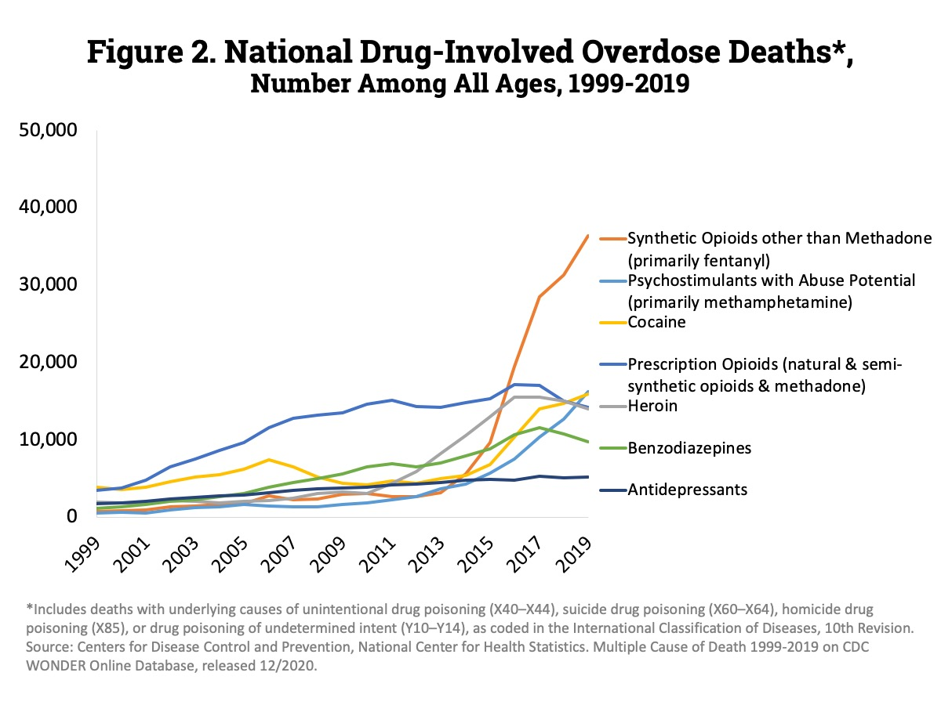

Slide 12
Aberrant behaviors
Frequent requests for early refills (lost, stolen prescriptions)
Use is more frequent or higher dose than prescribed
Use to treat non pain symptoms
Borrowing or hoarding meds
Using alcohol to relieve pain
Requesting more or specific opioids
Frequent ED visits for pain
Concerns by family members
Abnormal urine drug tests
Inconsistencies in history

Slide 13
Aberrant behavior suggestive of addiction
Buying street drugs
Stealing or selling drugs
Multiple prescribers
Trading sex for drugs
Illicit drugs
Forging prescriptions
Aggressive demands for opioids
Injecting oral or topical meds
Signs of intoxication

Slide 14
Potential Harms of Chronic Opioid Use
aggravation of sleep apnea
hypogonadism, sexual dysfunction
opioid hyperalgesia
immunosuppression
osteopenia / fractures
falls
substance use disorder
aggravation of depression
overdose/death

Slide 16
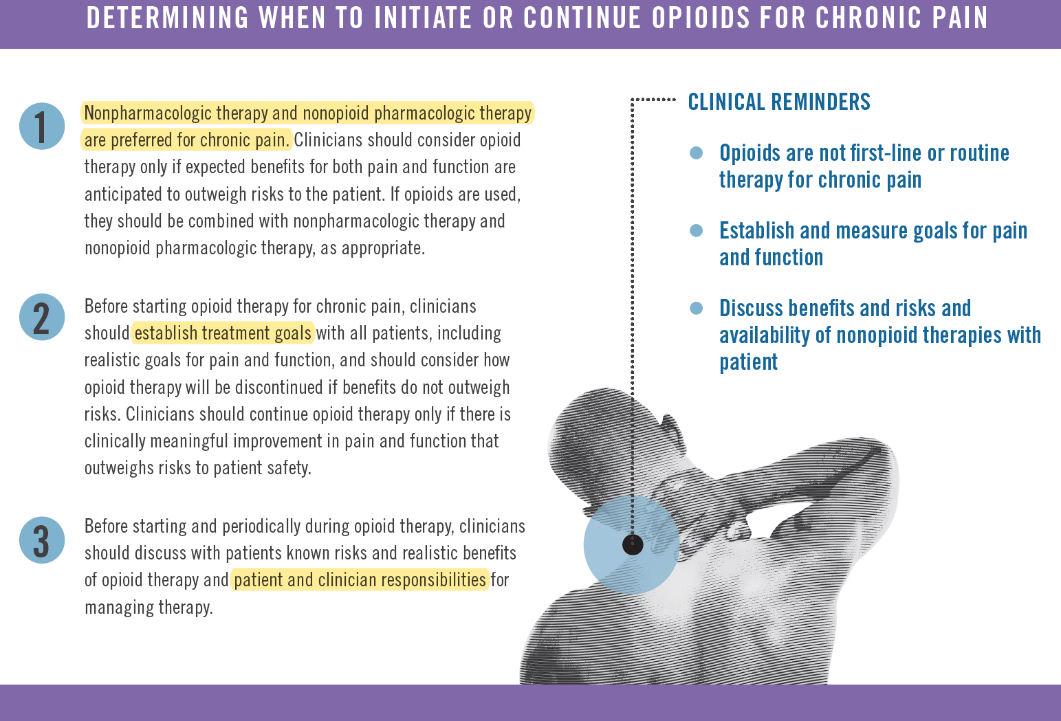

Slide 17
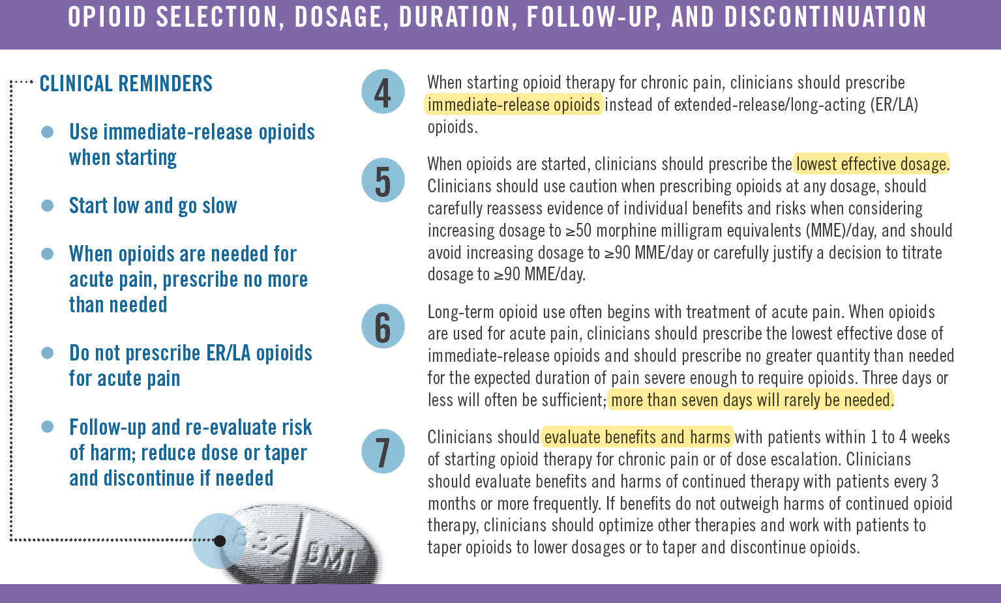

Slide 18
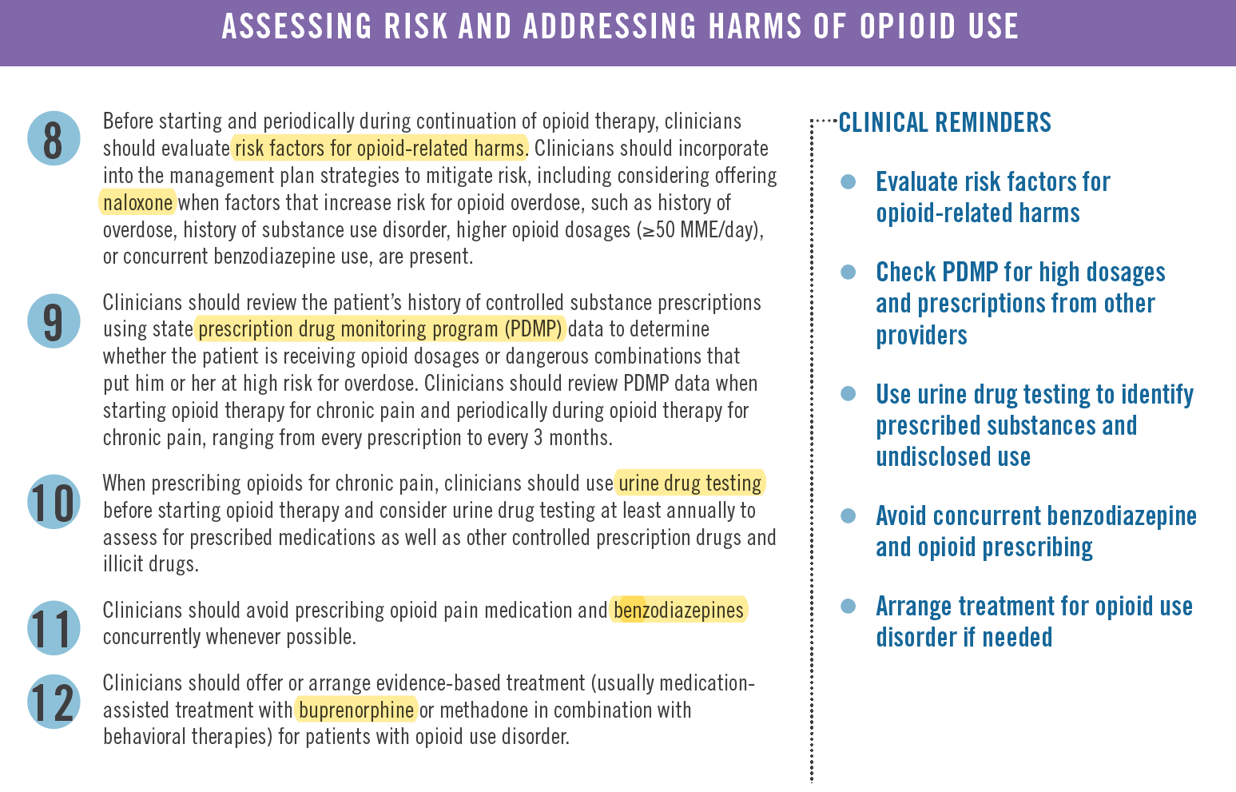

Slide 19
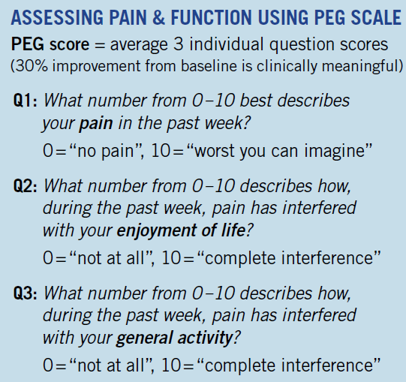
Krebs EE, Lorenz KA, Bair MJ, et al. Development and initial validation of the PEG, a three-item scale assessing pain intensity and interference. J Gen Intern Med 2009;24:733–8
Notes:
CDC guideline suggest assess Function as well as Pain
PEG score one validated tool to assess function
Need 30% improvement in baseline to be clinically meaningful

Slide 20

Chronic Pain Management Toolkit
Opioid Medication for Chronic Pain Agreement
This is an agreement between _______________ (patient) and Dr. _____________________________.
I am being treated with opioid medication for my chronic pain, which I understand may not completely rid me of my pain, but will decrease it enough that I can be more active. I understand that, because this medication has risks and side effects, my doctor needs to monitor my treatment closely in order to keep me safe. I acknowledge my treatment plan may change over time to meet my functional goals, and that my doctor will discuss the risks of my medicine, the dose, and frequency of the medication, as well as any changes that occur during my treatment. In addition, I agree to the following statements:
I understand that the medication may be stopped or changed to an alternative therapy if it does not help me meet my functional goals.
To reduce risk, I will take medication as prescribed. I will not take more pills or take them more frequently than prescribed.
I will inform my doctor of all side effects I experience.
To reduce risk, I will not take sedatives, alcohol, or illegal drugs while taking this medication.
I will submit to urine and/or blood tests to assist in monitoring my treatment.
Notes:
Patient and provider responsibilities should be defined
Best practice includes a “pain” contract—should probably be re-accomplished at least yearly.

Slide 21
I understand that my doctor or his/her staff may check the state prescription drug database to prevent against overlapping prescriptions.
I will receive my prescription for this medication only from Dr. ___________________________.
I will fill this prescription at only one pharmacy. (Fill in pharmacy information below.)
I will keep my medication in a safe place. I understand if my medicine is lost, damaged, or stolen, it will not be replaced.
I will do my best to keep all scheduled follow-up appointments. I understand that I may not receive a prescription refill if I miss my appointment.
Medication name, dose, frequency ____________________________________________________________________
Pharmacy name ___________________________________________________________________________________
Pharmacy phone number ____________________________________________________________________________
By signing below, we agree that we are comfortable with this agreement and our responsibilities.
_______________________________________________________________ Patient signature Date
________________________________________________________________ Physician signature Date
HOP 16050882

Slide 22
Ohio Medical Law
80 MME
1. All previous
2. Written permission with patient that includes
Before prescribing any opioid
1. H&P
2. Prior tx’s, response, adherence
3. Substance Use Screen (AUDIT/DAST) (If positive a urine drug screen)
4. Relevant Labs or diagnostic data
5. Functional Pain Assessment: ability to work, pain intensity, ADL’s, quality of life, social activities, family activities.
6. Treatment Plan: dx, goals, rationale for medication and dose, planned duration.
7. Discussion to include: Benefits and Risks, including addiction and overdose, patient’s responsibility to safely store and dispose medication.
8. Offer prescription for Narcan if: hx of opioid use disorder, dose exceeds 80 mme, patient co prescribed benzo, hypnotic, carisoprodol, tramadol, gabapentin, or has a substance use disorder.
50 MME
1. Review and update previous documentation
2. Formulate and document new tx plan
3. Obtain written informed consent that includes: benefits and risks, including addiction and overdose, and patient’s responsibility.
If on 50mme prior to Dec 2018, document consideration of:
1. Consult with specialist related to pain.
2. Consult with pain management specialist.
3. Consult with pharmacy for medication therapy management review.
4.Consult addiction medicine specialist or addiction psychiatry if suspicion of medication misuse or SUD
5. Offer prescription for Naloxone
Every 3 months:
1. Review course and pt response, adherence.
2. Interval history, physical exam, appropriate tests.
3. Assessment of patient adherence
4. Rationale for continue opioid tx and nature of benefits is present
5. Result of OARRS check
6. Screening for medication misuse or substance use, UDS based on clinical assessment, frequency based on clinical judgement.
7. Tapering of opioids if continued benefit cannot be established.
a. Permission for drug screening and release to speak with other practitioners about patients tx.
b. Cooperation with pill counts
c. Understanding the patient will receive opioid medication only from physician treating chronic pain.
d. Understand dosage may be tapered if not effective or patient not abiding by agreement.
3. Prescribe naloxone
If on 80 mme prior to Dec 2018 document obtaining at least one of the following:
a. Consultation with a specialist related to the pain.
b. Consultation with pain management specialist
c. Consultation with pharmacy for medication therapy management review.
d. Consultation with addiction medicine specialist or addiction psychiatry if suspicion of medication misuse or SUD.

Slide 23
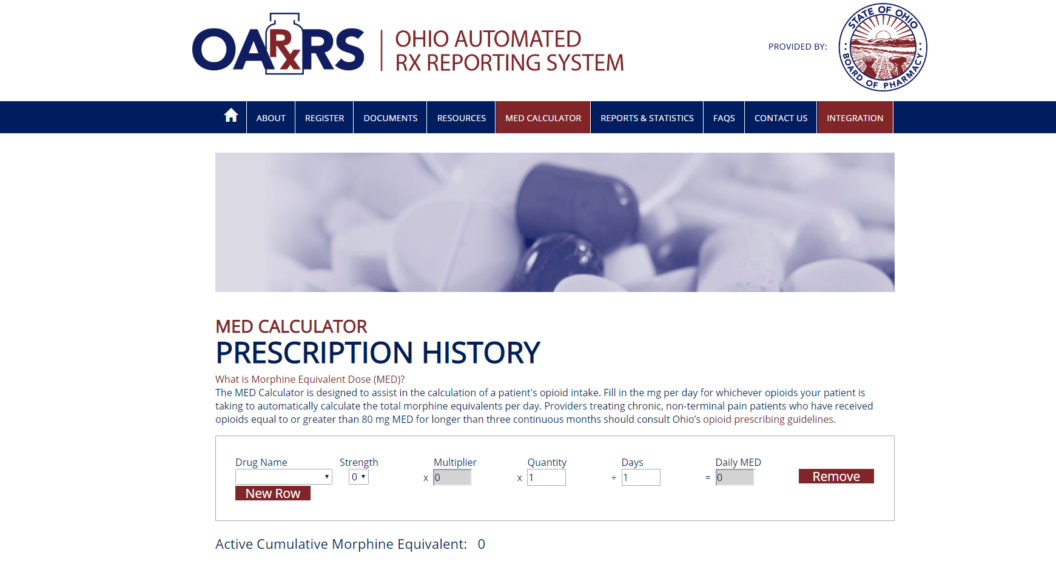
Prescription Drug Monitoring Program (PDMP)

Slide 24
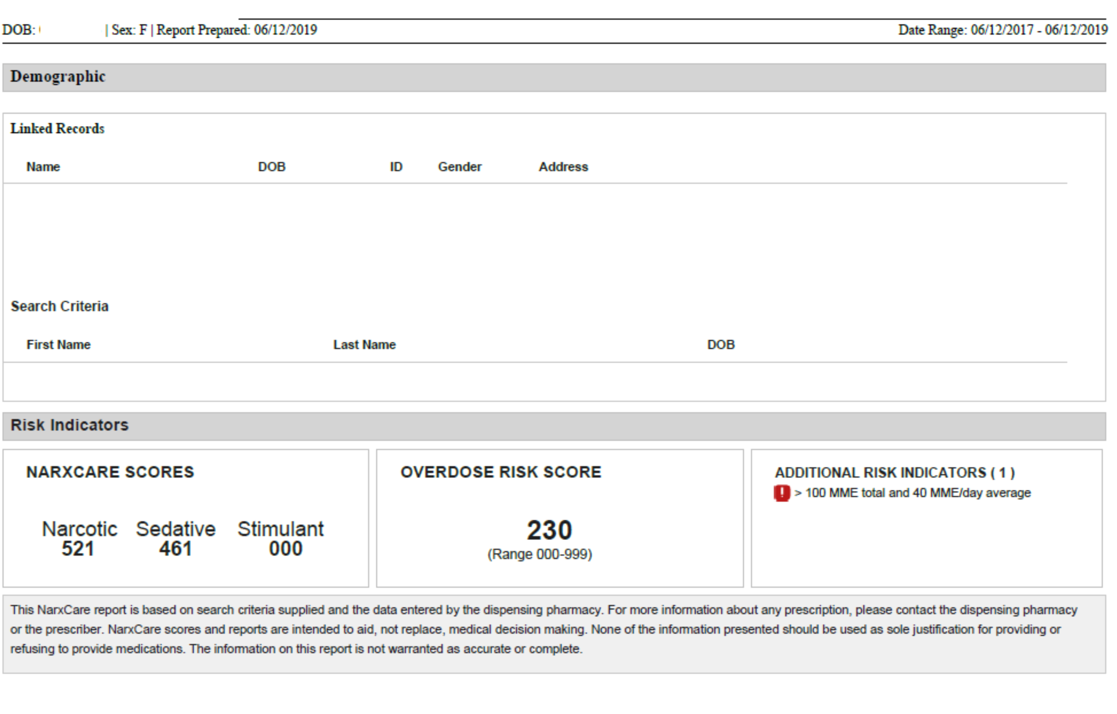

Slide 25
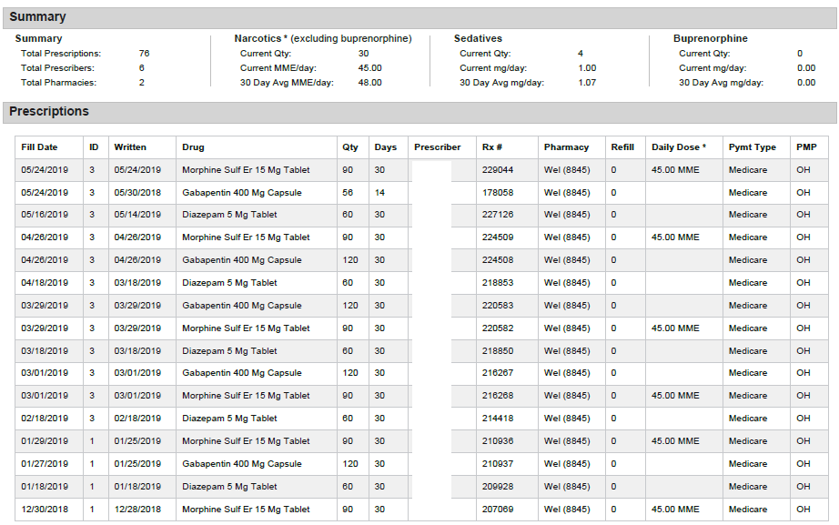

Slide 26
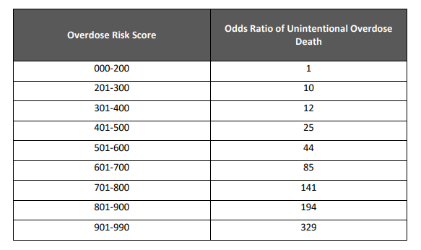
NARxCheck Table of Overdose Risk

Slide 27
Notes:
Physicians may find it easier to refer or dismiss patients rather than support through a taper
Could affect patient safety—may seek meds by other provider or illicit

Slide 28
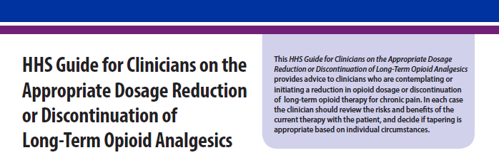

Slide 29


Slide 30
Risks – rapid opioid taper could provoke:
Withdrawal symptoms
Exacerbation of pain
Serious psychological distress
Seeking alternate source — including illicit opioid

Slide 31
Individualize taper rate
Slow 5-10% every month
Consider pause
Progress = success
Minimize withdrawal symptoms
Provide behavior health support
Ask how you can support the patient
Acknowledge fear
Assure your support
Provide frequent follow up

Slide 32
 | Tapering Worksheet
 | Medication:
 | Current dose:
 | Target dose:
 | Date | Dose (mg) | Frequency | # of weeks | total dose/day (mg)
 | Adapted from AAFP Chronic Pain Management Toolkit

Slide 33
Comfort Pack
Withdrawal symptom order set
Cholinergic Overload
 |  |  |  | Clonidine 0.1 mg |  | # 18
 |  |  |  | 1 tab tid for 3 days, then 1 tab bid for 3 days,
 |  |  |  | then1 tab daily for 3 days and stop
 |  |  |  | hold for BP <90/60
Nausea/Vomiting/Insomnia
 |  |  |  | dipheyhydramine 25 mg |  | # 36
 |  |  |  | 1 - 2 caps po q 4 hours prn
 |  |  | or
 |  |  |  | hydrxyzine 50 mg |  | # 18
 |  |  |  | 1 cap po q 4 hours prn
Diarrhea
 |  |  |  | Loperamide 2 mg |  | # 24
 |  |  |  | 2 tabs first dose, then 1 q 3 hours prn
Muscle spasms
 |  |  |  | clyclobenzaprine 10 mg |  | # 6
 |  |  |  | one-half tab po q 8 hours prn
Aches
 |  |  |  | acetominophen 325 mg |  | # 24
 |  |  |  | 2 tabs po q 6 hours prn

Slide 34
Patient’s Experience with Opioid Tapering: a Conceptual Model with Recommendations for Clinicians
Henry SG, Paterniti DA, Feng B, et. al. The Journal of Pain. 2019;
20(2):181-191.
Identify the social, emotional, health factors that will impact tapering
Address fears
Emphasize tapering for patient’s best interest
Help them know what to expect
Develop individualized tapering plan
Notes:
Identify the social, emotional, health factors that will impact tapering
Address fears (pain, withdrawal, abandonment)
Emphasize tapering for patient’s best interest (patients don’t buy the policy argument)
Help them know what to expect (timeline, what to do about pain flares…)
Develop individualized tapering plan (collaborative, some slower, pause if needed)

Slide 35
Assessing risk
hx substance use disorder
depression/PTSD
aberrant behavior
unexpected UDS
high dose (MME >50)
PDMP
multiple prescribers
multiple pharmacies
hx of OD

Slide 36
Buprenorphine products
PRESTO not for OUD
Medication Assisted Treatment

Slide 37
PRESTO
Severe
Risky
Low Risk
Dependence/abuse
Unwillingness to taper
Higher MME
Higher NARxCheck Score
Unexpected UDS
taking BZP, other sedatives
Documented functional goals
Documented pain control efficacy
Appropriate urine drug screen
Low MME
Low NARxCheck Score
Notes:
Analogous to SBIRT drinkers pyramid: 75% are probably low risk —but not validated, fuzzy boundaries

Slide 38
PRESTO
Severe
Risky
Low Risk
MAT or refer to pain/addiction specialist
Dependence/abuse
Unwillingness to taper
Taper/ PRESTO
Higher MME
Higher NARxCheck Score
Unexpected UDS
taking BZP, other sedatives
Re-assess
Documented functional goals
Documented pain control efficacy
Appropriate urine drug screen
Low MME
Low NARxCheck Score
Notes:
Analogous to SBIRT drinkers pyramid: 75% are probably low risk —but not validated, fuzzy boundaries

Slide 39
PRESTO Steps
Raise Subject & Explore/Determine Risk with the Patient
Enhance Motivation (w integrated feedback)
Negotiate a Plan

Slide 40
Raise Subject
Tell me about your history with _______ (opioid or benzodiazepine medication, or both).
Explore and determine risk, in the context of your desire to work with the patient on managing their pain and enhancing their function.

Slide 41
Raise Subject
Tell me about your history with _______ (opioid or benzodiazepine medication, or both).
  Open-ended exploration
    Let’s assess your pain and how you are functioning.
    How do you think the opioid is helping?
    How is your life now compared to before you started the opioid?
    What concerns do you have about the opioid?
    What don’t you like about taking the opioid?

Slide 42
Raise Subject
Explore and determine risk, in the context of your desire to work with the patient on managing their pain and enhancing their function. (Review of medical record also informs assessment of risk.)
    Higher MME
    Higher NARxCheck Score
    Unexpected UDS
    Taking BZP, other sedatives

Slide 43
PRESTO Steps
Raise Subject & Assess Risk
Enhance Motivation (w integrated feedback)
Negotiate a Plan

Slide 44
Enhance Motivation
Highlight your desire to work with the patient on managing their pain/anxiety (i.e., shared goals).
Emphasize elicitation of the patient’s thoughts, feelings, and perspectives. Be attentive to emotion and potential discrepancies. Develop (create) discrepancy.
Use reflective listening and open-ended questions liberally.
Ask permission to educate when indicated. Provide small bits of information and then elicit patient response to the information (i.e., “How does knowing this affect your thoughts about…?”)

Slide 45
Reflections
So opioids seem to have helped in the past but aren’t as effective any longer.
It sounds like you don’t want to be dependent on pain meds, but you’re afraid to come off.
You think other treatments will not work.
It sounds like our pain medicine isn’t allowing you do the things you want.
You’re aware of opioid overdose deaths, but don’t see how that could happen to you.

Slide 46
Enhance Motivation (1)
What do you like about taking opioids (benzodiazepines)?
What don’t you like about taking opioids (benzodiazepines)?
What concerns do you have about taking this (these) medication(s)?
What do you know about hyperalgesia?
What do you know about osteoporosis?
What have you noticed about your sexual function since you’ve been on these medications?

Slide 47
Enhance Motivation (2)
What have you noticed about your breathing?
What concerns do you have about driving while taking this(these) medication(s)?
How much risk of overdose death are you willing to have in your pain management regimen? (compare to NarX Check score)
With your current medication, it’s recommended that I prescribe naloxone (Narcan) for you. What are your thoughts about this?
What would be the downside and upside to tapering from your perspective?

Slide 48
Enhance Motivation (3)
Summarize what the patient likes about their current meds, and then summarize concerns that have been raised. “Given these concerns, how ready would you be to start a slow taper of __________, on a scale of 0-10 with 0 being not ready at all, and 10 being reading to start today?”
  If response is in the 8-10 range, move to discussion of tapering protocol.
  If response is in the 1-7 range, ask, “Why not a lower number?”
  If response is 0, acknowledge the unreadiness to change and ask, “What would it take for you to move from a 0 to a 1 or 2?”

Slide 49
Ask permission and provide information
Review benefits and harms
Review NaRxCheck Score
Suggest a tapering strategy and what it might look like
Review support you will provide
Recall benefits in other patients

Slide 50
Negotiate a Plan
Discuss the recommended tapering protocol. Elicit patient reaction to this.
Address any potential barriers/challenges/concerns that the patient has identified, with emphasis on eliciting from the patient how she/he might manage the concerns.
Summarize the benefits that have been discussed regarding the tapering.
Review specifics (e.g., follow-up, UDS, etc.)

Slide 51
Cultivating Engagement
Tell me more about current behavior.
What do you like about current behavior? Summarize
What don’t you like about current behavior?
How might your current behavior be related to your medical concern?
Suppose you don’t make any change. How does that look to you going forward? (How would this affect something the patient cares about?)
Given that there are some things you don’t like about current behavior and that you have some concerns about not making any change, how ready would you be to make a change? (0-10 scale)
Why not a lower number? (skip if 7-10)
What would change look like for you?

Slide 52
Office Encounter:
48 yo woman presents to establish with a new primary care provider. She has a remote history of gunshot injury to her right leg resulting in chronic osteomyelitis. She also has chronic anxiety, and post-traumatic stress disorder (PTSD.) She has OA with chronic pain in various locations including her low back, bilateral shoulders and bilateral knees. She has been prescribed hydrocodone/acetaminophen (Vicodin) for pain and alprazolam (Xanax) for anxiety and has been on that regimen for a number of years. Her main concern is chronic pain and anxiety which is fairly well controlled with Vicodin and Xanax.
PMH: osteoarthritis
anxiety disorder
PTSD
chronic osteomyelitis right tibia, from remote gun shot injury
gout
Medications: hydrocodone/acetaminophen 7.5 mg/250 mg, 2 tabs qid;
alprazolam 1 mg tid prn; allopurinol 300 mg daily;
ibuprofen 400 mg qid prn;
SH: no tobacco use; drinks wine, no more than 2 glasses per week; smokes marijuana

Slide 53
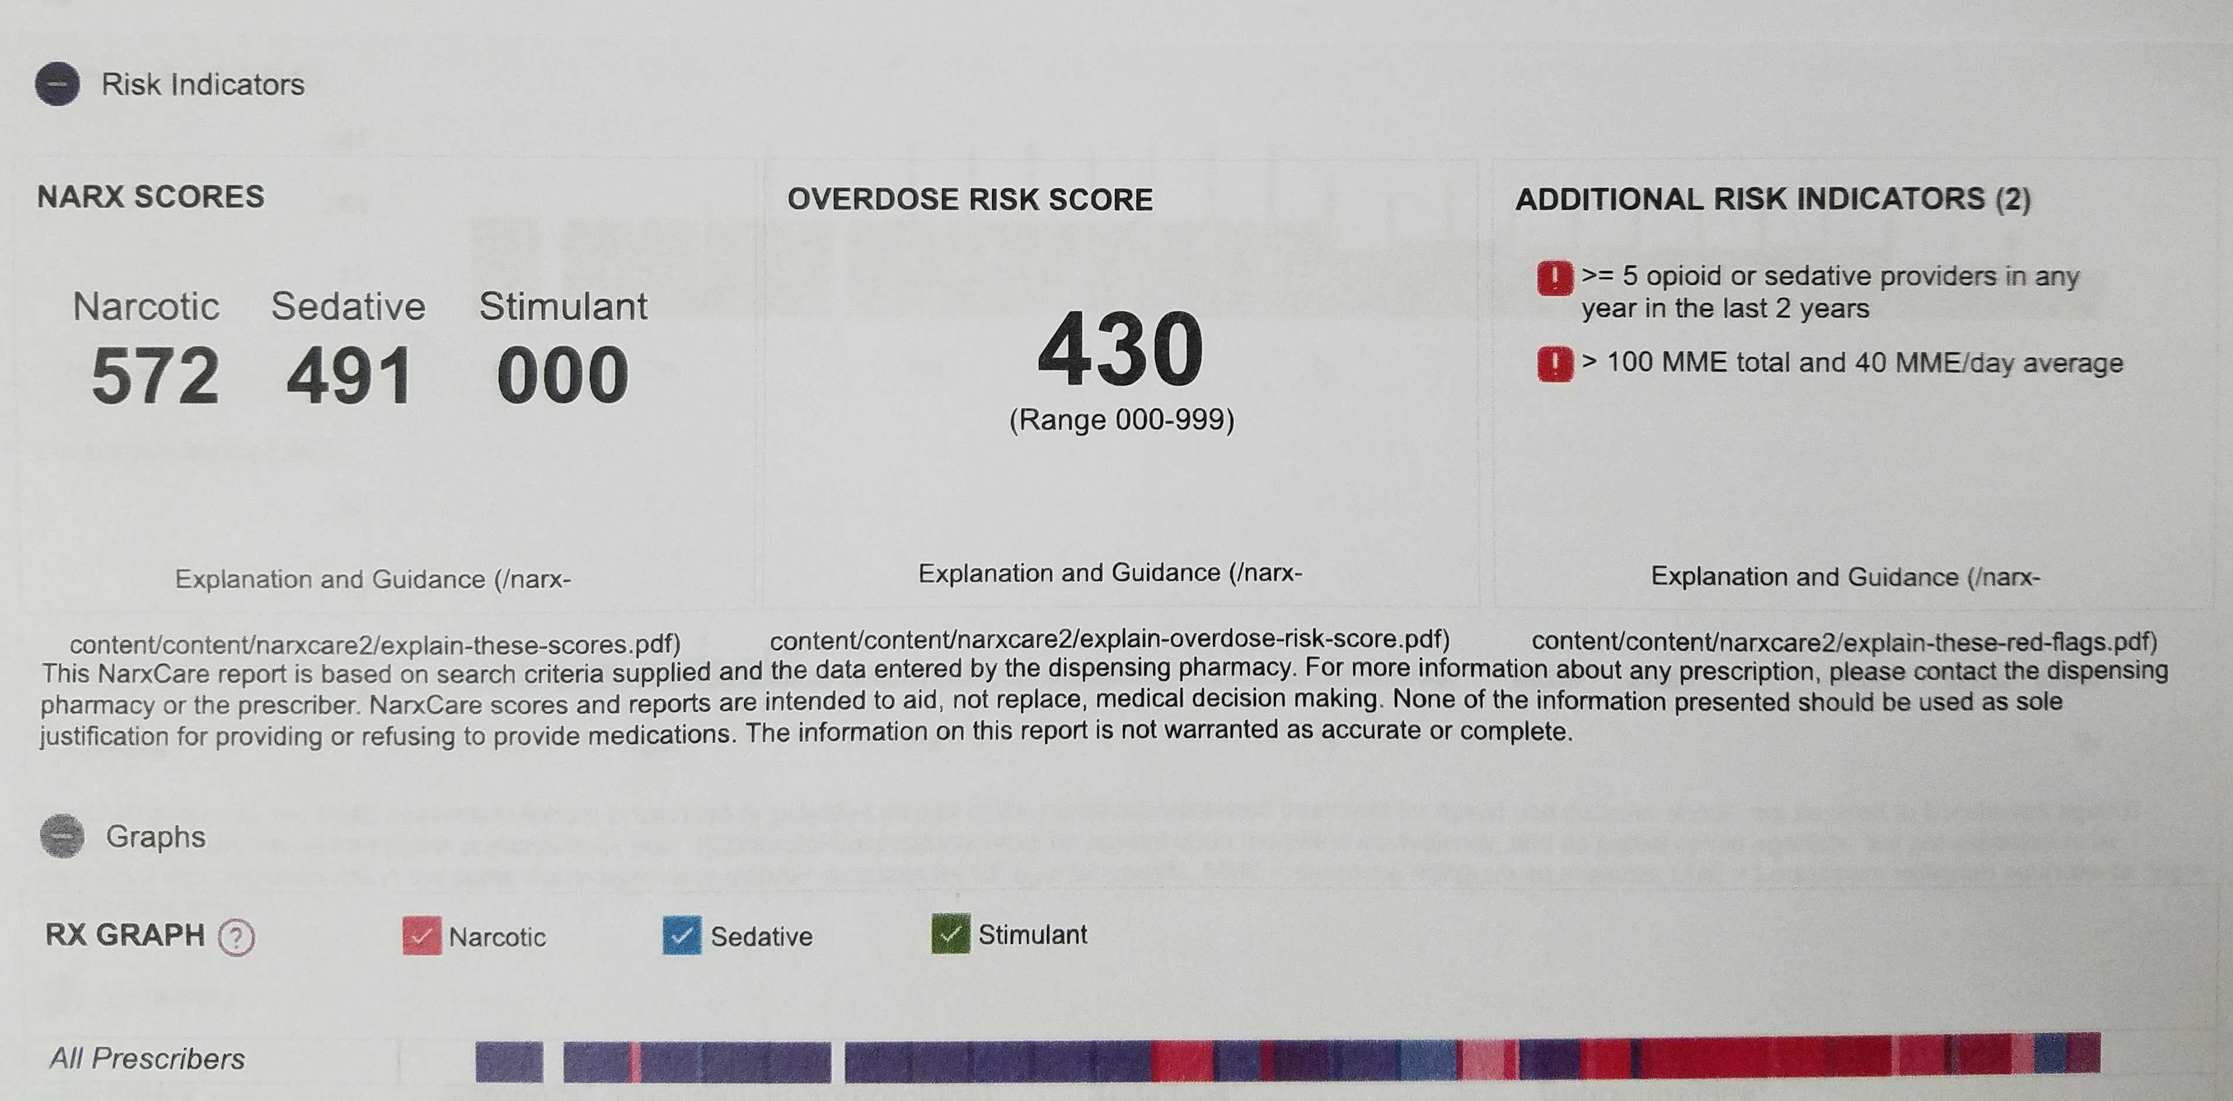

Slide 54
NARxCheck Table of Overdose Risk

Slide 55
Office Encounter:
48 yo woman presents to establish with a new primary care provider. She has a remote history of gunshot injury to her right leg resulting in chronic osteomyelitis. She also has chronic anxiety, and post-traumatic stress disorder (PTSD.)
Medications: hydrocodone/acetaminophen 7.5 mg/250 mg, 2 tabs qid;
alprazolam 1 mg tid prn; allopurinol 300 mg daily;
ibuprofen 400 mg qid prn;
SH: no tobacco use; drinks wine, no more than 2 glasses per week; smokes marijuana
NARX Overdose Risk Score: 430
Odds Ratio of Unintentional Overdose Death: 25

