Slide 1
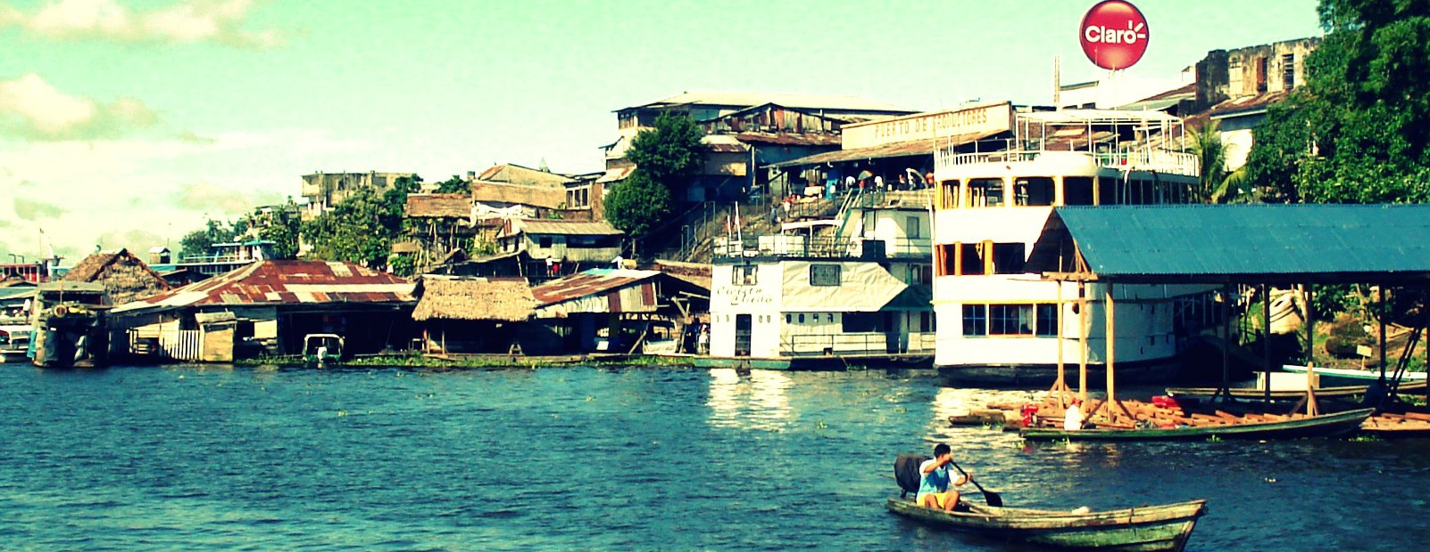
Peruvian Medical Missions
The Rural Amazonian Health Initiative
Notes:
Have you ever wanted to travel to South America and deliver medical care to people living in the rural rainforest? Well, you can! There is an elective opportunity to the Peruvian Amazon through an organization called The Rural Amazonian Health Initiative in partnership with People of Peru Project. You will get the opportunity to see a large portion of the country by medically serving in Iquitos and the surrounding rainforest, exploring Machu Picchu in Cuzco, and by touring Lima.

Slide 2
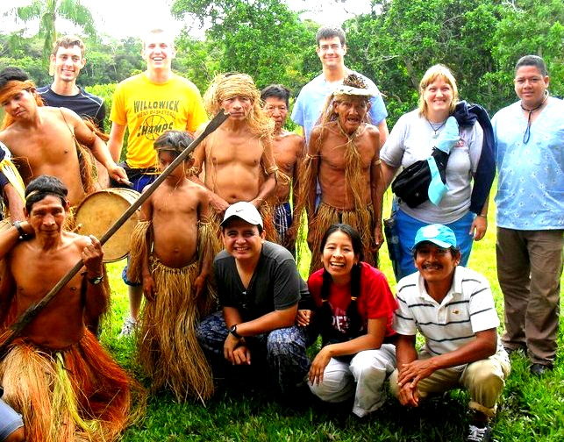
What is this organization?
Founded out of a desire to medically serve the people of the Amazon.
Focused on holistic care, medical education, and culturally acceptable treatment.
Partnered with People of Peru Project.
Learn more by checking out the organizations online:
The Rural Amazonian Health Initaitive
People of Peru Project
Notes:
In 2008, M2 Jon Stofer went on his first medical mission trip to the Peruvian Amazon. The team took a boat 16 hours into the deep jungle and then hiked 5 hours further to a small village that housed the Yagua tribe, a tribe discovered a year earlier by National Geographic. They were the first medical team allowed to come into this village, and after that experience, Jon fell in love with the people, the culture, and the adventure and has been leading teams back ever since.
Jon and a few friends wanted something more formal as a Non-Profit that focused more on the people and their spiritual, physical, mental, and emotional health, which is why ‘The Rural Amazonian Health Initiative’ was created.
The organization’s main philosophy is to holistically treat patients with a focus on sustainability through medical education and culturally acceptable treatment methods that encourages efficacy.
Part of the organizational goal is to partner with all of the medical mission organizations in the Amazon to coordinate actions so together they can share resources and more effectively meet the needs of the population.
The organization has many partners, but the one that meets the needs for a large group of Medical Students and the one Wright State University Boonshoft School of Medicine will be closely working with is called ‘People of Peru Project’.

Slide 3
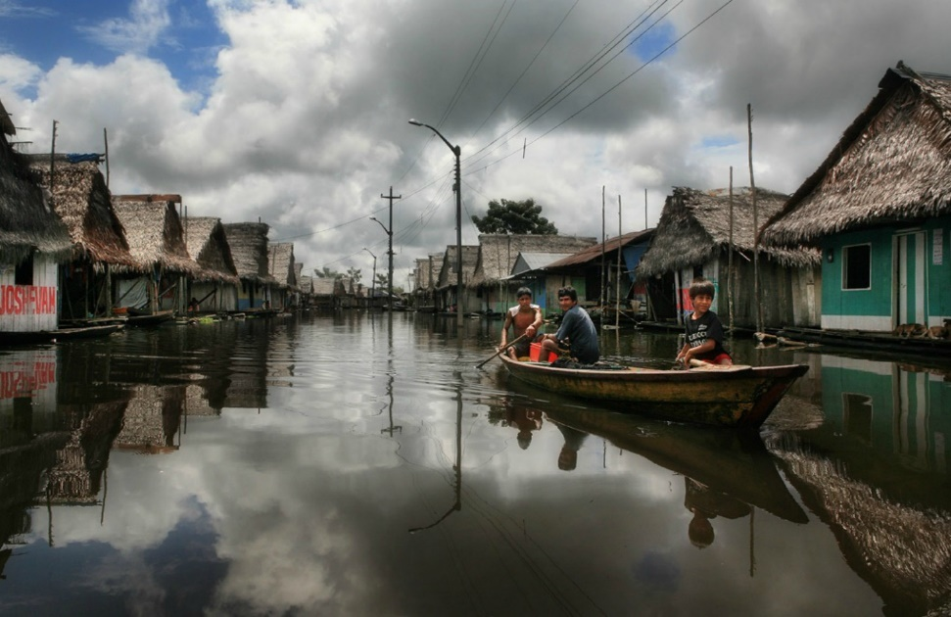
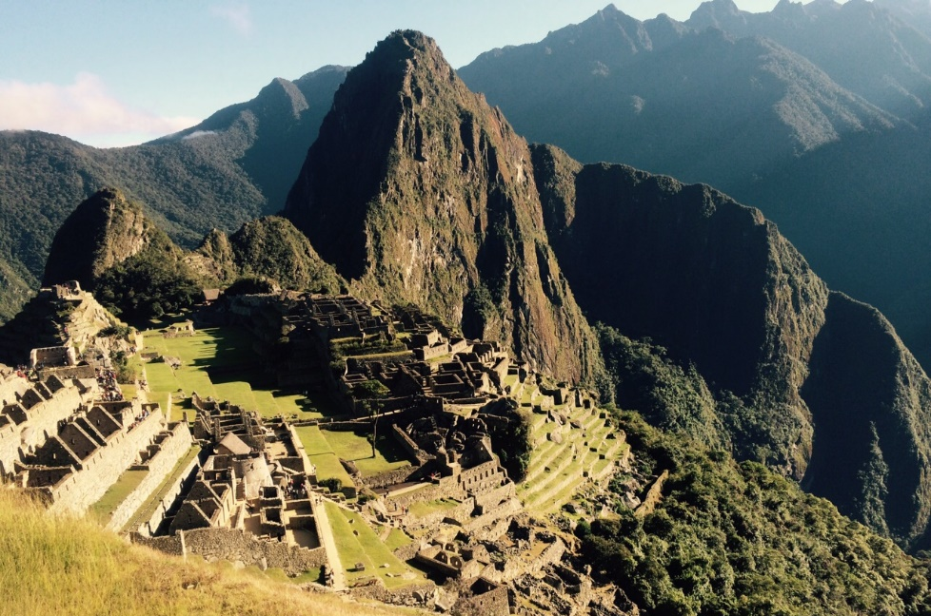
What are the dates, and cost?
Dates: June 22nd through July 12th (last year’s dates)
Volunteer Portion Cost: Estimated at $2,000
$1, 100 for round trip international flights
$200 for Lima/Iquitos/Lima flights
$700 for food, lodging, translators, bus, boats, jungle excursion, medications & supplies, and administrative support
Cuzco Portion Cost: $1,000
$850 for hotels, guides, tickets for Machu Picchu and the Sacred Valley, all ground transportation, bus, train to Agua Caliente, daily breakfast, buffet on the Sacred Valley tour day
$150 for lunch and dinner each day, and activities
Notes:
The dates that were reserved for the 2015 trip and scheduled with our on-site host were June 22nd through July 12th. The dates were chosen so that M1 students were able to take an elective over the ‘Elective Period’ that is traditionally the second and third weeks of June. The dates can be flexible as long as students are back in the U.S. by the time that second year starts at the end of July. It is important to be put on the schedule with ‘The Rural Amazonian Health Initiative’ and ‘People of Peru Project’ as early as possible so as to prevent overlap with other teams.
As far as cost goes, the trip is divided into two portions, the mandatory volunteer portion, and the optional Cuzco portion. The Cuzco portion is just tourism, however, is worth the extra money for the experience.
The cost for the volunteer portion is going to be approximately $2000 and is mostly dependent on the international flight cost. This amount covers the Lima/Iquitos/Lima round trip flight, food, lodging, translators, bus, boats for the Amazon River, overnight jungle excursion, medicine and supplies for the clinic days, follow up for patients after our group is gone, and whatever administrative support needed while in Iquitos. The headquarter facility where we will be staying has wifi, a food service program, and 24 hour security. Also, the 12 volunteer days covers the total 60 Service Learning hour requirement (it actually counts as 108 SL hours).
The cost for the optional Cuzco portion is $1,000. $850 of that covers hotels, tour guides, tickets for Machu Picchu, tickets for the Sacred Valley, all ground transportation including airport pickup and return, bus and train to Agua Caliente (at the base of Machu Picchu), breakfast every day, and a buffet on the Sacred Valley tour day. The rest covers lunch and dinner each day, and most of the available activities you can do on the ‘free day’ such as motorcycle touring, horseback riding, paragliding off the Andes, shopping, etc.

Slide 4
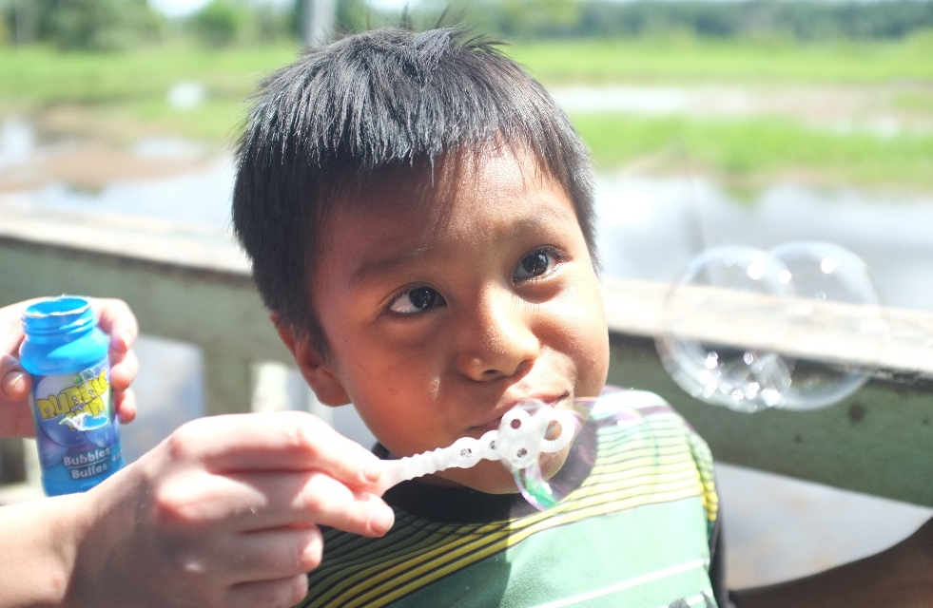
What are the logistics?
Breakdown:
Travel days – Flight time (~3 days)
Iquitos – Jungle clinics, preparation days & Iquitos tour (~11 days)
OPTIONAL
Cuzco – Tour Machu Picchu & the Sacred Valley (~5 days)
Lima – Tour (~1 day)
Other:
Sleeping
Hammocks on the boat or in tents
Bathing
Iquitos/Cuzco/Lima – Showers
Jungle – Amazon River
Notes:
As far as logistics go, this trip involves taking a boat into the jungle to serve several small villages, it will also include experiencing the other end of the Peruvian health care system by volunteering in a hospital in Iquitos, and will end with a little fun exploring Machu Picchu in the historic city of Cuzco if you choose to do that portion of the trip.
You will sleep in hammocks on the boat or sleep in tents in the schoolhouse depending on number of people and space. You will have showers in Iquitos, Cuzco, and Lima, however, in the jungle you will be bathing in the Amazon River.
I am not going to lie, it sounds like all fun, but this trip isn’t a luxury trip. It’s not all about the tourism, the monkeys, or the toucans. You will be hot and sweaty most of the time, the spiders are big and the anacondas are real, but it is all worth it to serve a people group that has zero access to care. It truly puts medicine into perspective.

Slide 5
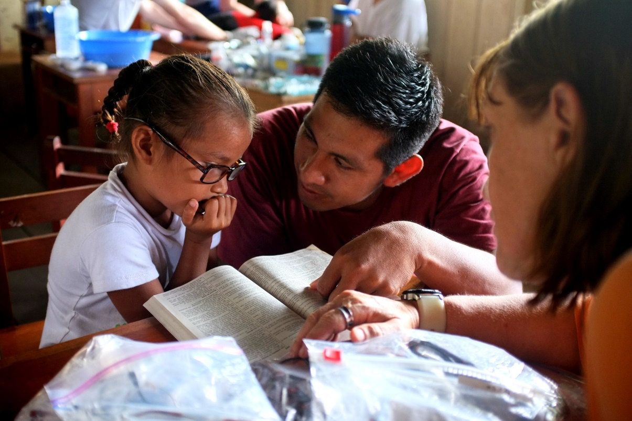
What do we do in clinics?
In our clinics you will get opportunities to:
Triage
Take Vitals
Medical Education
Dental Education
Dental Assisting
Pharmacy
Physician Assisting
Minor Wound Cleaning
What else?
Community Outreach
Play!
Notes:
In the clinics you will get the opportunity to experience all areas of health care including triaging patients where you will take vitals and utilize your ICM skills, organizing and packaging meds in the pharmacy, assisting the dentist with extractions, assisting and shadowing the physicians doing non-invasive procedures within your current scope of practice, and lastly, participating in medical and dental education.
As an advocate of Public Health, the education portion of our clinics is something that is important because it focuses on preventing disease, prolonging life, and promoting health. If we can sufficiently educate, these people can stop dying from preventable causes.
The other important things done in villages involve community outreach and playing soccer with the kids. Building a repor with the community increases the likelihood that they will adhere to our prescriptions and utilize the medical and dental education materials because they know we truly care about their well-being. Rural Peruvians have been treated poorly by other volunteer efforts as well as their own health care system, so when they understand that we aren’t there to tell them that all they do is wrong and Americans know everything, they tend to be more open to change.

Slide 6
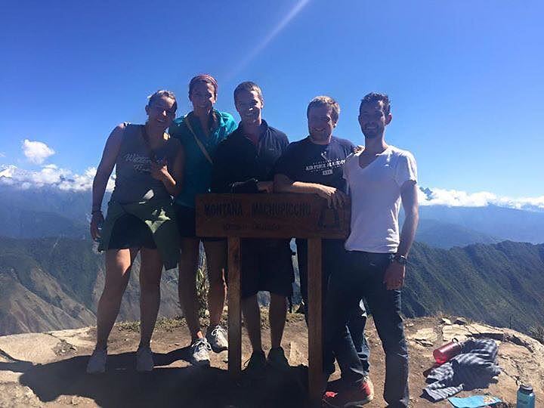
What do we do in Cuzco?
In Cuzco you will get opportunities to:
Tour the Sacred Valley
Hike Machu Picchu
Climb Machu Picchu mountain or Huayna Picchu mountain
Explore the city
Notes:
If you choose to do the tourism portion of the trip, in Cuzco you will get the opportunity to explore the city, go to the San Pedro Market (one of the largest markets in Peru with some interesting things you can buy: http://www.everintransit.com/weird-wonderful-things-at-cuscos-san-pedro-market/), take a two day tour of the Sacred Valley, take a train to Agua Caliente, hike Machu Picchu, and climb Machu Picchu mountain (2,139 feet) or Huayna Picchu mountain (1,158 feet).
Machu Picchu is an amazing sight to see. It was built by the Incan Pachycute, and according to legend was a secret city for semi-gods to be educated to rule human people. Machu Picchu was protected by two sets of mountains encircling the city (Machu Picchu mountain & Huayna Picchu mountain), the jungle, and the Urobumba River which protected it from Spaniard invasion and destruction. This is why it is the only major Incan ruins still intact today in the country of Peru. For centuries, Machu Picchu was hidden from view until it was scientifically discovered by a U.S. history professor from Yale, Hiram Bingam. He presented his findings for increased exploratory funding and to National Geographic who named it one of the '7 Wonders of the World'.

Slide 7
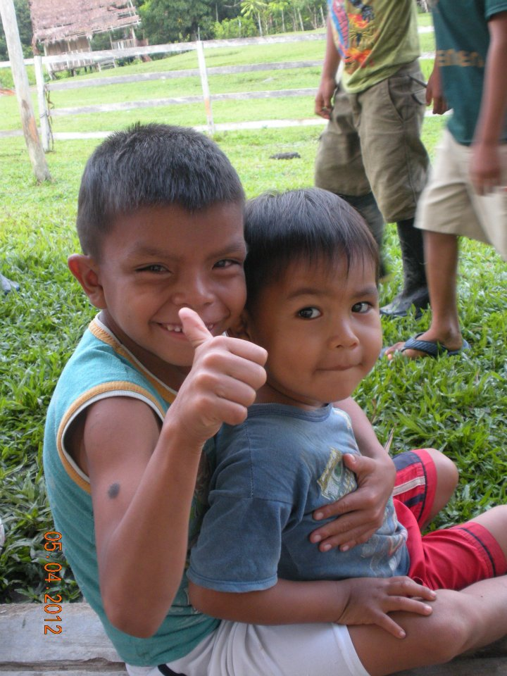
What did we learn?
Many of us learned that medical missions is something that we want to integrate into our lives as future physicians.
We learned how to diagnose many different tropical diseases.
We were able to utilize our ICM skills to treat patients.
We learned about the Peruvian health care system and how their physicians approach different diseases.
We learned more about Peru’s history, how the perceive Americans, and how they perceive medical mission organizations and volunteers.
Overall, we learned a lot about ourselves on this trip while also learning about the country, and learning more about medicine.
Notes:
Some people think it's strange that we would spend so much money and time to go to a third-world country for a few short weeks to deliver medical care. How can it make a difference to the health of these people? On the other hand, more people want to learn more and get involved. What is a medical mission? What is involved? And why would one want to do this?
There are many reasons for wanting to do a medical mission trip: the sense of adventure, a chance to see another country up close and personal, a meaningful vacation. When done in the right spirit, medical mission trips are much more than a vacation, they truly become a life-changing experience. It is easy to go on mission trips with the expectation that we are helping someone less fortunate than ourselves. What we often find is that we are touched and changed by the experience far more than the people that we are there to help. As Ralph Waldo Emerson said, "It is one of the most beautiful compensations of this life that no man can sincerely try to help another without helping himself."

Slide 8
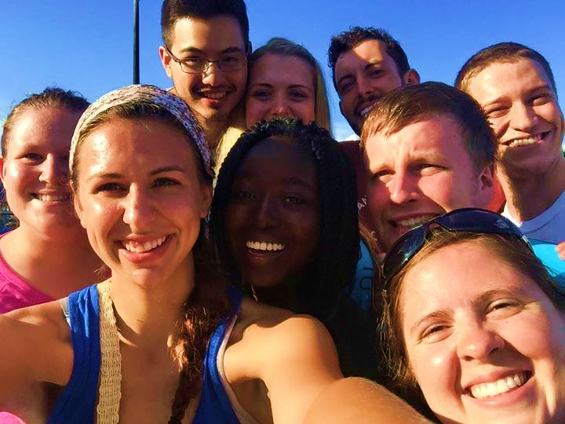
What was difficult?
This is not an easy trip. It is difficult to sleep in hammocks on boats or in tents in a schoolhouse. It is hard to go more than a week in heat while only bathing in the Amazon River. Its hard to live off of a boat and out of a single bag/backpack. Its hard to communicate when you have limited Spanish language skills.
The list goes on, however, every difficult experience is worth it to see one smile, hear one laugh, touch one heart. In the Peruvian Amazon, you will literally save lives and that is what will end up changing yours.

Slide 9
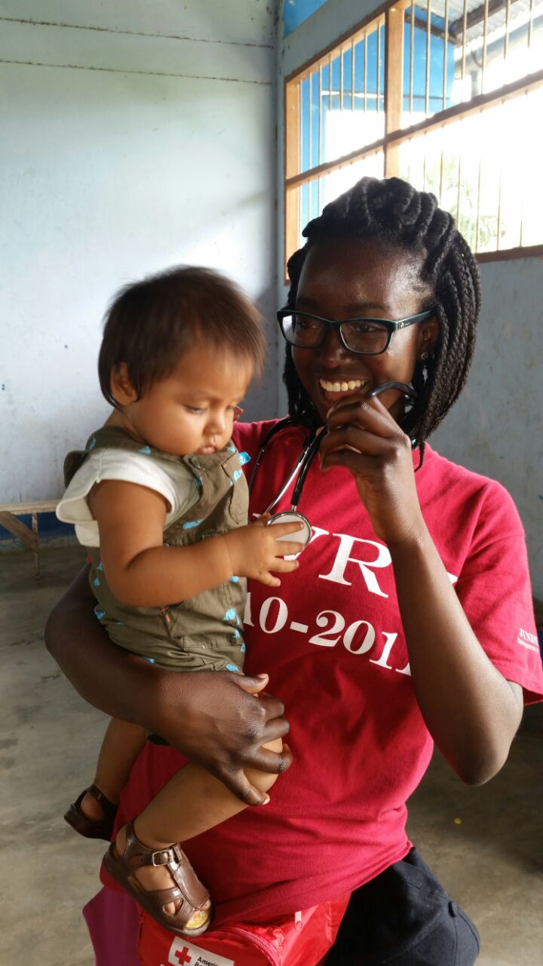
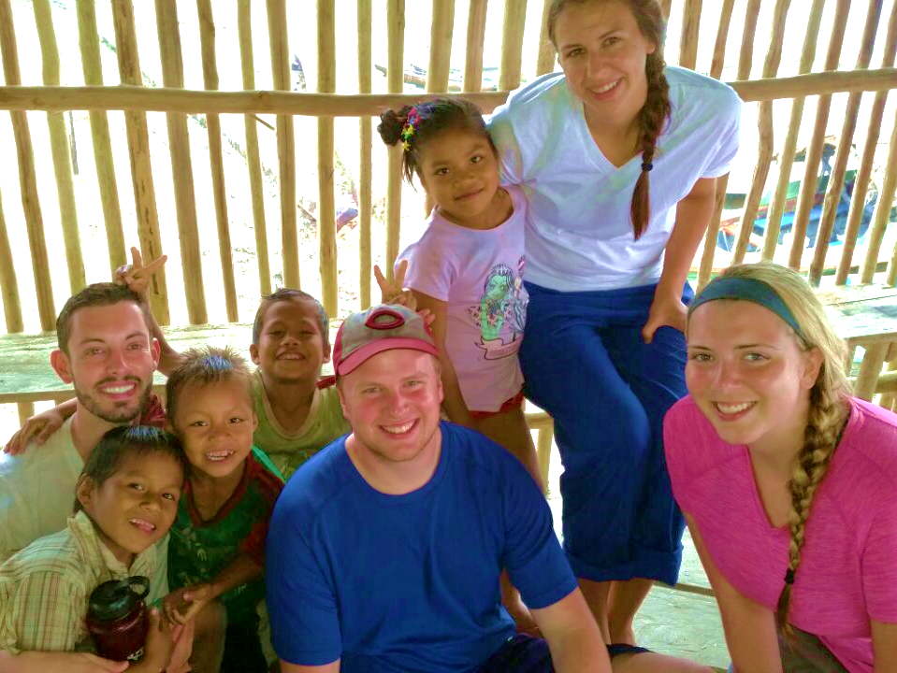
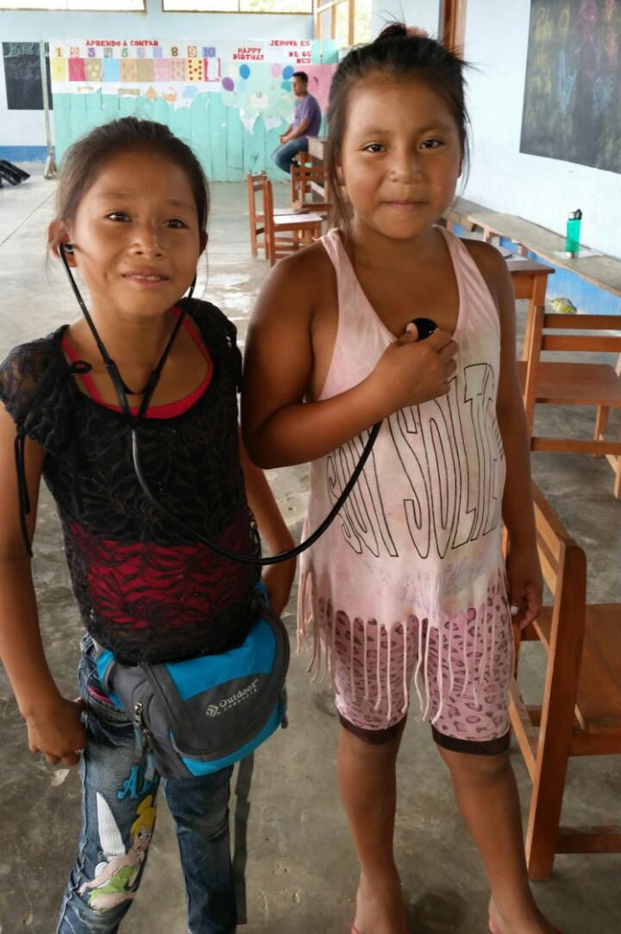
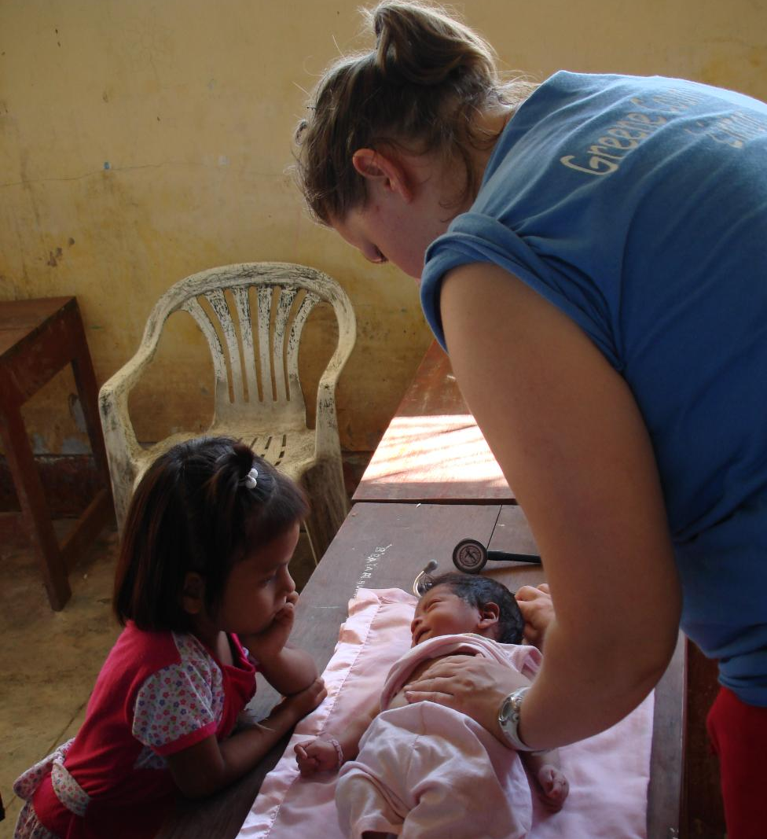
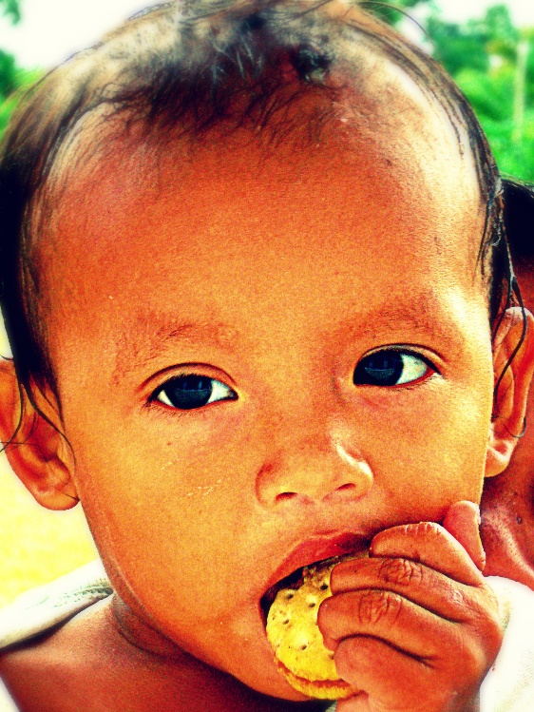
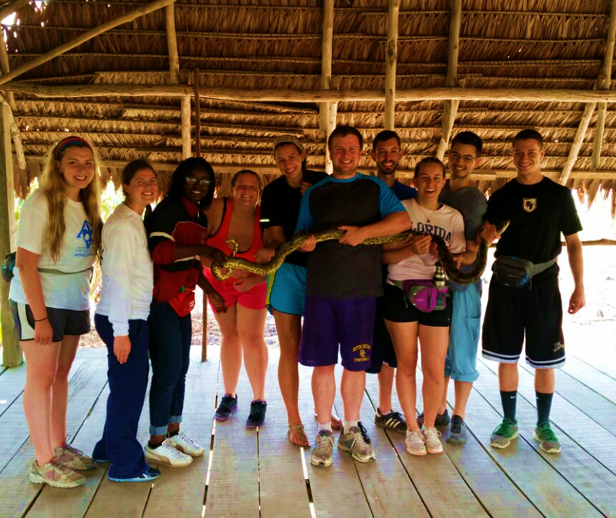
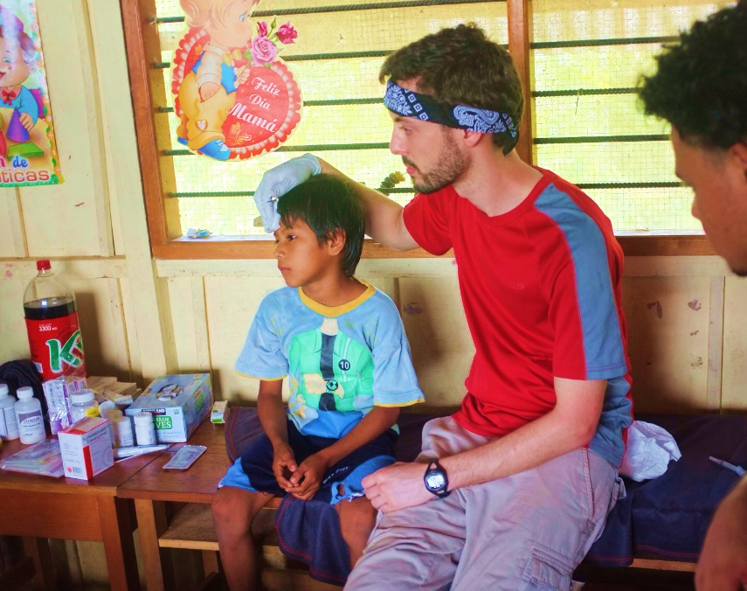
Notes:
It is easy to struggle with why we were given the opportunity to grow up with options, family support, and a good education… these rural Peruvians don’t get all that. Whether you go to Peru or somewhere else, find your reason for the privileges you’ve been given and give back to a world you didn’t even know existed.

Slide 10
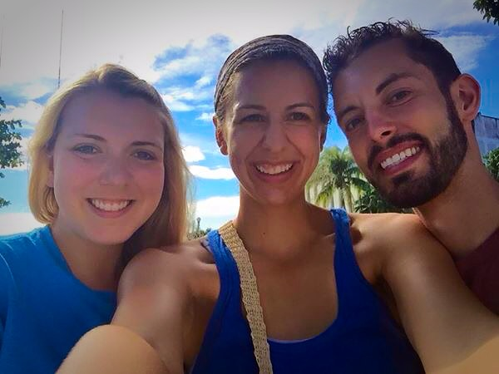
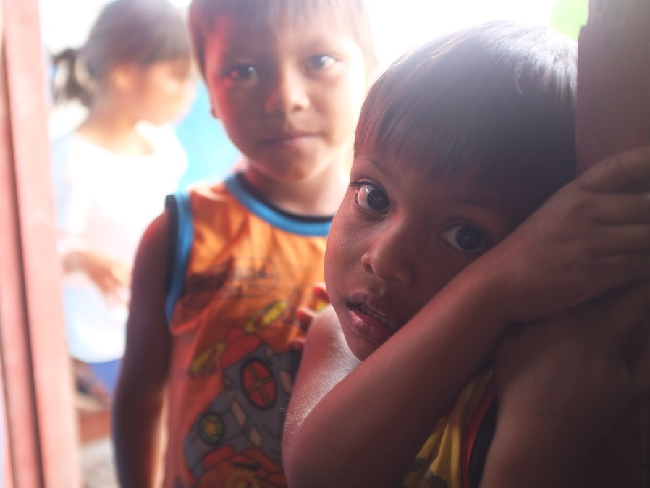
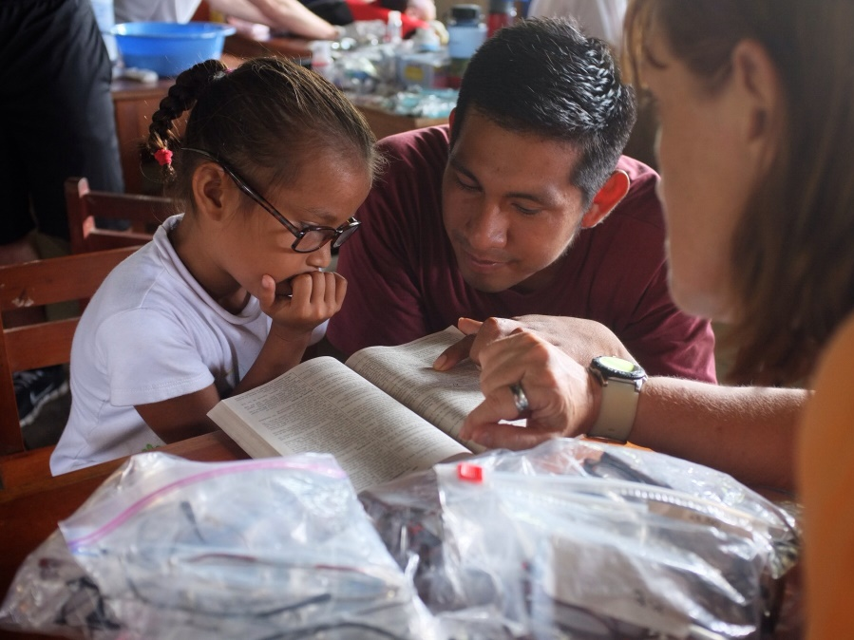
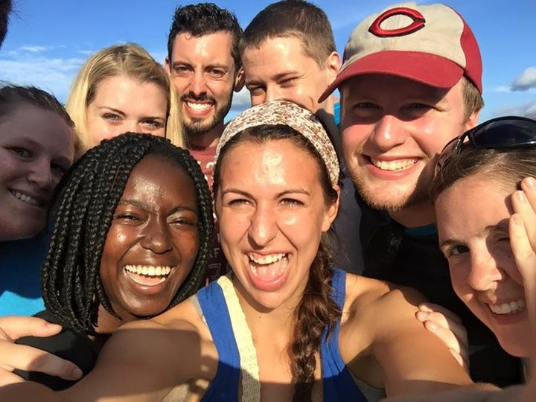
Check out more photos on our The Rural Amazonian Health Initiative website!
Notes:
For more photos, check out the Flickr account on our website: http://ruralamazonianhealthinitiative.zohosites.com/pictures.html

Slide 11
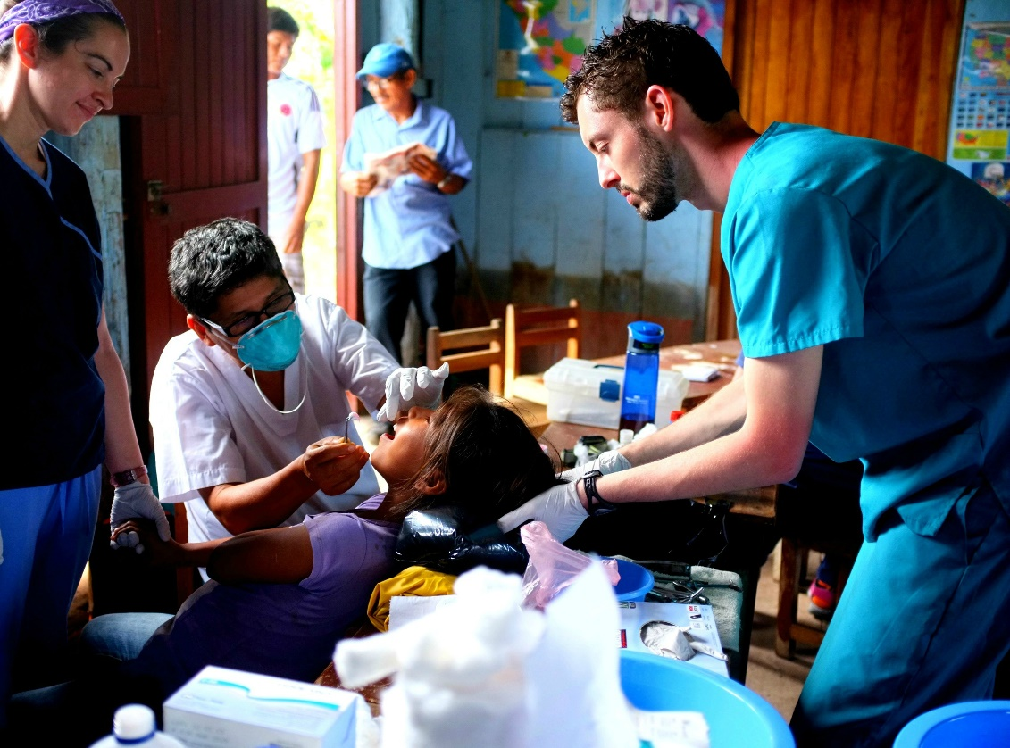
Organization Contact Information
Jonathan M. Stofer MPH, EMT
Wright State University
Boonshoft School of Medicine
MD candidate, Class of 2018
Cell Phone: 419.961.2285
Email: stofer.3@wright.edu
Website: http://ruralamazonianhealthinitiative.
zohosites.com
Notes:
“Peru and its people mean a lot to me and it would mean a lot to share the experience with you guys.
Please let me know if you have any questions, Peru is one of my favorite things to talk about, and if you are interested in exploring the jungle, please sign up for this trip!” - Jon

Slide 12
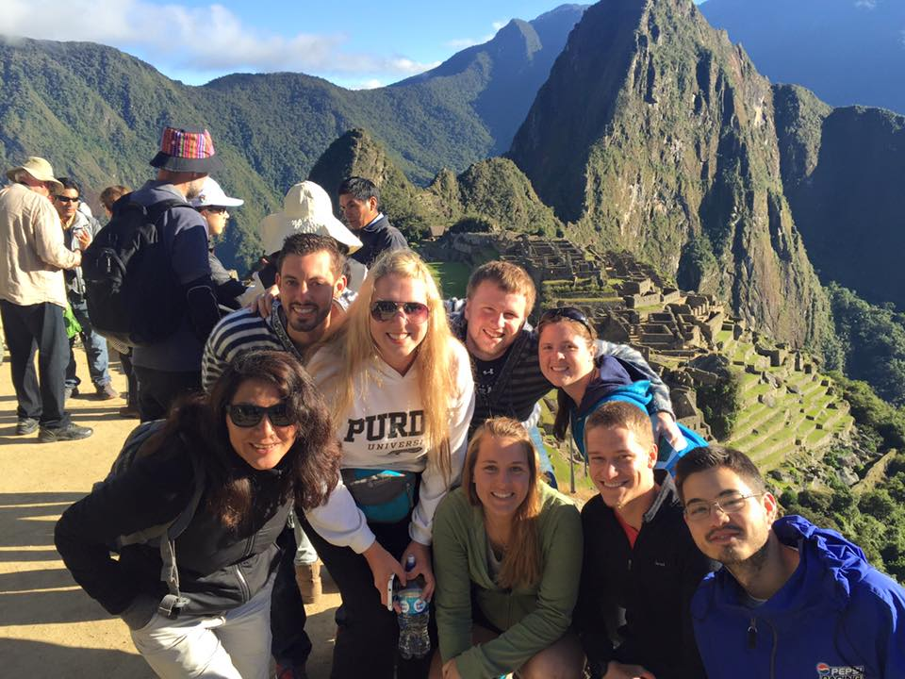
Student Contact Information
Peace Aminu, aminu.3@wright.edu
Kenneth Danielson, danielson.8@wright.edu
Bryan Grove, grove.24@wright.edu
Chris Ingersol, ingersol.2@wright.edu
Shaina Logemann, logemann.2@wright.edu
Lorena McConnell, mcconnell.48@wright.edu
Sydney Shepherd, shepherd.85@wright.edu
Claire Triplett, triplett.11@wright.edu

