Slide 1
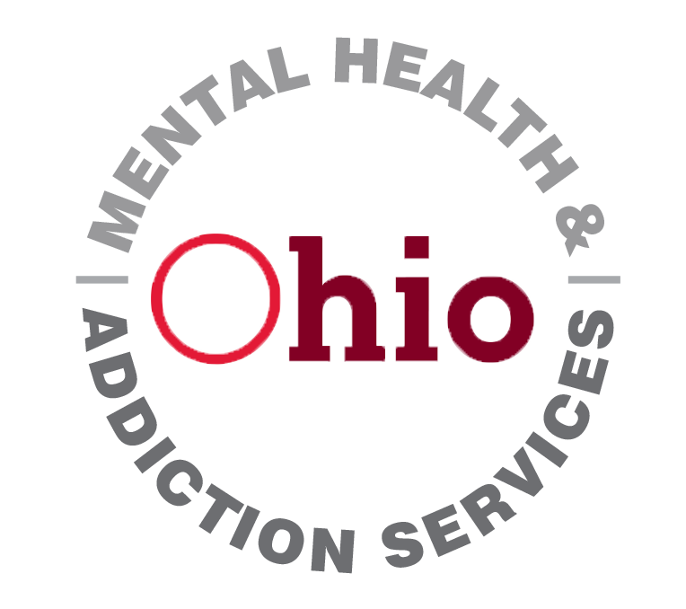
Screening, Brief Intervention, and Referral to Treatment

Slide 2
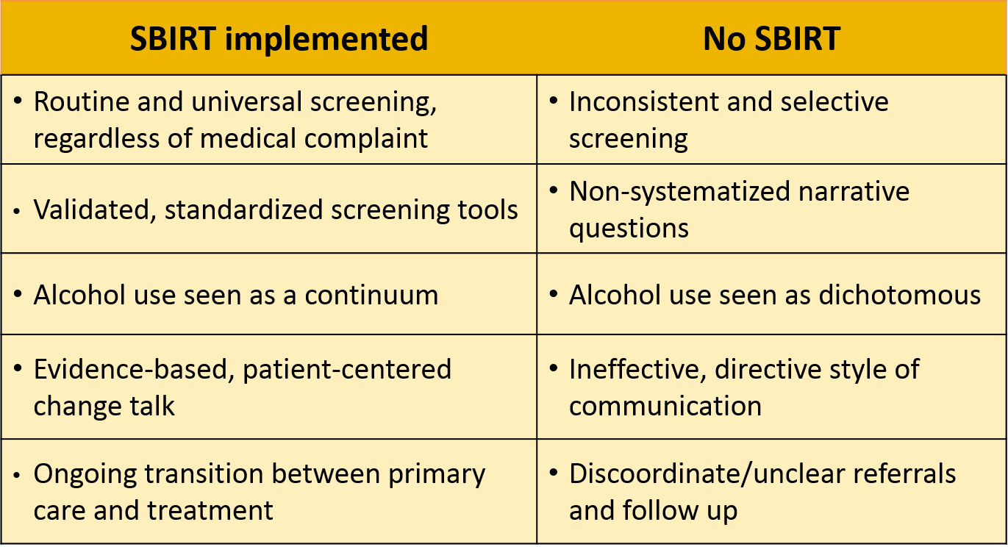
SBIRT vs. business as usual
Notes:
Many providers believe they already adequately address substance use without SBIRT processes in place, but there are important differences. With SBIRT implemented:
All patients are automatically screened for substance use, as opposed to relying on the chance that clinicians address it with only the patients who warrant screening.
Validated screening tools can do much of the work in identifying unhealthy substance use, while untested questions may not provide useful information.
Many clinicians view alcohol use under an alcoholic vs. non-alcoholic dichotomy, while SBIRT recognizes that substance use falls along a spectrum.
Brief interventions are evidence-based and employ Motivational Interviewing, as opposed to directing a patient to change their behavior.
Patients receiving specialized treatment for substance use continue to receive care from their PCP under SBIRT.

Slide 3
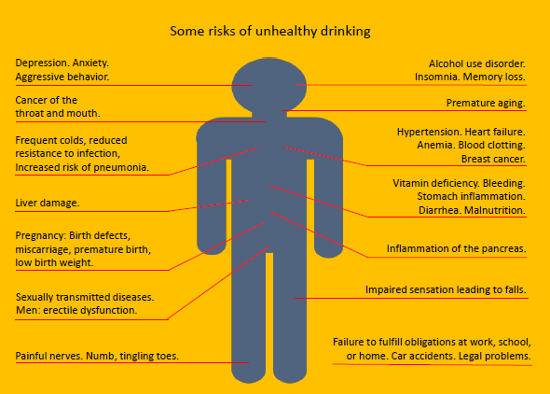
Medical and psychiatric harm of high-risk drinking
Notes:
Nearly every system in the body is impacted by alcohol use.
Premise of SBIRT is to link their physical complaint to their alcohol use.
Encourages not to address physical complaints in isolation but rather as coordinated with one another..

Slide 4

  USPSTF on alcohol SBI
    For both alcohol screening and brief intervention
    Adults and pregnant women
    Insufficient evidence for adolescents
Class
B
rating
Class
B
rating
USPSTF, 2004, 2013, 2018
Notes:
The U.S. Preventive Services Task Force has already looked at both the screening and brief intervention components of SBIRT, and given it a “B” rating, which means there is good evidence to recommend these processes. The evidence applies to adults and pregnant women. There is not yet enough evidence to determine the effectiveness of SBI with adolescent patients, or with Referral to Treatment in general.
Citation: United States Preventative Services Task Force: “Final Recommendation Statement Alcohol Misuse: Screening and Behavioral Counseling Interventions in Primary Care.” http://www.uspreventiveservicestaskforce.org/Page/Document/RecommendationStatementFinal/alcohol-misuse-screening-and-behavioral-counseling-interventions-in-primary-care

Slide 5
Alcohol SBI ranks high
Nine highest-scoring preventative services | Score
Aspirin chemoprophylaxis Childhood immunization series Tobacco-use screening and brief intervention | 10
Alcohol screening and brief intervention Colorectal cancer screening Hypertension screening Inﬂuenza immunization Pneumococcal immunization Vision screening—adults | 8
    25 recommended preventative services
    Ranked on health impact and cost-effectiveness
    Only 3 score higher than alcohol SBI
Maciosek, et al. 2006
Notes:
However, when preventative services are ranked according to their health impact and cost effectiveness, SBIRT receives the same score as hypertension screening and flu shots. Paradoxically, SBIRT also ranks among the lowest or preventative services that are implemented.
Source: Maciosek MV, Cofﬁeld AB, Edwards NM, Flottemesch TJ, Goodman MJ, Solberg LI. Priorities Among Effective Clinical Preventive Services. Results of a Systematic Review and Analysis. Am J Prev Med 2006;31(1). http://www.prevent.org/data/files/initiatives/prioritiesamongeffectiveclinicalpreventivesvcsresultsofreviewandanalysis.pdf

Slide 6

Adolescent low-risk limit for alcohol use: 0
    Even first use can result in tragic consequences.
    Adolescence is a period of neurodevelopmental vulnerability
    Earlier use increases chance of later addiction.
AAP, 2011
Notes:
There are no low risk limits for adolescent alcohol use. “Even the first use of alcohol or another drug can result in tragic consequences with teens, such as unintentional injury or death. All substance use involves health risks that can occur long before there is addiction, and teenagers seem to be particularly susceptible to health risk–taking behaviors. Research has also established that adolescence is a period of neurodevelopmental vulnerability for developing addictions; age at first use is inversely correlated with lifetime incidence of developing a substance use disorder.”
Citation: “Substance Use Screening, Brief Intervention, and Referral to Treatment for Pediatricians.” AAP, Committee on Substance Use, Pediatrics, 2011. http://pediatrics.aappublications.org/content/128/5/e1330.full.pdf

Slide 7
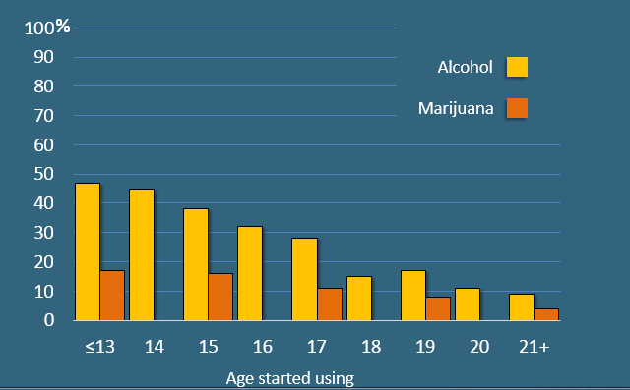
Percent experiencing dependence in lifetime, based on age of first use, U.S.

Slide 8
Adult low-risk limits for alcohol use in the U.S.
    Commonly recognized limits in U.S.
    Standard drink contains .6 oz of pure ethanol
Drinks per week
Drinks per
day
Men
14
4
Women
7
3
Ages >65
7
3
Pregnancy
0
0
NIAAA
Notes:
Low risk is defined as adult alcohol consumption below these amounts. These limits come from the National Institute of Alcohol Abuse and Alcoholism, who analyzed multiple studies of alcohol-related morbidity. Drinking above the weekly limit increases long term risks for outcomes such as heart disease, liver disease, breast cancer, etc. The daily limit defines binge drinking, which increases short-term risks of injuries, automobile accidents, STDS, etc. The difference in limits between men and women come from men being, on average, larger than women, with more blood volume and less body fat. Men also have a higher concentration of dehydrogenase – the enzyme that breaks alcohol down.
What do you think about these numbers?

Slide 9
Why these numbers?
Studies demonstrate that the 5+/4+ limits accurately reflect the amount of alcohol consumed at which psychomotor and cognitive impairment is notably increased in both men and women.
Epidemiologic risk curve analyses reveal significant and rapid increases in the risks of—
    Unintentional injuries
    Deaths resulting from external causes
    Being a target of aggression or taking part in an aggression-related event
    Alcohol use disorders
    Unfavorable medical, work-related, legal, and social consequences related to drinking
As the frequency of exceeding NIAAA’S guidelines increases, the likelihood of developing these problems increases.

Slide 10
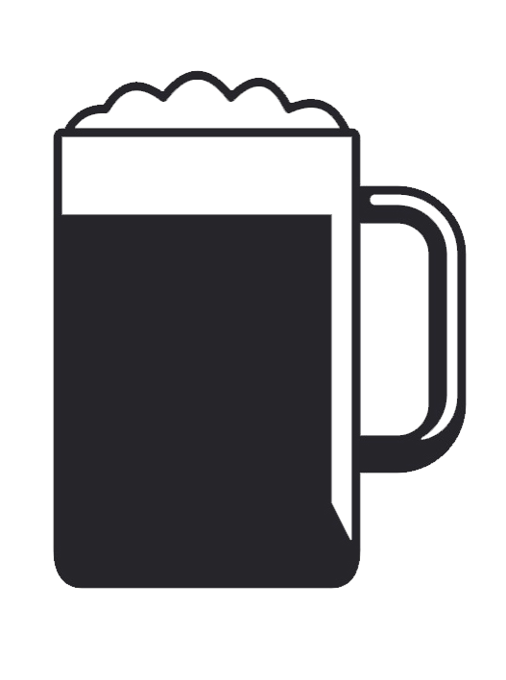
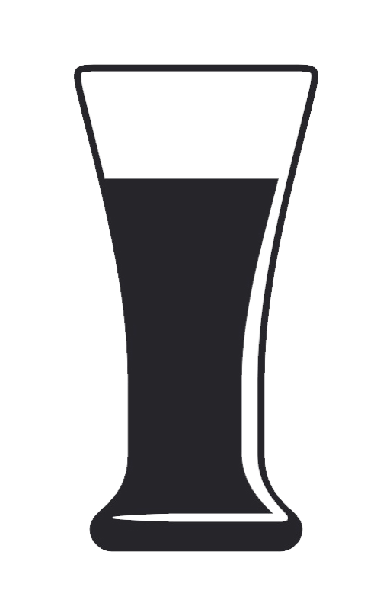
Standard drink: .6 oz. of ethanol
 | Volume | Standard drinks
Beer | 12 oz | 1
 | 16 oz | 1.3
 | 22 oz | 2
 | 40 oz | 3.3
Malt liquor | 12 oz | 1.5
 | 16 oz | 2
 | 22 oz | 2.5
 | 40 oz | 4.5
NIAAA
Notes:
When gauging number of drinks consumed, it’s helpful to know what counts as one drink. In the U.S., a standard drink contains 0.6 fluid ounces of pure alcohol (14 grams or about 1.2 tablespoons), which comes in a variety of servings. An 12 ounce can of beer, for example, is considered one drink. Malt liquor, which has a higher alcohol content and is popular with heavy drinkers, is a drink and-a-half at the same volume.
Citation: National Institute on Alcohol Abuse and Alcoholism. http://pubs.niaaa.nih.gov/publications/Practitioner/PocketGuide/pocket_guide2.htm

Slide 11


Standard drink: .6 oz. of ethanol, cont.
 | Volume | Standard drinks
Wine | 5 oz | 1
 | 750-mL bottle | 5
 | 1.5 liter bottle | 9
 | 5 liter box | 30
Liquor (80 proof) | 1 mixed drink | 1
 | 1 pint (16 oz.) | 11
 | One fifth (25 oz.) | 17
 | 1.75 liters (59 oz) | 39
NIAAA
Notes:
When gauging number of drinks consumed, it’s necessary to know what counts as one drink. In the U.S., a standard drink contains 0.6 fluid ounces of pure alcohol (14 grams or about 1.2 tablespoons), which comes in a variety of servings of beer, malt liquor, wine and liquor.
Citation: National Institute on Alcohol Abuse and Alcoholism. http://pubs.niaaa.nih.gov/publications/Practitioner/PocketGuide/pocket_guide2.htm

Slide 12
I. Screening
Notes:
Now that we have looked at the reasons why SBIRT is an important part of medical care, let’s look at screening specifically.

Slide 13
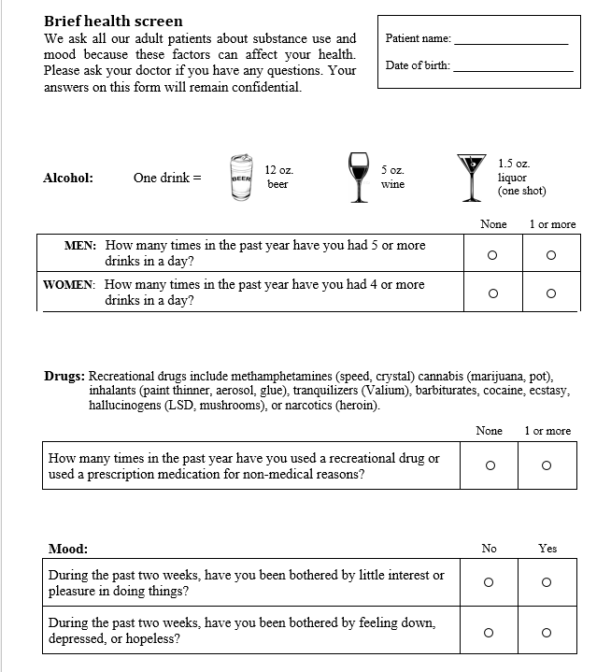
Adult brief screen
    Single item question recommended by the NIAAA
    Sens: 82% Spec: 79% for risky alcohol use
    One alcohol question ➔
    One alcohol question ➔
    Sens: 93% Spec: 94% for past year, self-reported drug use.
    One drug question ➔
    One drug question ➔
    PHQ - 2 ➔
www.sbirtoregon.org
Notes:
The Adult brief screen consists of a single validated question for adult alcohol use, and a single validated question for adult drug use. It acts as a “pre-screen” that filters out most patients who do not have unhealthy alcohol or drug use. Included at the bottom are two questions (PHQ-2) for depression. Depression is not part of SBIRT, but many clinics appreciate streamlining depression and substance use screening onto one paper form.
Citation: www.sbirtoregon.org

Slide 14
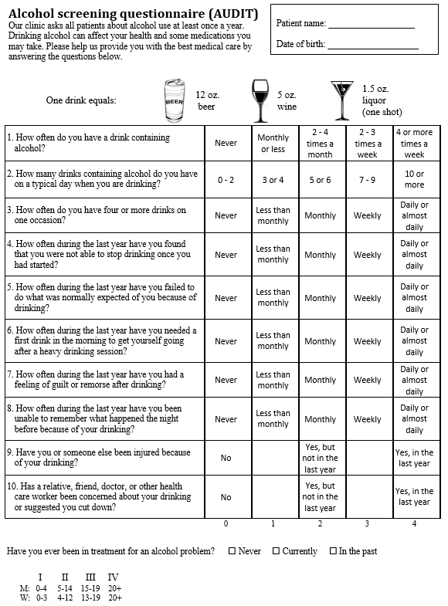
AUDIT
Alcohol Use Disorders Identification Test
Developed by WHO (World Health Organization)

Slide 15
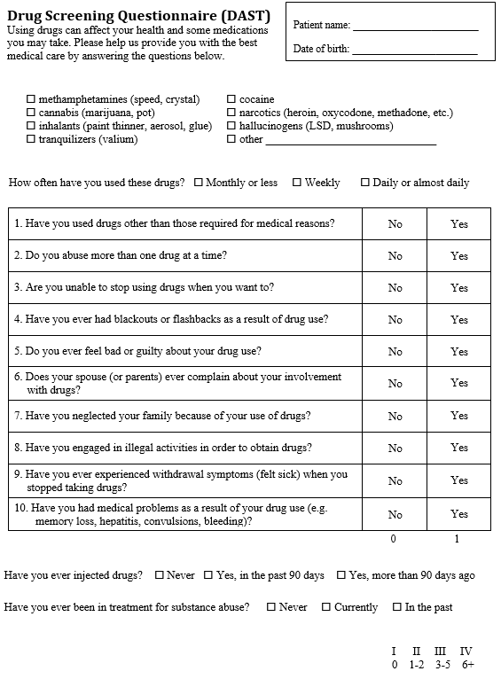
DAST
Drug Abuse Screening Test
10 items
Brief screen of drug use over the past 12 months

Slide 16
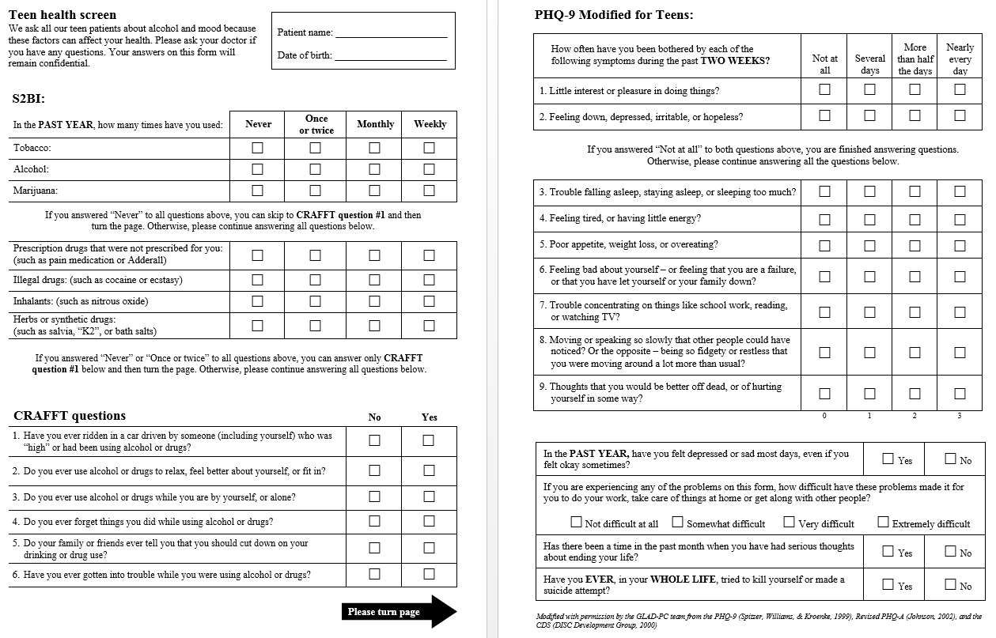
S2BI

Slide 17
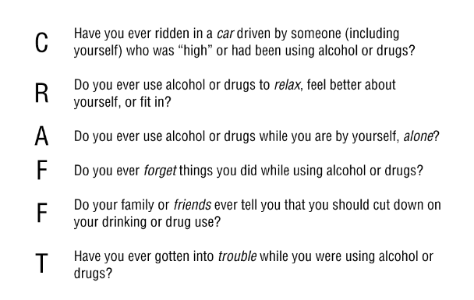
CRAFFT – Adolescent Screening

Slide 18
Screening Forms
https://www.sbirtoregon.org/screening-forms/

Slide 19
Zones of substance use
IV
Severe
III
Harmful
II
Risky
Low risk
I
Notes:
These are commonly used categories that stratify alcohol and drug use. The largest number of people fall into the Low-risk zone. We will look at how each category is defined.

Slide 20
Zone I: Low risk
    Defined by:
      No use, or
      Adult alcohol use within low-risk limits
    Low-risk limits do not apply to drug use
IV
III
II
Low risk
I
Notes:
The Low risk zone is defined by abstention from any use, or adult use of alcohol at low risk amounts. Low risk amounts have not been established for drug use or for adolescent alcohol use.

Slide 21
Zone II: Risky
    Defined by:
      Alcohol use that exceeds low-risk limits
      Any adolescent use
      Any recreational drug use
    Not (yet) dealing with consequences of use
IV
III
II
Risky
I
Notes:
The Risky zone is defined by adult drinking above low-risk alcohol limits, adolescent use of any substance without associated problems, or any drug use without associated problems. Individuals in the Risky zone are not currently experiencing negative consequences from use, but are likely to create new health problems or make existing ones worse over time. Any drug use is considered risky – partly because we do not yet know what amount of drug use poses short and long term risk, and because most drugs remain criminalized, which means pts can face consequences from a urine test at work or legal trouble.

Slide 22
Zone III: Harmful
    Defined by:
    Repeated negative consequences from use
    Failure to fulfill some major obligations
    Use continues despite persistent problems
    Likely correlates with mild or moderate SUD
IV
III
Harmful
II
I
Notes:
Patients who score into the Harmful Zone of use are not only using above low risk limits, but are likely dealing with some consequences associated from their use. They are starting to fail to meet some obligations due to their use. If they were formally diagnosed, they would probably be experiencing a mild or moderate substance use disorder.

Slide 23
Zone IV: Severe
    Defined by:
    Patient’s life orbits around use
    Distress or disability
    Tolerance and withdrawal
    Use in larger amounts or longer period than intended
    Likely correlates with moderate or severe SUD
IV
Severe
III
II
I
Notes:
Pts who score into the Severe zone spend a lot of time finding and using alcohol or drugs. If they were to stop using they would experience withdrawal symptoms. They may have tried to cut back or quit several times in the past but have failed. These individuals typically are unable to cut back to low risk levels of use, and need to abstain with specialized assistance. They would likely be formally diagnosed with a moderate or severe substance use disorder.

Slide 24
Alcohol use among adult patients
Emergency Room
Primary Care
5%
Severe
22%
Harmful
8%
26%
9%
9%
Risky
Low risk
Low risk: 38%
Abstention: 40%
Low risk: 38%
Abstention: 40%
Low risk or abstention: 74%
Ann Emerg Med, 2007. Manwell, et. al, 1998
Notes:
Large studies show that about 22% of primary patients (drinking patterns over past 90 days) have unhealthy alcohol use, and 26% (drinking patterns past 12 months) in ER departments. Notice that the smallest number of patients score into the Severe category. Most patients with unhealthy alcohol use do not need a referral to specialized treatment – most will only need a brief intervention. Therefore, SBIRT is not primarily a method that addresses patients with severe alcohol use disorders. Instead, it more often identifies risky and harmful drinkers before they suffer worst consequences over time.
Citation: Manwell LB, Fleming MF, Johnson K, Barry KL. Tobacco, alcohol, and drug use in a primary care sample: 90-day prevalence and associated factors. J Addict Dis. 1998;17(1):67-81. http://www.ncbi.nlm.nih.gov/pubmed/9549604
Academic ED SBIRT Research Collaborative. The Impact of Screening, Brief Intervention, and Referral for Treatment on Emergency Department Patients’ Alcohol Use. Ann Emerg Med. 2007 Dec;50(6):699-710, 710.e1-6. Epub 2007 Sep 17. http://www-ncbi-nlm-nih-gov.liboff.ohsu.edu/pubmed/17870206

Slide 25
Interventions and zones
Referral to specialized treatment
Severe
IV
    Brief intervention/referral
III
Harmful
II
Risky
    Brief intervention
    Positive reinforcement
Low risk
I
Notes:
Which intervention is appropriate to deliver to a patient depends upon the category of use the patient scores into as a result of completing a screening tool, as well as the judgment of the clinician or behavioral health specialist.

Slide 26
Work Flow
Ideally:
Front desk personnel distribute annual screen
MA’s distribute full screens as indicated
AUDIT/DAST should be completed by patient before provider enters the room
Provider’s job is to quickly score the full screen and deliver brief intervention if necessary

Slide 27
II. Brief Intervention
Notes:
Now that we have looked at the reasons why SBIRT is an important part of medical care, let’s look at screening specifically.

Slide 28
Steps of the brief intervention
Raise subject
Provide feedback
Enhance motivation
Negotiate plan
D`Onofrio, et al., 2005
Notes:
There are several models of brief variations but for the most part they all contain the same essential elements. The model we are presenting is called the Brief Negotiated Interview and was first developed for use in Emergency Room Settings. This BI model is an adaptation of Motivational Interviewing and adheres to the spirit and principles of MI.
Citation: The Yale Brief Negotiated Interview Manual (2005) Gail D`Onofrio, Michael V. Pantalon, Linda C. Degutis, David Fiellin, Patrick G. O’Connor, Yale University School of Medicine

Slide 29
Steps of the brief intervention
Raise subject
  Screening forms act as conversation starters
  Ask permission
  “Tell me about your substance alcohol/drug use”
Notes:
“Now that we have addressed your sore throat, I notice the screening form that you took the time to fill out beforehand – thank you for doing that. Is it ok if we have a look together?” Asking permission helps establish a sense of the patient’s concerns and wishes are central to the intervention. It also sends the message you are about to embark on a conversation together, rather than delivering a one-sided lecture. If the patient gives permission, it’s good to start with asking them, in their own words, to describe their substance use. This will provide information that may not have been disclosed on the screening tool.

Slide 30
Steps of the brief intervention
Provide
feedback
  State zone of use
  Ask and explain connection between use and health issue
  State low risk limits
  Give recommendation to reduce use or abstain
Notes:
How feedback is delivered will dramatically affect how a person receives the feedback – important to demonstrate empathy during this step. Your patient deserves to know the facts, regardless if they want to change their behavior. Facts such as: his/her AUDIT and DAST score, any connections between alcohol/drug use and the health problems addressed by this visit, and NIAAA guidelines for low-risk drinking. This step is particularly important for individual who are in the precontemplation stage as it provides them with information that might create some discrepancy in how they view their drinking and how it is viewed from a health perspective. An example might be a woman who drinks 2-3 glasses of wine every night, but has never considered this to be a problem. Even if she verbalizes not thinking her alcohol use is a problem she will leave the clinic thinking about the discrepancy between her perception of her use and the information she just received about her use relative to others and her health risks.

Slide 31
Steps of the brief intervention
Enhance
motivation
  Ask and reflect about perceived pros and cons of use
  Use the 0 – 10 scale
  “Why not a lower number?”
Notes:
Patients use alcohol and drugs for positive reasons, and it’s important to ask (and reflect back) what they perceive as the pros and cons of their use. Recognizing when the cons of a behavior begin to outweigh the pros is what can lead to behavior change. Assess Readiness to change by using the readiness ruler: “On a scale from 1-10, with 1 being not at all ready and 10 being very ready, how ready are you to change any aspect of your drinking?” Asking why they chose that number rather than something lower encourages the patient to verbalize what motivation does exist to change, even if it is small on a scale. If a patient tells you he/she is a 1 or 2 use a follow-up questions such as “What would have to happen for you to think about changing your drinking habits?”

Slide 32
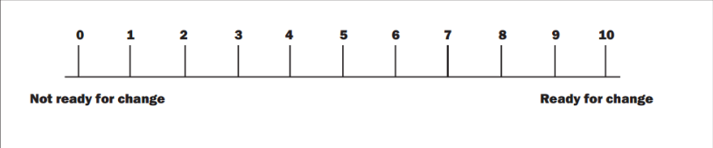
The Readiness Ruler
“On a scale of 0 to 10, how ready are you to decrease your use?
Score | Readiness | Stage of Change
0-3 | Not Ready | Pre-contemplation; Early Contemplation
4-7 | Unsure | Contemplation
8-10 | Ready | Preparation; Action

Slide 33
Steps of the brief intervention
Negotiate
plan
  If patient sounds ready, ask,
  “What would change look like for you?”
  Re-state your recommendation
  Ask to schedule follow-up
Notes:
If the patient seems ready enough to make a positive change with their drinking or drug use, the next step is to ask, “so what would that look like for you?” Patients may come up with a variety of plans to change their behavior, which may or may not achieve your recommendation, such as: cut back on how often I drink: cut back on how much I drink on days when I do drink; never drink and drive; a trial period of not drinking; stop drinking entirely; get help from someone with my drinking; do nothing. Discussing a plan can build self-efficacy by avoiding being argumentative, clarifying goals, giving advice with the patient’s permission, and expressing optimism in his or her intent to change. Remember to re-state your recommendation at the end and suggest follow-up for drinking level/pattern with an appropriate person, and provide any contact information necessary.

Slide 34
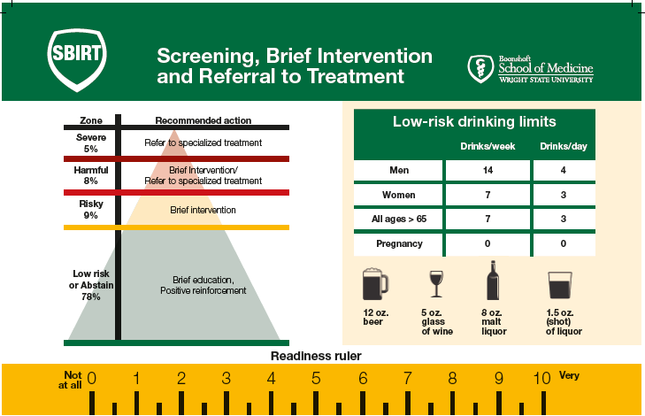

Slide 35
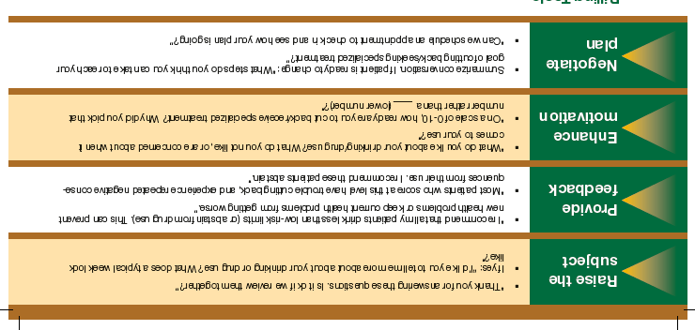

Slide 36
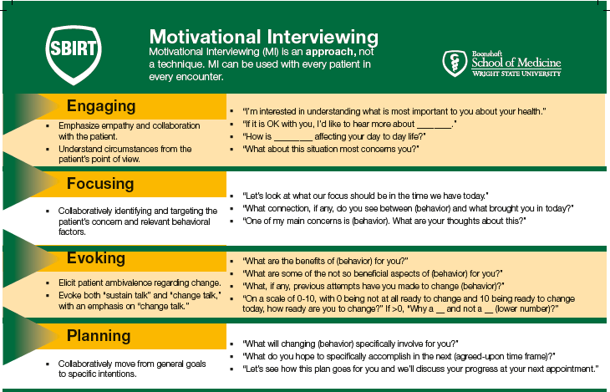

Slide 37
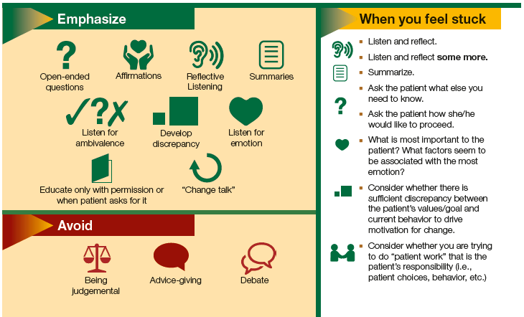

Slide 38
https://www.sbirtoregon.org/video-demonstrations/

Slide 39
Adult Brief Intervention
https://www.youtube.com/watch?v=MaxHuf17A44

Slide 40
Adolescent Brief Intervention
https://www.youtube.com/watch?v=GvaOXREccHI

