Slide 1
Evidence-Based Medicine:
Current Trends and Effective Teaching Methods
STReME 2010 series
October 6, 2010
Marc A. Raslich, MD
Internal Medicine & Pediatrics

Slide 2
Plans for today
Information and Ideas
  Explain background EBM methodology and what is expected of the students in the clinical realm
Share
  Share experiences from biennium 1 and 2
  Review common EBM teaching points
Reflect and Participate
  Incorporate an EBM objective into a current teaching activity

Slide 3
Clinical scenario
41 year-old male
Refuses to act in accordance with stated age and ill-advisedly plays basketball with a group of robust teenagers
Sprains right ankle following a violent, flagrant foul
Immediate swelling and difficulty bearing weight on the court
Found to have point tenderness just below the lateral aspect of his right ankle

Slide 4
Information and Ideas

Slide 5
Think
Take 2 minutes to consider and record on the provided worksheet:
  What type of knowledge/information would be necessary for a clinician to make the “best” clinical decisions in this case

Slide 6
Pair-Share
In groups of 2-3 – briefly discuss and record your responses
  Try to pair with people from outside your specialty

Slide 7
Some of my thoughts
Clinical findings and manifestations – anatomy and H/P skills
Etiology
Differential diagnosis – sprain vs fracture
Therapy – “RICE”, medications
Diagnostic testing – need and choice
Prognosis – with and without therapy
Prevention
Patient context
Counseling skills

Slide 8
Think
Take 2 minutes to consider and record on the provided worksheet:
  Where do you think clinicians acquire this information?

Slide 9
Pair-Share
In groups of 2-3 – briefly discuss and record your responses
  Try to pair with people from outside your specialty

Slide 10
Resources
Experience
Colleagues
Specialists
Textbooks
Journal articles
Internet (Wikipedia!)

Slide 11
Should clinical decisions be based on the most valid resources we’ve identified?
Yes
No

Slide 12
Think again
Take 2 minutes to consider and record on the provided worksheet:
  How does a clinician determine which of the numerous resources available is the most relevant and valid?

Slide 13
Pair-Share
In groups of 2-3 – briefly discuss and record your responses
  Try to pair with people from outside your specialty

Slide 14
Selecting evidence to apply to patient
That’s EBM in a nutshell!

Slide 15
EBM: My interpretation
Mostly taken from CDM course at the beginning of second year – consider:
  What could help prepare the students during the first year?
  What will you be able to build on in years 2-4?

Slide 16
Clinical Decision Making -1
This is a process
Each clinician compiles their own data (as discussed above) and then constructs an argument for a particular disease state based on their interpretation of these "facts"
The strength of their case will depend on the way in which they gather and assemble information and the validity of the facts

Slide 17
Clinical Decision Making -2
Medicine involves playing the odds, assessing the relative chance that a patient is/is not suffering from a particular illness, that a therapy will be of greater benefit than harm, or describing the likelihood of a particular outcome
What follows is one way of viewing this complex process and helping clinicians make optimal decisions

Slide 18
Clinical Decision Making -3:
How a clinician approaches a problem
Does this particular clinical situation seem familiar to me and is there a single best explanation? experience
What other explanations exist?
    Differential Diagnosis
What do I need to do to rule out the "really bad things" and how quickly does this need to be done? triage
Of these potential explanations, do I need additional tests or am I comfortable enough with the available information to make a presumptive diagnosis and proceed?
    Diagnosis

Slide 19
Clinical Decision Making -4:
How a clinician approaches a problem
Does this condition require specific therapy and which therapy has proven benefits in this case?
    Therapy
What are the chances of particular outcomes from this disorder that need to be considered?
    Prognosis
Is the patient on board with this plan?
My Belief
CDM can be improved with incorporation of valid, relevant evidence in the above steps when making diagnostic, therapeutic and /or prognostic decisions

Slide 20
4 Themes: CDM and EBM
EBM and approach to clinical problems
All evidence is not equal
EBM complements clinical practice
Evidence alone is not enough

Slide 21
EBM Defined-1
The conscientious, explicit and judicious use of current best evidence in the care for individual patients

Slide 22
Knowledge for Clinical Decisions:
Original model
Clinical Expertise
Clinical Decisions & Actions

Slide 23

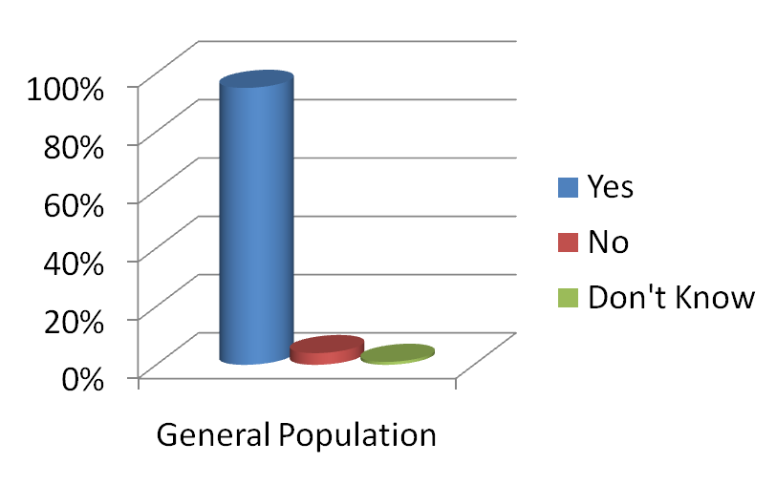
Do you believe that the health care services you receive should be based on the best and most recent research available?
Source: National Survey, 2005
Charlton Research Company for Research!America

Slide 24
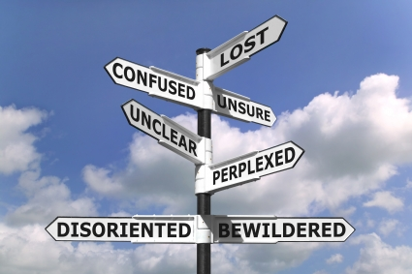
EBM-1: Necessity
Much clinical care research published
Changed over 50 yrs
Only tiny fraction valid, important, & applicable to care
Need it frequently
‘Usual’ sources don’t work well …*

Slide 25
Traditional CME Works Poorly
Randomized controlled trials show traditional, didactic CME fails to modify our clinical performance and is ineffective in improving the health status of our patients.
Davis D. JAMA 1999; 282: 867 - 874

Slide 26
EBM-2: scary scenario
With time, as our unanswered questions accumulate
our knowledge of current best care diminishes
and our clinical competence begins to decline
And, too little time to do much about it!
Avoid planned obsolescence

Slide 27
Clinical Experience and Quality of Care-1
Systematic review, 62 evaluations
  12 studied ‘Knowledge’
    negative association in 12 of 12
  24 studied ‘Diagnosis, Screening, Prevention’
    negative association: 15 of 24
  19 studied ‘Therapy’
    negative association: 14 of 19
  7 studied ‘Outcomes’
    negative association: 4 of 7
Choudhry Ann Int Med 2005; 142: 260

Slide 28
Clinical Experience vs. Quality of Care-2
“We cannot maintain competence passively through accumulating experience. We must actively cultivate competence throughout a professional career.”
“We can still customize care to each patient’s needs – evidence-based standards are the best starting point for flexible, patient-centered approaches.”

Slide 29
EBM: The evidence behind evidence
Systematic Review, 34 studies looking at outcomes for cardiovascular disease
Death rates found to be lower among patients who received evidence-based treatments at optimal doses, compared with patients who are not given these treatments or who do not take these drugs at target levels
Decrease in observed mortality is proportional to the number of appropriate therapies received (of all possible indicated)
Mehta et al. Am J Med. 2007; 120: 398 – 402.

Slide 30
Process of EBM
Patient
dilemma
Act & Assess
Ask
Acquire
Principles of
Evidence-Based
Clinical Decisions
Appraise
Hierarchy
of evidence
Apply
Evidence alone does not
make a clinical decision

Slide 31
Ask
In patients with a potential ankle fracture, are there historical and/or physical findings which would decrease the need for an X-Ray?
Format extremely important – more later

Slide 32
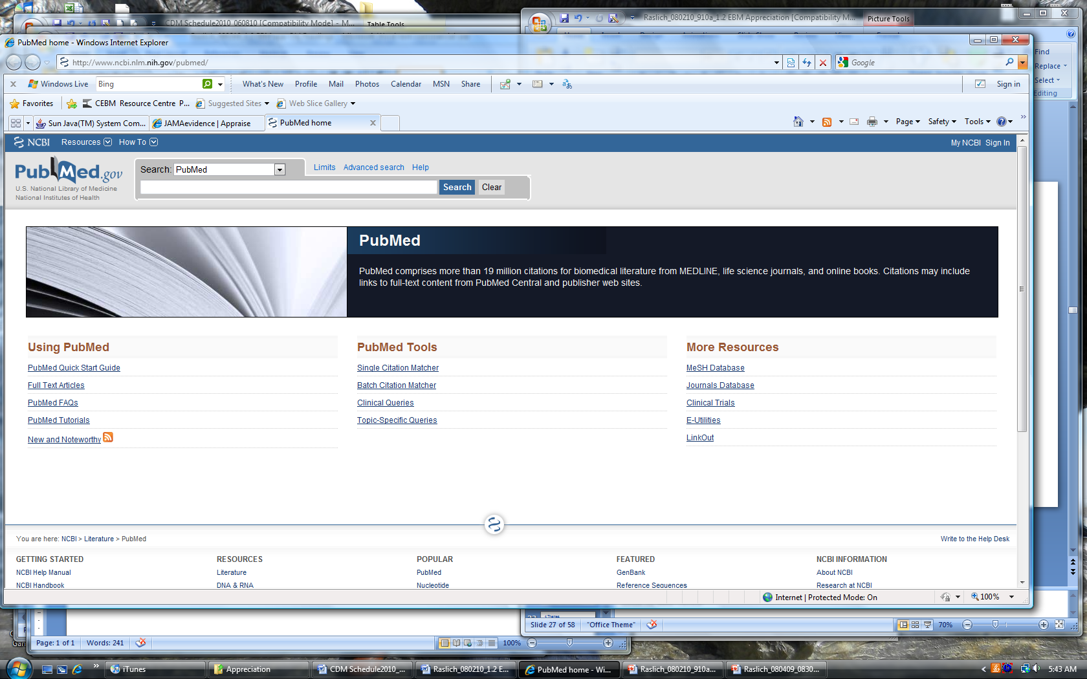
Acquire-1

Slide 33

Appraise
We need to be sure that what we find is valid and important to our patient’s care

Slide 34
Apply
This is why we’re in this business
Evidence needs to be applicable to our patient within their context

Slide 35
4 Themes: CDM and EBM
EBM and approach to clinical problems
All evidence is not equal
EBM complements clinical practice
Evidence alone is not enough

Slide 36

All evidence is not equal

Slide 37
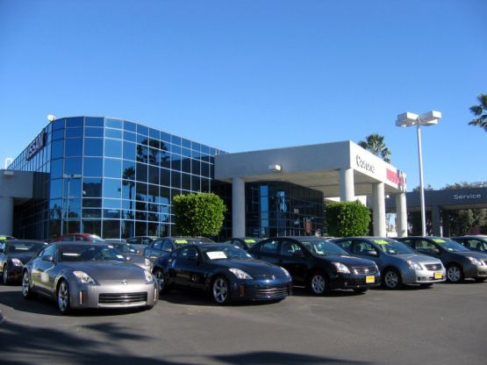
Everyday Decisions-1

Slide 38
Everyday Decisions - 2
What sources did you use to research?
How many people did you talk to?
How many lots did you visit?
How many cars did you drive?

Slide 39
EBCDM: Back to Why
We can’t make informed decisions without information
Not all information is created equal
Misinformation can be worse than no information
Strong evidence can lead to better outcomes

Slide 40
All evidence is not equal
Hierarchy of strength of evidence Prevention & Treatment
N-of-1 randomized trial
Systematic reviews of randomized trials
Single randomized trial
Systematic review of observational studies
Single observational trial
Physiologic studies
Unsystematic clinical observations
Table 2-1

Slide 41
Evidence hierarchy
The hierarchy is not absolute
The hierarchy implies a clear course of action for physicians
Although it may be weak – there is always evidence.

Slide 42
4 Themes: CDM and EBM
EBM and approach to clinical problems
All evidence is not equal
EBM complements clinical practice
Evidence alone is not enough

Slide 43
We need to keep up-to-date
New evidence
New interpretations of evidence
New illnesses
New strategies and tactics
New questions
→ New decisions !

Slide 44
We need to keep up-to-date
Get the evidence straight
  Find the evidence efficiently
  Appraise critically
Formulate evidence-based decisions
  Integrate evidence with other knowledge
  Use values explicitly
Act on decisions
  Implement: right patient, right time, right way?
  Assess: are we doing what we know to do?

Slide 45
4 Themes: CDM and EBM
EBM and approach to clinical problems
All evidence is not equal
EBM complements clinical practice
Evidence alone is not enough

Slide 46

Evidence alone is not enough

Slide 47
Evidence is just the beginning
Knowledge and Skills necessary for evidence-based practice
In-depth background knowledge
Effective searching skills
Effective critical appraisal skills
Diagnostic expertise
Define and understand alternatives
Appropriately apply evidence to the individual
Sensitivity and communication skills
Elicit and understand patient values and incorporate in decisions
Table 2-2

Slide 48
Knowledge for Clinical Decisions
Clinical Expertise
Clinical Decisions & Actions

Slide 49
Knowledge for Clinical Decisions
Human Biology
Clinical Decisions & Actions

Slide 50
Knowledge for Clinical Decisions
Clinical Expertise
Human Biology
Clinical Decisions & Actions
Clinical Care Research

Slide 51
Knowledge for Clinical Decisions
Clinical Expertise
Patients’ Perspectives
Human Biology
Clinical Decisions & Actions
Professional Values, Ethics
Clinical Care Research
Health Systems

Slide 52
Break

Slide 53
Choose the correct order in the process of EBM
Acquire Appraise Apply
Apply Acquire Approve
Approve Ask Appraise
Ask Acquire Appraise
Ask Apply Approve

Slide 54
Process of EBM
Patient
dilemma
Act & Assess
Ask
Acquire
Principles of
Evidence-Based
Clinical Decisions
Appraise
Hierarchy
of evidence
Apply
Evidence alone does not
make a clinical decision

Slide 55
Large group – Current state
Biennium 1
Biennium 2

Slide 56
How can I help learners with this process?
Break into each component
Have available resources
Build into existing clinical and teaching activities

Slide 57
EBM teaching points - 1
Question Development
  Question categories
  PICO format
Search and retrieval
  Resources
  PubMed tutorial

Slide 58
EBM teaching points - 2
Critical Appraisal
  Bias and validity criteria
  Format
Results
  Basic statistics (don’t go heavy on the math!)
  Sen/Spec, LR’s; RRR/ARR/NNT; RR/OR
Application
  Transitioning evidence into practice

Slide 59
Break

Slide 60
Reflect and Participate

Slide 61
Another group activity ?
Individually identify one teaching scenario you are responsible for
Groups of 5-6
Briefly discuss scenarios – and choose one to work on as a group (consensus!)
Complete provided worksheet

Slide 62
How likely are you to incorporate this material into your current teaching?
Very likely
Likely
Not sure
Unlikely
Very unlikely

Slide 63
Resources available on website http://med.wright.edu/aa/facdev/Events/STReME.html
Questions?

