Slide 1
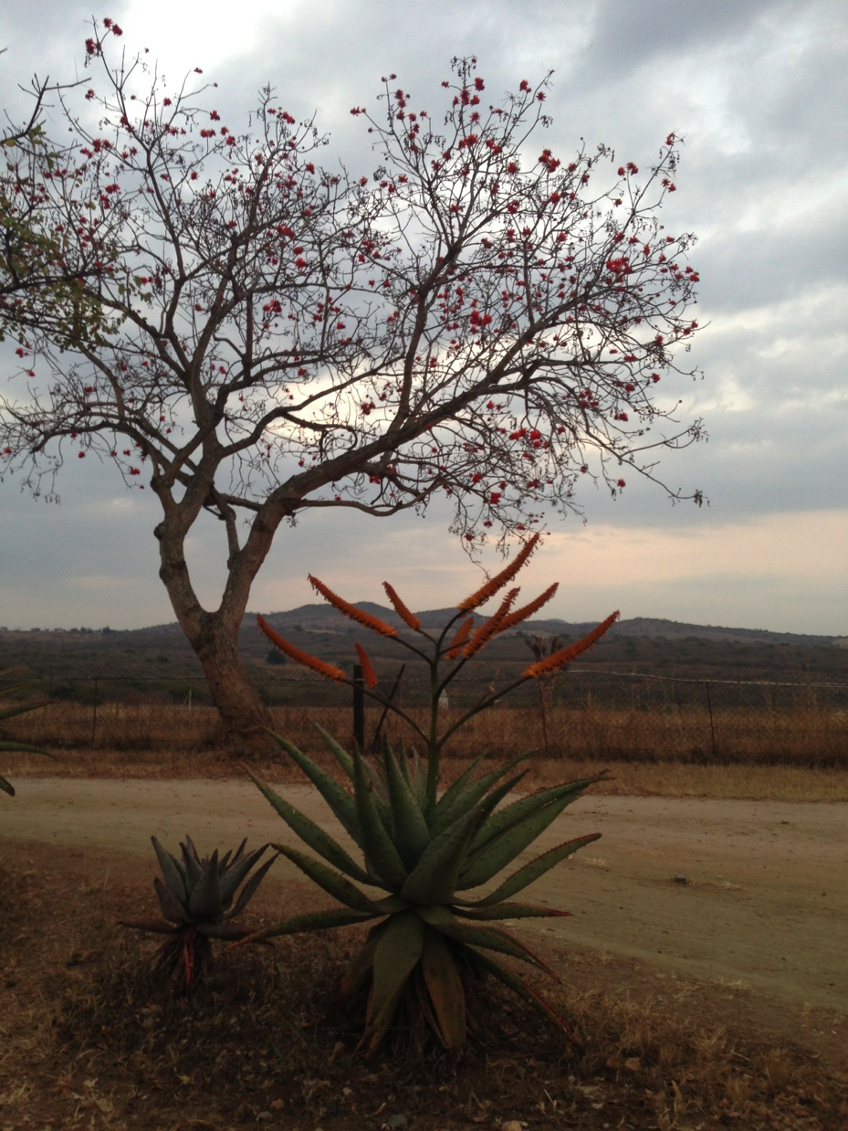
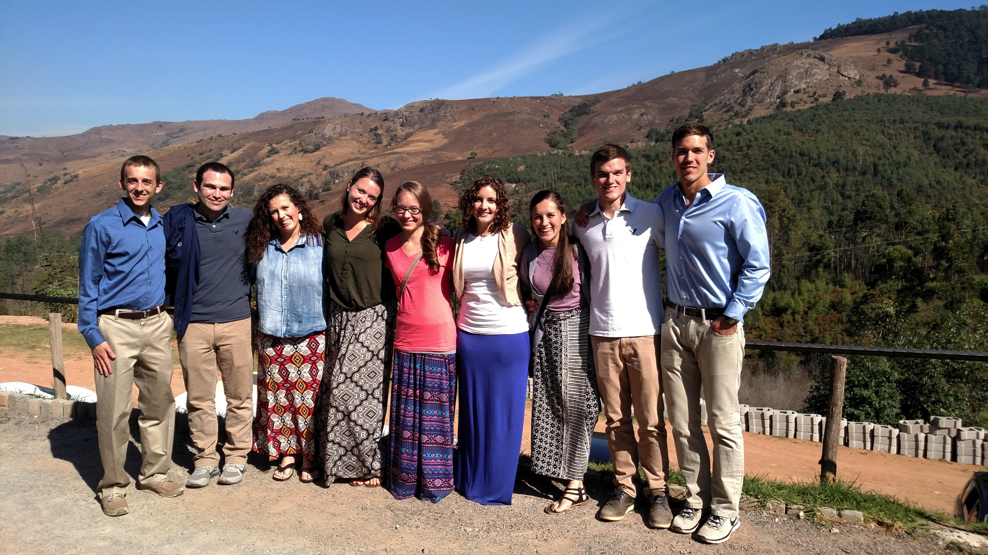
Swaziland

Slide 2
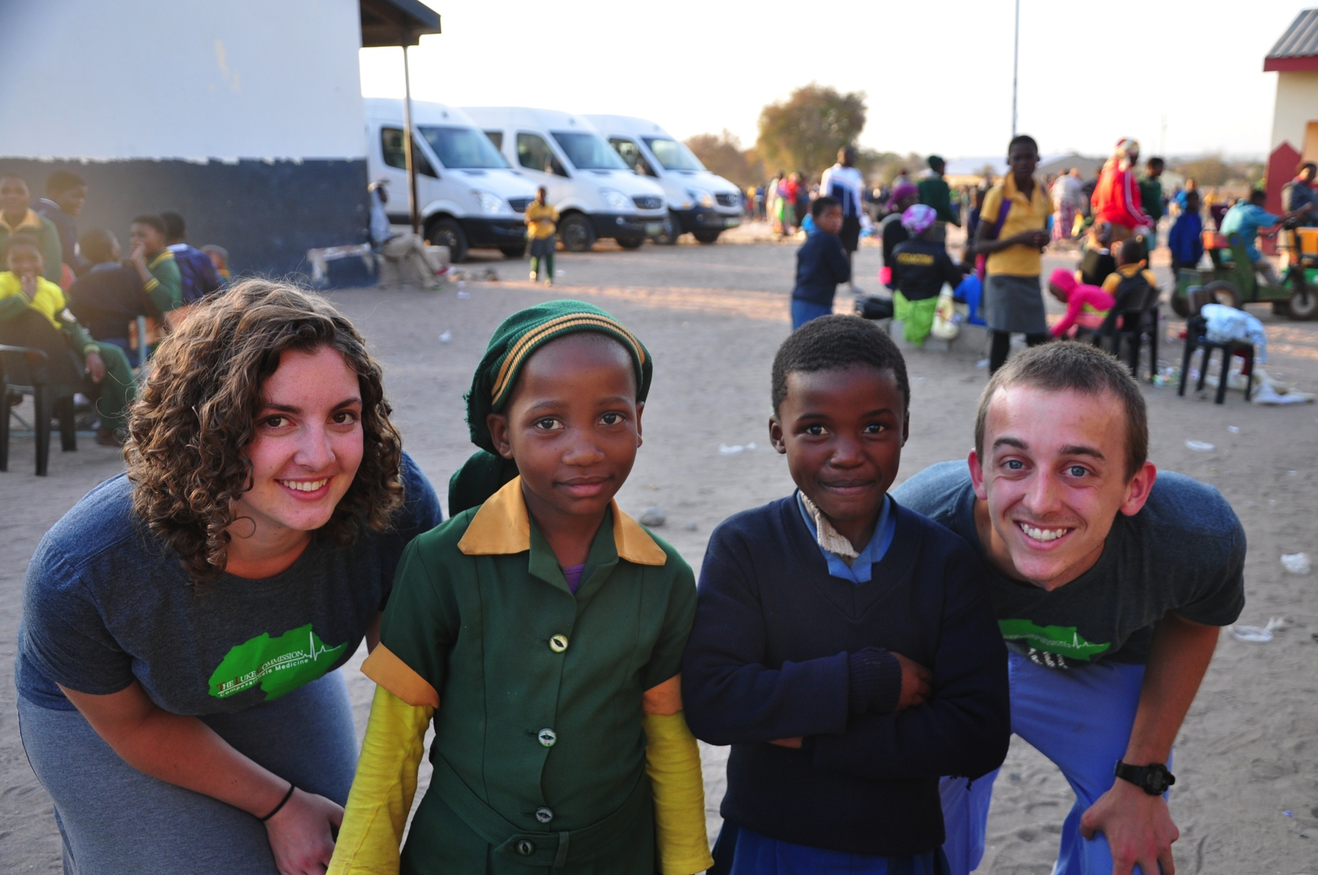
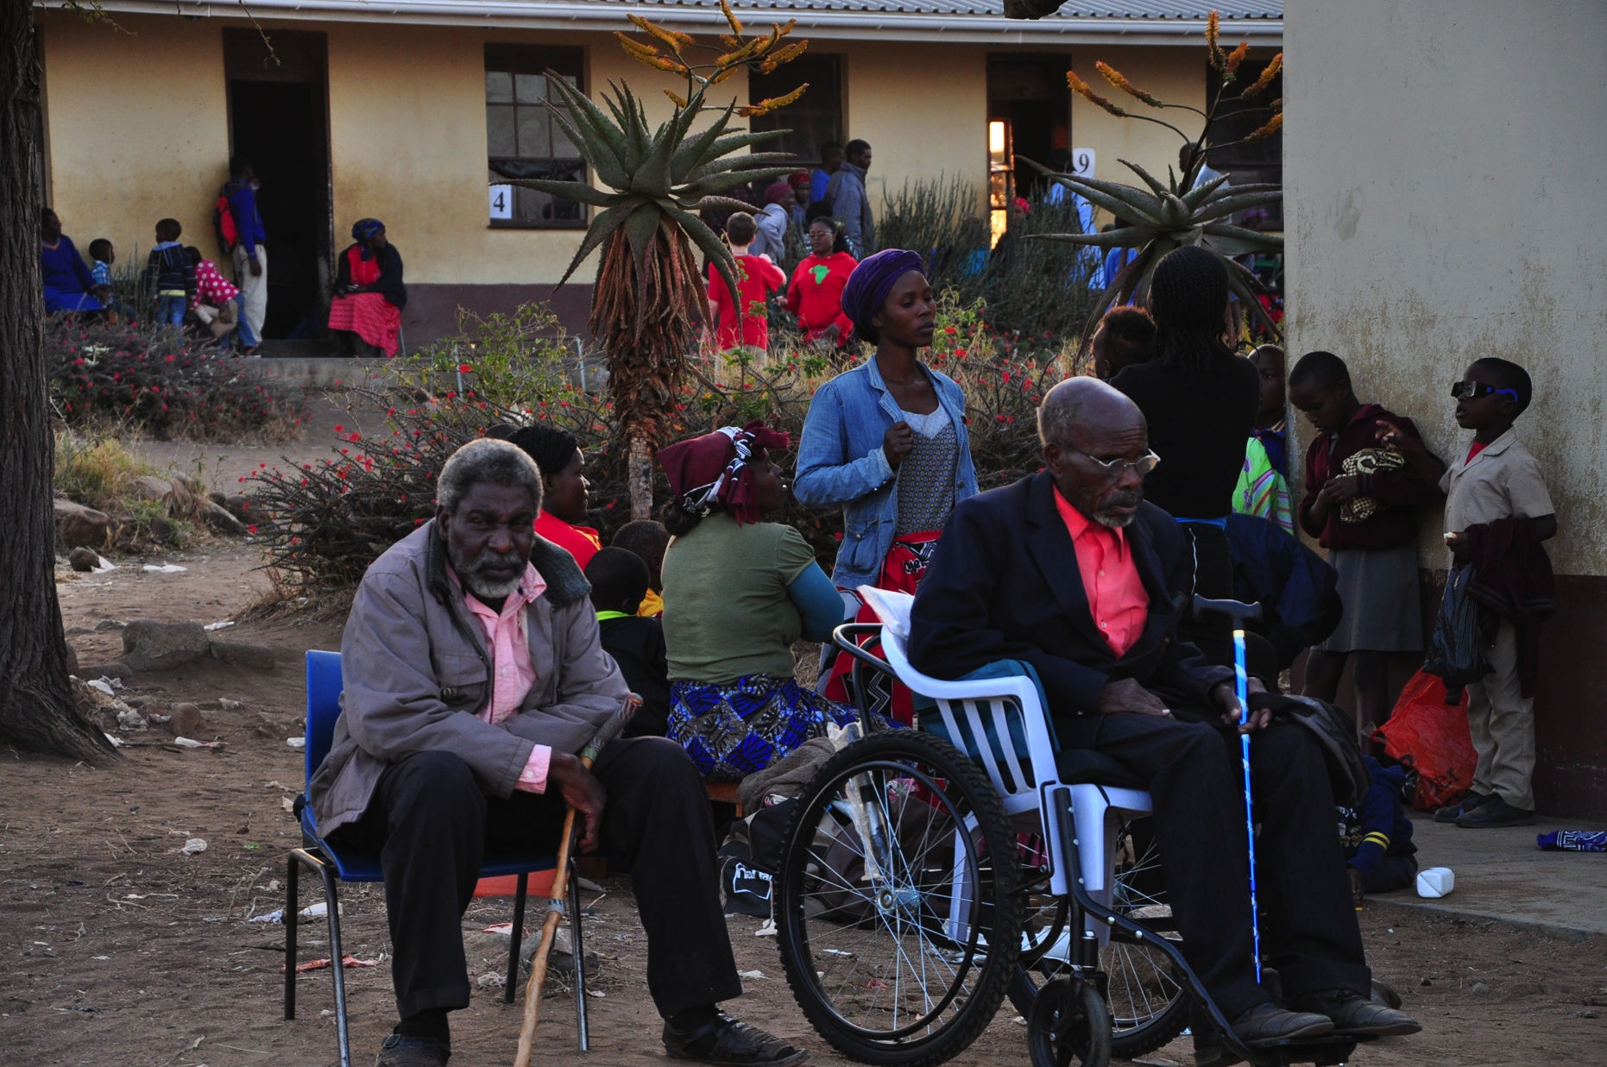
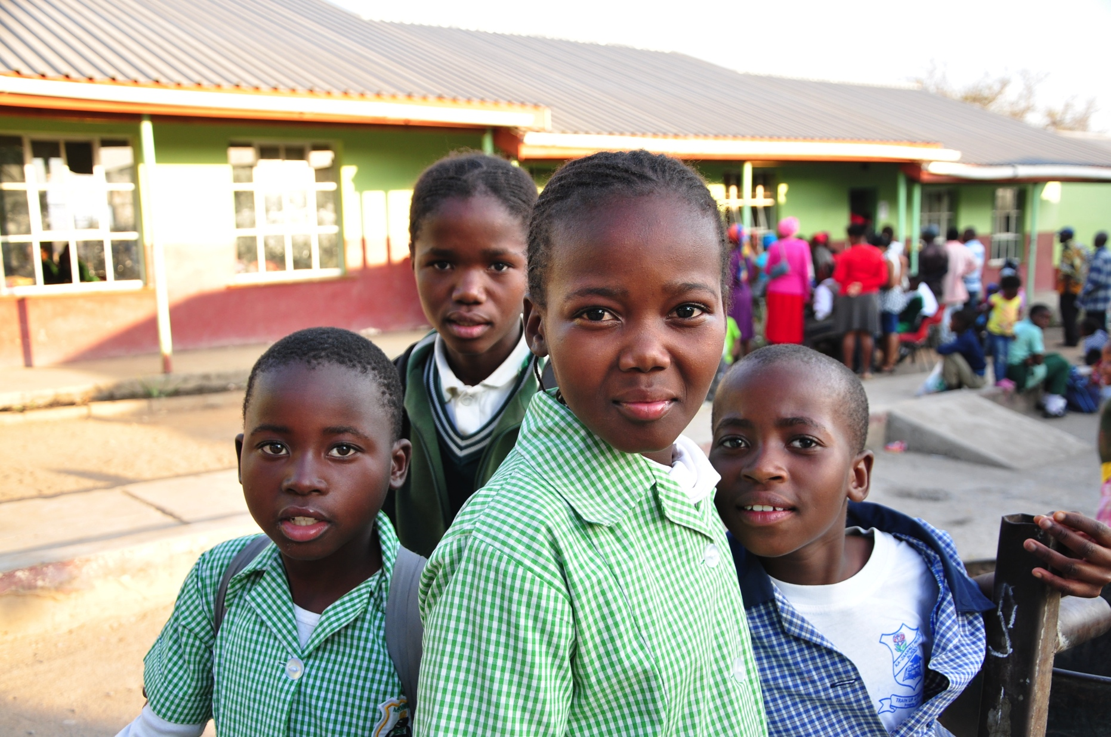
Who we worked with
The Luke Commission
The primary medical outreach to rural communities in Swaziland
http://www.lukecommission.org/

Slide 3
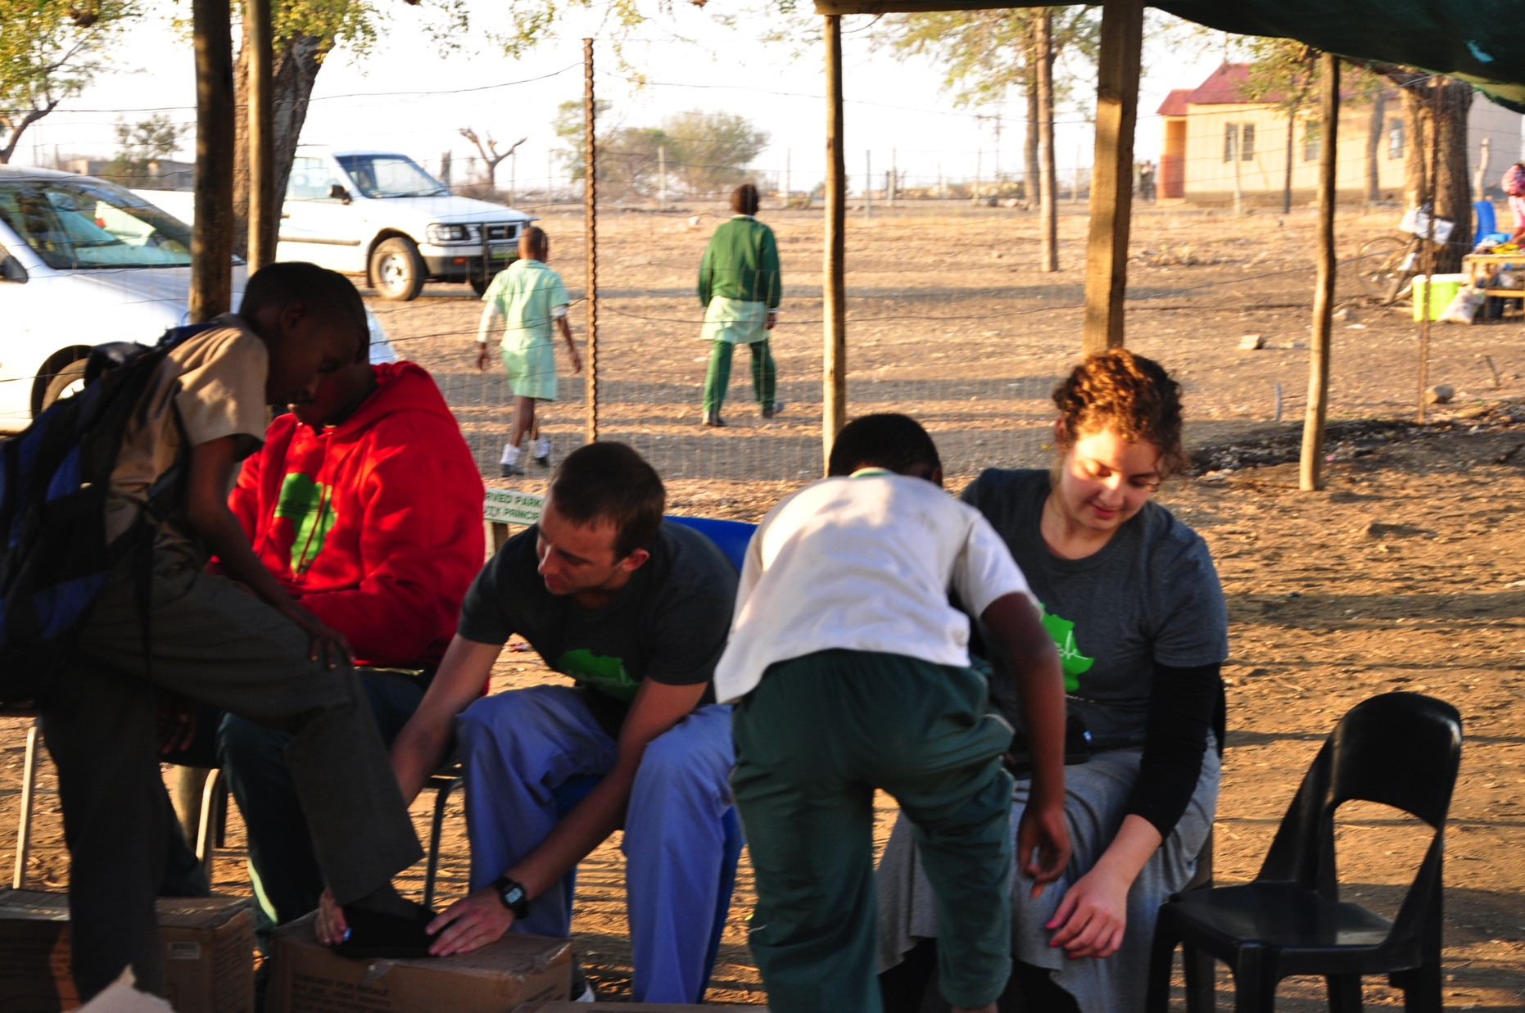
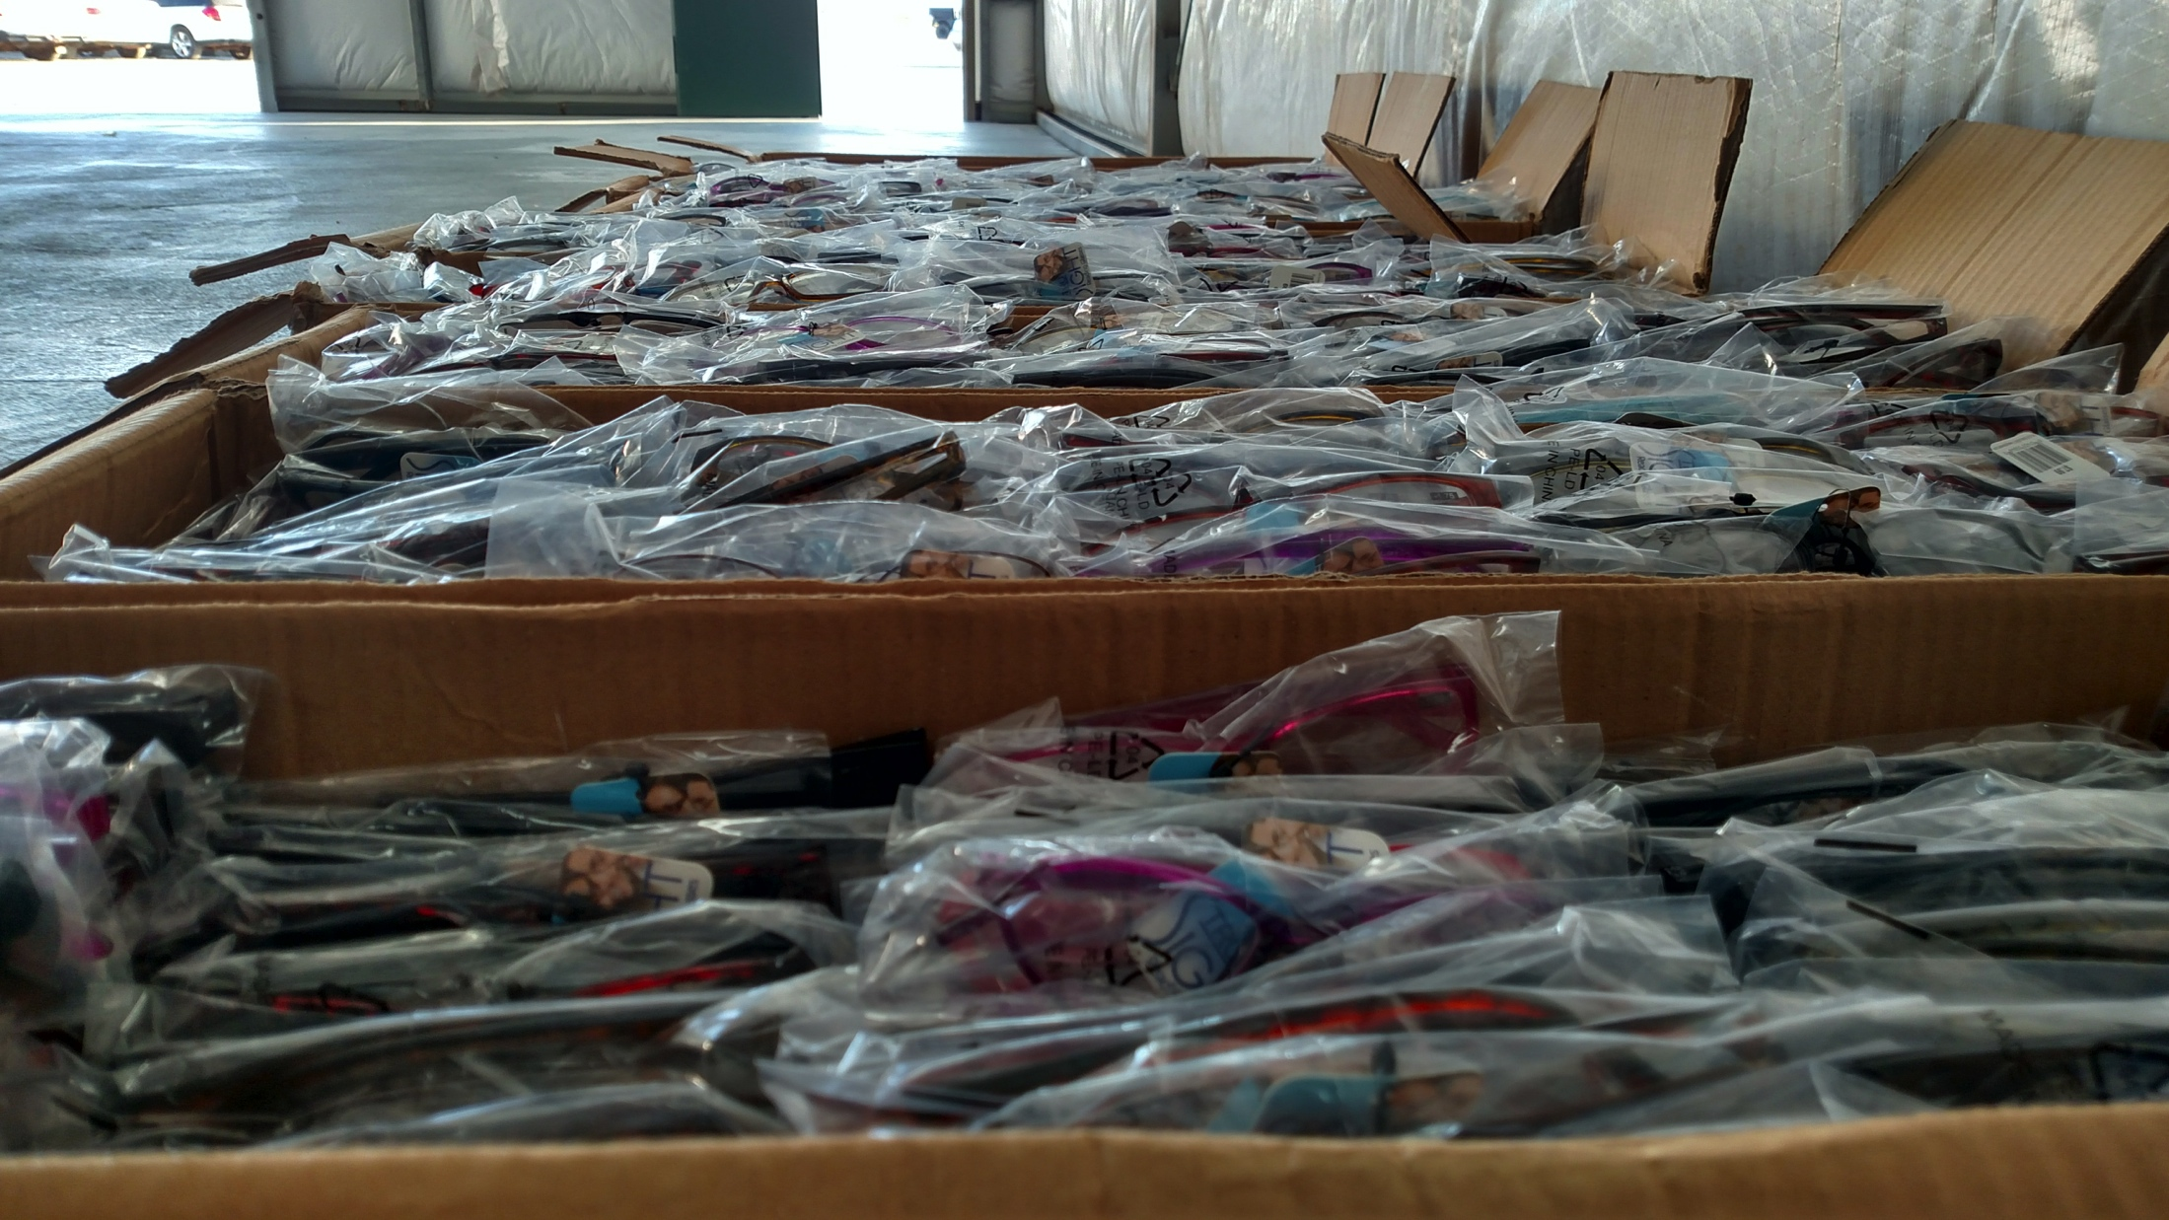
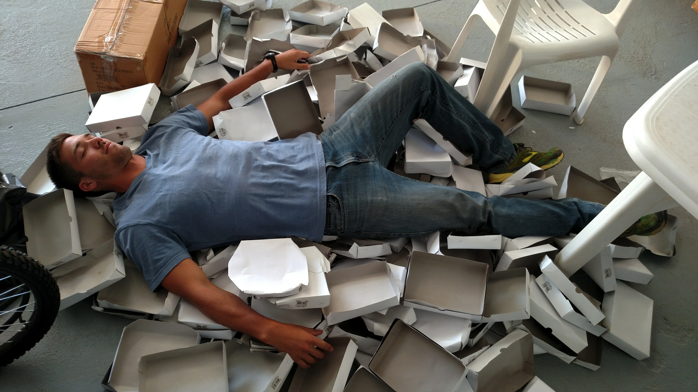
What we did
Clinics days
Set up/clean up
Triage
Sit with nurse/doc
Pharmacy
Eye screening
Surgery
Shoes
Non-clinic days
Sort organize eye glasses
Build wheelchairs
Count pills
Data entry
Organize pharmacy

Slide 4
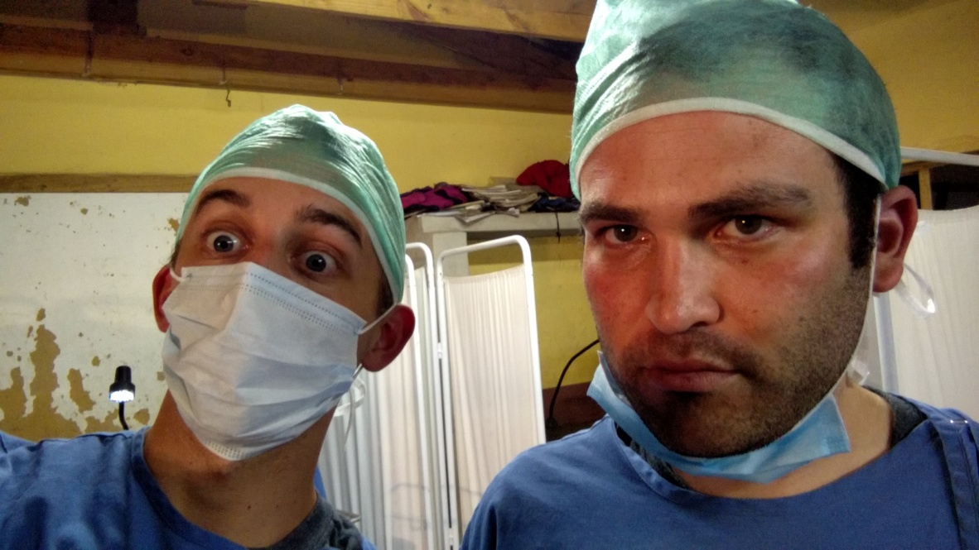
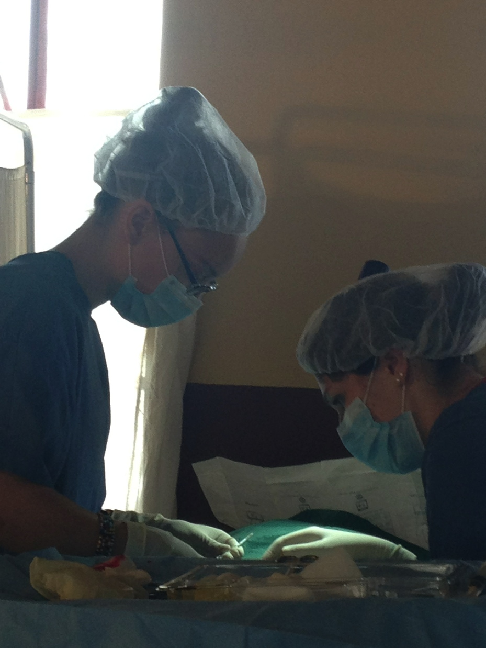
Clinical experience
Triage
BP
HIV tests
Blood sugar
Pharmacy
Help distribute medications
Surgery
Patient prep
Basic assisting
Observe primary care provider
Learn how 3000+ patients can be seen in 1 day

Slide 5
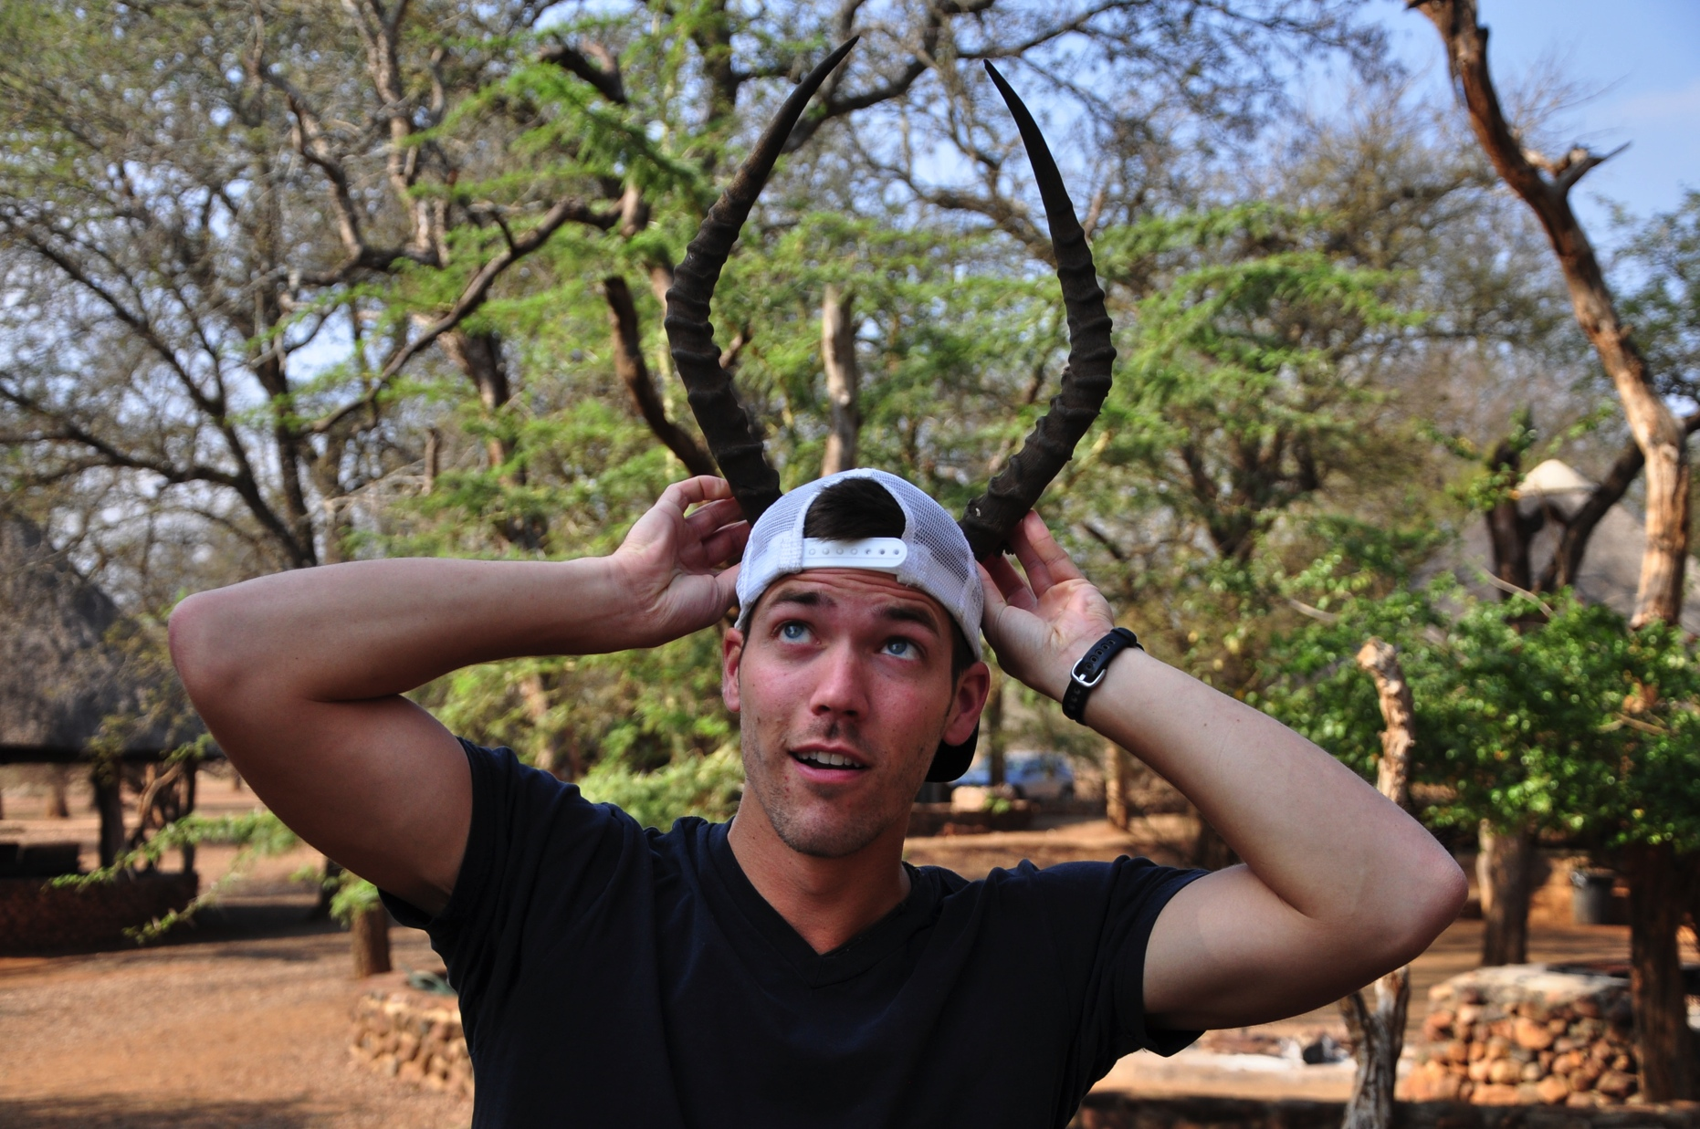
The boring details (like money)
Airplane (~$2300)
Flat cost to Luke commission (~$1700)
Includes all food and accommodations for entire stay with The Luke Commission
Money for souvenirs (~$200)
Plus extra for touring South Africa for a whole week

Slide 6
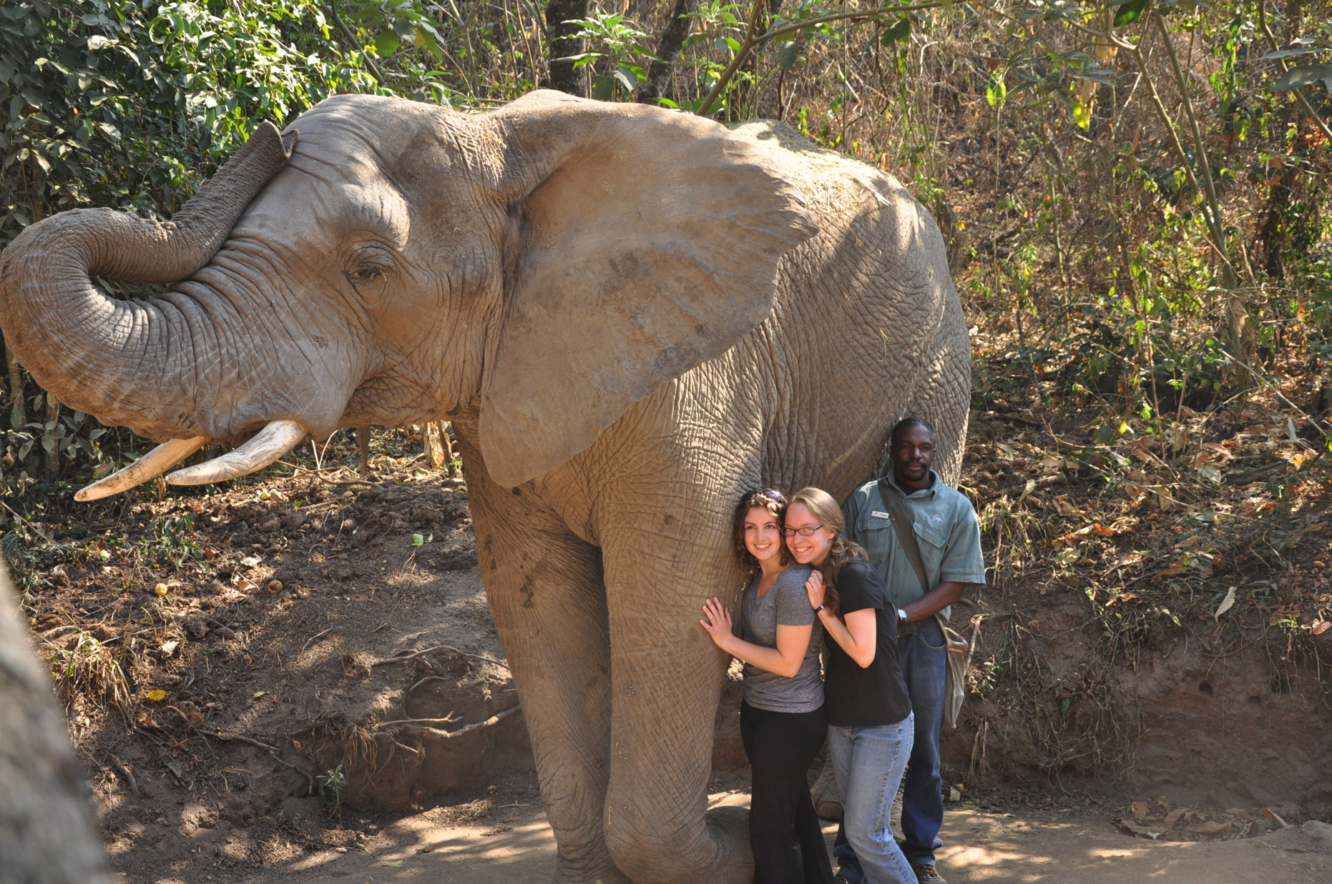
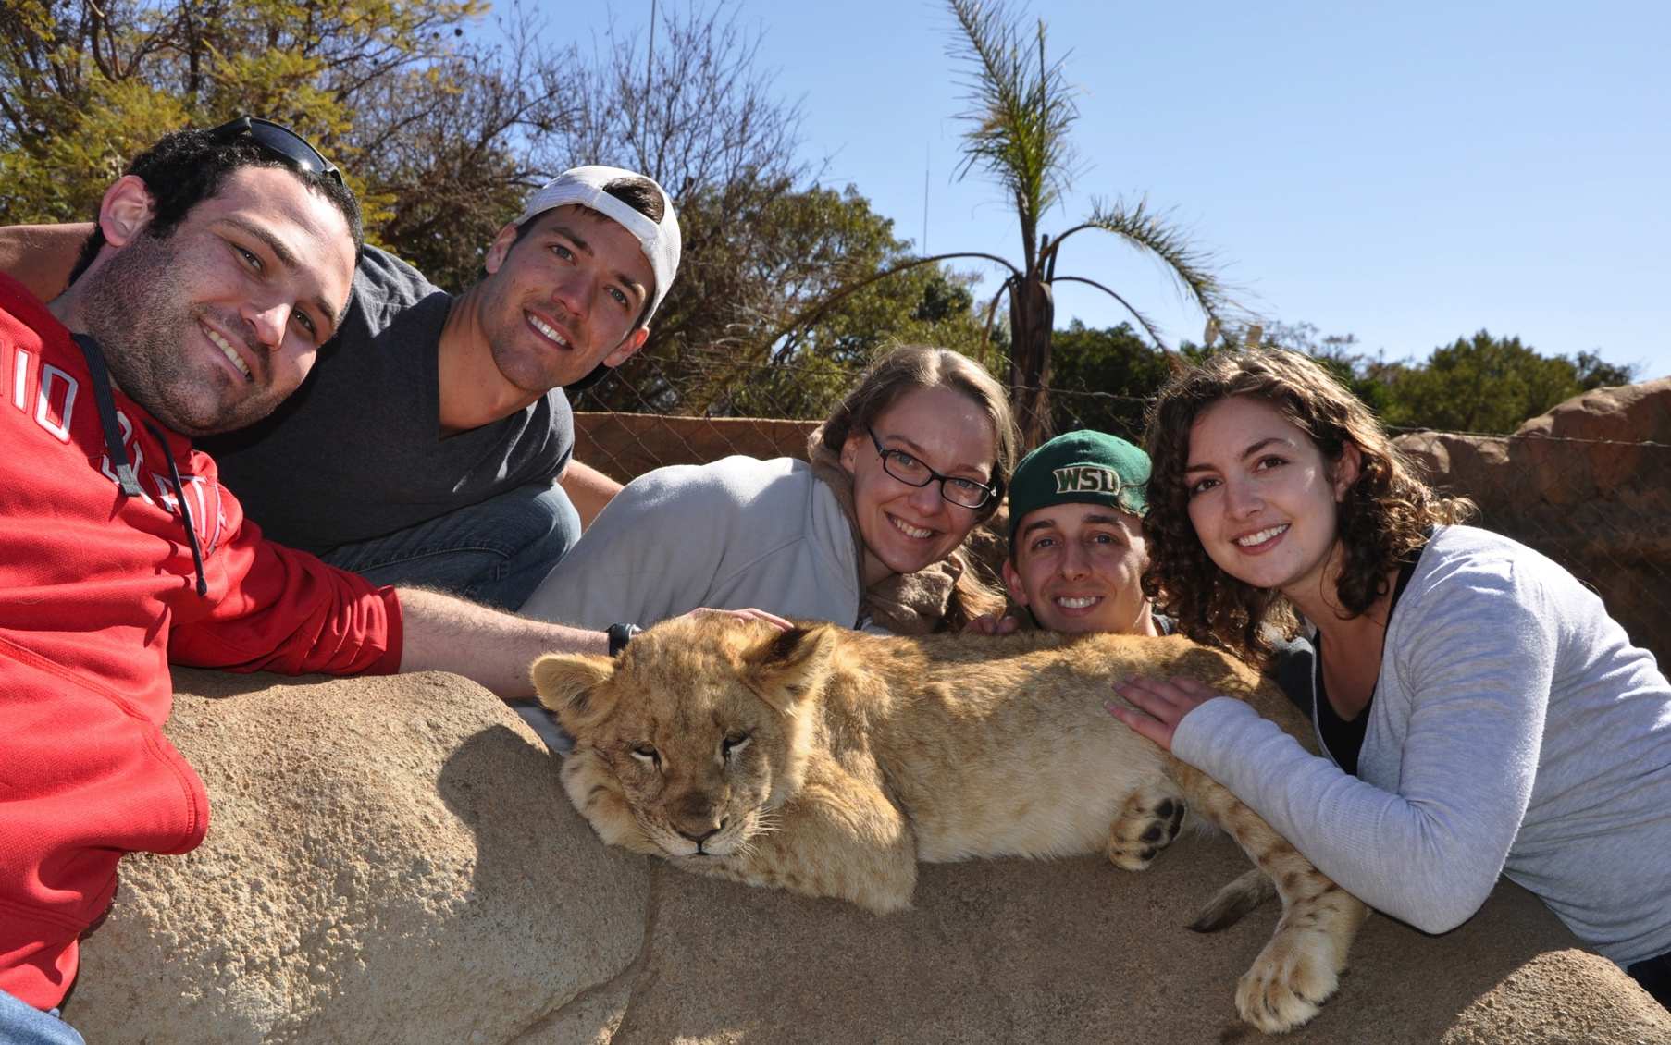
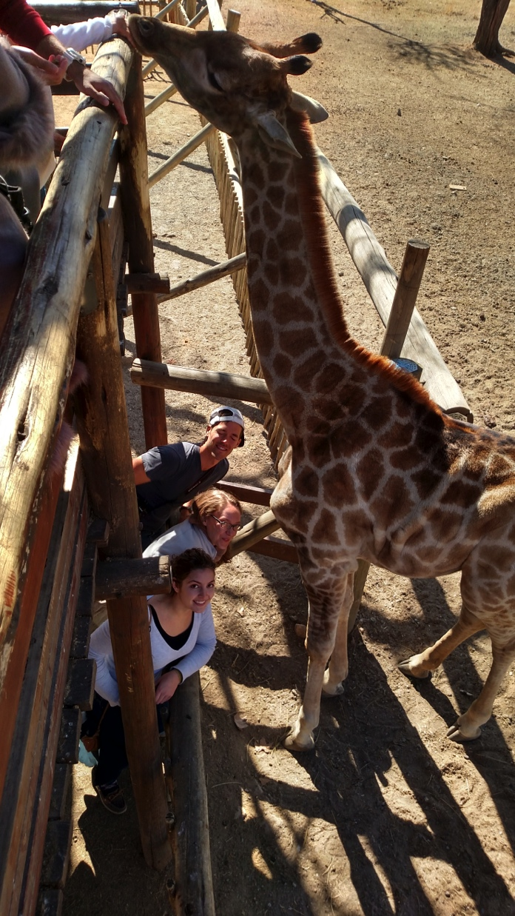
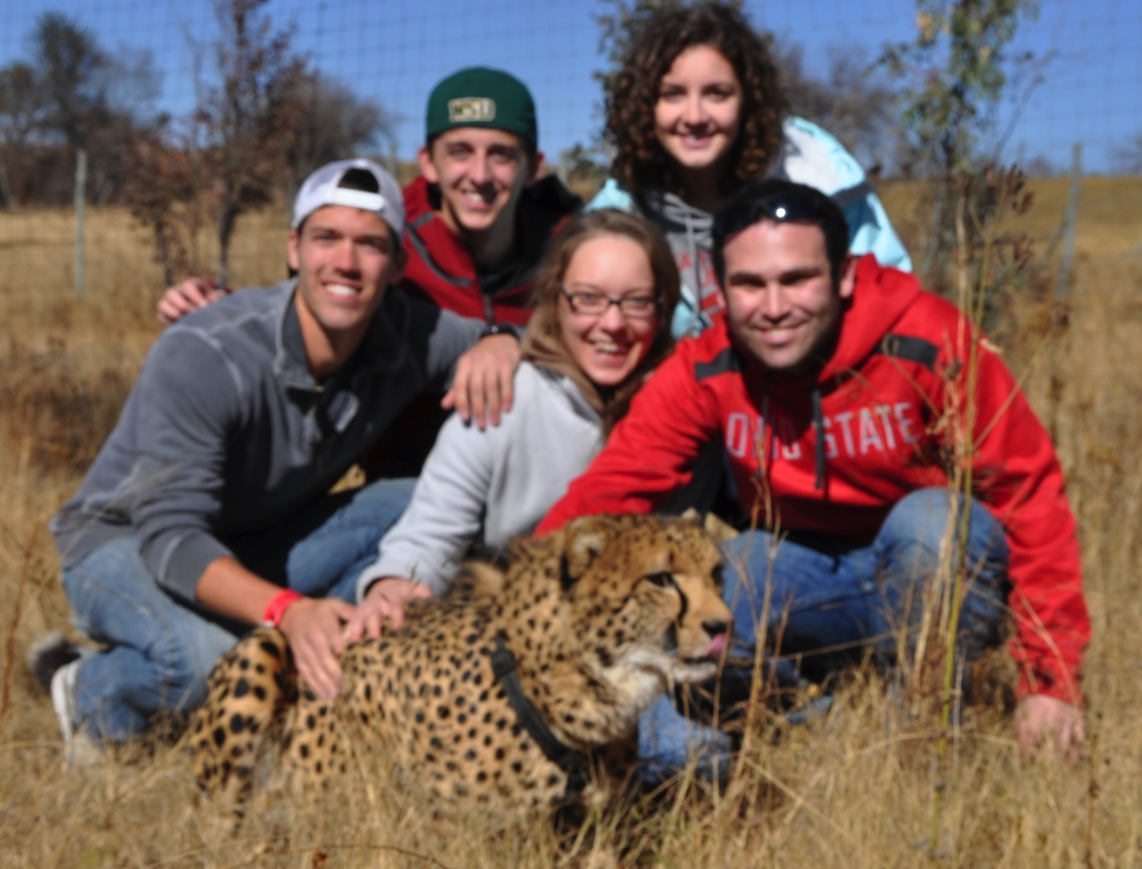
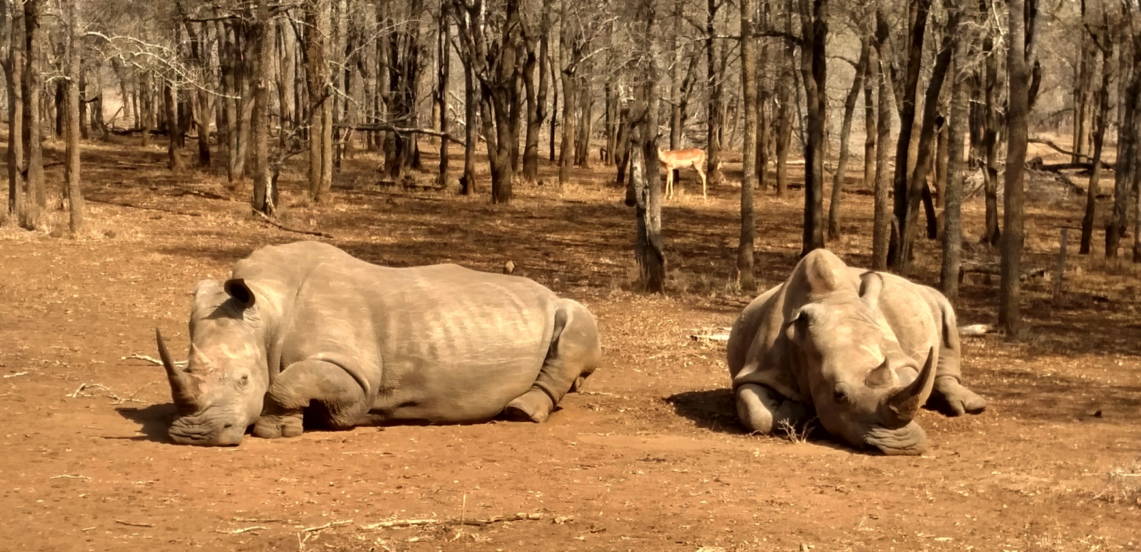
Just because we were in Africa….
Petting all of the wild(ish) animals!!
Lion park
Kruger
Wildlife rescue park

